Slide 1
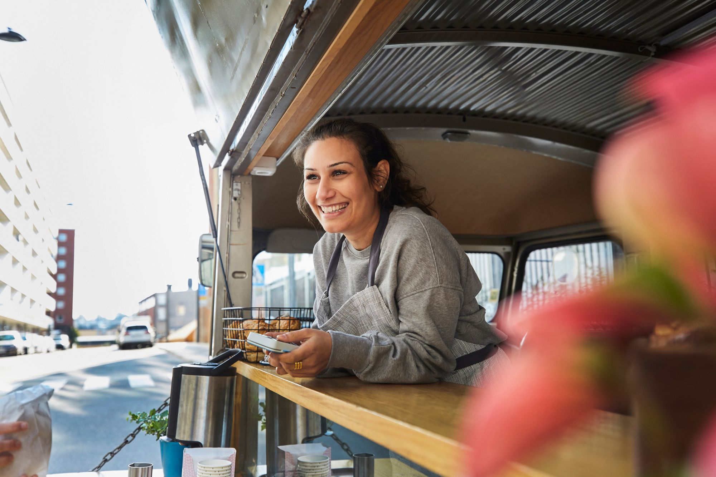
STEP 8.
THE CONFIDENCE TO KEEP GOING AND GROWING
www.3kitchens.eu

Slide 2
Contents
PAGES
Entrepreneurship isn’t a job, it’s a lifestyle 4- 7
8 ways to boost your confidence in business 8 - 13
Taking risks 14 - 19
Building resilience - 7 useful tips and techniques to overcome stress 20 – 30
Defining Success 31- 41
Learn to live with failure 42- 49
Find happiness in your work and business 50 - 58
This is your final step on our EMIMENT entrepreneurship journey, we end, not by sharing more business advice, we end by sharing the essential tools to stay resilient and realistic. Your plan is never finished. In order to stay in business, you need strength and vision for the rewarding road ahead.
01
Entrepreneurship isn’t a job
02
8 ways to boost your confidence in business
03
Taking Risks
04
Building Resilience
05
Defining Success
06
Learn to live with failure
07
Find happiness in your work and business

Slide 3
Learning Objectives – Step 8 The Confidence To Keep Going And Growing
This is your final step on the 3 KITCHENS entrepreneurship learning adventure. We end, not by sharing more business advice, but by sharing the essential tools to stay resilient and realistic. Your plan is never finished. In order to stay in business, you need strength and vision for the rewarding road ahead. In this final step, you will learn..
Understand how confidence, mindset, and resilience affect the long-term success of your business
Learn to use practical tools to manage fear, self-doubt, and the pressure to succeed
Reflect on failure and how to turn it into useful learning
Define what success means for you personally and professionally
Reconnect with what brings you energy, purpose, and joy in your business
Recognise when it’s the right time to grow the business

Slide 4
01
ENTREPRENEURSHIP ISN‘T A JOB – IT‘S A LIFESTYLE

Slide 5
ENTREPRENEURSHIP ISN‘T A JOB – IT‘S A LIFESTYLE
Entrepreneurship can be exciting, creative, and empowering, but it’s also demanding. Unlike a job you can leave at the door, being an entrepreneur often affects every part of your life, from your time and energy to your relationships and wellbeing.
Especially for migrant women, entrepreneurship brings unique rewards and pressures:
You may be juggling family, cultural adjustment, and limited resources.
You may be building a business without a safety net, or facing doubts from others or from yourself.
As your own boss, there’s no guaranteed income, no clocking out, and no one else to take over when you're tired. This makes entrepreneurship as much about resilience and self-belief as business planning. That’s why we start this final step by recognising the reality:
This isn’t only work. It’s your life.
Your wellbeing needs to be part of your business plan.

Slide 6
ENTREPRENEURSHIP – EMPOWERING AND OVERWHELMING
Why? Because entrepreneurship means:
Making hundreds of tiny decisions every day, without always knowing the “right” answer.
Carrying the pressure of representing your culture or community through food.
Having no backup plan if sales are slow, supplies run out, or childcare falls through.
But it also means:
Having the freedom to cook what you believe in.
Being able to work in ways that reflect your values and traditions.
Creating something that belongs to you and no one can take it away.
Building something your Family can be proud of.

Slide 7
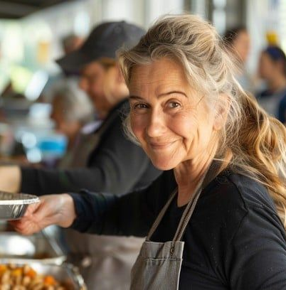
You’re Starting a Food Business AND You’re Also Starting Over
When you step into food entrepreneurship, especially in a new country, it’s more than profit. It’s about reclaiming agency.
It’s about proving your value in a system that may not yet see it.
It’s about saying: “My skills, my story, my food—these matter.”
Emotional Labour Is Real
Running a business takes more than cooking; it requires emotional strength. You need
The courage to put your food and your identity on display.
The energy to bounce back from rejection or criticism.
The patience to explain what you're doing, why it matters, and why it costs what it costs.
The bravery to price your work fairly, even when others ask for discounts.
And because you’re doing it on your own, you carry it all—not just the recipe, but the responsibility.

Slide 8
You’re Starting a Food Business AND You’re Also Starting Over
Small Steps Count
You don’t need to grow fast. You need to grow strong. That means:
Saying no to things that don’t align with your vision.
Saying yes to help when it’s offered.
Setting boundaries between work and rest even when your business is your passion
Forgiving yourself when it’s hard or slow, or messy
You’re not behind; you’re building something new. On your own terms.
Redefine Success
Success doesn’t have to mean becoming a celebrity chef or opening five locations. It can mean:
Having one reliable income stream
Being known and respected in your local market
Supporting your family without giving up who you are
Enjoying your work—even if it’s still hard

Slide 9
02
8 WAYS TO BOOST YOUR CONFIDENCE IN BUSINESS

Slide 10
8 WAYS TO BOOST YOUR CONFIDENCE IN BUSINESS
Get clear on your higher purpose
When you’re rooted in a strong purpose, it becomes easier to speak about your work, share your offers, and connect with others. You’re not promoting yourself—you’re standing for something you believe in. That’s where real confidence begins.
Stop waiting to feel confident
Many women believe they need to feel confident before they take action. But that belief keeps us stuck.
Confidence doesn’t come first—action does. The truth is, you can feel unsure and still move forward. You can be scared and still show up at a market, talk to a customer, or price your food fairly. Act as if you believe in yourself, even if your voice shakes. Confidence often comes after, not before.
Read
Ryan James Lock is an international success coach and business consultant. 8 Ways To Boost Your Confidence In Business (wisdomtimes.com

Slide 11
8 WAYS TO BOOST YOUR CONFIDENCE IN BUSINESS
“When I first sold at a market, my hands were shaking. I thought, ‘What if no one buys?’ But I told myself, just get through the day. And I did. That day changed everything because I didn’t wait to feel brave. I just showed up.” Mariam, Syrian home cook & caterer, Berlin
3. Focus on the benefits to the customer
When promoting your business, products or services always focus on the benefits to the customer. People have a lot of choices. If you clearly show how your food makes their life better, they’ll remember you.
When your focus is on helping someone else, it becomes easier to speak up.
“I used to feel shy telling people about my cakes. But then I saw how many of them said it tasted like their grandmother’s. I realised I’m giving them something they miss. That gave me the confidence to talk about it proudly.”
Farzana, pastry cook, Italy

Slide 12
8 WAYS TO BOOST YOUR CONFIDENCE IN BUSINESS
Understand: you are not your work
Running a food business is deeply personal, but you are not your business. Your food can be judged. Your prices might be questioned. But that doesn’t mean you are being rejected.
When we tie our self-worth to our work, every setback feels like a failure of identity. Instead, try seeing feedback as part of growing the business, not as criticism of you. You are allowed to rest. To try again. To change direction.
Your business is something you build, not something you are.
“At first, when people didn’t buy, I felt like I wasn’t good enough. But over time, I saw it differently. It’s a stall, not a test of my value. Some days you sell more. Some days you don’t. I stopped taking it personally.
Aisha, street food vendor, France

Slide 13
8 WAYS TO BOOST YOUR CONFIDENCE IN BUSINESS
Learn to love “No”
If you're afraid of hearing "no," you’ll find it hard to grow. Every rejection feels personal, especially when your food and culture are on the line. But “no” isn’t the end—it’s part of the process.
Each time someone says no, you learn something: how to improve your pitch, how to explain your food, how to try again with more clarity.
“At first, I was embarrassed every time someone walked past my stall without buying. But I started asking, ‘What didn’t work today?’ That helped me change my display. The next week, I sold out.”
Eleni, Greek market vendor, Brussels

Slide 14
8 WAYS TO BOOST YOUR CONFIDENCE IN BUSINESS
6. Get over your fear of rejection
Rejection stings. But in business, it’s normal. It’s not always about your food or your worth. Sometimes it’s just timing, budget, or taste. You are still capable, skilled, and deserving, even if someone says no today.
“One café turned me down, and I almost stopped. But a friend reminded me: it was just one ‘no’, it is not the end. The second café said yes. That changed everything.”
Nadia, Syrian caterer, Paris
Play “How would I act….”
Confidence is often about mindset. Try this: Ask yourself, “How would I act if I believed I could do this?” Then act that way. Try it for one day. Small actions shift how you see yourself—and how others see you too.
“I used to feel small at markets, like I didn’t belong. Then I told myself: ‘Pretend you’re confident, even just for today.’ I smiled more. Talked more. And I sold more. Confidence followed action.”
Anita, Jamaican food truck owner, Rotterdam

Slide 15
8 WAYS TO BOOST YOUR CONFIDENCE IN BUSINESS
Practice
Confidence isn’t a gift. It is a skill. You build it by using it. Start small: post your menu, talk to a stranger at a market, share your food story online. Every act of courage counts. Ask yourself daily:
“How can I practise confidence today?”
I challenged myself to introduce my food to one new person every week. At first, I was nervous. But now it’s routine. I believe in my food because I kept showing up.” Leila, Moroccan home cook, Milan

Slide 16
CONFIDENCE, A KEY INGREDIENT
Confidence is just as, if not more, important in life than competence.
Being an entrepreneur takes an incredible amount of confidence for things you probably would never expect.
In this video, Erin discusses 5 unexpected situations you need confidence for in entrepreneurship, and share a recent personal experience that truly put her confidence to the test.
Click to View
Challenges I Face Being a Young, Black, Woman Business-Owner
CONFIDENCE IN ENTREPRENEURSHIP | Challenges I Face Being a Young, Black, Woman Business-Owner

Slide 17
03
TAKING RISKS

Slide 18
TAKING RISKS VS. BEING RISKY
It’s important to understand the difference between taking risks and being risky.
Taking risks is a regular part of our lives. We take on certain risks daily in order to enjoy valuable rewards. Most of us have learned to solve this risk vs. reward equation quickly in our heads, and failure rates are low.
Being risky, on the other hand, is a behaviour trait which is characterised by doing careless actions. It involves much higher failure rates and more serious consequences.
As an woman entrepreneur, you will often be faced with difficult decisions. To help you in these situations, here is an effective three-step process for calculating risk vs. reward.

Slide 19
CALCULATING RISKS IN 3 STEPS
Remove the fear of failure
We often let fear of failure hold us back. It is the number one reason why most people avoid risk, and therefore never end up making the necessary decisions.
You need to examine the cost of not taking a risk. Can you afford it?
Do your sums
When weighing on risk vs. reward, you need to do the sums, literally.
Look at all the ways you can fail and what it will cost you. Then, consider how you can push the boundaries just enough to make some mistakes and learn quickly. From there, adjust your way and go. Along the way, some decisions will be wrong, but you’ll get comfortable with that. Be open to adjusting to get back on track.
Let others challenge you
For entrepreneurs, the higher the risk, the more homework there is to do. You can ask others in your network to create a list of the reasons why something won’t work. This will help you define the risks more clearly.
Source: https://www.forbes.com/sites/brockblake/2019/04/23/3-steps-to-take-more-calculated-risks-as-an-entrepreneur/

Slide 20
FOOD & BEV: A 3-STEP PROCESS FOR RISK MANAGEMENT
An article titled Food & Bev: A Three-Step Process for Risk Management | Woodruff Sawyer outlines a simple framework tailored to food and beverage businesses like market stalls, catering ventures, or small-scale production units
1. Identify Risks
Understand the unique threats your business faces. These could include food safety issues, equipment breakdowns, low sales, supply problems (such as ingredient shortages), or regulatory non-compliance.
2. Assess Risk Impact & Likelihood
Evaluate how likely each risk is, and what impact it could have—on customers, profits, operations, or reputation. This prioritization helps focus your time and resources where they matter most.
3. Manage Risks Strategically Choose whether to:
Avoid (stop doing risky things)
Control (implement safety procedures, quality checks, HACCP)
Transfer (get insurance, share responsibility with partners)
Accept (prepare for small, low‑impact risks)

Slide 21
FOOD SAFETY-SPECIFIC GUIDANCE
RESEARCH AND APPLY EU AND COUNTRY SPECIFIC FOOD SAFETY GUIDANCE
For businesses that handle and sell food, food safety is a major risk—both legally and for customer health:
Food safety risk assessment (under systems like HACCP or ISO 22000) involves:
Identifying hazards (biological, chemical, physical)
Evaluating how likely they are and their severity
Setting control points to prevent risks
International food safety standards (like ISO 22000) provide a structured way to build and manage these safety systems, ensuring traceability, quality records, and supplier checks

Slide 22
WHY RISK MATTERS?
Margins in food businesses are tight, and mistakes can be costly.
A clear risk plan helps you stay compliant with safety laws, protect customers, and avoid food waste
It protects your reputation as consumers trust you when they see clear safety steps. It helps you plan for unexpected situations, like a slow market day or a power outage
In Practice: A Simple Risk Toolkit
Start with a checklist: List common risks—food spoilage, missing ingredients, low sales, transport issues, regulatory fines
Rate each on scale 1–5: How likely is it? How badly could it hurt the business?
Add actions:
High-risk: implement stricter food safety routines, fridge checks
Medium-risk: consider insurance coverage
Low-risk: monitor and revisit after a month
Review monthly: Especially when you add a new dish, open a stall, or change suppliers

Slide 23
04
BUILDING RESILIENCE

Slide 24
OVERCOMING STRESS
Resilience is not about pretending things are easy. It’s about finding ways to keep going even when things are hard.
For migrant women running food businesses, resilience means facing language barriers, financial pressures, or even cultural bias, and still showing up. Still cooking. Still believing in your dream.
Here’s what resilience looks like in real life:
You adapt your menu when an ingredient is unavailable.
You try again after a market day with no sales.
You keep going, even when others doubt you.
There are 7 useful tips and techniques which you can learn to help you through the stress…

Slide 25
01. GET BETTER AT DEALING WITH CHANGE
“How you respond to the issue…is the issue.“
Frankie Perez
Disappointment, delays, and detours happen in every business. What matters is how you respond.
Learning to shift your mindset helps you bounce back faster. It gives you space to grow, and to see options you couldn’t before. This is resilience in action.
The more you practise this mindset, the more flexible and confident you’ll feel when things don’t go to plan.

Slide 26
02. AVOID ENTREPRENEURSHIP BURNOUT
Even if you love your work, you can still burn out.
Many women entrepreneurs, especially those juggling family and business, feel exhausted after months of pushing hard. That’s normal. It doesn’t mean you’re failing.
Burnout is unfortunately common among women entrepreneurs. After months or years of constant effort, it’s only natural that you’d start feeling exhausted or frustrated in your business.
To avoid or mitigate that burnout and remain interested in your work, try these long-term strategies:
Set realistic expectations (you don’t have to do it all at once)
Establish boundaries (especially around time)
Change up your routine if you feel stuck
Reconnect with why you started
Take real time off—no guilt
Rest is part of the work. Not a reward for when it’s “all done.”

Slide 27
03. ESTABLISH BOUNDARIES
Boundaries are not a weakness. They are protection for your energy, your health, and your business. Burnout happens when we push ourselves too hard or expect too much too fast. You may feel pressure to succeed quickly, especially when money is tight. But success takes time. Instead of setting impossible goals (like launching in 2 weeks when 3 months would be healthier), ask:
What’s a timeline I can manage without hurting myself?
What can I do well, rather than rushing to do it all?
Realistic expectations help you stay steady and protect your joy in what you’re building.
When you work for yourself, it’s easy to feel like you should always be “on.” But that’s a fast road to exhaustion.
To avoid burnout, give yourself clear rules, and stick to them.
Try things like:
No answering messages after 7pm
No work during family mealtimes
Only working a half-day on weekends
Saying no to events or orders that take too much from you

Slide 28
04. LEARN TO SAY “NO” WITHOUT GUILT
Many women feel they must say yes to every request, every order, every invitation. But not every opportunity is worth it, especially if it leads to stress, underpricing, or overwhelm.
It’s okay to say:
❌ “That deadline is too soon.”
❌ “That budget won’t cover my ingredient costs.”
❌ “That doesn’t fit with my goals right now.”
Saying no is part of saying yes to yourself, your vision, and your long-term wellbeing. You are allowed to protect your time and energy. That’s not selfish. It is sustainable.

Slide 29
05. REMIND YOURSELF WHY YOU STARTED
When things feel heavy or overwhelming, take a moment to reconnect with your original purpose. Why did you start this journey?
Was it to share your food and culture?
To support your family?
To build something that was truly your own?
Write it down. Say it out loud. Keep it close.
Your “why” is your anchor when things get tough.
“On the days I doubt myself, I go back to the first day I sold out of bread. That memory reminds me I belong here.”
Amena, baker, Rotterdam

Slide 30
06. TAKE REAL TIME OFF
You are not a machine. You cannot pour from an empty cup.
Resting is not laziness; it’s a smart strategy.
Even short breaks can reset your mind, improve your focus, and bring back your creativity. Whether it’s:
A few minutes of deep breathing
A walk around the block
A full day with no business talk
Time off isn’t a reward. It’s part of running a sustainable business.

Slide 31
07. CREATE YOUR IDEAL ENVIRONMENT
The space where you cook, work, or think has a significant impact on how you feel.
Whether it’s your home kitchen, a borrowed stall, or a quiet corner for planning, your environment can either stress you out or support you.
Ask:
Do I feel calm and focused here?
Is this space clean, safe, and set up for my flow?
What small changes would make this feel more like mine?

Slide 32
05
DEFINING SUCCESS

Slide 33
SUCCESS – WHAT DOES IT LOOK LIKE?
We all see success differently. Your definition of success is shaped by your story: your culture, your goals, your values, and the challenges you’ve already overcome.
As a migrant woman, success may be about more than income, it might be about freedom, stability, dignity, or building something for your children.
Success can be complex, but it can also be quite simple. It’s about reaching what matters to you—even if others don’t see it.
To move forward with confidence, it’s essential to have a clear personal definition of success. That’s the version that will truly motivate you.
What does success mean to you, right now, in your life and business?

Slide 34
DID YOU KNOW – THERE ARE 10 TYPES OF SUCCESS?
MATERIAL SUCCESS Being able to afford what you need (and some of what you want)
EMOTIONAL SUCCESS Relationships, self-esteem, contentment
INTELLECTUAL SUCCESS Learning, understanding, challenging
SPIRITUAL SUCCESS Connecting with your purpose or faith
PHYSICAL SUCCESS Having energy, health, and balance
COMMERCIAL SUCCESS Business growth, profit, reputation
EVANGELICAL SUCCESS Sharing your story, culture, or values with others
ENVIRONMENTAL Creating space that feels good and sustainable
TIME SUCCESS Controlling how you spend your days
COLLECTIVE SUCCESS Lifting others up as you rise

Slide 35
DEFINING SUCCESS ON YOUR OWN TERMS
Every experience you’ve had, your choices, and your challenges have taught you something important about who you are and what matters to you.
Use those lessons to guide what success means in your life and business. It doesn’t need to match anyone else’s idea. It doesn’t have to be big. It just has to feel right to you. Stop comparing your path to someone else’s. Your version of success is already valid, because it’s yours.
You might define success as:
Selling your food with confidence
Balancing family and business with dignity
Feeling proud of your story and where it’s taking you
Earning just enough to create space, freedom, or joy
http://www.huffingtonpost.com/carissa-lada/what-does-success-look-like_b_5651592.html
Read

Slide 36
DEFINE SUCCESS ON YOUR OWN TERMS
Relfection and Visualisation
Who do you want to be?
Stripped of all expectations, becoming your true self is your life’s purpose.
What is your passion? Your real passion, if there were no obstacles.
Dare to be different. Define and measure your successes differently.
Too much conformity leads to group think and failure.
To be a true entrepreneur, you need to think differently and not feel the pressure to conform.
Don’t feel the need to define your successes by other people‘s standards.
Exercise
Define Success on your Own Terms

Slide 37
SETTING REALISTIC AND ACHIEVABLE ENTREPRENEURIAL SMART GOALS
Goal setting is an important part of life and business. There are some parameters to goal setting that we should know and follow. The easiest way to remember them is to think SMART.
Specific.
Goals need to be very clear and as detailed as possible.
Measurable.
Goals need to be tangible; results need to be measurable. Ask yourself “When?” and “How much?”
Action-oriented.
Make sure you can identify the steps you need to take to reach each goal.
Realistic. Be honest about what’s possible for you right now, given your time, resources, and support. A goal should challenge you but not overwhelm you. Example: Develop one new product per month, not launching 10 at once.
Time-Bound. Set a deadline. It helps you focus and take action. Ask: “By when?”. Example: “I’ll apply for two pop-up markets before the end of next month.”

Slide 38
“DRAW YOUR FUTURE” VISUAL APPROACH TO GOAL SETTING
Goal Setting Isn’t Rocket Science
Visual goal setter Patti Dobrowolski captivates and inspires audiences using the business leadership tool: Drawing Solutions.
Drawing your future helps you to set your goals, envision your desired future, create positive change, enhance culture and accelerate team performance for a better bottom line.
Click to View

Slide 39
EXERCISE: WATCH VISUAL GOAL SETTING “DRAW YOUR FUTURE”
In this TEDx talk, Patti draws a visual representation for the future and desired reality of Joe, an aspiring entrepreneur
Click to View
Exercise
Draw your future

Slide 40
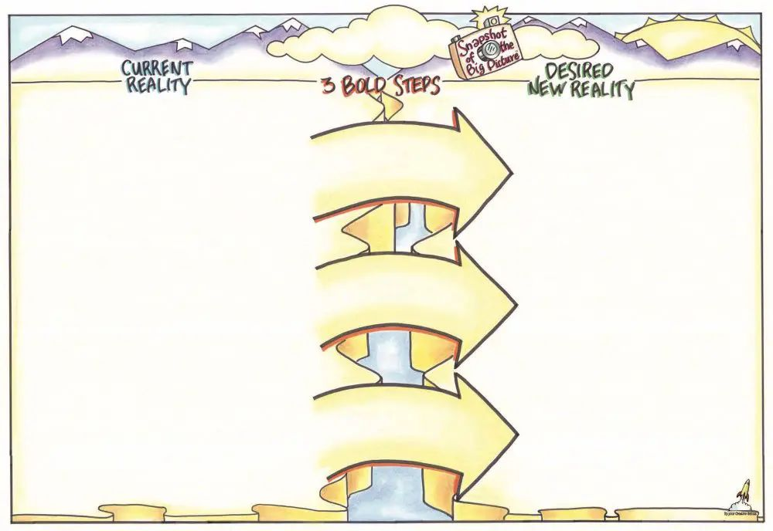
“DRAW YOUR FUTURE” TEMPLATE
Source: https://upyourcreativegenius.com/keynote-speaker/draw-your-future/

Slide 41
HOW TO “DRAW YOUR FUTURE”
Exercise
This is an activity will help you map your future. Get a large blank page
How to “Draw your Future”
Starting on the left write 1–2-word representations of where you're currently at. After writing each word draw a small picture to visually represent it. It doesn't have to be an exact visual, it could be a question mark or exclamation point around an area of tension, confusion, etc.
Do the same thing for the other side, drawing what you want your future to be. In between the two sides are three arrows.
After finishing writing down as many words and pictures as possible, use the arrows to write three "action steps" that can help make that imagined future a reality.

Slide 42
06
LEARN TO LIVE WITH FAILURE

Slide 43
LEARN TO LIVE WITH FAILURE
Failure hurts; there’s no denying it.
Whether it’s a bad market day, a dish that didn’t sell, or an opportunity that didn’t work out, it’s easy to feel discouraged.
But failure doesn’t mean the end. It means you tried. And every time you try, you’re learning what to do next.
What matters is how you respond. The better you get at facing failure, the faster you recover and the stronger your next move can be.
In this section, we explore 7 practical ways to face failure and keep going, without losing heart.

Slide 44
01. EMBRACE YOUR EMOTIONS
Don’t bottle it up. When something goes wrong, it’s okay to feel sad, angry, or disappointed.
Research shows that naming and feeling your emotions can actually help you move forward faster than pretending everything’s fine. Let yourself feel it. It’s okay to say:
“This feels unfair.”
“I worked so hard and it didn’t turn out.”
“I’m embarrassed that it didn’t sell.”
Once you’ve felt it, try reflecting:
What was in my control?
What will I try next time?
What can I forgive myself for?
You may even want to write a small reflection note:
“This happened.”
“This is what I learned.”
“This is how I will move forward.”
Read
https://www.verywellmind.com/healthy-ways-to-cope-with-failure-4163968

Slide 45
02. PRACTICE HEALTHY COPING SKILLS
When things go wrong, many of us fall into unhealthy patterns without noticing:
Blaming ourselves harshly
Ignoring the failure and pushing forward in silence
Working harder and harder without rest
Withdrawing from help, community, or support
These responses are natural, but not sustainable. Build a toolkit of healthy responses, e.g.:
Emotional tools: Call someone who listens with kindness, not judgment
Say aloud: “This is difficult, but it doesn’t define me.”
Write down the things you did do right
Physical tools:
Go for a walk, stretch, or move your body
Cook for comfort, not for selling
Rest. Nap. Pause. (This counts as recovery)
Business tools:
Review what went wrong with a calm mind later
Adjust your plan instead of scrapping it entirely
Remind yourself: One failure doesn’t erase your overall progress
Self-care is not a luxury; it’s actually a survival skill!

Slide 46
03. ACKNOWLEDGE IRRATIONAL BELIEFS ABOUT FAILURE
Sometimes, what holds us back isn’t the failure itself, it’s what we’ve been taught to believe about failure. Maybe you’ve heard:
“If you fail, it means you’re not good enough.”
“People will stop trusting you.”
“You only get one chance.”
These thoughts are not true, but they can become deeply rooted. Migrant women often feel extra pressure to prove themselves in a new culture, language, or system. But forgetting one ingredient, making a slow sale, or not understanding a form does not mean you’re failing. Success in a new country might mean simply showing up, learning, and continuing—even when it’s hard.
“I used to feel ashamed for not understanding business Swedish. Now I say, ‘I’m still learning. Ask me again.’ That’s not failure, that’s strength.”
Lamia, pop-up cook, Sweden

Slide 47
04. DEVELOP REALISTIC THOUGHTS ABOUT FAILURE
When you think, “I’ll never get this right,” pause and ask:
Is that really true? Or is it fear talking?
Then try replacing that thought with one that’s honest and helpful:
“This is hard, but I’m learning.”
“One failure doesn’t cancel my progress.”
“This mistake shows I’m trying to grow.”
These small shifts in thinking are called reframing. They don’t erase pain, but they help you move forward with less fear. Repeat them often—especially in moments of doubt.
“When my first event was quiet, I thought it was a sign to quit. But I told myself: ‘It’s just one day.’ The next market went much better.”
Reyna, chutney maker, The Netherlands
Reframe

Slide 48
05. ACCEPT AN APPROPRIATE LEVEL OF RESPONSIBILITY
Responsibility doesn’t mean blame. It means power to shape what happens next.
When things go wrong, we tend to do one of two things:
Take time to ask:
What was in my hands? What was outside of my control? What could I adjust next time?
“I couldn’t control the weather that closed the market but I could plan for a
backup location. Now I always have a Plan B.”
Chinyere, food stall owner, Dublin
Blame ourselves for everything, even what wasn’t in our control
Blame others completely, and lose the chance to learn
True responsibility lies in between.

Slide 49
06. CREATE A PLAN FOR MOVING FORWARD
Thinking about what went wrong is normal, but getting stuck there won’t help you grow.
Instead of replaying the failure again and again, shift your focus forward:
What exactly happened?
What would you do differently next time?
Who or what could support you better?
Now turn those answers into a small plan:
Adjust your pricing
Improve your setup
Ask for help or training
Try again, making the change that is needed. Remember, every mistake carries a lesson—but it only helps you if you apply it.
“I didn’t bring enough packaging for my second market. I made a checklist for the next one and now I use it every time. That one mistake made me better.” Arwa, food stall owner, Madrid

Slide 50
07. FACE YOUR FEARS
Most of the time, fear isn’t about failure; it’s about what we think it means:
“People will judge me.”
“I’ll lose money.”
“I won’t know what to do next.”
But fear shrinks when we face it. Start small.
Say yes to a new event
Apply for a small grant
Post a photo of your food online
Introduce yourself to someone at the market
Each brave act builds your strength and proves that even if you stumble, you can get back up. The most successful entrepreneurs have all failed. What made them succeed is that they didn’t stop there.
“The first time I gave a food demo, I almost cancelled. But I did it—and now I love talking about my food. The fear didn’t go away. I just moved through it.”
Raheema, community kitchen lead, Amsterdam

Slide 51
07
FIND HAPPINESS IN YOUR WORK AND BUSINESS

Slide 52
FIND HAPPINESS IN YOUR WORK AND BUSINESS
Running your own business is hard work. Most days, it’s tiring. Some days, it’s frustrating. But in the middle of all that, it can still feel good. For many women, especially those who’ve had to start over in a new place, there’s a unique kind of happiness that comes from knowing:
You made your own money
You fed someone with your food
You had control over your day, your time, your choices
Happiness in business isn't something you earn after success. It is something you can choose to cultivate along the way.
“It’s not easy. I go to bed exhausted. But when I see someone eat my food and smile and or when I count my profits, I feel full inside..”
Zeinab, home cook & food stall owner, Malmo

Slide 53
FIND FUN
Yes, business is serious. But that doesn’t mean it can’t also be fun. Fun doesn’t mean unprofessional. It means enjoying what you’re building.
Dancing in your kitchen while you prep orders.
Laughing with customers.
Feeling proud of your creativity.
For many women, fun is part of what keeps the business going especially when times are tough. You can find and share fun by:
Choosing your own playlist
Designing your stall
Naming your products
Seeing your ideas come to life
If you’re enjoying it, others will feel it. People not only buy your food, they buy your energy.

Slide 54
ENJOY YOUR OWN SUCCESS AND LOOK TO THE FUTURE
Enjoy your own success. You’re allowed to laugh, rest, celebrate small wins. Stand back and look beyond today to determine what's in the best interest of your business and yourself over the long run.
So, as you move forward with your food business, remember this:
You’re allowed to enjoy your own success.
You’re allowed to laugh, rest, celebrate small wins.
You’re allowed to build a business that brings you joy—not just customers.

Slide 55
WHEN IS IT TIME TO GROW YOUR BUSINESS ?
Here are signs that you might be ready to take the next step:
You’re consistently selling out - You can’t keep up with demand, and people are asking for more.
You’re turning down opportunities - Pop-ups, events, collaborations but you just don’t have the time or capacity.
You’ve mastered your routine - You’ve built a solid process, and it’s working. Now you want to do it at a bigger scale or a new location.
You want more time for strategy - You’re spending all your time in the day-to-day, and need help so you can focus on growing your vision.
You have steady income and can reinvest - You’ve saved or earned enough to buy better tools, rent space, or bring in support , without risking your core income.
Ask yourself: “Do I want to grow now or am I just feeling I should?”
Choose growth when it’s exciting, not just exhausting.

Slide 56
GROW YOUR BUSINESS WITHOUT OVERSTRETCHING
Growth doesn’t have to mean huge investment or long hours. You can grow slowly, wisely, and in a way that works for you.
Here are smart, manageable ways to grow your food business:
Increase your prices (if you’re undercharging). Even a small increase can boost your income and reflect your value.
Add one new product or service. Test a seasonal dish, catering option, or delivery service but don’t launch everything at once!
Work with others. Share a sales outlet, partner on events, or take turns at markets. Collaboration reduces cost and pressure.

Slide 57
GROW YOUR BUSINESS WITHOUT OVERSTRETCHING
4. Improve your systems. Create checklists, prep routines, or templates to save time and reduce stress.
5. Join a local kitchen, network, or programme. Gaining access to equipment, training, or markets can open doors without huge investment.
6. Outsource just one task. Whether it's accounting, packaging, or social media, freeing up just a few hours a week makes space to grow.

Slide 58
EXERCISE: GROWING YOUR BUSINESS
How to do it
Take 15–20 minutes of quiet time (or do it in pairs or a group if you prefer discussion).
Go through each section of the reflection guide:
Tick what feels true for you
Add your own thoughts and ideas
Be honest — this is for you
Use the “Personal Notes” section to plan one small action or ask for support.
Prompts for reflection:
“What kind of growth feels right — not just necessary?”
“What would help me enjoy my work more?”
“What’s one small step I could take in the next 2 weeks?”
Exercise
When to grow the business
DOUBLE CLICK WORD DOC ICON for the file you need

Slide 59
Congratulations!
YOU HAVE COMPLETED OUR 3 KITCHENS LEARNING ADVENTURE.
WE WISH YOU EVERY POSSIBLE SUCCESS.
www.3kitchens.eu

