Slide 1
STEP 7.
THE POWER OF COLLABORATION + NETWORKS
www.3kitchens.eu

Slide 2
Contents
01
What is collaboration and why is it important?
02
How collaboration will help your new food business
03
How to be a great collaborator in 6 steps
04
Finding people to collaborate with
05
Tips and tools for successful collaborations
06
The Power of Networking, including European Networks for female food entrepreneurs

Slide 3
Learning Objectives – Step 7 The Power of Collaborations + Networks
By the end of Step 7, you will be able to:
Understand what collaboration means and why it matters for migrant women working in food.
Recognise the benefits of collaboration in building a stronger, more resilient food business.
You will learn the key characteristics of a strong collaborator and reflect on your own strengths.
Practice using a simple 6-step process for starting and managing successful collaborations.
Learn how to identify and map potential collaborators in your network or community.
Understand the difference between networking and collaboration and when to use each.
Explore where to find collaborators, including local events, online platforms, and European networks.

Slide 4
01
What is collaboration and why is it important?
Collaboration is a popular buzzword these days, but it is a truly powerful business approach that can help you on your way.

Slide 5
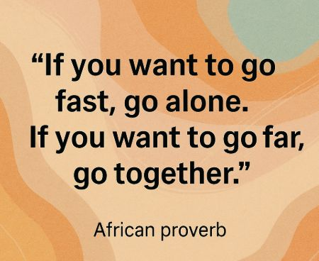
WHAT IS COLLABORATION?
Collaboration is the process of two or more people or organisations working together to achieve shared goals. In the context of migrant women and food, this can mean:
Pooling resources to access kitchens, equipment, and markets
Sharing knowledge and supporting each other’s businesses through mentoring, co-selling, and referrals
Building networks that create safety, confidence, and opportunities for growth
Many migrant women face barriers, be they, language, isolation, or systemic inequality. But through collaboration, they can build collective strength. From cooking circles and community kitchens to cooperative catering and joint ventures, collaboration becomes a bridge, from surviving to thriving.

Slide 6
WHAT IS COLLABORATION?
When migrant women come together around food, they do more than nourish—they build futures. These kinds of collaborations can help you navigate unfamiliar systems, amplify your cultural assets, and create more resilient income pathways.
Collaboration provides access to skills, networks, and resources that elevate ideas into impact.
This might mean:
Developing a new food product by combining traditional knowledge with commercial insight
Sharing a licensed kitchen space to reduce startup costs
Co-hosting a community meal to build reputation and local trust
Partnering with others to gain visibility, access funding, or meet legal and safety standards

Slide 7
COLLABORATION DOESN'T HAPPEN BY ACCIDENT
It requires:
Time and trust
Shared values and clear goals
A culture that is open to change and learning
Effort from all parties to listen, adapt, and follow through
In food, collaboration is especially powerful because food is inherently social.
When trust, presentation, and consistency are key to your business success, working together can unlock greater impact, revenue, and sustainability than working alone ever could.
Collaboration is about sharing the work but also multiplying the opportunity.

Slide 8
THE VALUE OF COLLABORATION
We know the saying - a problem shared is a problem halved. Research shows that discussing problems with people in similar situations reduces stress levels.
Problems don’t seem as overwhelming when you talk about them, and two people are more likely to find a solution than one.​
Peer Support Reduces Entrepreneurial Stress
A study with 300 South African women entrepreneurs found that peer support significantly reduced emotional exhaustion, helping to protect their drive to grow their businesses. Without peer support, entrepreneurial stress directly decreased their intent to scale; with peer support, that negative effect was much smaller
READ THE ARTICLE - (PDF) Why Peer Support Matters: Entrepreneurial Stressors, Emotional Exhaustion, and Growth Intentions of Women Entrepreneurs

Slide 9
THE VALUE OF COLLABORATION
When you bounce ideas off someone or lean on someone for their ideas and critiques, you magnify your own abilities in several ways.​
Momentum: Someone else is supporting you to move to the next step​
Sources: You add another lifetime of knowledge with more ideas, more research, etc
Perspective: You see angles and flaws you would not have seen yourself
Speed: You are able to work faster, identify better ideas more quickly​
Decisions: A sounding board helps you talk through your own decisions and understand your own thinking more easily. ​
Validation: A good collaboration partner not only sees the flaws in your work but can help support your best ideas and spur you forward in the right direction.​

Slide 10
WHY COLLABORATE?
“A great partner lets you soar without drifting away. Sometimes they are the ​ wind that’s hoisting you up. Sometimes they are the ones on the ground, holding the kite string. We need to play all of these ​roles for each other.”​
​
Source: http://www.flightofideas.net/Articles/Dynamic%20Duos%20-%20the%20Power%20of%20Creative%20Partnerships%20-%20Summer%202006.pdf ​

Slide 11
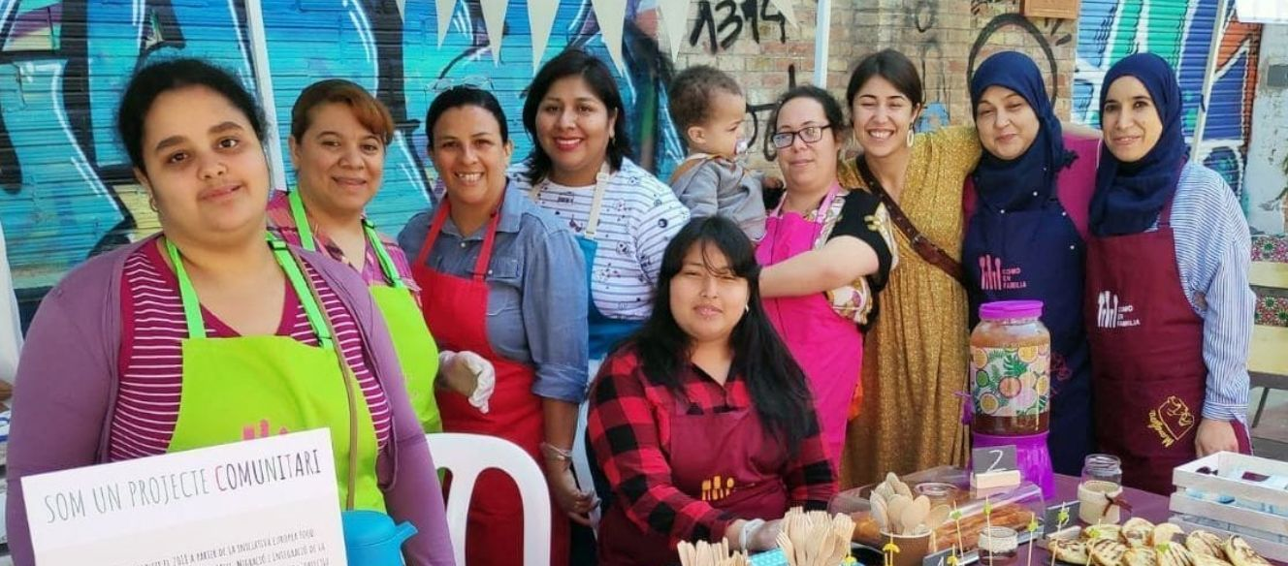
CASE STUDY - COLLABORATION CREATES BELONGING
You’re not alone, and that changes everything.
Isolation is one of the biggest hidden barriers for migrant entrepreneurs. And even more so for women. Beyond business, collaborative opportunities offer emotional support and a sense of community. Feeling seen and supported increases motivation, resilience, and pride.
Food Relations (Italy, Germany, Spain, Greece)
VISIT Do You Know the Project Food Relations? - ABD
A 2019 European initiative designed to empower migrant and refugee women through food, running pilots in Milan, Freiburg, Thessaloniki, and Barcelona.
How it works:
Training in intercultural community kitchens (5-month courses)
Participants co-create products reflecting their diverse culinary traditions
Launch of a “Como en Familia” brand—woman-led and community-run

Slide 12
CASE STUDY - Saha! Food Truck – Malta
An initiative by the Migrant Women Association Malta in 2018 raised over €50,000 to start a food truck entirely run by migrant women.
How it worked:
Crowdfunded startup covering kitchen setup, adaptations, and licensing
Women chefs took turns operating the truck at local markets and events
Why it matters:
Created employment and visibility for migrant women
Enabled cultural exchange and community presence through food
Demonstrates solidarity, strengthening social integration
WATCH A SHORT VIDEO
OF THEIR FUNDRAISING CAMPAIGN
https://youtu.be/0fDEMeNtid0

Slide 13
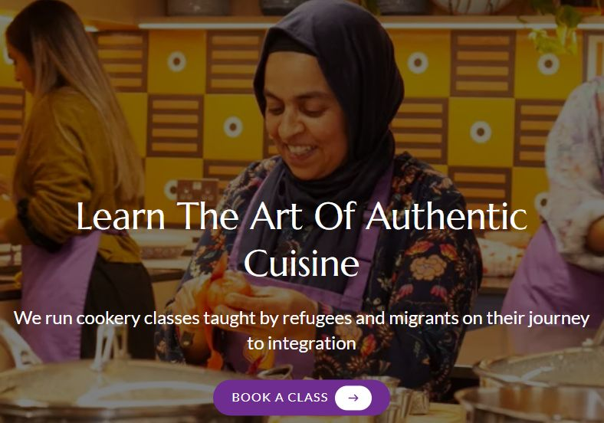
CASE STUDY - Migrateful
Migrateful is a renowned London-based social enterprise where refugee and migrant women (and men) collaboratively deliver cookery classes, sharing their traditional cuisines with the
How migrant women collaborate:
Small teams of chefs co-design and co-teach classes featuring recipes from countries such as Iran, Rwanda, Syria, and Colombia.
They support each other in running sessions, one leads cooking while another handles storytelling, ingredient sourcing, and logistics.
They pool experiences and marketing ideas, helping each other grow and adapt.
Screenshot from the Migrateful website

Slide 14
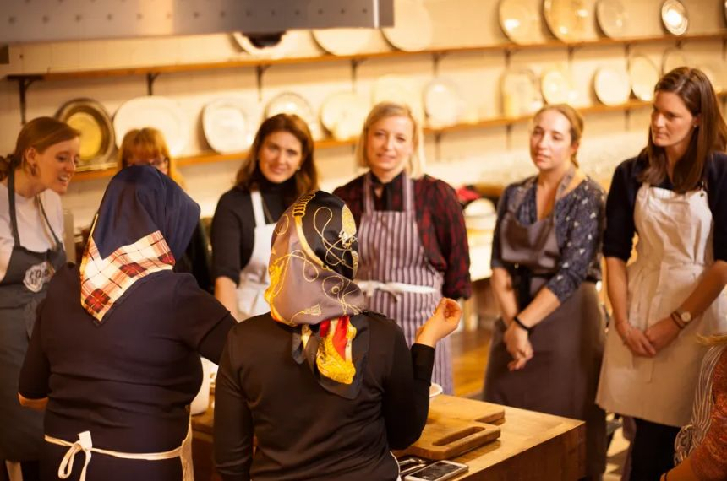
CASE STUDY - Migrateful
Business impact:
Chefs earn income through teaching; some branch into catering, private dining, and recipe development.
Shared visibility builds brand reputation, transforming individual knowledge into a thriving community enterprise.
A fascinating collaboration (it is a social enterprise and a charity), check out
The Team | Migrateful
Become A Migrateful Chef | Migrateful
Photo from Migrateful website

Slide 15
02
HOW COLLABORATION WILL HELP YOUR NEW FOOD BUSINESS

Slide 16
6 WAYS COLLABORATION WILL HELP YOUR BUSINESS
The connections you form with others, and the different ways you collaborate will help you grow your business to new levels. There are
Collaboration Will Inspire You
Running a food business can quickly become routine, especially when you're working on your own. But connecting with others sparks new energy and creative ideas.
Talking to another woman about how she prepares or sells her food might show you a better, faster, or more beautiful way to do it.
Sharing your story may help someone else and hearing theirs may reignite your own motivation. Inspiration comes from sharing space, sharing stories, and seeing that you're not alone.

Slide 17
6 WAYS COLLABORATION WILL HELP YOUR BUSINESS
2. Collaboration Helps You Grow Your Network
Growing a business takes more than good food—it takes connections. But this can be more challenging. Being successful in business requires that you consistently make connections and form alliances. But do it naturally, every time you attend a shared training, event, or kitchen session, you’re meeting people who can help you move forward.
Successful entrepreneurs have a common interest in meeting new people and building a list of contacts and colleagues. Word of mouth, referrals, shared suppliers, or introductions to customers often come from within your network. For migrant women, collaboration makes it easier to build the relationships that open new doors.

Slide 18
6 WAYS COLLABORATION WILL HELP YOUR BUSINESS
3. Collaboration Is Educational
One of the biggest benefits of collaboration is the opportunity for learning. In fact, every interaction you have with someone outside of your immediate circle can teach you something valuable.
Collaborating with others means learning from their strengths, their mistakes, and their experience e.g. learning a quicker way to cost your menu, or a smart strategy for dealing with food inspectors.

Slide 19
6 WAYS COLLABORATION WILL HELP YOUR BUSINESS
4. Collaboration Can Help You Save Money
Working alone means paying for everything on your own: time, space, and supplies. Collaboration allows people to share kitchens, tools, transport, or even market stalls, reducing the pressure on any one person.
It also allows you to split tasks, e.g., one person handles orders, another cooks, and another markets.
For example:
If you collaborate with another business in sharing marketing expenses; you can double your budget! You might share a trade show stand with a complementary partner, then co-market their participation. This can attract more customers and enhance the experience visitors have to your stand.

Slide 20
6 WAYS COLLABORATION WILL HELP YOUR BUSINESS
5. Collaboration Builds Confidence and Solves Problems
Running a food business comes with constant challenges, from pricing and sourcing ingredients to navigating permits and customer feedback. Facing these alone can be overwhelming. But when you collaborate, you don’t have to solve everything by yourself. Sharing problems out loud helps reduce stress and often leads to more effective, faster solutions.
Different women bring different life experiences, cultural knowledge, and business ideas. You might find that someone else has already faced the issue you’re struggling with and knows a way through it.
Collaboration builds confidence because you're not stuck in your own head.
“A problem shared is a problem halved” is a saying, but it’s also a business strategy

Slide 21
6 WAYS COLLABORATION WILL HELP YOUR BUSINESS
6. Collaboration in Action Is Win-Win
When people collaborate, everyone has something to gain, and that’s what makes it powerful.
A woman who bakes bread can partner with someone who makes chutney. Both offer a more appealing product together.
Two businesses can share a market stall: one selling hot meals, the other sweets. Each draws more customers to the other.
One food entrepreneur might feature another’s product on social media, and both grow their audience.
Collaboration doesn’t mean giving something up; it means creating more value together than you could alone. In the food world, collaboration is often the ingredient that turns small businesses into community favourites.

Slide 22
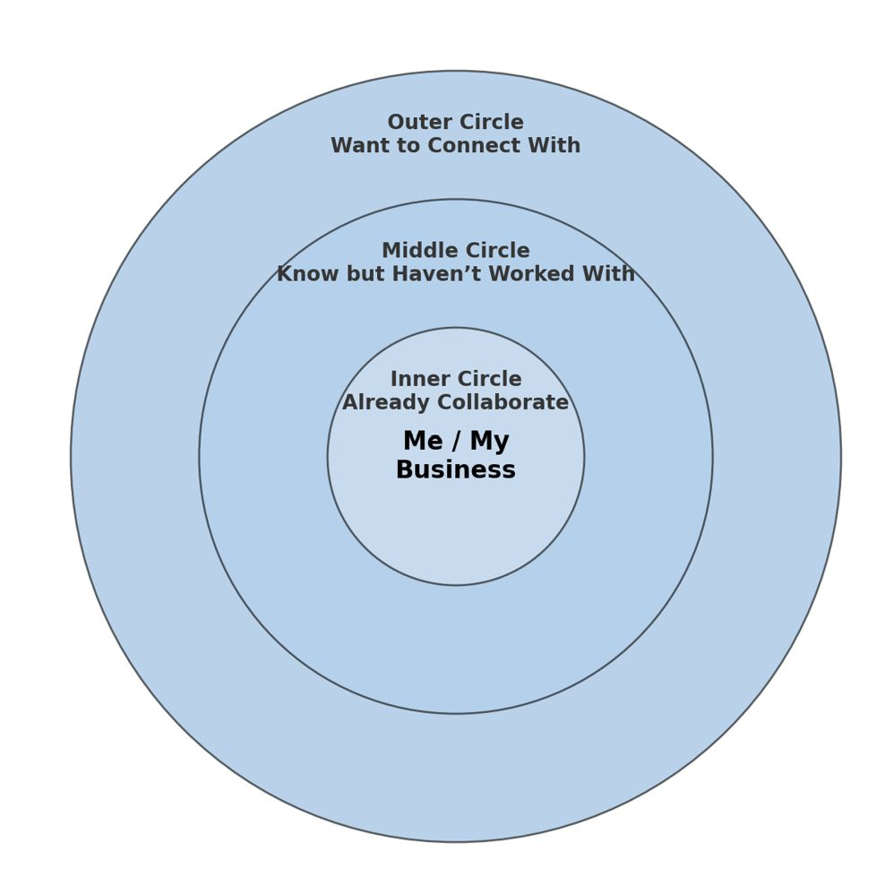
EXERCISE -Mapping Your Collaborators
This simple tool helps you visualise your support network.
Start by placing yourself at the centre.
Then think about who’s around you:
Inner Circle – People you already collaborate with (e.g. co-sellers, shared kitchen users)
Middle Circle – People you know but haven’t worked with yet
Outer Circle – People or groups you want to connect with (e.g. shops, mentors, event organisers)
Use this map to reflect, plan your next steps, and see how collaboration can grow your food business.
DOWNLOAD THE TEMPLATE TO HELP YOU
DOUBLE CLICK WORD DOC ICON

Slide 23
03
HOW TO BE A GREAT COLLABORATOR

Slide 24
STARTING WITH YOU - HOW TO BE A GREAT COLLABORATOR ​
You recognise that working together and sharing knowledge can take your food business further than working alone.
You value your own food and skills, but you also see the value in learning from others, especially when it helps everyone improve.
You are open to different ways of cooking and doing business—even if they’re not your own.
You approach collaboration like a recipe: with curiosity and flexibility. You know there is always something to learn from how others cook or run their business.

Slide 25
TOP 8 CHARACTERISTICS OF A GREAT COLLABORATOR
Team focused - To successfully collaborate, you need to be a team player and think about "we" rather than "I". A great collaborator is mindful of shared goals and the success of the group.​
Generous - A great collaborator is willing to take the first step and pitch in, even if they won't get the spotlight. Generosity is also an incredibly desirable leadership characteristic.
Curious - Great collaborators are good at asking the right questions. They don’t interrogate; they simply follow their natural curiosity because they want to understand.​
Appreciative - The best collaborators express sincere appreciation for all that team members have contributed. They’re not shy about expressing this appreciation, and they give credit where credit is due.
Listens to understand - Great collaborators listen attentively to what is being said. But more importantly, they listen to understand. ​

Slide 26
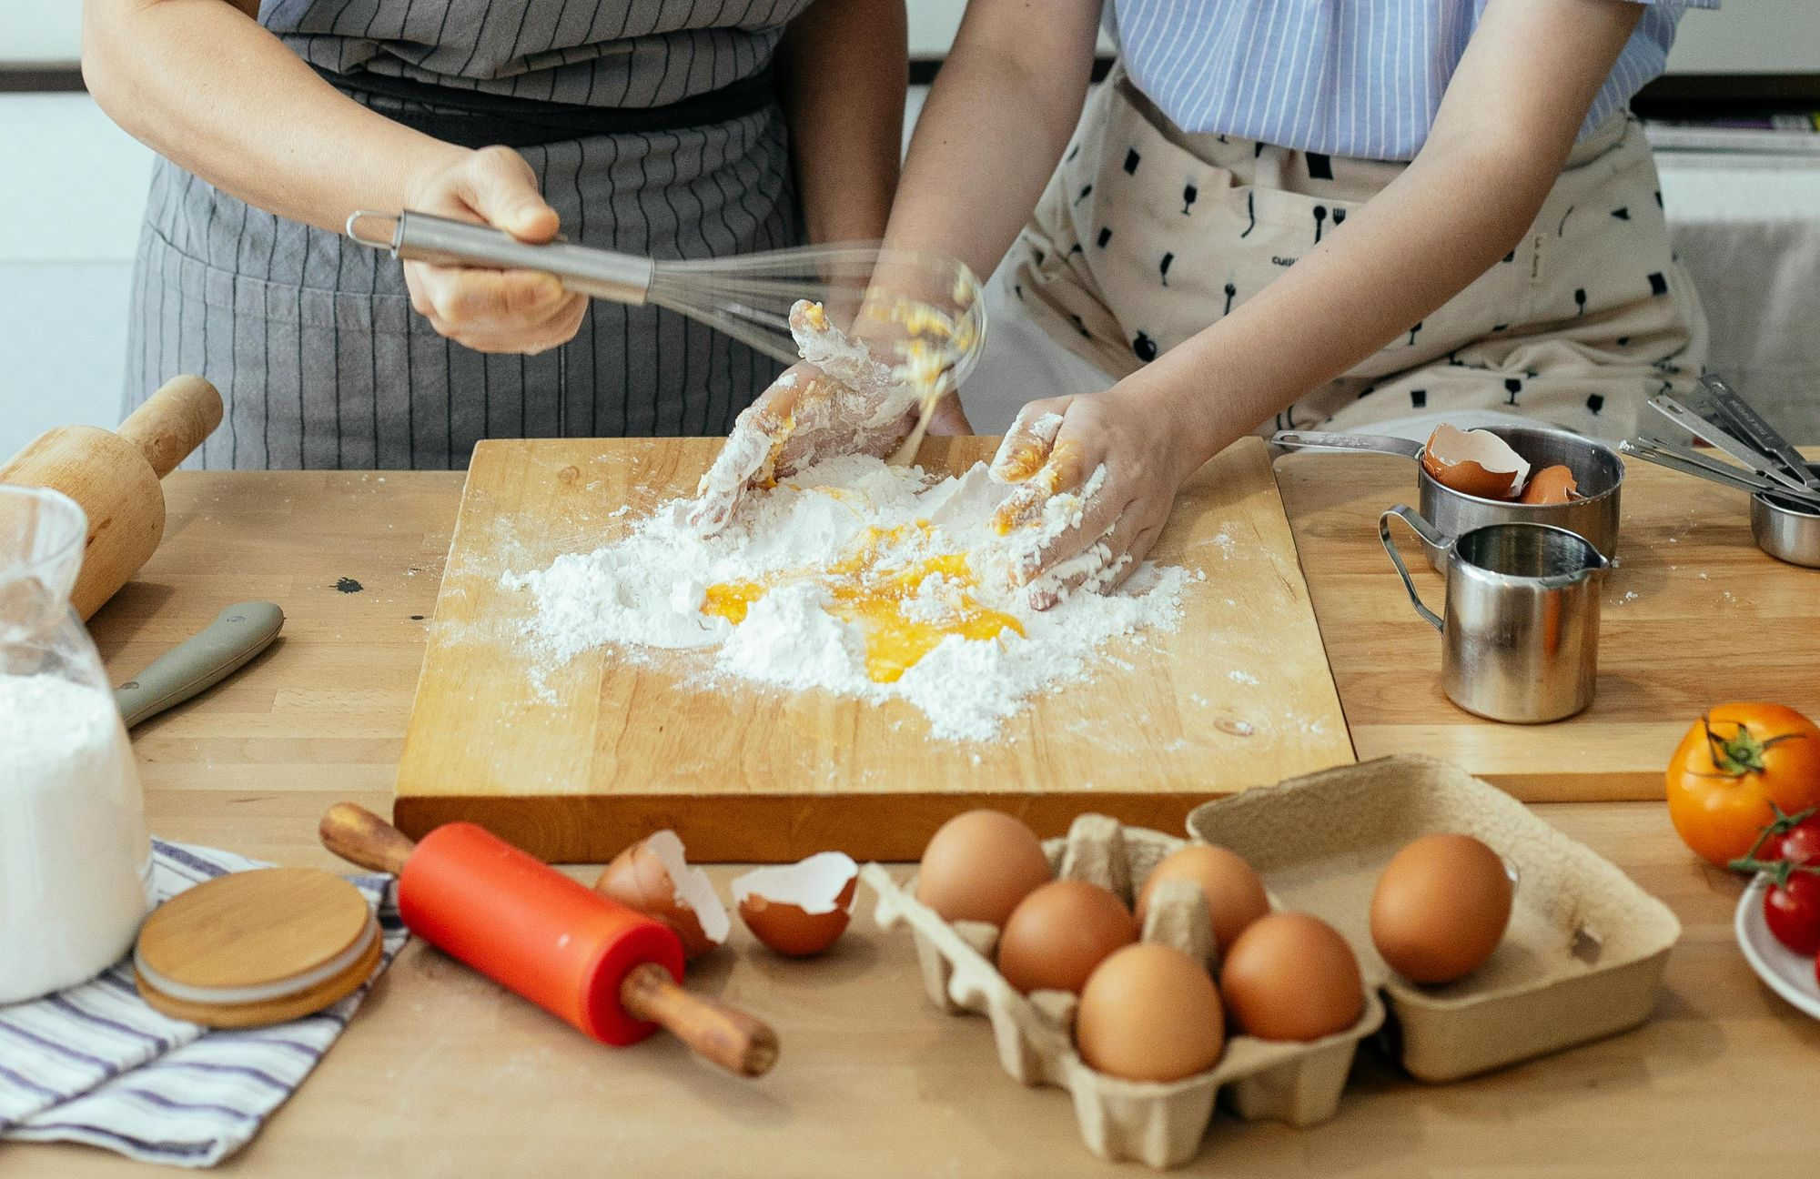
TOP 8 CHARACTERISTICS OF A GREAT COLLABORATOR
Gives and expects trust - More than anything, highly successful collaborations are built on safety and trust. Great collaborators help create and maintain that trusting environment. They give their trust freely and expect to receive trust in return.
7. Builds relationships - Collaboration is all about working together. Great collaborators see the value in being well-connected and work hard to build and maintain relationships with others.​
8. Diplomatic - The best collaborators are diplomats. They know that relationships are built on mutual respect.
Adapted from Source: www.samepage.io/blog/10-top-qualities-great-collaborator ​

Slide 27
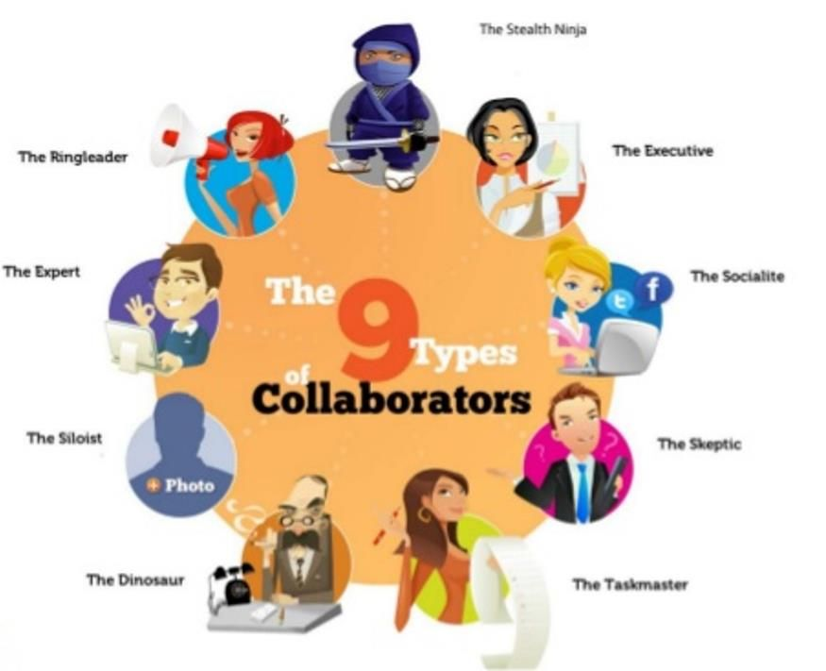
TYPES OF COLLABORATORS​ WHICH ONE DO YOU THINK YOU MIGHT BE?​

Slide 28
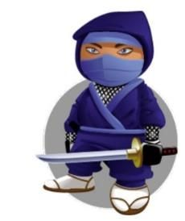
TYPES OF COLLABORATORS - PURPOSE DRIVEN USERS​
Decision maker that is driven by time, speed and efficiency.
The Executive​
Likes to lay low and oversee without too much involvement​.
The Stealth Ninja​
Loves being organised, is operational focused and keen to get things done, loves lists and action plans​.
The Taskmaster​

Slide 29
TYPES OF COLLABORATORS - POWER USERS​
The Big ideas person, discussion starter and collaboration initiator, lots of creative energy.​
The Ring Leader​
Borderline geek, loves trying and mastering, new and innovative ways of working.
The Expert​
Natural storyteller and connector, great communication skills and is used to social conversations on Facebook, Twitter etc.
The Socialite

Slide 30
TYPES OF COLLABORATORS - RELUCTANT USERS
Enjoys working alone, often reluctant to​ share work in progress, likes to hoard information.
The Siloist​
The Dinosaur
Creature of habit, not keen on trying​ new things, takes encourage to embrace​ new tools.
The Skeptic​
Can be very vocal opponents to collaboration,often focus on the WIIFM (what’s in it for me?) mentality.

Slide 31
6 STEPS TO COLLABORATE SUCCESSFULLY ​
1. Choose the right collaborators
Work with people who bring different strengths to the table—skills, ideas, or access you don’t already have.
In food, that might be someone with packaging experience, event contacts, or kitchen access.
2. Be clear about roles
Before you start, agree on who does what, who’s cooking, who’s handling sales, who’s posting on social media.
Clarity avoids confusion, tension, or disappointment later on.
3. Plan how you’ll communicate
Good communication keeps things moving and avoids assumptions.
Decide how and when you’ll talk—WhatsApp, voice notes, meetings?

Slide 32
6 STEPS TO COLLABORATE SUCCESSFULLY ​
4. Be open and respectful
Create a space where everyone feels safe to share ideas, even if they’re not perfect.
Listening well builds trust and leads to better solutions.
5. Write things down
Keep track of decisions: pricing, task lists, stall bookings, orders.
A shared notebook, whiteboard photo, or digital note can save time and prevent misunderstandings.
6. Check in regularly
Don’t wait for problems to grow.
Agree to meet or message regularly to review progress, fix issues early, and celebrate wins together.

Slide 33
04
FINDING PEOPLE TO COLLABORATE WITH

Slide 34
FINDING PEOPLE TO COLLABORATE WITH
FRIENDS FIRST
If you are seeking a collaboration partner, look first among your friends. Friendship can be a solid and common foundation for a good creative partnership. ​ While some people argue against mixing business and friendships. Be clear about roles, compensation, and expectations from the outset. Friendship and business can work together when there’s honesty and respect.
Look around: is there someone you’ve cooked with, sold beside or supported in the past? That’s a good place to start.
The late Jim Henson, originator of The Muppets explains
“When you work with your friends, it doesn’t feel like work at all. It feels like fun. I like to work with people I know and trust. With them, the ideas come naturally.”

Slide 35
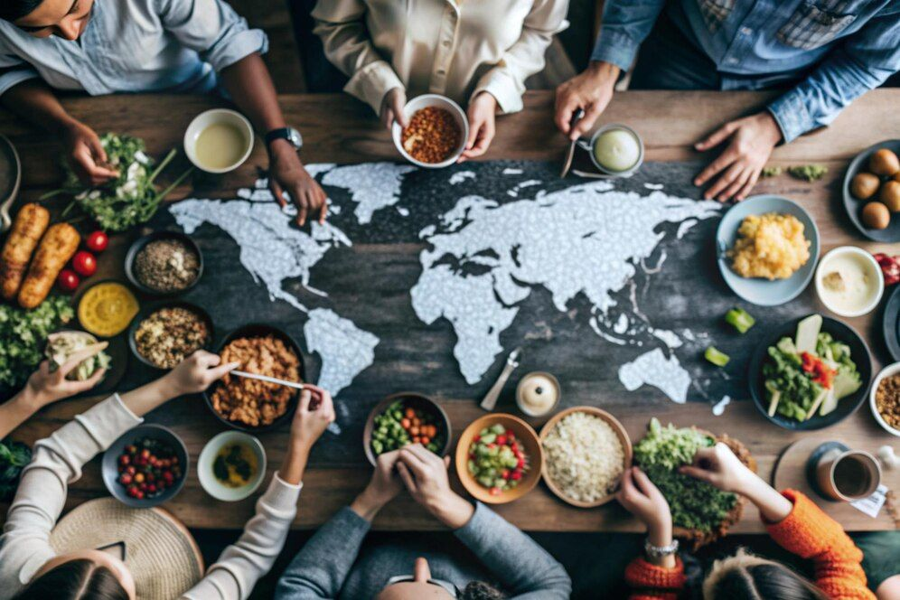
FINDING PEOPLE TO COLLABORATE WITH
UNITY OF PURPOSE
Never underestimate the power of common goals. They can move mountains even when collaborators are distant from each other.
​
Collaboration works best when everyone wants the same thing, whether it’s selling more food, joining a market, or launching a group brand.
Even if your personalities or skills are different, a common purpose creates focus and helps solve problems faster.
Great collaborators talk openly, make shared decisions, and respect each other’s contribution.
​

Slide 36
FINDING PEOPLE TO COLLABORATE WITH
YIN & YANG​
Not all collaborators are alike—and that’s a good thing. One of you might be great at cooking, the other at social media. Or one prefers face-to-face, while the other thrives behind the scenes.
Instead of clashing, use your differences as strengths. What feels like “opposite” can become balanced, with the right communication and trust.
Great collaborators know how to celebrate their differences.

Slide 37
05
TIPS AND TOOLS FOR SUCCESSFUL COLLABORATIONS

Slide 38
TIPS FOR SUCCESSFUL COLLABORATIONS​
Keep these in mind as you plan and work with others:
Be open to ideas that aren't yours—you might find a better way.
Don’t fear changes in direction. Great collaborations adapt.
Honesty is key ingredient of any collaboration; make sure each player knows and is clear about what they expect from the partnership from the outset. There needs to be clarity on why the collaboration is taking place and what each partner hopes to achieve.​
Collaborate with people who care about the process, not just the outcome.
Document key agreements—especially about money, time, and credit.
Stay open to ideas you didn't expect. ​

Slide 39
CHALLENGE WITH CARE
Collaboration should stretch you, not stress you.
Tension can be a sign of growth, if it’s handled with care. Good collaboration doesn’t mean always agreeing. It means caring enough to question. If you’re working together, it’s because you want the project to succeed, not just survive. That sometimes means challenging each other in a respectful, growth-focused way.
Ask the tough questions:
Is this really the best time for that event?
Are we reaching the quality we promised?
Is this goal still realistic—or are we playing it too safe?
Push for progress—not perfection or control:
Keep each other moving forward, rather than getting stuck in old habits.
Speak up if something isn’t working, early and kindly.
Focus on solutions, not blame.
Keep each other accountable:
Ask for updates without judgment.
Stay focused on actions, not just ideas.
Encourage big thinking—don’t be afraid to say, “We could go further.”

Slide 40
PLAN FOR FRICTION
Two people will often disagree on the best solution to a problem. But disagreements are opportunities for insight and can lead you to learn a new perspective on the problem.
Some things to consider:​
Pick Your Battles: Decide which battles to fight. Weigh the cost and benefits of each debate and whether it is worth the friction. Don’t be afraid to defend a great idea with passion, but avoid creating unnecessary arguments.​
Listen For Passion: Be cognizant of the other person’s passion when disagreement takes place. If they are defending their ideas, it might be an opportunity for you to listen more.
Adapted from:​ https://medium.com/@jasonkeath/partners-in-crime-the-power-of-finding-your-creative-collaborator-7d8aaf7af07b ​

Slide 41
Real-World Inspiration: How Collaboration Creates Opportunity
Aishah Al Fadhalah: Creating a Community Through Food
Aishah co‑founded Mera Kitchen Collective, a worker‑owned cooperative empowering refugee and immigrant women through cooking and community building.
She shares how food connects people, unlocks careers, and moves newcomers from isolation to leadership.
Watch her TEDx talk for more inspiration! ➔
https://youtu.be/nx5wdXm7QT8

Slide 42
WHERE TO FIND COLLABORATORS?
You don’t have to wait for collaborators to come to you—there are many ways to find people who share your energy, ideas, and goals.
Social Media (e.g. Facebook Groups)
Join open groups focused on food business, local markets, women entrepreneurs, or migrant communities.
Don’t just scroll—introduce yourself, ask questions, and offer help.
You can also create your own private group to stay connected with peers or collaborators from a training program or project.
Forums for Entrepreneurs, Expats & Women
Look for entrepreneurship forums, expat spaces, or women’s networks that include migrant voices.
These are great for asking advice, sharing opportunities, or finding people with similar goals.
Expat.com offers space to network, ask for support, and promote your business.

Slide 43
WHERE TO FIND COLLABORATORS?
Thessaloniki, Greece – Food, Migration & Belonging Talks
Belonging Talks Series on Food and Migration | Integration and Belonging
What it is: Academic & community events using food to explore migration, culture, and belonging
When: Ongoing; For example workshop on Culinary Sustainability as a Belonging and Resilience Practice for Syrian Refugees
Why it helps: Mixes storytelling, research, and practical collaboration, opening doors to network, co-cook, co-host.
Look in your own community for similar events
Watch their video for more inspiration! ➔
https://youtu.be/FNI4QbCb45s

Slide 44
WHERE TO FIND COLLABORATORS?
Mazí Mas is a roaming restaurant in London (but also pops up in Germany) that brings exciting, authentic global home cooking to the public, and in so doing creates employment opportunities for aspiring women food entrepreneurs from migrant and refugee communities.
‘Mazí mas’ means ‘with us’ in Greek, and creates a space in which long-term unemployed and socially marginalised women can open their own restaurant, an unrealised dream for many.
Read more: mazí mas global home cooking to the public
Look in your own community for similar events
Watch their video for more inspiration! ➔
Link to video

Slide 45
WHERE TO FIND COLLABORATORS?
Meetup (app/website)
www.meetup.com is a global platform where people create and join in-person or online events based on shared interests, like food, entrepreneurship or women’s empowerment. It’s free to join as a participant and available in most EU cities.
You can browse:
Food entrepreneur meetups
Migrant community events
Women in business mixers
Local market groups or sustainability workshops
Examples:
Food Startups & Sustainability – The Hague, Netherlands
Women Who Create (Food & Art) – Berlin, Germany
Refugee Women Connect (Pop-Up Events) – Liverpool, UK
Female Founders in Food – Barcelona, Spain

Slide 46
06
NETWORKING
As a female migrant food entrepreneur, you may sometimes feel alone, without any resources to utilise but your own. Finding your network or tribe means having a ready-made group to provide support and encouragement. ​

Slide 47
DIFFERENCE BETWEEN COLLABORATION AND NETWORKING
COLLABORATION
Working together on a shared goal or project.
Collaboration = Let’s do something together.
Key features:
Involves joint action (not just conversation)
Often includes shared tasks, decision-making, or outcomes
Requires trust, communication, and accountability
Happens over time, not just in a single moment
NETWORKING
Building & maintaining professional relationships
Networking = Let’s get to know each other.
Key features:
Meeting people, exchanging ideas or info
Doesn’t always lead to immediate action
Helps grow visibility, reputation, and access to opportunities
Can lead to collaboration later
Examples in food business:
Attending a food festival or training session
Introducing yourself on social media

Slide 48
WHAT IS NETWORKING?
Networking will be very useful at the start of your food business when you are less well connected.
Networking keeps you in touch with opportunities. You can turn to more people for help and advice.
Effective networkers are more likely to be offered opportunities.
Networking allows you to contribute something to others and build your reputation – people buy people.
The Oxford Dictionary defines the verb “to network” as to
‘interact with others to exchange information and develop professional or social contacts’
Networking is a very deliberate and conscious act. It does not happen by accident, and it is a two-way process.
Of relevance to our 3 Kitchen learners, analyses show that, in most cultures, women network in a different way from men. Women usually have smaller networks and closer relationships with their contacts than men.

Slide 49
TYPES OF NETWORKING
Networking helps you meet people who can support, guide, or open doors for your business.
It’s a low-cost, high-value way to build relationships, leading to referrals, learning, and collaboration.
Formal Networks Paid, structured groups that meet regularly to exchange business referrals. Example: BNI (Business Network International)
Best for women ready to grow sales through active referral partnerships.
Casual Contact Networks Open events where attendance is flexible. Great
for meeting people locally. Example:
Local Chamber of Commerce. Good for exploring opportunities without long-term commitment.
3. Regional Food Networks
Local organisations, cooperatives, or partnerships that support small-scale food producers, caterers, growers, and vendors in a specific area or region.
4. Online Networks Social media and niche forums for food, women, or migrant entrepreneurs. Ideal for staying connected, asking questions, and learning from others.
Examples:
Facebook Groups (e.g. “Women in Food EU”)
LinkedIn groups, Slack communities

Slide 50
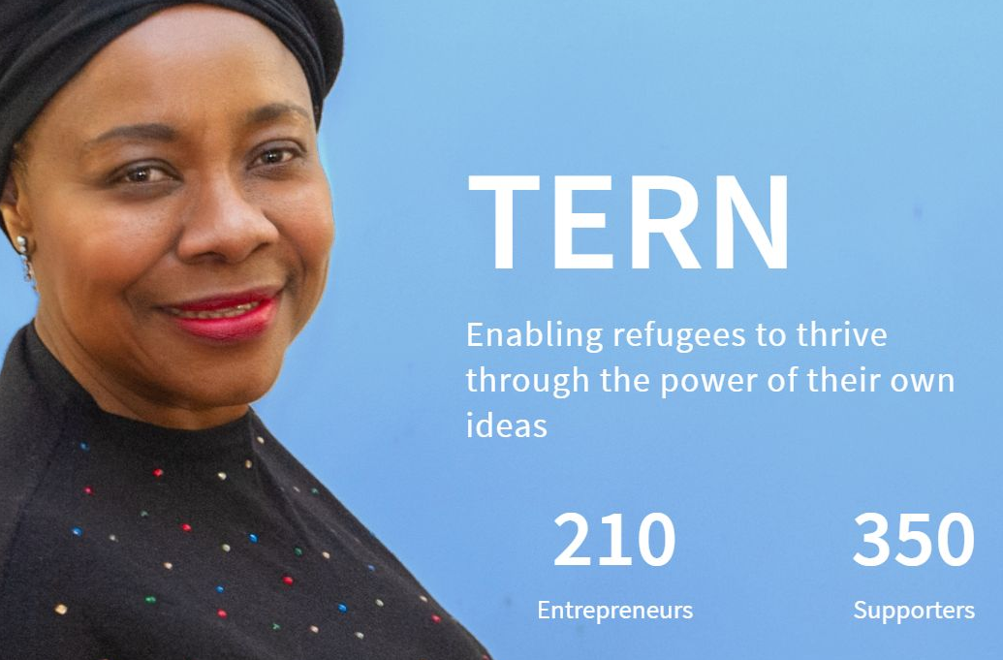
The Entrepreneurial Refugee Network - Supporting refugees into business, UK
SPOTLIGHT ON TERN.
TERN enables refugees to thrive through the power of their own ideas. Their goal is to launch 2000 refugee-led businesses by 2025.
It has helped many female led businesses through Wearetern | Herfutureforward – full of wonderful examples of empowered refugee
business women
www.wearetern.org
​

Slide 51
EXERCISE.
Research the networking platforms that you can access in your
Area/region
Sector
Online specific that are relevant to your business
​
How much time can you set aside to network each month?
​

Slide 52
3 networking tips for introverts
Click to View
Click to View
10 Simple Ways To Improve Your Networking Skills - How To Network With People Even If You're Shy!

Slide 53
THE DIFFERENCE IN FEMALE NETWORKING
Women are more focused on building long-term personal connections or friendships.
Women often make contacts through people they know and tend to form smaller, deeper networks based on trust.
They also frequently seek advice for both personal and professional needs.
In contrast to men, women generally hesitate to ask for what they want out of a networking interaction. Instead, they think about what they can do for the other person first.
Many women don’t want to attend events after work, because they want to get home to be with their families (the majority of women are still the primary caregivers).
READ. Why Women Need To Network Differently Than Men To Get Ahead (forbes.com)
​

Slide 54
FOR DEEPER LEARNING, THE DIFFERENCE IN FEMALE NETWORKING
Men generally go into networking opportunities with more clarity of what they want to achieve and with focus solely on their professional needs.
Women Connect on Multiple Levels: While many of the women are interested in learning more about business and how to improve their own, they also want to share the personal challenges they face in running both a business and maintaining family at the same time. A large component in networking is the process of women creating connections with each other.
In a women’s networking group, women feel safe to express how they FEEL about their work/life challenges and look to other women with similar experiences for support and advice.
READ. How Women Network Differently Than Men - Small Business BC
​

Slide 55
THE DIFFERENCE IN FEMALE NETWORKING
Women are Wired to Connect
Women are wired to connect and can be natural networkers. Typically women want to see other women succeed. While they do acknowledge competitors, they prefer to build capacity over competition. In some cases women try to work with their competitors, finding ways in which the two businesses can align to mutual benefit.
The Queen Bee is Not a Networker
Women are generally still fighting to define their place in the world of business. By connecting and networking with peers they are validating their important role and also beating the loneliness that can come from being a woman in business.
READ. How Women Network Differently Than Men - Small Business BC
​

Slide 56
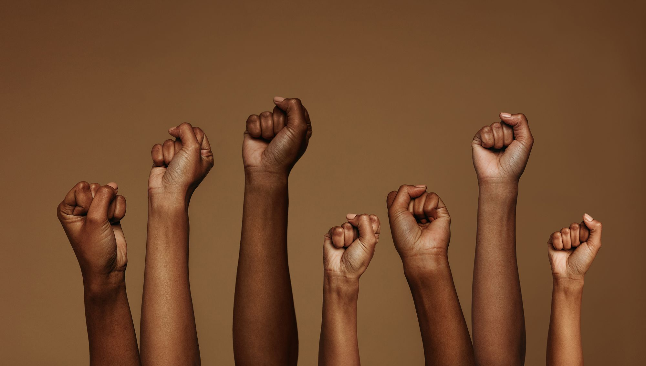
OVERCOMING BARRIERS TO NETWORKING
Networking sometimes has negative connotations reflecting suspicion about the motives behind it.
You may have heard people make comments such as ‘the old boys’ network’ which is an obvious challenge to female migrant entrepreneurs, but new types of networks and new ways of networking have emerged that mean that the accessibility of networking is increasing all the time.

Slide 57
RELEVANT EUROPEAN NETWORKS FOR FEMALE ENTREPRENEURS
Several influential European networks support female and migrant entrepreneurs in food and related sectors.
European Network of Migrant Women (ENoMW)
A migrant-women-led platform uniting over 50 grassroots groups across 20+ European countries. Focuses on advocacy, capacity building, and solidarity, offering a strong peer network. Contact your local network via
List of Members - European Network of Migrant Women
WEgate
A European Commission-funded online portal dedicated to women-led startupsIncludes tools, events, funding calls, mentorship, and established networks like Women Business Angels. Useful for finding resources, connections, and expertise relevant to migrant entrepreneurs. Includes food businesses, social enterprises, retail, technology, health, care, and services.
WEgate - WEgate
​

Slide 58
Next and finally, Step 8
THE CONFIDENCE TO KEEP GOING AND KEEP GROWING
Resilience, Managing Risk and Managing Wellbeing
www.3kitchens.eu

