Slide 1
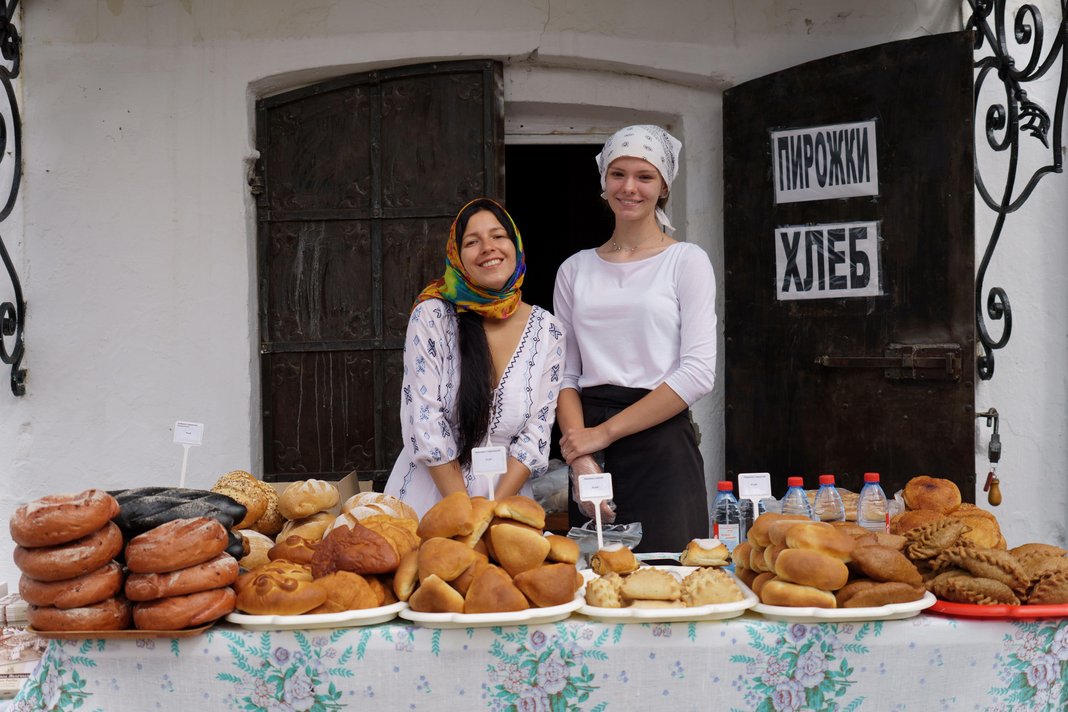
STEP 6.
SALES ARE
THE ENGINE OF YOUR FOOD BUSINESS
www.3kitchens.eu

Slide 2
Contents
01
Getting Started with Sales
02
Dealing with objections
03
Closing the sale - approaches that work
04
Upselling

Slide 3
Learning Objectives – Step 6 Sales are the Engine of Your Food Business
By the end of Step 6, you will be able to:
Understand how sales drive your business and build customer trust at every stage of the buying journey
Communicate your value clearly using real stories, customer benefits, and simple, confident language
Respond to objections with confidence using proven techniques that feel respectful and natural
Ask for the sale and close the deal with strategies that suit your product, personality, and customer
Use upselling, follow-up, and calls to action to increase income and grow long-term relationships

Slide 4
01
GETTING STARTED WITH SALES

Slide 5
GETTING STARTED WITH SALES
People buy from People
No one knows your product/service as much as you. Allow your natural enthusiasm to shine through. It’s infectious.
Get the timing right
Respectful timing builds trust — and many customers appreciate space."Is this a good time to talk? If it's not, perhaps we can meet another day”.
Being open, honest, and transparent
Cultural sensitivity is essential. Understanding and knowing about cultural differences of your customers is a crucial skill for succeeding in sales.
Let’s be honest — selling can feel hard. Many women say it's the most challenging part of running a business, especially when language, confidence, or cultural expectations come into play.
But here's the good news: your voice, values, and food are your biggest sales tools.

Slide 6
A simple way to look at the customer buying cycle is to break into three stages:
01
02
03
AWARENESS
CONSIDERATION
PURCHASE
When a customer first becomes aware of your food product. Or where a customer first becomes aware of a need that they want to fulfil
They’re thinking about trying it, comparing, asking questions, or tasting. They are evaluating solutions to their need.
They decided to buy. When a customer makes the decision and completes the purchase

Slide 7
WHAT YOU CAN DO AT EACH STAGE
Share your story in a way that makes people curious. Use your chosen marketing tools and ask “This is my family’s recipe from Morocco. Want to taste?
AWARENESS
CONSIDERATION
Explain what’s inside, how it’s made, or how to use it
Provide backup proof – customer testimonials, reviews
PURCHASE
Make it easy: clear prices, QR code, or menu
PERHAPS Offer an incentive
Say a genuine thanks for the purchase

Slide 8
TYPE OF SALESPEOPLE - Which one are you?
01
02
03
ORDER TAKER
You wait for customers to approach you. Typical in a market or shop setup.
If you are online, you have a website or WhatsApp link and wait for orders.
ORDER CREATOR
ORDER GETTER
You spark interest by sharing your story. At a market, you don’t wait, you engage e.g. offer a sample to create that deeper interest.
Online, this could look like a behind-the-scenes post, a cooking tip via short video.
You are proactive in generating new business and more sales from existing customers
Online, you DM people, reach out to influencers, or run online promos.

Slide 9
DEVELOPING A WINNING SALES PITCH – 4 STEP PROCESS
Step 1: Identify your Unique Selling Points
Know What Makes You Special. What do you do differently from others? Make a list of 3–5 things that make your food or service unique. Think: taste, story, process, values, culture, packaging, or how you serve customers.
Step 2: Understand the benefits of what you are selling from the customer’s perspective. Show How Your Product Helps the Customer. Why should they care?
Give examples of how your product or service has provided customer value to others e.g. “This sauce is ready in 2 minutes — perfect for busy people.”
Step 3: Be Ready for Questions or Doubts - Handle Objections
What if they say, “It’s too expensive” or “I don’t know how to use it”? Reply kindly and confidently: “It lasts 5 days in the fridge and here’s a free recipe card to help.
Step 4: Close the deal! Don’t be shy. Guide the customer forward.
“Would you like to try one?” “Can I pack that up for you?” Would you like to order again for next week?”

Slide 10
STEP 1 - IDENTIFYING YOUR USP (UNIQUE SELLING POINTS)
We explored USP (UNIQUE SELLING POINTS) in Step 5: Marketing on a Shoestring, and now it’s time to use that work in your sales pitch.
Ask yourself again:
“What do I offer that makes my product different, valuable, or meaningful?”
Use 3–5 key points that reflect your:
Ingredients or sourcing
Cultural roots or family recipe
Values (e.g. sustainability, inclusion, tradition)
Packaging, service, or quality
What people say when they try it
Exercise
Your sales pitch starts here: “What makes our food special is...”: “What makes our food special is...”

Slide 11
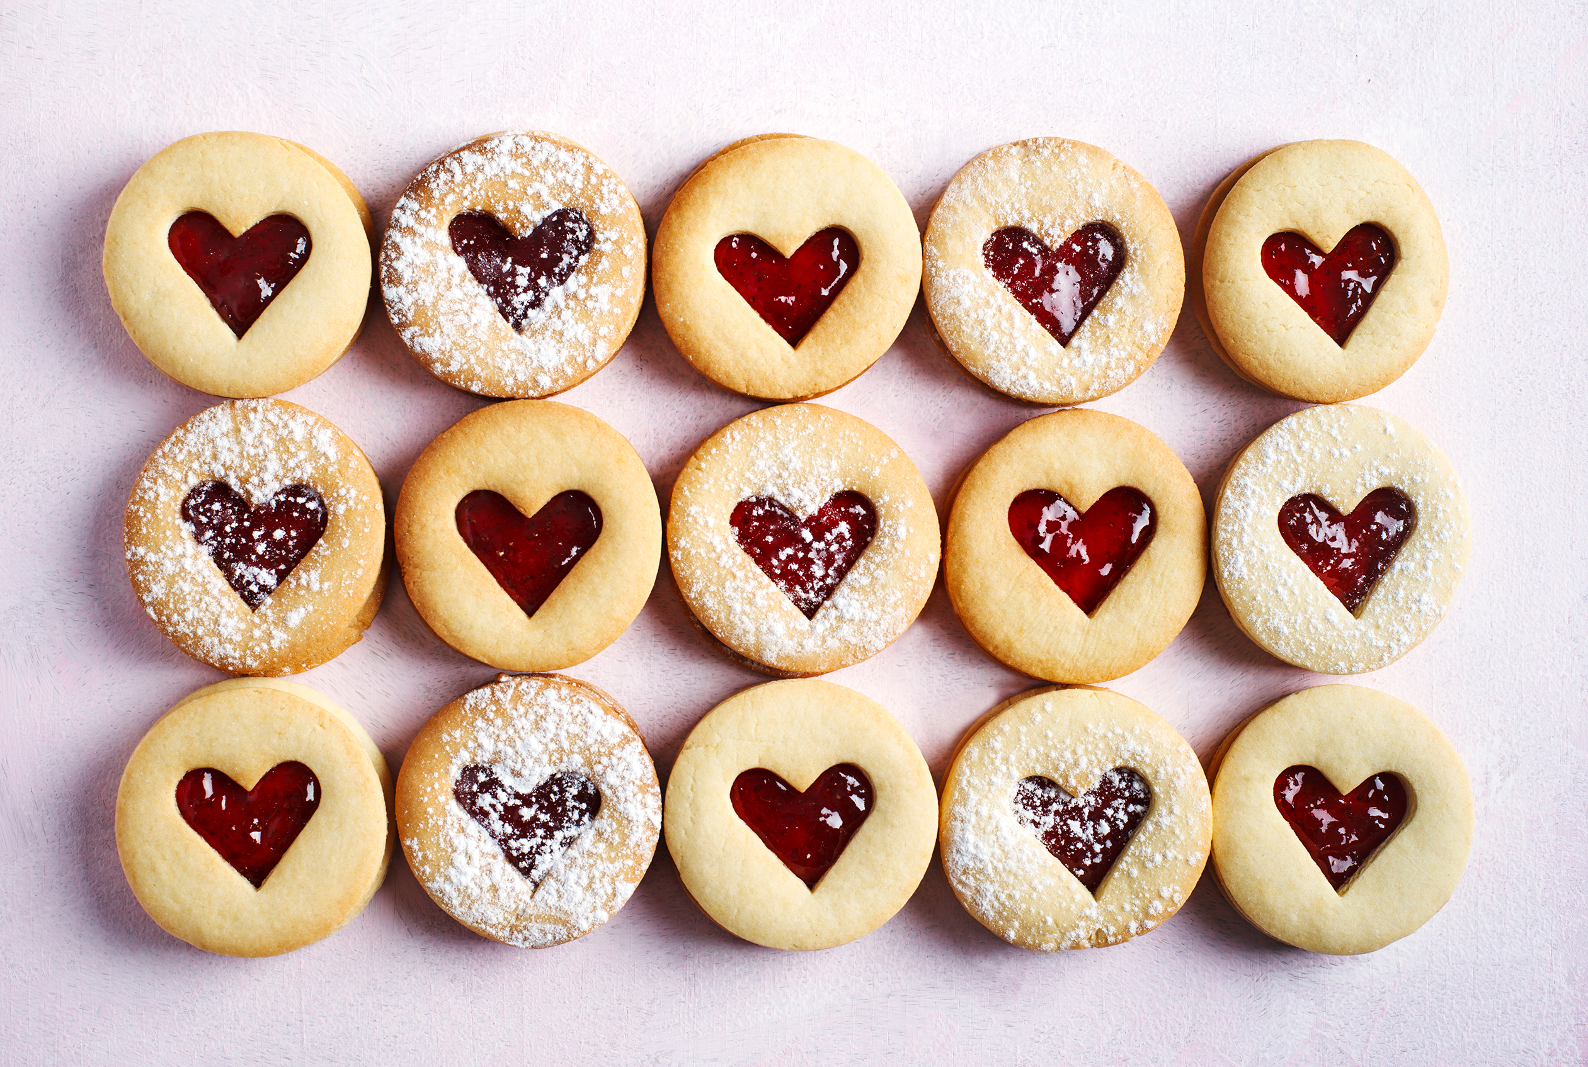
REMINDER! WHAT SELLING REALLY IS
When you're selling, you're helping someone solve a problem.
Don’t just list what you make, show how your product helps:
Saves time
Brings comfort
Shares culture
Offers something joyful or handmade with care
Instead of saying “I make pastries,” say:
“I make handmade pastries filled with flavours from home — perfect for gifting or enjoying with tea.”

Slide 12
SALES SKILLS AT EACH PHASE OF THE BUYING CYCLE
Buying Phase of the Customer | Sales Skills to Use
Need Recognition | Ask questions. Show that you care about their needs. Smile. Share your story.
Information Search | Explain what your product is, how it’s made, and why it matters. Be patient.
Evaluation | Compare, give options, explain value (“This is gluten-free and freshly made this morning”)
Decision | Ask with confidence: “Would you like to take one today?”
After Purchase | Thank them! Ask if they’d like to come back. Share a follow-up or free tip to build rapport

Slide 13
TELL A GREAT STORY – ARTICULATE
The best way to build trust? Tell a real story.
Why Stories Matter:
They help people see themselves using or enjoying your product
They create an emotional connection — especially in food, where memory and culture are powerful
They make your brand feel genuine and relatable
Use a short example from someone you’ve served or helped: “Fatima bought 3 jars of my spiced tomato sauce and messaged me later. She said it reminded her of her grandmother’s cooking.”
Tell it simply and honestly; people love real-life stories.
How to Choose the Right Story:
Keep it brief — one moment, one person, one feeling
Make it relevant to the customer you’re speaking to
Focus on outcomes — how your food helped, solved, or delighted

Slide 14
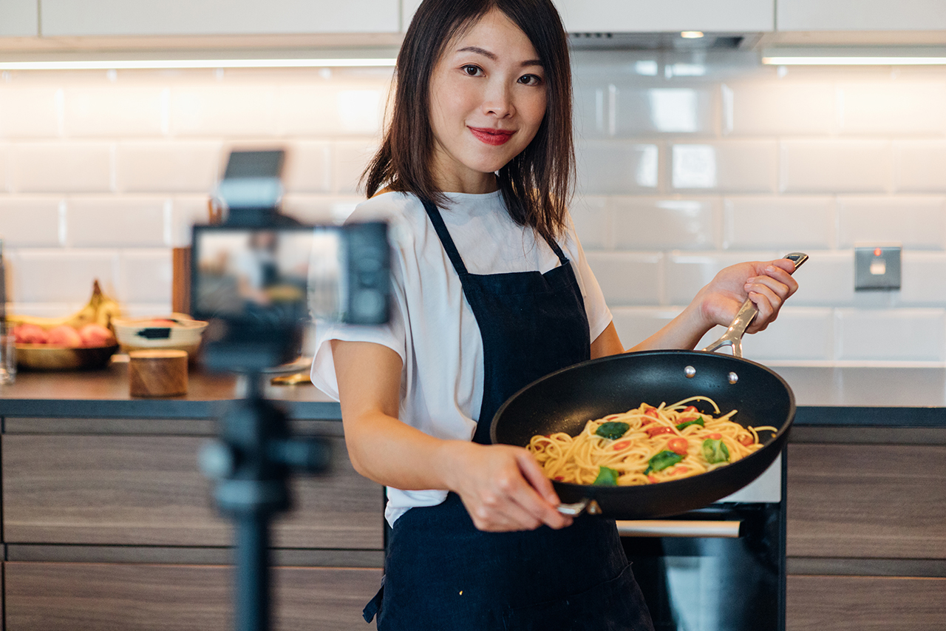
TELL A GREAT STORY - USE VIVID LANGUAGE
Provide proof using vivid imagery rather than words alone to tell your story… examples:
Less Impactful
“My food is authentic and nutritious.”
More Powerful
“This recipe was passed down from my grandmother. I use fresh herbs I grow myself, and each meal takes just 10 minutes to prepare, perfect for busy people.”

Slide 15
DESIRE – Help Customers Feel Confident About Buying
To help someone say yes, first understand why they might want what you offer.
People buy for different reasons:
Rational (Practical): Profit, health, safety, convenience, quality - “This dish is healthy, freezer-friendly, and ready in 5 minutes.”
Emotional (Feeling): Love, nostalgia, celebration, pride, comfort - “This tastes like what my grandmother made.”
What You Can Do:
Think: What’s the main reason someone would buy from you?
Use proof to build trust: Share real feedback or photos. Show the before and after.
Mention repeat customers: “This is Jamila’s favourite treat, she buys 3 every Friday for her family.”

Slide 16
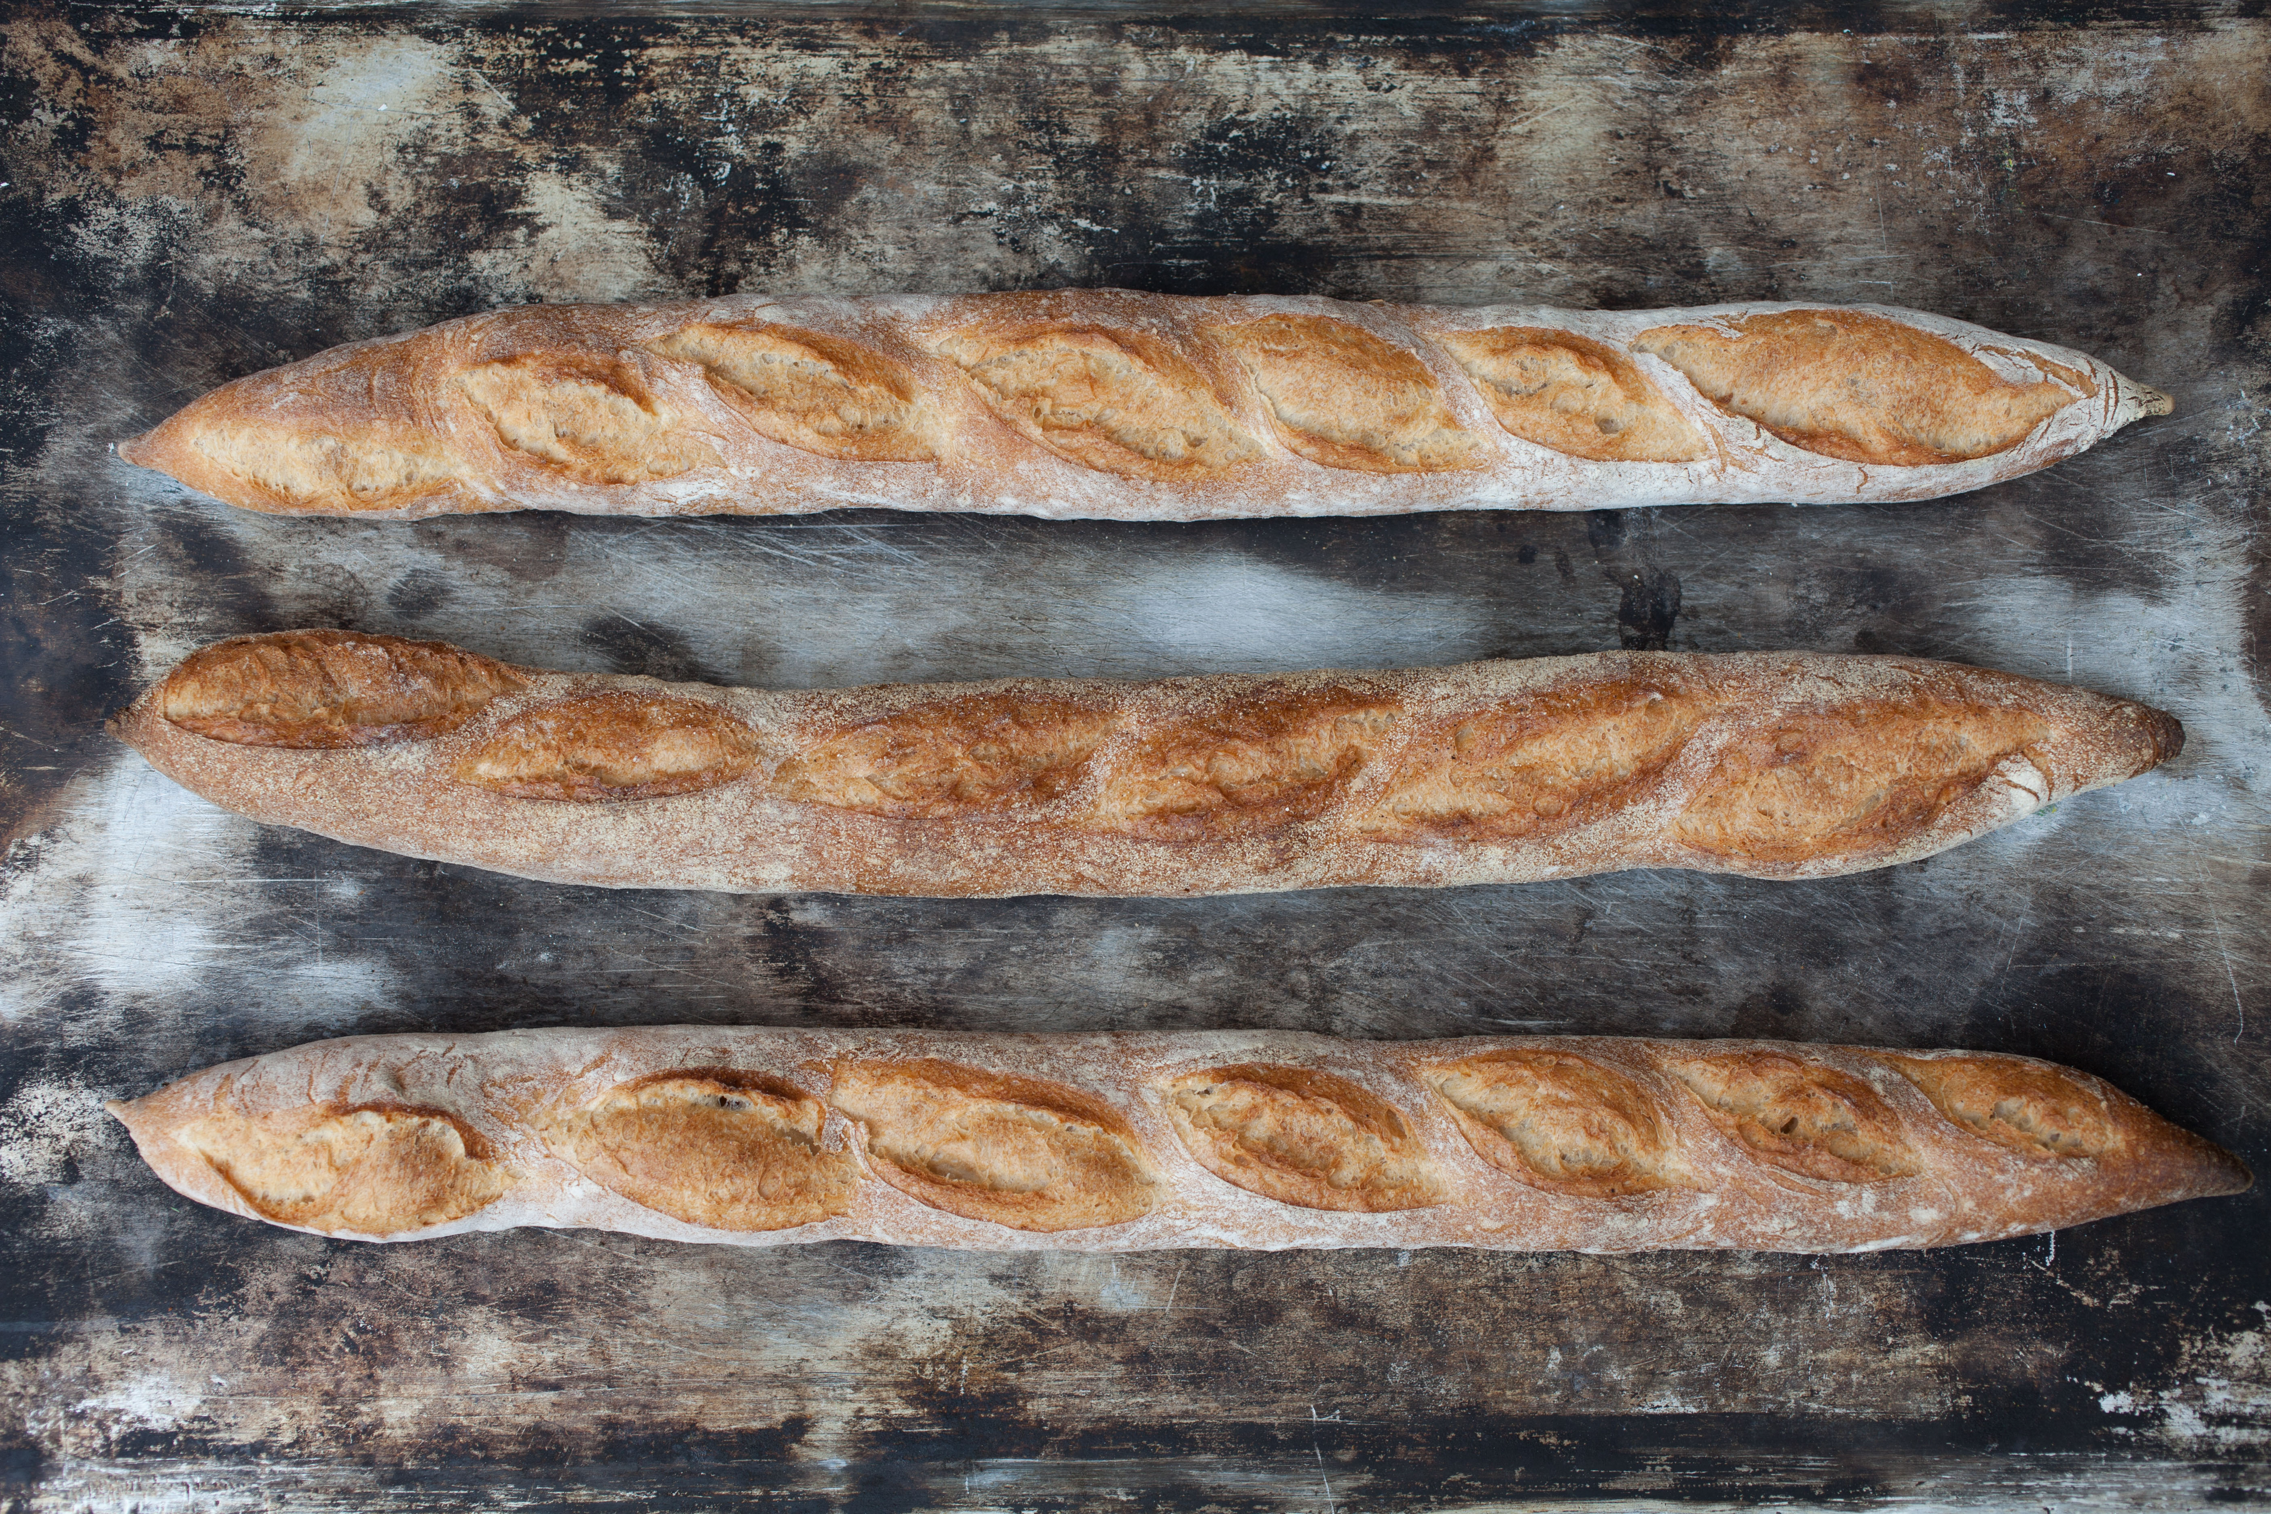
TELL A GREAT STORY – SHARE PROOF
Easy ways to demonstrate your value:
Use a short video or photo of your food being made or served
Share a real-life tip or process (e.g. “How I keep my herb mix fresh for weeks”)
Post a customer quote or visual before-and-after moment
Create a short “Did you know?” guide:“3 ways to use our tamarind paste”
If your knowledge is your product (e.g. cooking lessons, nutrition guidance):
Share mini tutorials or cultural facts
Create simple downloads: “How to store your spices”“Foods to eat during Ramadan”

Slide 17
REMINDER! – TOP TIP EFFECTIVE SELLING!
Selling is a skill and like all skills, it can be learnt.
Selling isn’t about pressure; it’s about connection. You don’t have to be “pushy” to be effective. You just need to learn a few key habits, and practice.
Good sellers:
Ask questions and truly listen
Speak with care, not rush or pressure
Explain clearly, check for understanding
Adapt their message depending on who they’re talking to
Don’t give up after one “no”. They stay curious and kind
Know when someone’s ready to buy and help them say yes
You already have many of these skills. With a little structure and support, you can sell with confidence.

Slide 18
CREATE A STRONG, SIMPLE SALES PITCH
Evaluate What stage is your potential customer at in the buying cycle? Are they just hearing about your product? Curious but unsure? Or ready to buy?
Articulate Personalise your sales pitch based – what is their pain point? What problem are they trying to solve? How does your product help them? Instead of “These are my vegan dumplings,” say: “These are perfect for people who want comfort food without meat, and they’re ready in 10 minutes.”
Illustrate What picture are you trying to paint? What language are you using? Use words that paint a picture. Show what it feels like to enjoy your food. Use sensory details or emotional touchpoints. “This spice blend brings back the smell of home, warm, familiar, full of flavour.”
Demonstrate Give real-life examples or proof. Tell a short story about a happy customer or show before-and-after results.

Slide 19
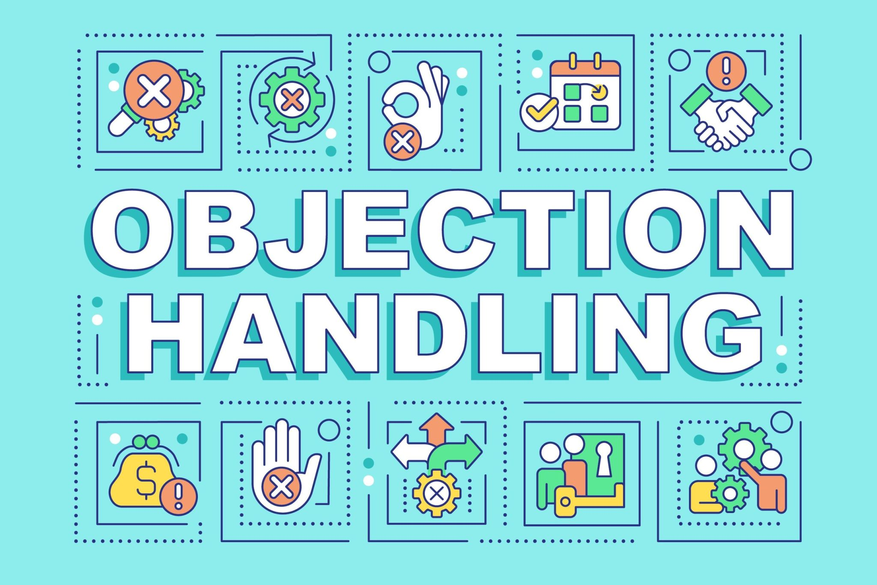
HANDLE OBJECTIONS
Now that you have successfully articulated what you are selling, you must be prepared to
- Handle Objections
- Close the Deal
This involves being comfortable with resistance and asking for the sale and knowing the right techniques and knowing when to use them!
Sections 2 and 3 will guide you through.

Slide 20
02
DEALING WITH OBJECTIONS

Slide 21
DEALING WITH OBJECTIONS
Objections aren’t rejections; they’re just part of the conversation. It means the customer is thinking and that’s a good thing. Objections don’t always mean “no”, they could mean “not yet”, the sale may still be on the way!
What to Do When Someone Hesitates:
Listen First: Don’t interrupt. Let them finish and show you care what they think.
Stay Calm and Curious: Ask gently: “Can I ask what’s holding you back?” or “Is there something you’re unsure about?”
Try These Friendly Techniques: Agree and Respond (The “Yes… and” technique): “Yes, I understand it’s a bit more than supermarket brands, this one is handmade, with no preservatives.”
Ask for Clarification: “What would make it feel like a better fit for you?” or “Is it the size, price, or something else?”
Offer a Simple Solution (if possible):“I have a smaller portion size if you’d prefer to try it first.”

Slide 22
OBJECTION HANDLING TECHNIQUES
01
02
03
04
PUSHBACK TECHNIQUE
REFRAMING TECHNIQUE
JUSTIFICATION TECHNIQUE
PRE-EMPTIVE TECHNIQUE

Slide 23
PUSHBACK TECHNIQUE
01
What it is: Gently challenge the objection while showing respect.
Use when: You believe the customer’s concern is based on a misunderstanding.
Examples: “I understand it seems expensive, but did you know it’s handmade with organic spices, and lasts up to 2 weeks?”
or “Some people say that about the product at first but then they taste it and come back for more!”
This technique: -
discredits the statement NOT the customer
avoids confrontation approach
demonstrates empathy by validating the concern
OBJECTION HANDLING TECHNIQUES

Slide 24
REFRAMING TECHNIQUE
02
What it is: Help the customer look at the situation from a new angle.
Use when: They need help seeing the value or benefit.
Examples: “I know it’s more than supermarket sauces, but you’re not just buying sauce, you’re buying premium ingredients and recipe made with care, by hand.”
“Instead of thinking of this as a one-time treat, think of it as a simple way to add flavour all week.”
This technique:
You can reframe an objective as a buying motive
Helps your prospect to think about a purchase along a completely different dimension
He or she can turn a small difference into a critical difference
OBJECTION HANDLING TECHNIQUES

Slide 25
JUSTIFICATION TECHNIQUE
03
What it is: Explain the reasoning behind your price, ingredients, or approach.
Use when: The customer needs facts or reassurance to decide.
Examples: “This price includes high-quality, locally sourced ingredients, and I make each batch fresh, that’s why so many of my customers say it’s worth it.” “I use compostable packaging because I want to run a sustainable business, I believe it’s part of what makes this special.”
This technique builds trust by showing that your choices are thoughtful, responsible, and rooted in quality and not just price.
OBJECTION HANDLING TECHNIQUES

Slide 26
PRE-EMPTIVE TECHNIQUE
04
Handle the objection before the customer brings it up. Show you understand their concerns and that you’ve already thought of a solution.
You: “You might think this is expensive — but it’s handmade with local ingredients and feeds 4 people. It’s great value for a busy family.”
You: “Some people worry about trying new flavours. That’s why I offer free tasting so you can feel confident before you buy.”
You: “Many first-time buyers ask if this freezes well and the answer is, it does! I’ll give you tips on how to store and reheat it at home.”
This technique shows you’re thoughtful, honest, and one step ahead, and this builds trust.
OBJECTION HANDLING TECHNIQUES

Slide 27
PRE-EMPTIVE TECHNIQUE
04
Evaluation
- Puts you as the salesperson in a position of strength
- They bring the objection up first so it cannot be brought up again
- The objection becomes weak and the handling becomes strong
Previous customer example demonstrates empathy and avoids
isolation
OBJECTION HANDLING TECHNIQUES

Slide 28
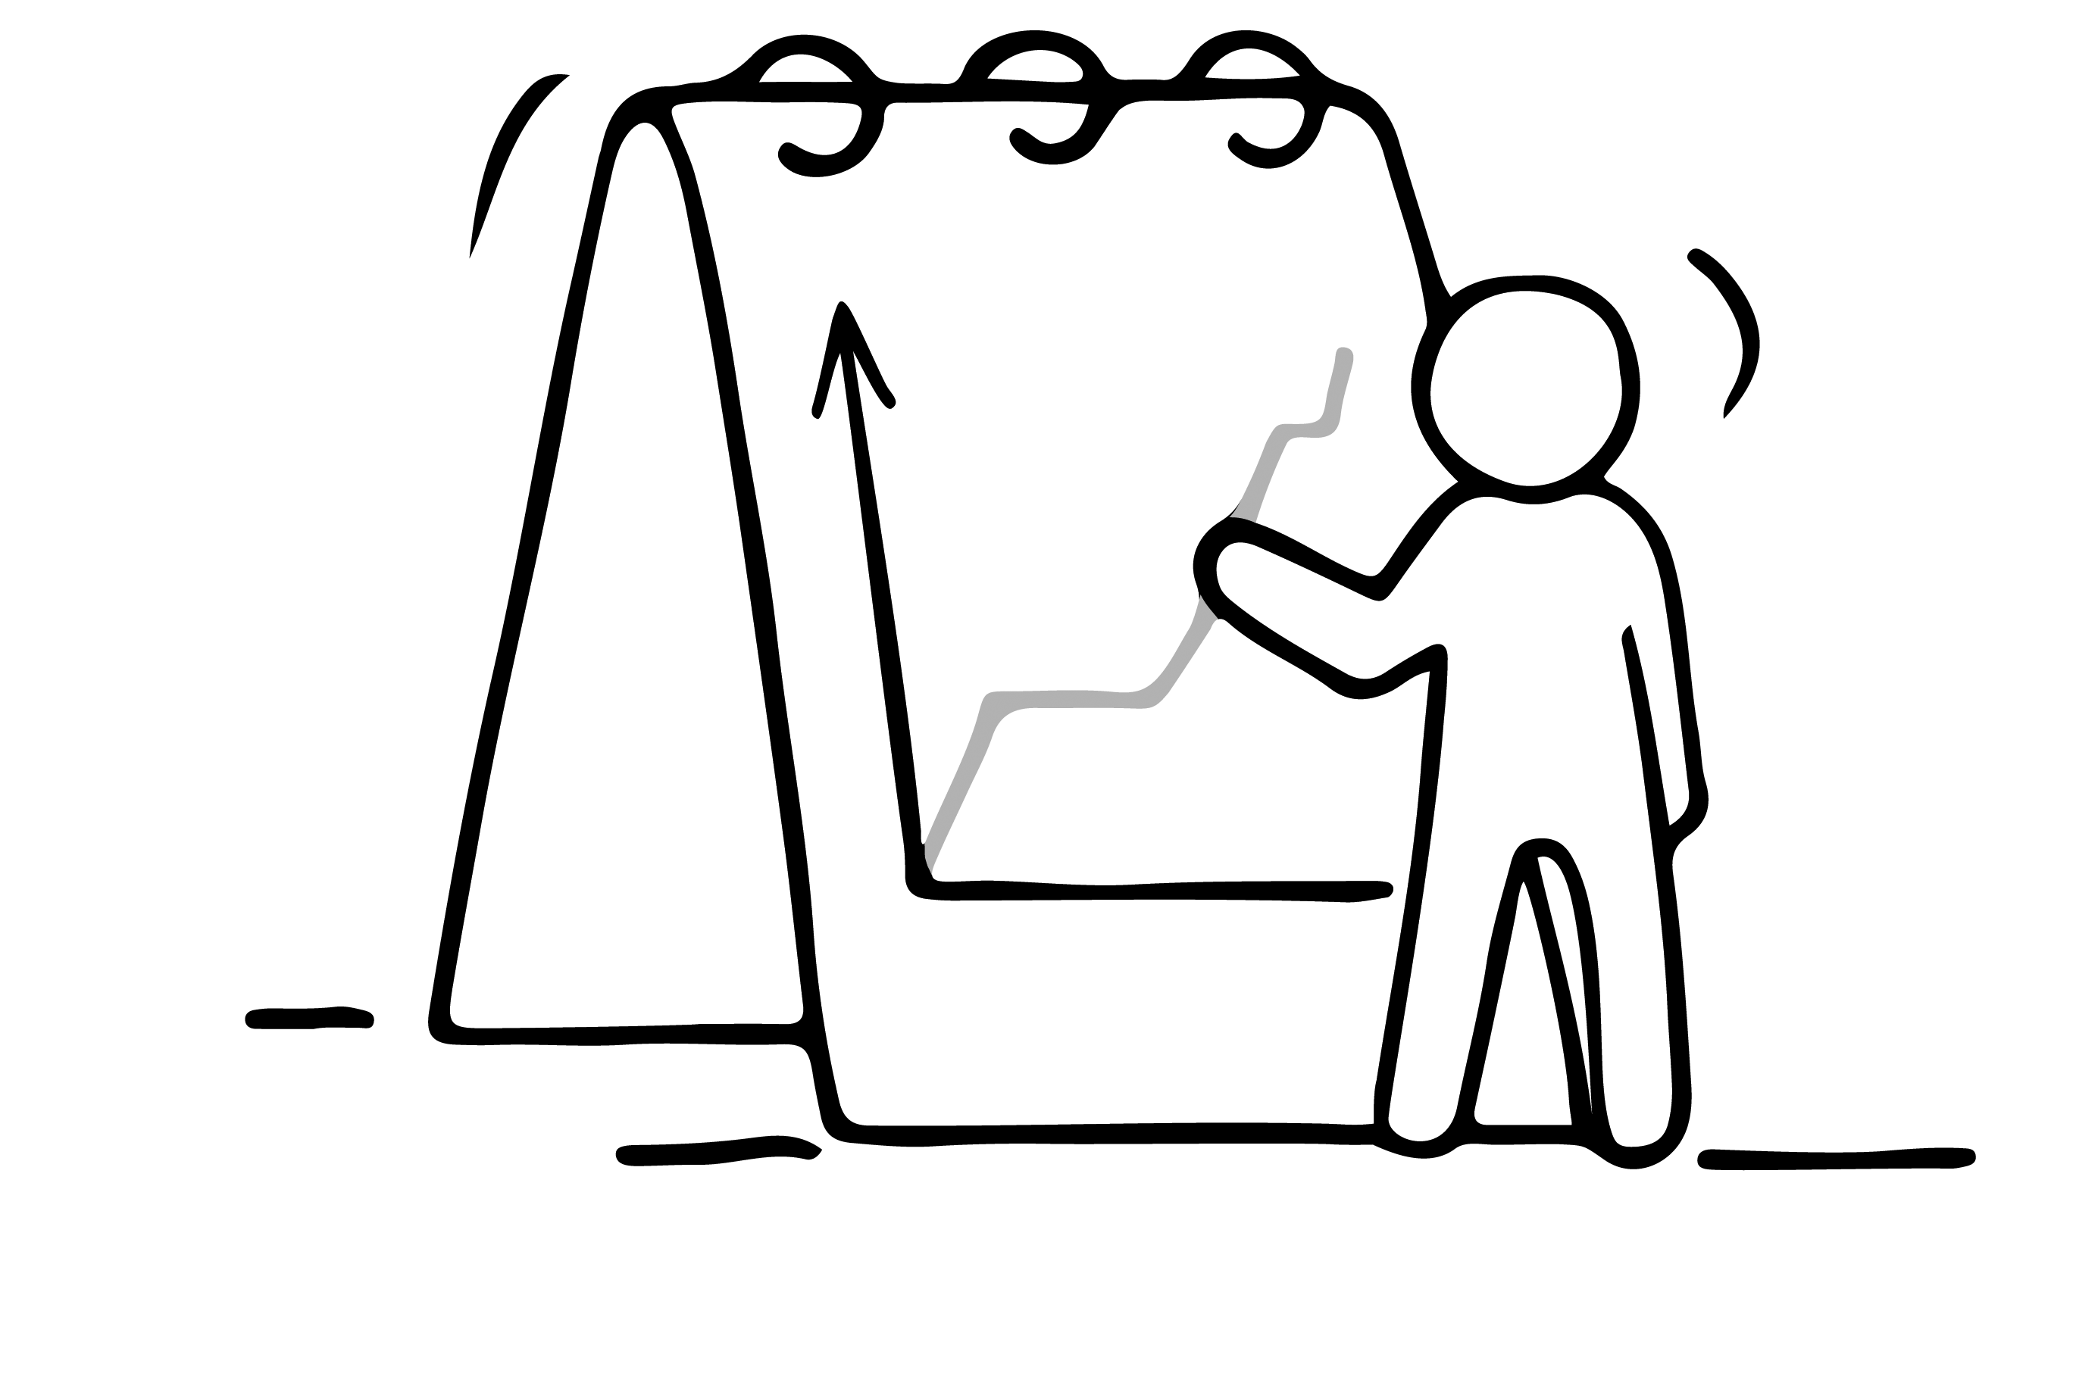
REMINDER! – TOP TECHNIQUE EFFECTIVE SELLING!
Anticipate & Overcome Objections
Objections are part of any successful sale.
Use a mix of the pushback, reframing, justification & pre-emptive techniques to calmly & confidently overcome objections

Slide 29
03
CLOSE THE DEAL

Slide 30
CLOSE THE DEAL
Are You Ready to Close the sale?
You need to be in a position to close the sale when you think the buyer is ready to buy
Reflect ….
Have you made every attempt to properly assess the needs of the buyer?
Have you handled all objections?
Have you answered all questions?
Have you made use of taste tests and visual aids to support the claims of the product or to show what it can do?
Have you offered testimonials from other customers who are using the food product/service?
Have you identified if there are any other people that need to be involved in the purchase decision? If so, have you met with them?

Slide 31
4 TYPES OF CLOSING TECHNIQUES
01
02
03
04
ASSUMPTIVE CLOSE
CONDITIONAL CLOSE
BONUS CLOSE
CUSTOMER REFERENCE CLOSE

Slide 32
ASSUMPTIVE CLOSE
01
Going with the assumption that the customer is going to buy unless you are told otherwise
“We can deliver next Friday evening if that works better for you?”
“Would 2 boxes be enough or do you think you would need more?”
“I’ll put you down for one delivery and we can confirm the exact amount before we deliver”
Underlying Philosophy: Based on the assumption
That if you portray confidence that something is
true it makes it hard for the other party to deny it
CLOSING TECHNIQUES

Slide 33
CONDITIONAL CLOSE
02
This technique works by offering a small solution or extra help, and then asking for the sale. Put it back to the customer by setting an appealing ‘condition’ to buy from you now!
“If I save one for you at the market on Saturday, will you come and collect it?”
“If I deliver 10 sample jars on Friday morning and give you 10 days to try them out with your customers, would you consider placing a regular order?”
“If I offer your staff a short tasting and provide shelf labels in two languages, would you be happy to trial my product for a month?”
Underlying Philosophy: Based on the exchange principal,
If I solve your problem, then you will buy from me
CLOSING TECHNIQUES

Slide 34
BONUS CLOSE
03
Used when you are almost there! Based on giving the Customer
something extra
Well because you are one of our loyal customers, I am going to give you an extra 10% off if you book today.
I can call the office and rearrange a few things so that we can schedule delivery for tomorrow
Underlying Philosophy: Based on the delight principal
and the fact that you can not only meet but exceed the
customer’s expectations
CLOSING TECHNIQUES

Slide 35
CUSTOMER REFERENCE CLOSE
04
Sometimes the best way to build trust is to let others speak for you.
If someone’s unsure, share a story or comment from a customer who already said “yes.” Examples:
“One of my regular customers first tried this at a market — now she orders every Friday for her family. Would you like to see her message?”
“I delivered this to a local café last month — the owner said it sold out in 3 days. Want me to share what they said?”
Underlying Philosophy: Based on convincing the prospect
by providing evidence from a credible third-party source
CLOSING TECHNIQUES

Slide 36
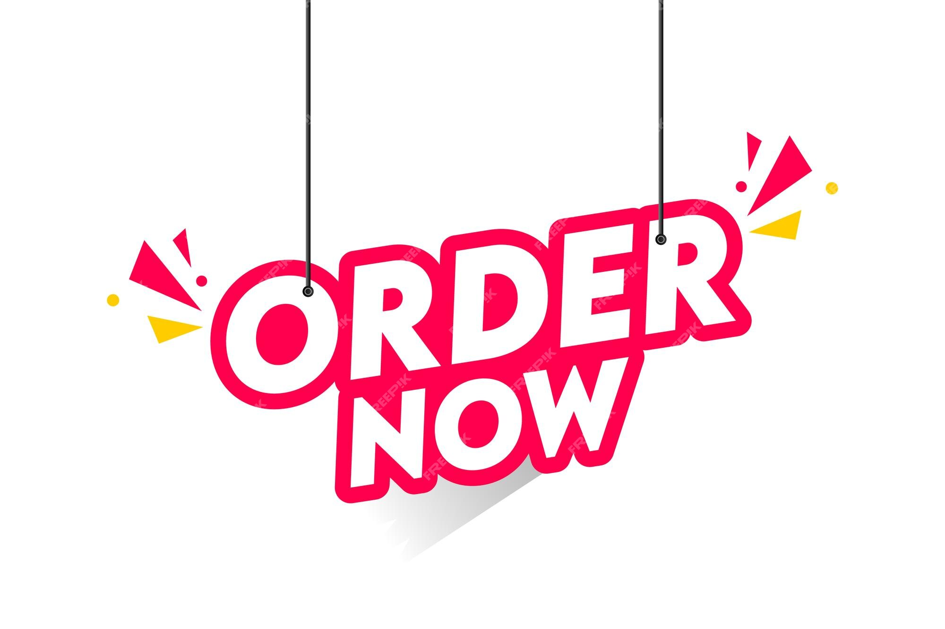
CREATING COMPELLING CALLS TO ACTION
A call to action is what you say (or write) to guide your customer toward the next step.
A Good Call to Action Should:
Start with a Strong Verb: “Order now” | “Message me” | “Try a free sample” | “Follow for next week’s menu”
Be Clear and Direct: “Call this number to book” |“Scan the QR code to view the menu” | “Send me a message on WhatsApp by Monday 10am to order or delivery on Thursday”
Be Short and Snappy: “Hungry? Let me handle dinner.” | “Ready in 5. Homemade with love.” |“Fresh, fast, and full of flavour.”
Add Social Proof if You Can: “Over 100 people ordered last month, and many came back for more!” |“This is our most re-ordered product!”
Test and Try Again: See which call to action version works better and more people respond to. The clearer and more confident your invitation, the more likely people will follow through.

Slide 37
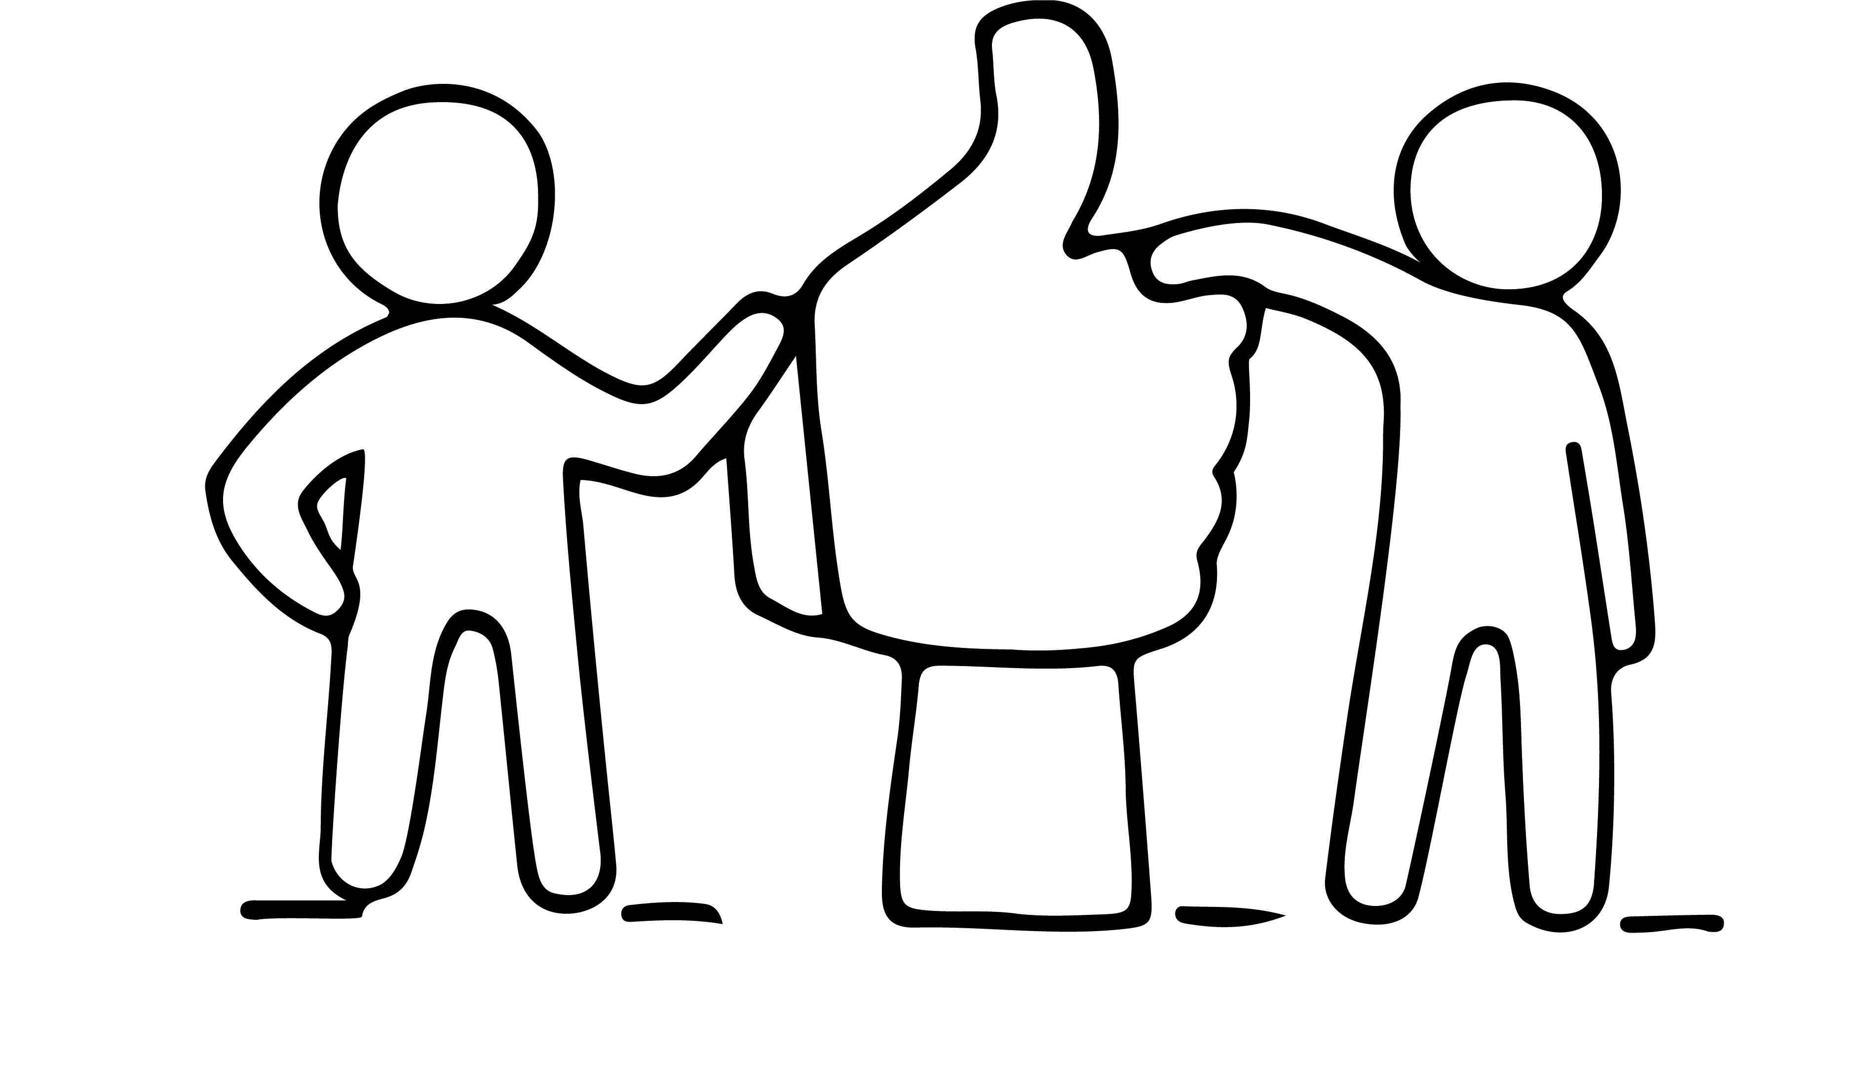
CLOSING THE SALE - APPROACHES THAT WORK
Simply ask for order
Shall I reserve one for you?
Would you like to buy it?
Summarize and then ask for the order
The concession close
“if you are willing to place an order now, I’m willing to reduce the price by 5%”
The alternative close
“Would you like it in vanilla or chocolate ?” “Would you like it delivered on Tuesday or Friday?”

Slide 38
FOLLOW UP – EVEN IF NO SALE
Just because someone didn’t buy today doesn’t mean they won’t in the future. Following up shows respect, professionalism, and helps you build long-term relationships.
Why Follow Up Matters:
Keeps the door open for future opportunities
Shows you value the conversation, not just the sale
Builds trust and helps you learn from the experience
Practical Ways to Follow Up:
Send a short, polite thank you message (WhatsApp, email, or handwritten)
Include your business card, flyer, or menu
Ask if you can follow up again in a few months “Would it be okay if I check back with you before the next season?”
Ask for referrals “Is there anyone you know who might be interested?”
Ask for feedback “Was there anything I could improve or explain more clearly?”
Invite suggestions “Is there something you’d love to see me offer in the future?”

Slide 39
REMINDER! – TOP TECHNIQUE EFFECTIVE SELLING!
Close Effetively & Increase Sales
All sales hinge on conversion.
Use a mix of the Assumptive, Conditional, Bonus & Customer reference closing techniques to increase your conversion rate

Slide 40
04
UPSELLING

Slide 41
UPSELLING
Upselling means offering something extra that adds value to the original purchase. It is simply offering more value to someone who already said “yes”. It’s about being helpful, not pushy.
Examples:
Offer a bundle: “Would you like the chutney and flatbread together for €8?”
Suggest a side item: “This goes really well with our spiced rice. Would you like to try it?”
Offer a larger portion: “For €3 more, I can give you the larger size.”
Upsell a repeat order: “Most customers get 2 jars to last the week, do you want to take another?”
READ MORE www.wikihow.com/Upsell

Slide 42
UPSELLING - How to Ask Without Feeling Awkward
Upselling is a natural part of friendly service, especially when your offer is useful.
Phrases to try:
“Lots of people pair this with…”
“Would you like to try our family-sized option?”
“That’s our most popular combo; would that work for you too?”
“I’ve got a fresh batch of [X]. Would you like to add one?”
Tip: Practice saying it out loud until it feels natural — like you’re giving good advice.

Slide 43
UPSELLING - Plan Your Own Upselling Offer
Exercise
How can you add upselling opportunities to your business ?
Let’s make this practical. Complete these prompts:
Main product I sell: _________________________
Add-on or upgrade I could offer: _________________________
How I’ll phrase it: “_____________________________________________________”

Slide 44
CASE STUDY – SALES IMPACT
Lena Derisavifard – BiBi Bakery - READ HER FULL STORY and visit website Home | BiBi Bakery
Background: Iranian baker who transitioned from finance to culinary entrepreneurship with a focus on Persian vegan treats like cardamom-rose baklava and saffron ice-cream sandwiches
Sales Strategy:
Started with weekend pop-ups in Brooklyn bars and markets using postcards and story-driven displays (“barberry and saffron”).
Joined a women-focused incubator (Hot Bread Kitchen), where she learned pricing, packaging, and sales techniques—supporting her transition from hobbyist to consistent seller
Results:
Saw a 16% increase in sales year-over‑year and built a loyal following focused on cultural storytelling and product excellence
Now working toward opening a full bakery, fueled by consistent direct sales and community engagement.

Slide 45
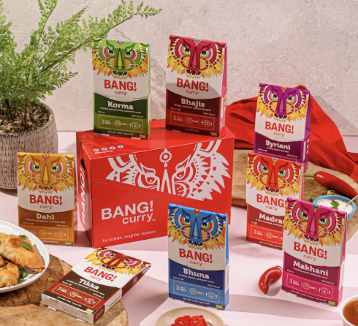
CASE STUDY – SALES IMPACT
Shelly Nuruzzaman – BANG! Curry Kits READ HER FULL STORY
Background: Former scientist who started selling DIY curry kits from her kitchen on a £650 budget
Sales Strategy: Sold in local markets and cookery classes, introducing people directly to the product and story. Landed retail partnerships (e.g., Waitrose), boosted by strong direct sales performance and brand credibility
Results: Achieved multi-six-figure annual revenue, combining direct consumer sales with strong retail presence
Visit her website: Bang Curry

Slide 46
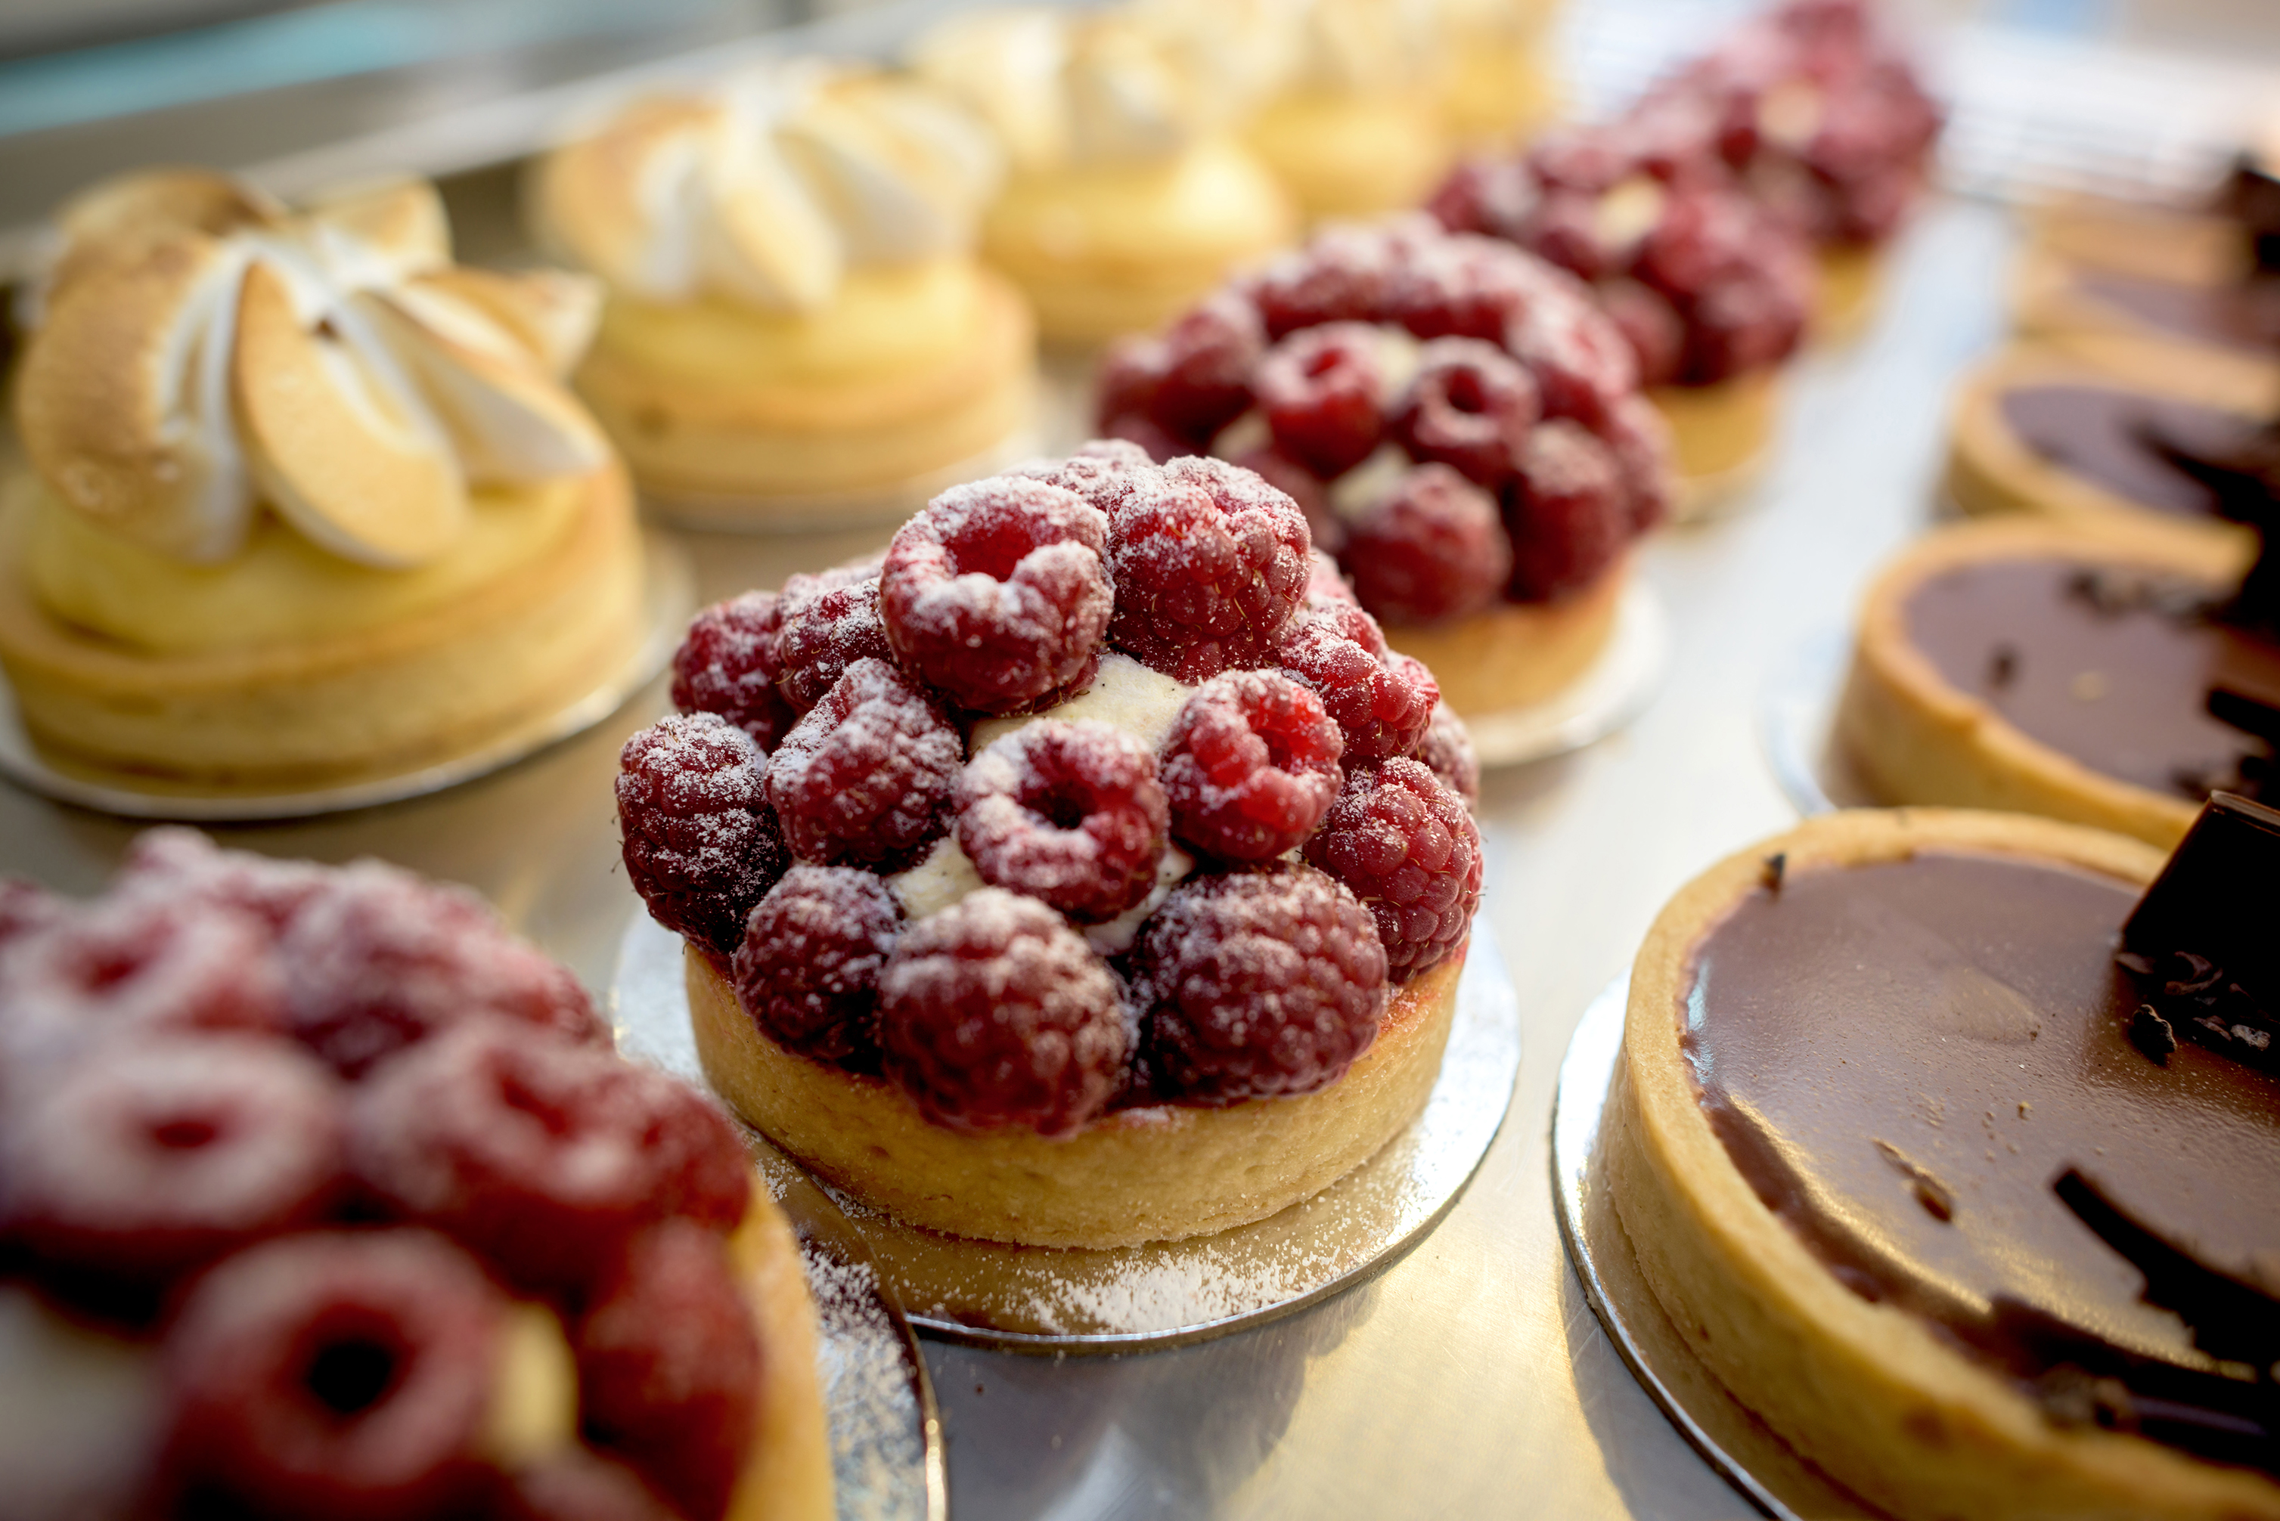
KEY TAKEAWAYS
Begin small. Market stalls, pop-ups, and sample events are powerful ways to build trust and test your offer.
Use your unique story, culture, and values to stand out, these are your strength/superpower.
Join a support network or accelerator programme to grow your skills and confidence in selling.
Remember: direct sales can lead to bigger opportunities, like wholesale partnerships or regular subscriptions.
And most importantly: Practice. Practice. Practice. You get better with every conversation.

Slide 47
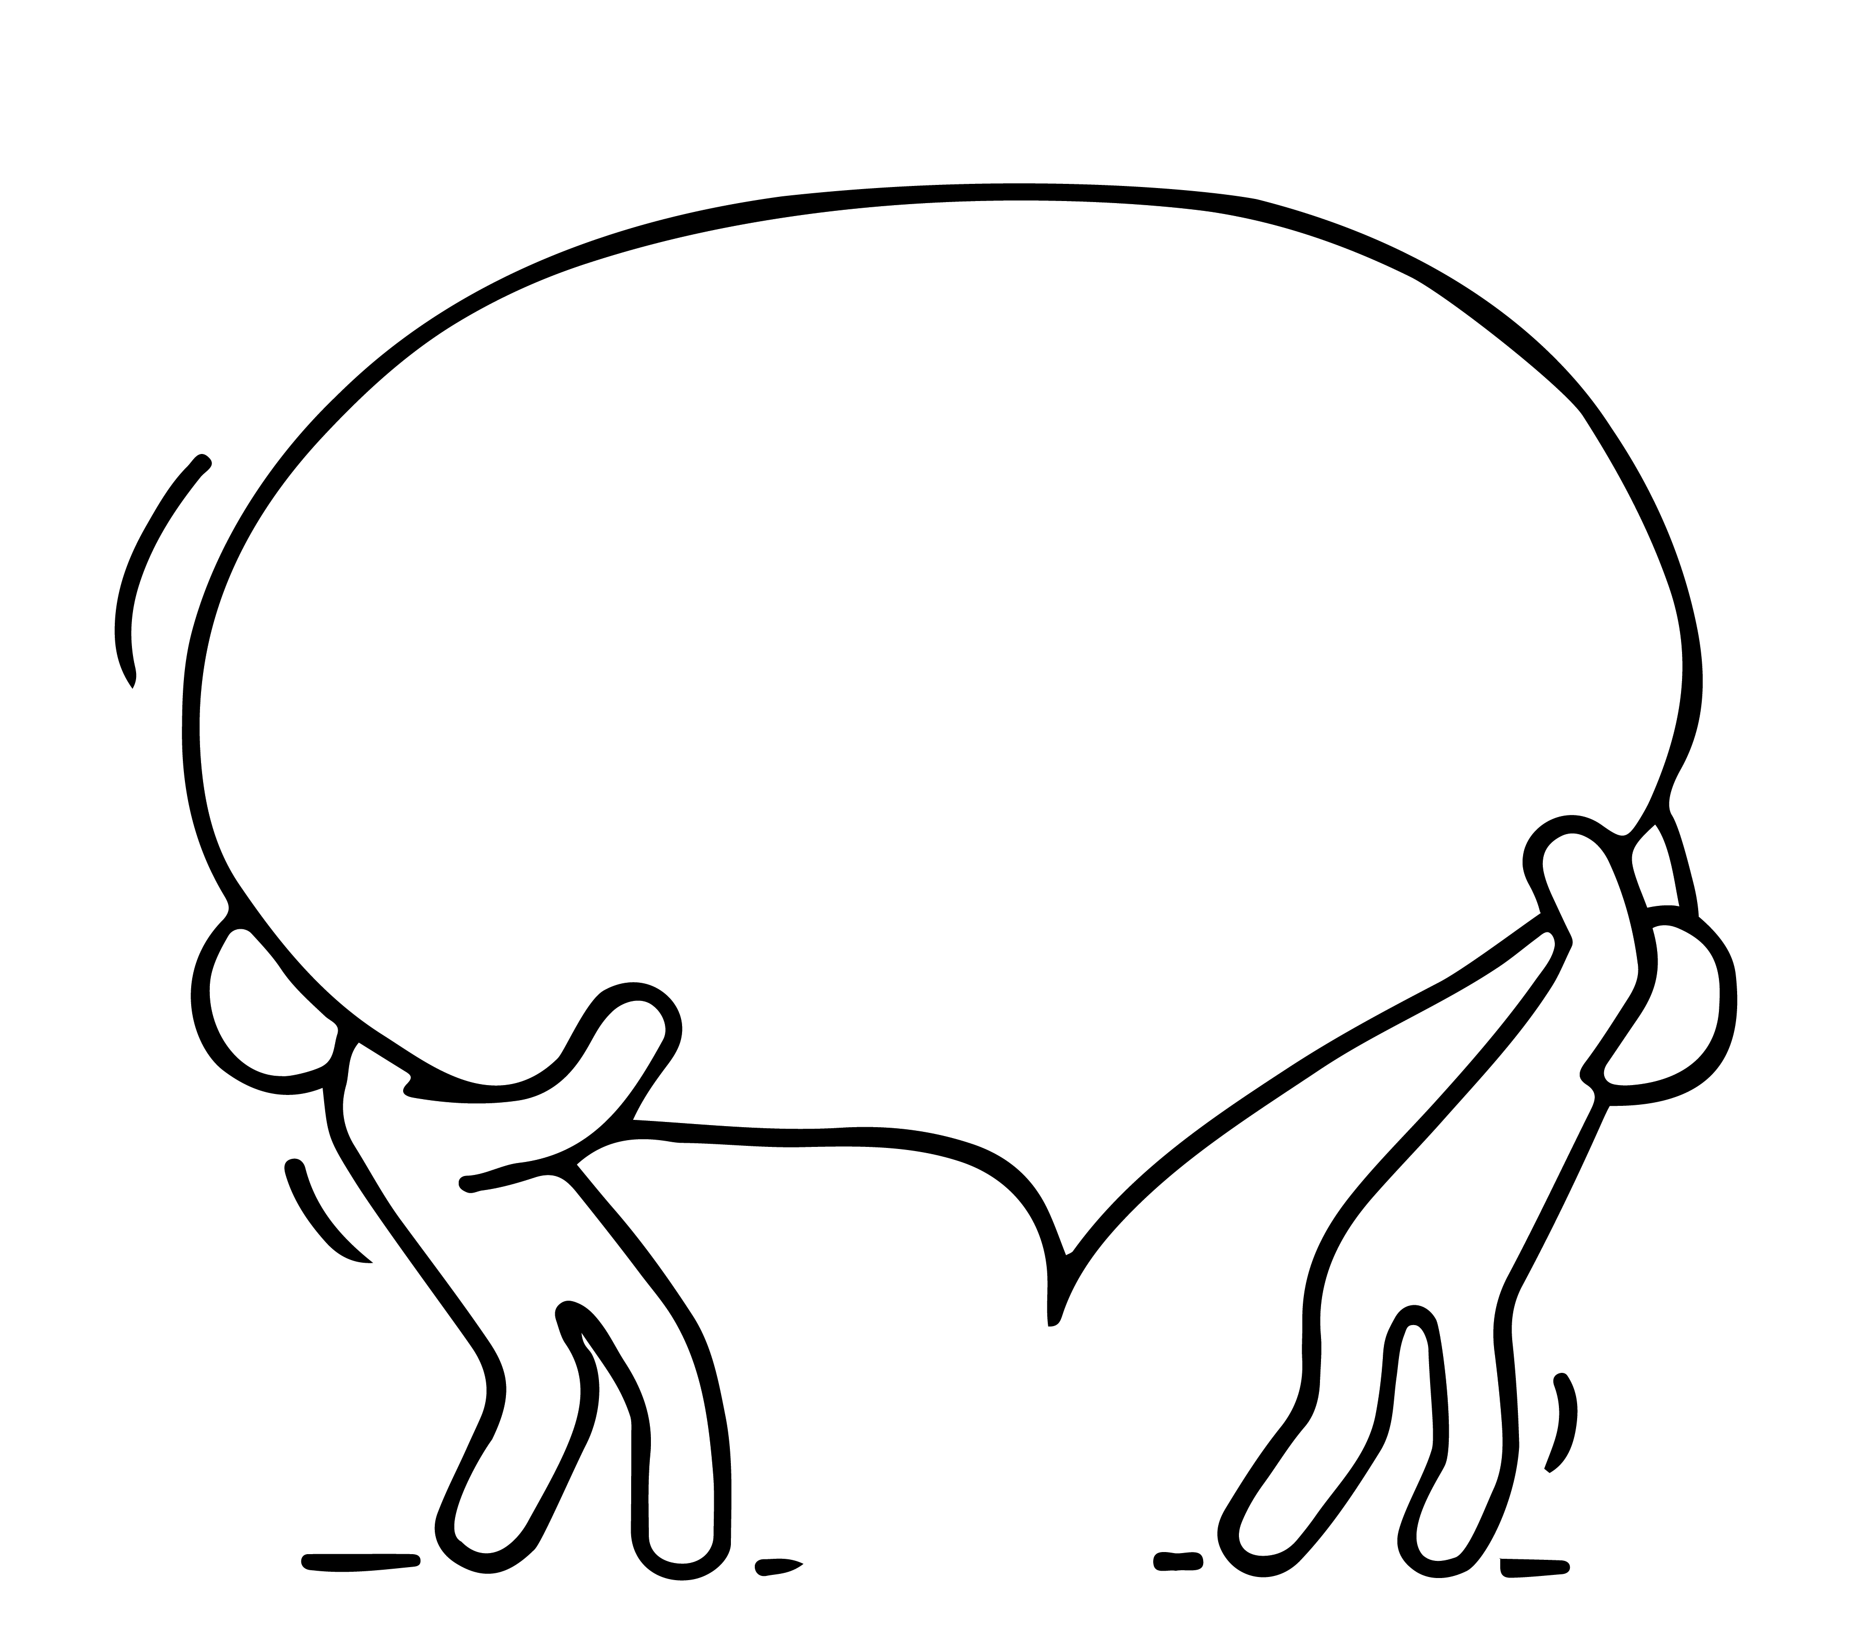
Next
Step 7: The Power of Collaborations and Networks
www.3kitchens.eu

