Slide 1
STEP 5.
FOOD MARKETING ON A SHOESTRING
www.3kitchens.eu

Slide 2
Contents
01
Relationship between marketing and sales
02
Your brand story is so important
03
Coming up with your brand name
04
3 ways to build your brand’s trust, credibility & reputation
05
What are you selling?
06
Your marketing toolbox – 11 powerful tools to use with a tiny budget

Slide 3
Learning Objectives – Step 5: Food Marketing on a Shoestring
By the end of Step 5, you will be able to:
Understand the difference between marketing and sales and how they work together to grow your business
Explain why your brand story matters and how to craft a brand that builds trust
Identify what makes your product or service stand out in a crowded and competitive food market
Learn how to turn product features into meaningful benefits that connect with your customers
Understand 11 low-cost, high-impact marketing tools that will uplift your new food business

Slide 4
01
RELATIONSHIP BETWEEN MARKETING AND SALES

Slide 5
RELATIONSHIP BETWEEN MARKETING AND SALES
Many people wonder about the difference between and sales and marketing. Let’s be clear, while marketing and sales are related in business, they are not the same thing
MARKETING
Focus: Long-term
Purpose: To build awareness and relationships
Approach: Marketing is the pull. It helps customers discover your food, connect with your story, and want to know more.
SALES
Focus: Short-term, action-based
Purpose: To close the deal, get the customer to buy
Approach: Sales is the push. It motivates a specific person to take action now
Tailored to individual customers and focused on converting interest into purchase
Think of it this way:
Marketing brings the customer to your door.
Sales convinces them to walk in and buy.

Slide 6
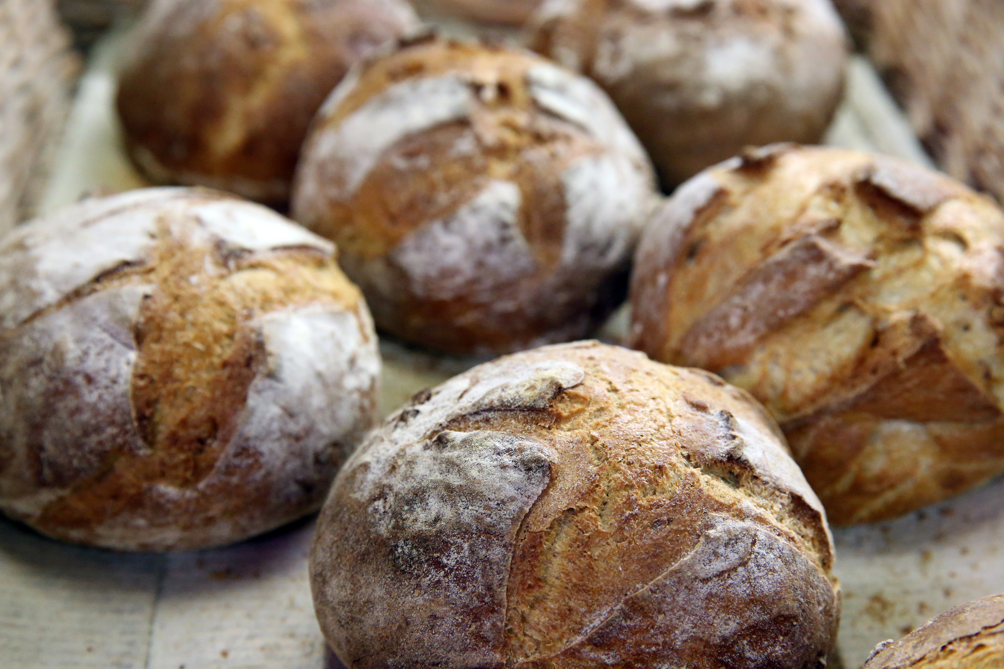
MARKETING is….
everything you do to place your product or service in the hands of potential customers. It’s how you create interest, get noticed, and make people curious enough to want a taste of what you offer.
Think of marketing like the scent of freshly baked bread in a crowded market. You don’t have to shout because the smell does the talking. It draws people in .Once they’re at your stall, that’s when selling begins.

Slide 7
MARKETING IS ABOUT STANDING OUT!
Marketing is any interaction between you and someone who might become your customer. It’s not a one-time action, it’s a way of thinking, showing up, and building relationships consistently.
Marketing is how you stand out in a world full of choices and this is especially true in the food world. Standing out doesn’t always mean spending more. For food entrepreneurs, especially those just starting out, it means:
Sharing the story behind your food, why you make what you make
Using colours, smells, packaging, or display to grab attention quickly
Offering a unique flavour, service, or experience people remember
Showing your personality and values in every interaction, both online and in person

Slide 8
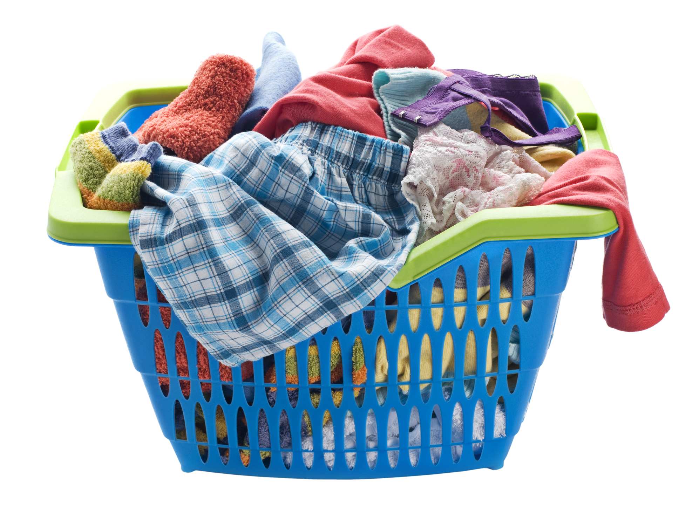
MARKETING NEVER STOPS
Marketing never stops. Like the laundry, it is never done! It is about standing out and trying harder, every day (not just when you feel you should or you need to).
Marketing is about relationships. You are your most important marketing tool.
Marketing is sharing your unique story, offer and solution with the right people

Slide 9
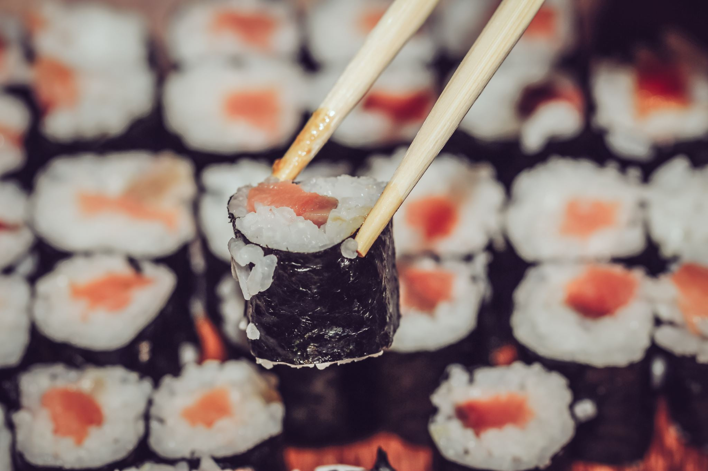
WHAT DOES GREAT MARKETING LOOK LIKE?
Great marketing is multifaceted and dynamic, combining creativity, strategy, and effective communication to resonate and connect with its audience and achieve specific business objectives. But what does great marketing look like?
It is a Customer-Centric Approach
Great marketing starts with a deep understanding of the target audience’s needs, preferences, and pain points. This insight comes from thorough market research and direct customer feedback.
High levels of personalisation and tailored marketing messages (precision marketing) to meet the very specific needs and interests of different customer segments.

Slide 10
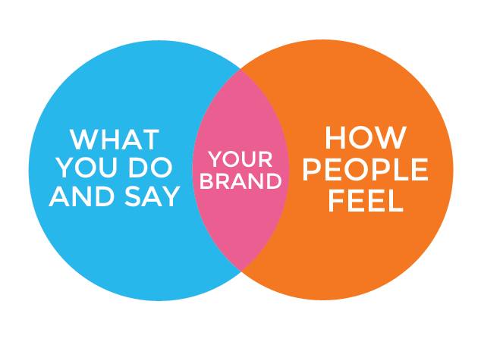
GREAT MARKETING STARTS WITH YOUR BRAND
Your brand is more than your name and logo (although these are very important).
Your brand is your promise to your customers – a promise of quality, of consistency, of usability, of durability, all the things that help make your product or service special in the minds of your customers.
The key strength of branding is it should make an emotional connection with the consumer and stay in their memory.

Slide 11
01
Identify Your Food’s Personality
THE KEYS TO BUILDING A STRONG FOOD BRAND ARE:
Think of your food brand as a person, what is its personality? Is it traditional and comforting, bold and spicy, fresh and clean, or fun and quirky? This personality should come through in your packaging, logo, voice, and even your menu or product names.
02
Know your Core Values
These should form the basis of all decisions you make with regard to your brand. By sharing what you stand for as a brand (e.g. food flavours that you have brought from home), you will attract customers who share your beliefs.
03
Be Unique
Study the market: what’s missing from the shelf, the menu, or the market stall? If everyone else is doing sweet, could you do savoury? If others use plastic, could you go eco? Great food brands fill gaps.

Slide 12
THE KEYS TO BUILDING A STRONG BRAND ARE:
04
Be Consistent
Your food packaging, signage, social media posts, and even your uniforms or delivery bags should all tell one story. Whether you're at a market stall or delivering to a shop, customers should instantly recognise your brand.
05
Do Things Properly
Don’t cut corners. If you only have the budget for one great label or photo, do that instead of 10 poor ones. Quality packaging, clear labels, clean design, and well-lit photos build trust in your food before anyone takes a bite. Every communication that goes out to your customers is an opportunity to reinforce your brand.

Slide 13
IT MAKES FINANCIAL SENSE TO BUILD A GREAT BRAND
Are less focused on price. When customers trust your brand and believe in your values, they are more likely to choose your product even if it’s not the cheapest option on the shelf.
Feel emotionally connected to your business. This connection often comes from shared values, a compelling brand story, or a consistently positive experience with your food.
Spread the word for you. Loyal customers often become enthusiastic brand ambassadors, recommending your food to friends, sharing your social media posts, or bringing your product to community events.
Stick with you longer. Loyal customers come back again and again, which means more repeat sales and more predictable income.
Cost less to serve. Winning a new customer usually costs significantly more than keeping an existing one.
Brand loyal customers:

Slide 14
02
YOUR BRAND STORY IS SO IMPORTANT

Slide 15
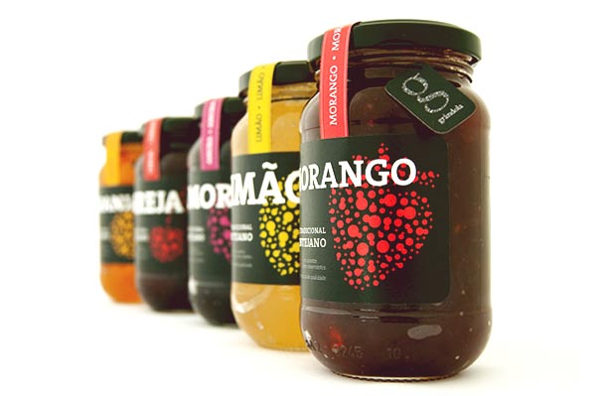
YOUR BRAND STORY IS SO IMPORTANT
Your brand story is the foundation of how people connect with your food business. It explains:
Why you started
What you care about
How your product fits into people’s lives
This could be your passion for your cultural heritage, healthy eating, your commitment to sustainability, or a personal journey that inspired your recipes.
Every part of your customer experience, from packaging to social media, should reflect what you stand for.

Slide 16
YOUR BRAND STORY IS SO IMPORTANT
Your brand story is a complete picture made up of facts, feelings and interpretations:
A brand story includes:
The reason your business exists
The way you choose ingredients and prepare your food
How you communicate — through design, tone, service and packaging
The feelings and values your brand represents (trust, joy, community, innovation)
Great food brands have a clear identity that people recognise and relate to.
They’re built around values and personality that make customers feel:
“This is for me.”
or
“This is someone I trust.”
Your story is not something extra — it’s what shapes the way people see and remember your brand.

Slide 17
IT’S IMPORTANT TO SET YOUR BRAND APART!
The food industry is filled with powerful, well-known brands , but challenger brands like yours are changing the landscape.
Your challenge is to stand out, not by being bigger, but by being more authentic, more creative, or more meaningful to the customer.
Think about what only you can offer. Is it your story? Your ingredients? Your values? Your community connection?
You don’t have to outspend the big players, outshine them in clarity and connection.

Slide 18
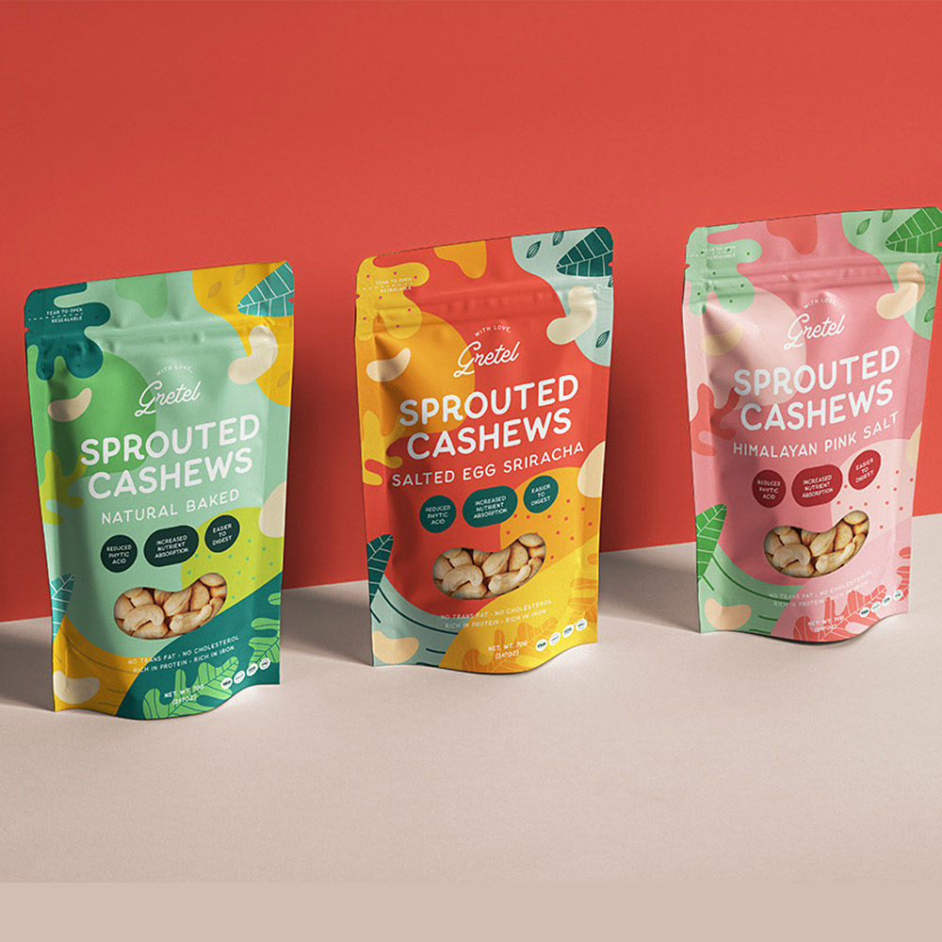
WHAT IS A CHALLENGER BRAND?
A challenger brand is a business that aims to compete with larger, more established brands, not by being the biggest, but by being different, bold, and meaningful.
In the food world, challenger brands are usually smaller, independent companies that:
Offer something new or disruptive (e.g. a new flavour, format, or value)
Have a clear mission or social impact (e.g. sustainability, reducing waste, supporting fair trade producers)
Speak directly to a specific audience and build a loyal following
Use creativity, storytelling, and community connection instead of big advertising budgets

Slide 19
IT IS IMPORTANT TO SET YOUR BRAND APART
In today’s food market, good taste and fair pricing are no longer enough.
Customers are looking for something deeper, a brand they connect with on a personal level.
They buy with emotion, loyalty, and purpose.
That’s why you need more than a great product, you need a clear message that shows who you are, what you stand for, and why your product deserves their trust.
Let’s look at an example...
The strongest food brands stand for something — not just something to eat, but something to believe in.

Slide 20
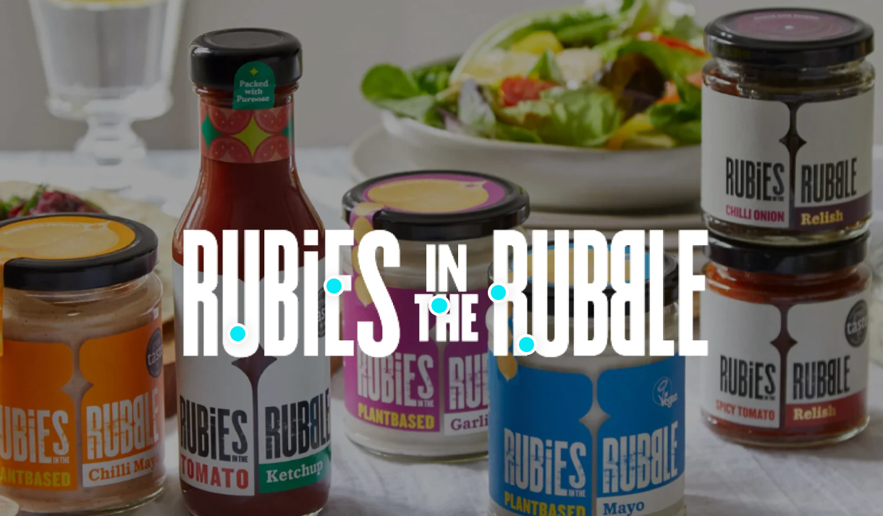
BRAND PROMISE EXAMPLE..
Rubies in the Rubble https://rubiesintherubble.com/ is a UK-based food brand that turns surplus and imperfect fruit and veg into award-winning relishes, chutneys, and condiments.
“We believe that food should be valued, not wasted. Every jar is packed with purpose, made with ingredients that would have gone to waste but rescued and turned into something delicious.”
WATCH https://fb.watch/zWrqVocMsw/
READ THEIR CASE STUDY
How we fight food waste with Rubies in the Rubble

Slide 21
THE ELEMENTS TO CREATE OR CAPTURE YOUR BRAND STORY…
Crafting your brand story is about connecting the dots between who you are, why you do what you do, and how customers experience your business. The most powerful stories feel personal, authentic, and memorable.
Start with these core elements:
1. Your Personal Story
What led you to start your food business? Talk about your background, your journey, key decisions you made, and any important people or moments along the way.
2. Your Passion Story
What do you love most about food, and why does it matter to you? This helps people understand your commitment and makes your brand feel human.

Slide 22
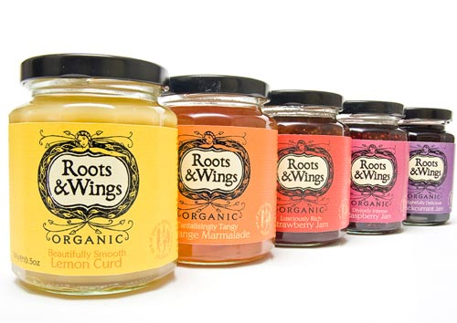
THE ELEMENTS TO CREATE OR CAPTURE YOUR BRAND STORY…
3. Your Personality Story
How does your brand show up in the world? This includes your style, your tone, your service — whether you’re warm and friendly, bold and energetic, or calm and thoughtful. It shapes how people feel when they engage with you.
4. Your Customer Story
What do customers say about you? Use real feedback, testimonials, or anecdotes. This shows that your story doesn’t just come from you, it’s reflected back by the people you serve.

Slide 23
03
COMING UP WITH YOUR BRAND NAME

Slide 24
WAYS TO COME UP WITH YOUR BRAND NAME…
To build your food brand, you need to come up with:
A strong, memorable brand name
A short, clear tagline (what your brand stands for)
A website domain that matches or complements your name
Tools like Shopify’s Business Name Generator can help spark ideas — but the best names are rooted in who you are and what your business stands for.
Let’s explore some creative naming approaches…
CLICK TO VIEW

Slide 25
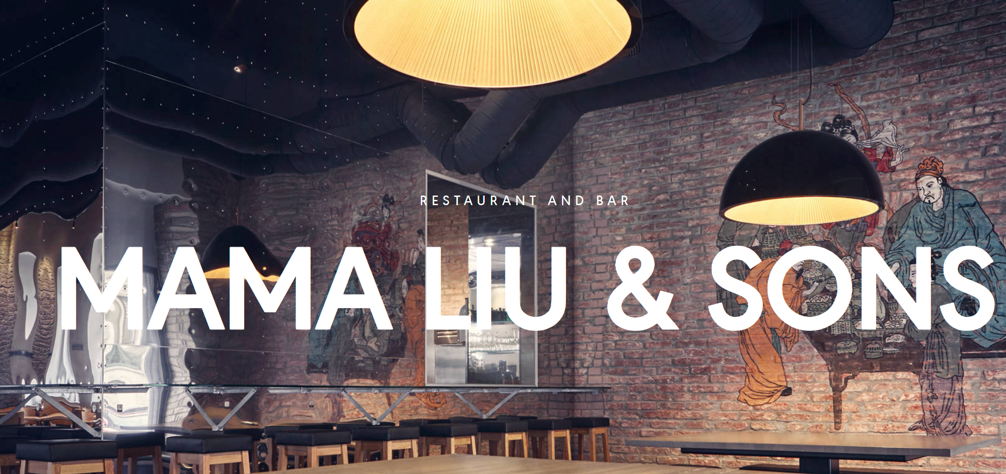
WAYS TO COME UP WITH YOUR BRAND NAME…
FOUNDERS' NAMES
01
Using the names or nick names of real people
PROS
Your stamp of ownership
A legacy for your family
Signal Nationality or not
CONS
May take longer to become established
May need a further description
Example.. Mama Liu & Sons

Slide 26
WAYS TO COME UP WITH YOUR BRAND NAME…
FOUNDER NAME EXAMPLE
Brand Name: Mama Liu & Sons
Founder: Liu Chang
Location: Vienna, Austria
Website: https://www.mamaliuandsons.at/
Name Story:
The brand name "Mama Liu & Sons" plays on the affectionate family nickname “Mama Liu,” referring to the founder’s mother. known for her homestyle Chinese cooking. The name captures a sense of warmth, tradition, and family roots. It combines personal heritage with a welcoming, familiar identity that instantly connects with customers.
Why It Works:
“Mama Liu” is a friendly, nickname-style name that conveys comfort and authenticity“& Sons” adds a classic, heritage-inspired feel, even though it’s modern and stylish. The name reflects homemade quality, family recipes, and Chinese cultural roots while being easy to remember
01

Slide 27
WAYS TO COME UP WITH YOUR BRAND NAME…
02
PERSONIFICATION
Brands that take their names from myth
Elovena is a Finnish food brand known for its oat-based products, including porridges, flakes, and snack bars. The brand name combines "Elo," meaning life or harvest in Finnish, and "Avena," the Latin word for oats, reflecting commitment to natural foods.
Why the Name Works:
Cultural Significance: The name resonates with Finnish heritage and the country's association with high-quality oats.
Simplicity and Memorability: "Elovena" is easy to pronounce and remember, aiding brand recognition.
VISIT THEIR WEBSITE
https://elovena.fi/
READ THE STORY
https://en.wikipedia.org/wiki/Elovena

Slide 28
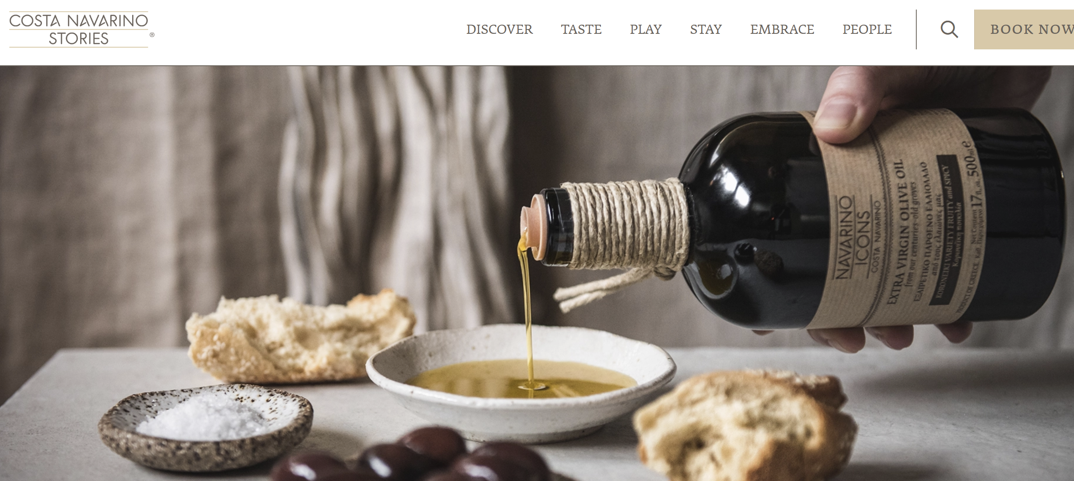
WAYS TO COME UP WITH YOUR BRAND NAME…
03
GEOGRAPHY
Brands named after place of origin
Navarino Icons: The superfoods from Messinia
Navarino Icons is a premium Greek food brand that celebrates the rich culinary heritage of Messinia, a fertile region in the Peloponnese. Launched in 2011 by Costa Navarino, the brand aims to promote the history and culture of the Messinian region through traditional food products and art objects.
READ: https://www.costanavarino.com/stories/navarino-icons-superfoods-from-messinia/

Slide 29
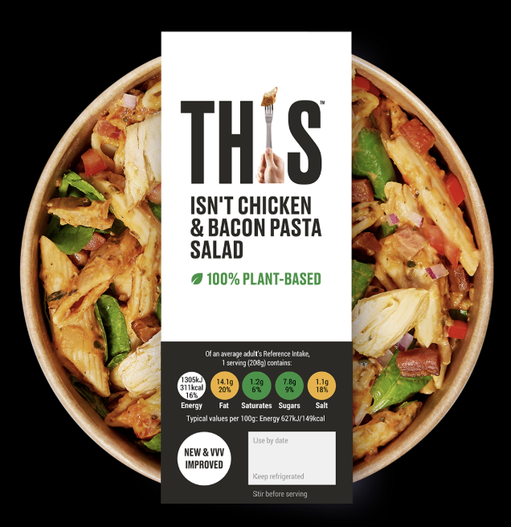
WAYS TO COME UP WITH YOUR BRAND NAME…
HUMOUR
04
THIS™ IS PLANT-BASED. PROMISE.
From poking fun at meat-eaters to joking about existential sausage dilemmas, the THIS brand leans into a cheeky tone that makes plant-based eating feel fun, not preachy.
Its humour seeks to disarm, engage, and build a standout brand voice.

Slide 30
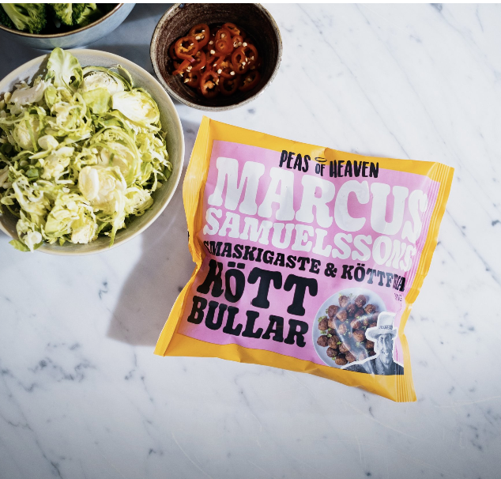
WAYS TO COME UP WITH YOUR BRAND NAME…
04
HUMOUR
Peas of Heaven, Gothenburg, Sweden https://www.peasofheaven.se/ Overview: Peas of Heaven is a plant-based food startup that produces meat-free products like chorizos, bratwursts, and burgers. The brand employs humour in its marketing campaigns, such as depicting plant-based meats growing in fields, to make plant-based eating more approachable and fun.
READ: https://www.adweek.com/brand-marketing/the-brand-that-aims-to-see-the-funny-side-of-plant-based-food/

Slide 31
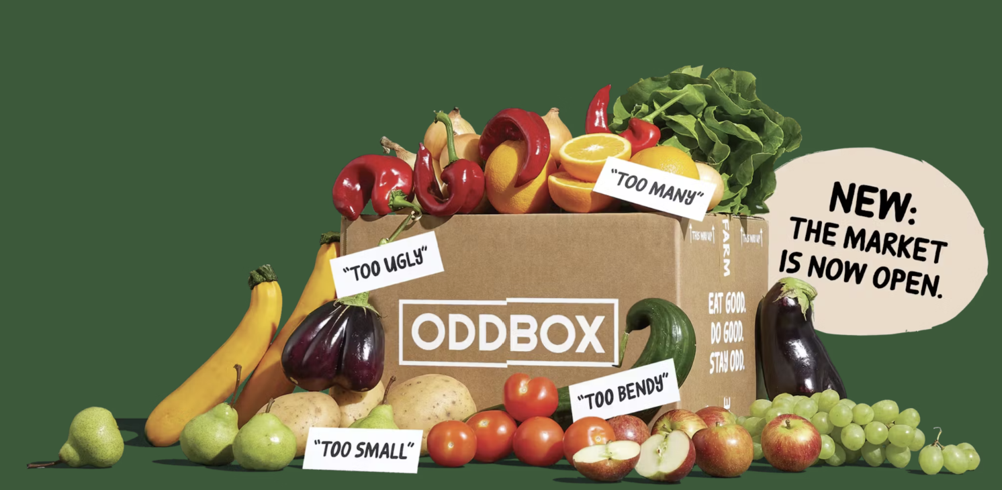
WAYS TO COME UP WITH YOUR BRAND NAME…
VALUES BASED
05
Oddbox is a UK-based fruit and veg subscription service with a clear values-first brand built around fighting food waste. but what really sets it apart is how it turns that mission into an emotionally compelling, user-friendly experience.
Brand Core Mission: "Rescue odd and surplus fruit & veg to fight food waste and climate change.“
USP: Works directly with farmers to save produce that’s too big, small, oddly shaped, or surplus from being wasted.
Model: Weekly or fortnightly subscription boxes delivered to your door, with detailed info about what's in the box and why it would’ve been wasted.
VISIT Wonky Fruit & Veg | Deliciously Odd & Delivered to Your Door

Slide 32
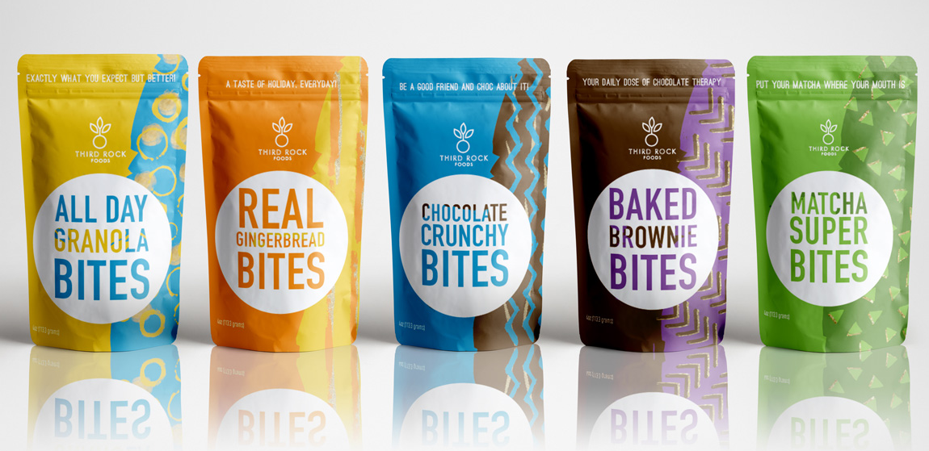
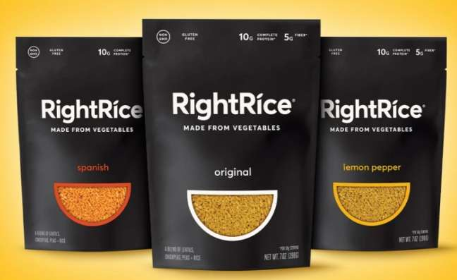
THE PSYCHOLOGY OF COLOUR IN BRANDING
Did you know there is a science behind colour?
Each colour carries subconscious associations. Here's a quick rundown:
Green - Sustainability, health, nature (e.g. Oddbox)
Blue - Trust, calm, professionalism (think water and frozen food brands )
Yellow - Optimism, warmth, attention-grabbing (Tony’s Chocolonely, Rubies in the Rubble)
Red - Boldness, energy, urgency
Purple - Creativity, luxury, quirk
Black & White - Modernity, minimalism, sophistication
The Psychology of Color in Branding for Food Entrepreneurs — FEAD
Read

Slide 33
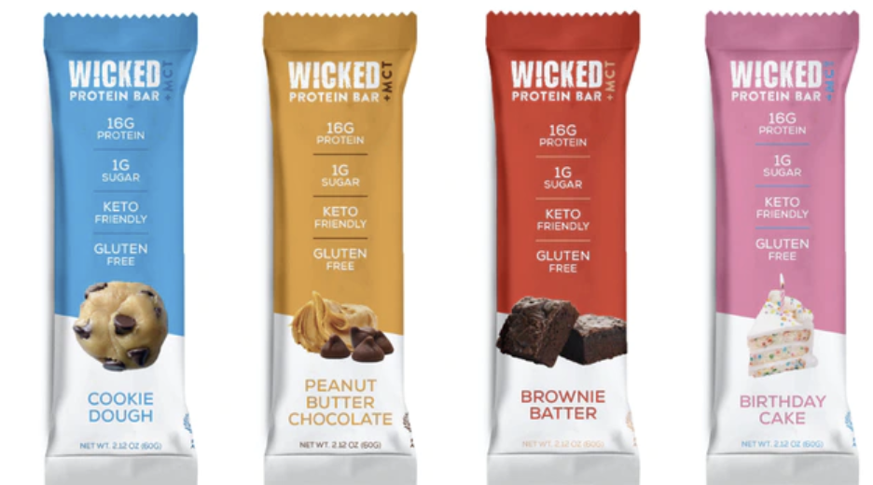
THE PSYCHOLOGY OF COLOUR IN BRANDING
Why It Matters
Customers process colour faster than text or shape.
It builds instant recognition, evokes emotion without saying a word
It aligns visual identity with brand values (Are you rebellious or wholesome? Premium or playful?)
The Psychology of Colors in Branding
Food Service
Read

Slide 34
CULTURAL INNOVATION IN BRANDING
For women migrant entrepreneurs in food, your cultural dimension is about expressing who you are, where you come from, what you care about , and building a brand that connects with others through shared values and identity.
How to Build Cultural Dimension Into Your Brand:
Tell the story behind your ingredients or heritage
Use colours, symbols, or language that reflect your roots or values
Share your motivations — as a woman, as a founder, as a changemaker
Celebrate community — highlight collaborators, growers, family, and rituals
Don’t hide emotion — show passion, resilience, humour
Read

Slide 35
GREAT BRANDS ARE CONSISTENT AND CREATIVE
This exercise helps you tell your brand story — in your voice and on your terms.
Your story matters. It’s what connects your food to your values, your purpose, and your audience.
Exercise
Tell the story of your business through images
Photos of yourself, your passions and skills
Photos of your product
Snippets of behind-the-scenes work
What motivates / inspires you ?
Download and complete the Tell Your Story Storyboard
Double click Word icon
to download

Slide 36
04
3 WAYS TO BUILD YOUR BRAND’S TRUST, CREDIBILITY & REPUTATION

Slide 37
3 WAYS TO BUILD YOUR BRAND’S TRUST, CREDIBILITY & REPUTATION
01
ESTABLISH YOUR CREDIBILITY
Show Who You Are with Pride
Your personal story matters , especially in food, where people buy from people.
Let your audience see the face and values behind the business.
Use a clear, professional photo of yourself on your promotional materials , website, and social media. You don’t have to look corporate, just real and confident.
Share what motivates you: family, roots, flavour, community — these are powerful trust-builders.
Let your visual branding reflect your culture, values and personality.

Slide 38
3 WAYS TO BUILD YOUR BRAND’S TRUST, CREDIBILITY & REPUTATION
01
ESTABLISH YOUR CREDIBILITY
Let Your Experience Speak and Translate It into Value
Your journey has taught you a lot. Tell people why that matters to them.
List your skills, training, or lived experience, whether it's culinary education, home-grown expertise, or years of hands-on practice.
Connect those skills to how you help others: “I trained in regional Ethiopian cooking — which means I know how to blend flavour and tradition in every sauce I make.”

Slide 39
3 WAYS TO BUILD YOUR BRAND’S TRUST, CREDIBILITY & REPUTATION
01
ESTABLISH YOUR CREDIBILITY
Let Others Speak for You Too
The strongest voice for your brand is often someone else’s.
Collect testimonials from happy clients, customers, or partners. Even one sincere comment is gold.
Ask for endorsements or quotes you can use on your site or packaging.
Join local and online communities — from food networks to migrant women’s business circles — where you can build visibility and give as well as receive support.

Slide 40
02
BE VISIBLE AND ACCESSIBLE
3 WAYS TO BUILD YOUR BRAND’S TRUST, CREDIBILITY & REPUTATION
People can only support your business if they can find you, understand what you offer, and feel welcome to connect. Visibility isn’t showing off, it’s showing up. And accessibility means being open, responsive, and relatable in a way that works for you and your customers.
Keep your online presence up to date. Make sure your contact info, business hours, and product/service details are easy to find on your website, Instagram, or WhatsApp Business profile.
Use platforms your customers use. If your local audience uses Facebook or messages via WhatsApp, go where they are, and make it easy to reach you.
Show up in your own way. You don’t have to post daily or dance on TikTok. Just share real, honest content that reflects your work and voice. Even one strong post a week builds connection.

Slide 41
02
BE VISIBLE AND ACCESSIBLE
3 WAYS TO BUILD YOUR BRAND’S TRUST, CREDIBILITY & REPUTATION
Be approachable. If someone sends you a message, respond warmly and clearly. Use friendly language. Include visuals or voice notes if that helps you feel more comfortable.
Be seen in your community. Markets, local pop-ups, food collectives, a flyer in a shop window or a chat at school drop-off can make your brand more memorable.

Slide 42
3 WAYS TO BUILD YOUR BRAND’S TRUST, CREDIBILITY & REPUTATION
03
REFERRALS
Word of mouth is powerful, especially in food and community-based businesses. If someone loves what you’ve made or how you’ve served them, they’ll often be glad to spread the word.
Once up and running, get as many customer referrals as you can. Don't be afraid to ask for referrals. If you've done a good job for someone, they'll likely be more than happy to refer their friends and business associates to you.
But if you don't ask, they'll rarely think to do it. Don't leave this to chance.
Are they happy with your food products or service?
Are they happy with the job you did for them?
Is there anything else you can do for them?

Slide 43
05
WHAT ARE YOU SELLING?
We’ll explore sales more deeply in Step 6 — but here’s where your offer starts to take shape.

Slide 44
WHAT ARE YOU SELLING?
Product Features
Features are descriptive, they describe what a product or service does.
Product Features = What it is (e.g. handmade sourdough, gluten-free cookies, slow-roasted spices)
Product Benefits
Benefits speak to what your product does for the person eating it. Meeting consumer needs is one of the best ways of selling your products/service.
Product Benefits = Why it matters (e.g. easier to digest, rooted in your culture, perfect for busy parents, planet-friendly)
People don’t just “buy food”, they buy what it means to them. They’re buying:
A sense of home or comfort and nourishment
A moment of health
A treat that reflects their values
Your story, culture, and care all come through in what you sell.

Slide 45
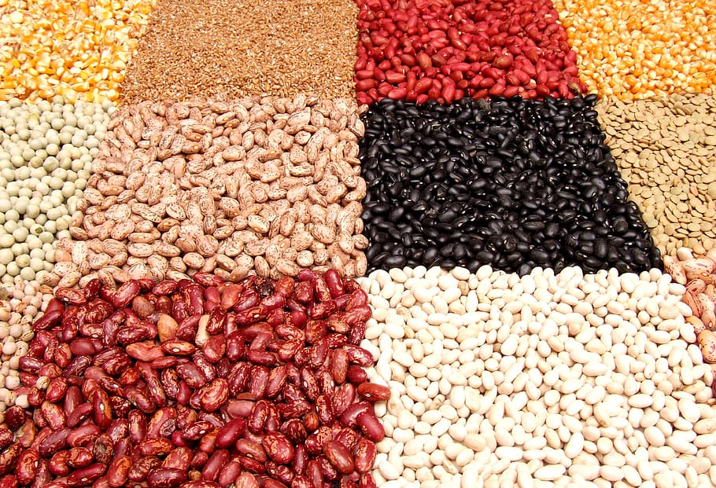
WHAT ARE YOU SELLING?
Product Features | Product Benefits
Spiced lentil soup made from scratch | A warming, protein-rich dish made with love and tradition — perfect for family meals.
Plant-based, egg-free cupcakes | Delicious, allergy-friendly treats that include everyone and support a kinder planet.

Slide 46
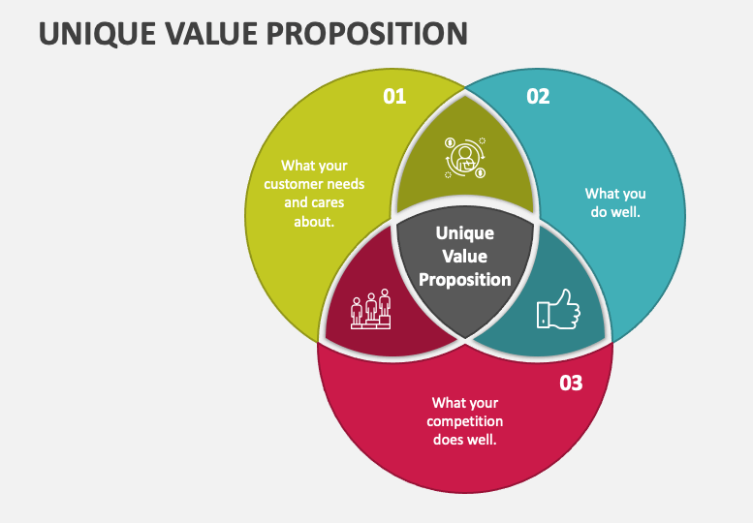
Unique Selling Proposition (USP)
This is what makes your product different and better for the right people. If you cannot pinpoint, explain or highlight what makes your business or product unique from your competitors, you won’t be able to target your marketing efforts successfully.
Your USP might be:
A treasured family recipe
Sourcing from local or women-led suppliers
A deep understanding of your customers’ cultural taste preferences
Zero-waste or allergen-friendly packaging

Slide 47
Exercise
BENEFITS VS FEATURES
Now turn each feature into a benefit — what does it actually do for your customer? Enter the real-life value behind each point: :
________________________
________________________
________________________
________________________
Enter four features your food product or company will provide:
________________________
________________________
________________________
________________________
Now ask yourself why these features are important to uncover your benefits!

Slide 48
06
YOUR MARKETING TOOLBOX…

Slide 49
YOUR MARKETING TOOLBOX- food business edition
Marketing is how people discover, trust, and remember your brand. This toolbox is designed to empower you with practical, low-cost tools that help you show up confidently, tell your story, and connect with the customers who need what you offer.
Some marketing tools you will use immediately, and others can be introduced as the business grows.
Your Web Presence
Packaging
Samples & Tastings
Recipe Cards or Serving Ideas
Photography That Sells
Farmers Markets & Street Fairs
Printed Materials
Social Media Tools
Local Influencers or Cultural Ambassadors
Word of Mouth & WhatsApp Groups
Email Marketing (Optional but Powerful)

Slide 50
1. YOUR WEB PRESENCE
Think of your website as your hub serving as your always open shopfront. It’s what people will see when they look for you. Make sure your first impression is a good one. Thought and effort into the design of the website will pay dividends.
Define your goals for the website
What information do you want to highlight on the website?
How can you highlight your Unique Selling Points?
How do want the visitor to experience this ? E.g. through video, image gallery, downloads etc.
What layout is appropriate to your business?
How can your website capture potential leads? E.g. Sign up to our newsletter
Cost considerations – can a free site give the same functionality as a custom design?

Slide 51
YOUR WEBSITE, THE ESSENTIALS
Buying Your Domain Name
Your domain name is your online address — like www.yourfoodname.com. It helps people find you.
Why You Need a Domain Name
Makes your business look more professional
Easier for people to search and share
You own your name , not a platform like Facebook or Instagram. You can use it for email (e.g. hello@yourbusiness.com)
How to Choose a Good Domain Name
Short, simple, and easy to spell
Reflects your business name or what you sell
Avoid numbers or dashes (unless they’re part of your brand)
Use .com if you can, or your country (like .ie, .fr, .de)
Check that it’s not already taken or trademarked

Slide 52
YOUR WEBSITE, THE ESSENTIALS
Where to Buy a Domain Name
You can search and buy directly from domain sites such as:
Platform Notes
Google Domains (merging with Squarespace) Easy for beginners. Namecheap, Affordable and simple to use.
GoDaddy Popular, but watch for upsells
Wix, Weebly, Shopify, You can buy while setting up your site
Costs:
Usually between €10–20/year. You don’t need to pay for extras like “site protection” right away.

Slide 53
DEVELOP IT YOURSELF – WEBSITE OPTIONS
Beginner-Friendly Website Builders
You don’t need to hire a web designer or be a tech expert to build a simple, effective website. Here are accessible, budget-friendly platforms and tips to help you get started:
.
Platform | What It’s Good For | Notes
Wix https://www.wix.com/ | Beautiful templates, drag-and-drop ease | Free plan available, ideal for small food businesses
Square/Weebly https://www.weebly.com/ | Easy for food sellers with physical or online stores | Great if you already use Square for payments
Shopify https://www.shopify.com | If you’re ready to sell products online | Best for e-commerce, has more monthly cost
WordPress.com https://www.wordpress.com/ | Flexible and scalable | Requires a bit more setup, good for blogs or info-based sites

Slide 54
YOUR WEBSITE, THE ESSENTIALS
Home Page – Make a Strong First Impression
Your home page should answer two key questions within seconds:
What do you do? e.g. “We make handcrafted Syrian pastries with love and local ingredients.”
Why should I trust you? e.g. Use real photos, kind words from customers, and your brand story.
About Page – Share Your Story
This is where trust grows. Tell people who you are, what inspires your food, and what you care about.
Share your background, values, and passion. Include photos of yourself and products
Add a testimonial/success story.
Contact Page
Make It Easy to Reach You. Don’t make people hunt for your info.
Show your phone number and email clearly — ideally on every page.
Add your location or delivery area if relevant.
Use a Google Map if you have a physical space. A simple contact form is a great bonus.

Slide 55
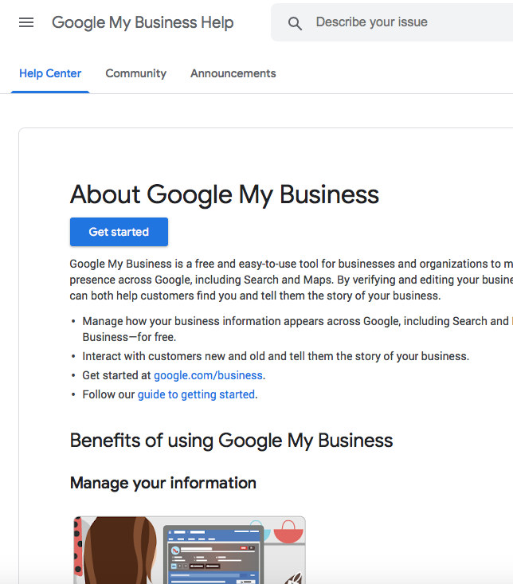
YOUR WEBSITE, THE ESSENTIALS
GOOGLE MY BUSINESS
Once you have a web presence, use Google My Business to get your business information to show up in Google Search, Google Earth, other Google apps. https://support.google.com/business
QR CODES
A QR code (Quick Response code) is a scannable black-and-white square that opens a specific link on a phone, like your website, Instagram, or online menu.
How to Create a Free QR Code:
Go to a free QR code generator like:
https://www.qr-code-generator.com
https://www.canva.com (has a QR tool in design)

Slide 56
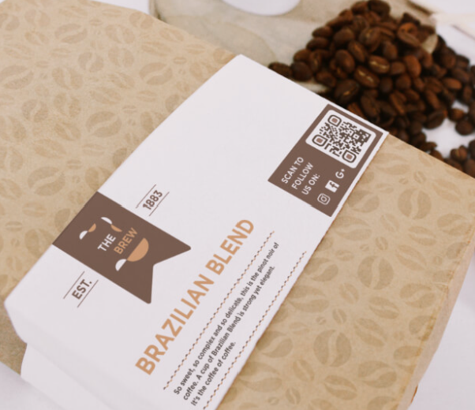
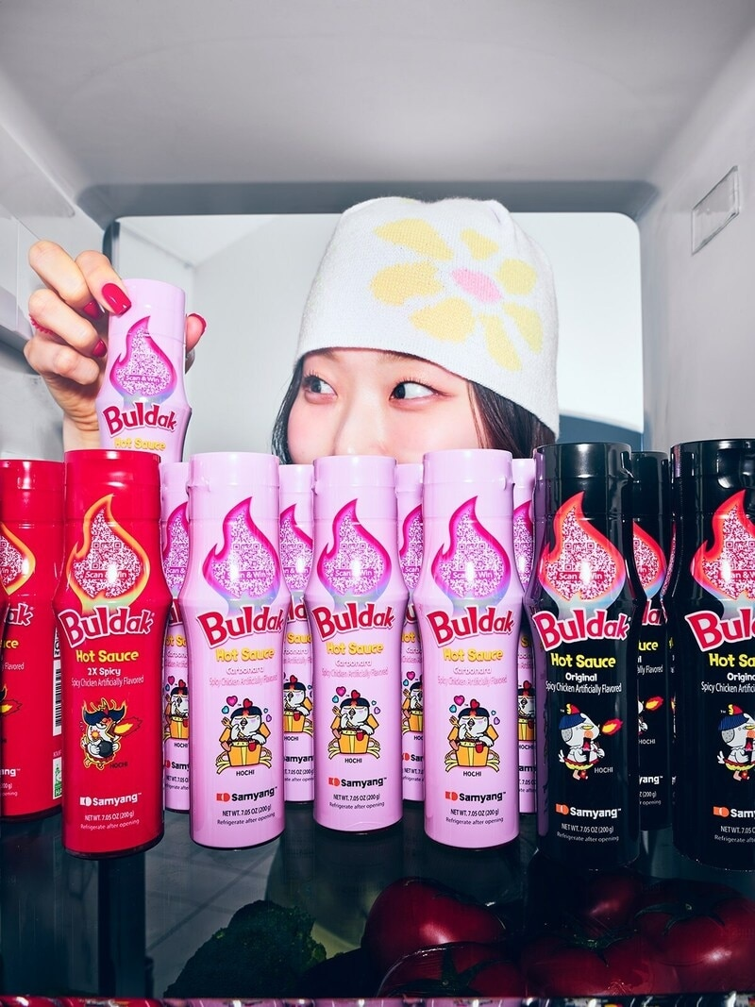
YOUR WEBSITE, THE ESSENTIALS
Read: Buldak's New Hot Sauce Packaging Integrates a Convenient QR Code https://www.trendhunter.com/trends/buldak-hot-sauce-packaging
2. Paste your link (e.g. your Instagram page, online store, or Google Form)
3. Click “Generate” and download the QR code image
4. Add it to:
Flyers
Food packaging
Pop-up banners
Recipe cards
Business cards

Slide 57
2. PACKAGING
What Great Food Packaging Does:
Protects the food
Tells your story – heritage, values, or process
Builds trust – with clear ingredients, dates, and contact info
Stands out – on shelves, at markets, or in a photo
What to Include:
Your business name + logo
A short message or tagline: “Made with love in Lisbon”
Ingredients & allergens (required if selling publicly)
A call-to-action: “Follow us on Instagram @…”
Optional: QR code for recipes, reviews or online orders
Tip: Simple packaging (paper bags, stamps, labels) can feel special with the right touch

Slide 58
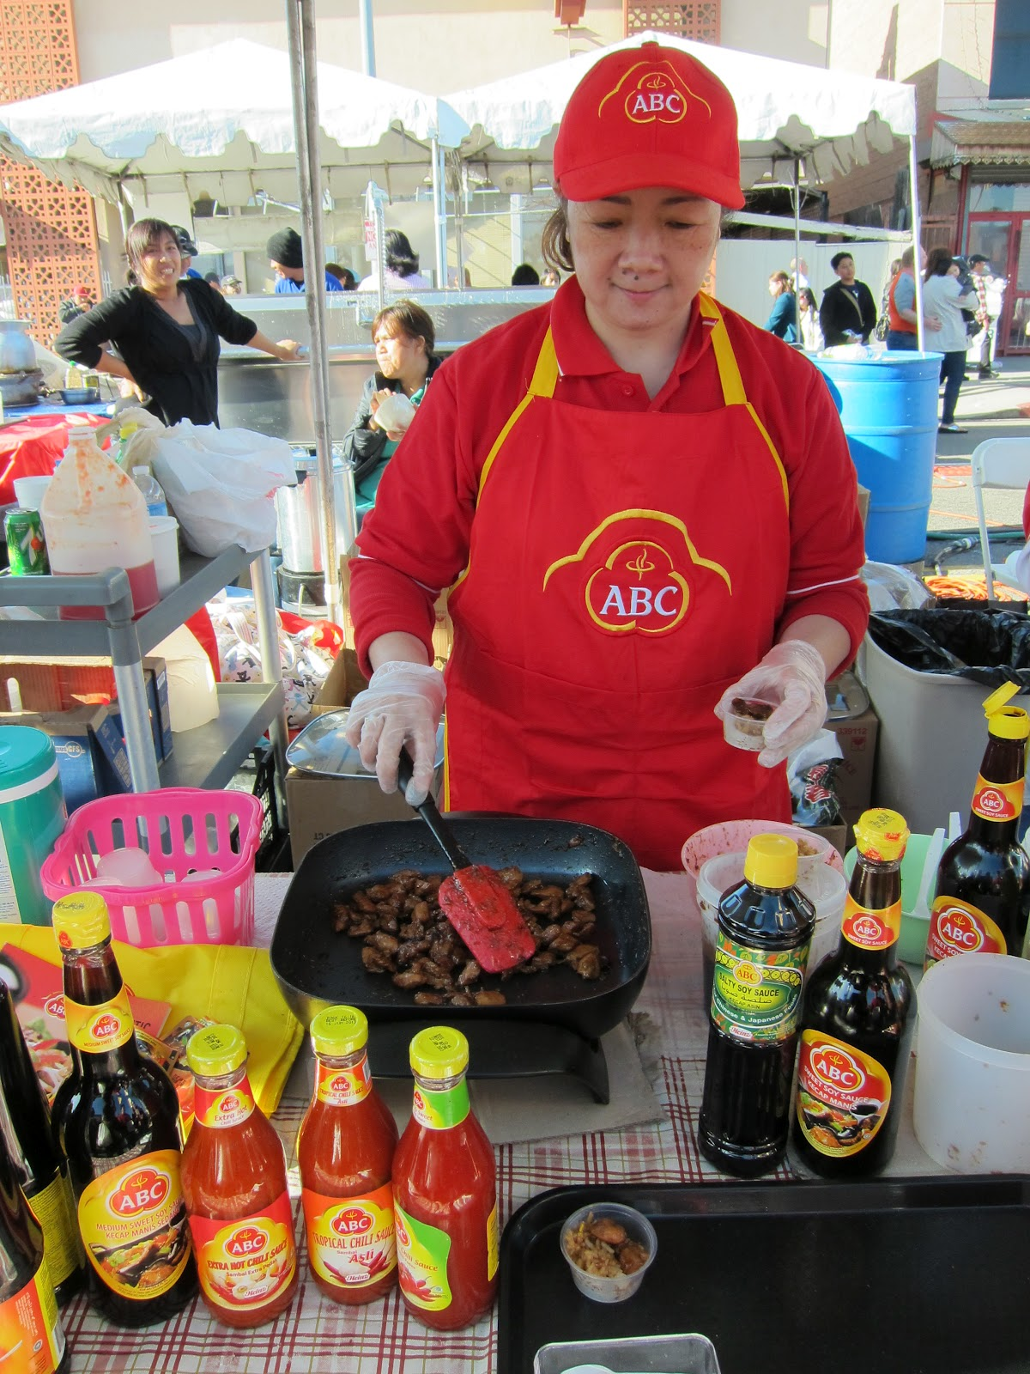
3. SAMPLES AND TASTINGS
The fastest way to win a customer? Let them taste it.
Food is emotional, sensory, and memorable, and tasting turns interest into trust.
Why Samples Work
People remember what they taste
Builds trust quickly, especially for unfamiliar or cultural foods
Creates an opportunity to talk about your story and your values
Opens the door to immediate feedback or orders
Where You Can Offer Tastings
Local markets, food fairs, or community festivals
During pop-ups, open kitchens, or cooking demos
At networking events, women’s groups, or cultural celebrations

Slide 59
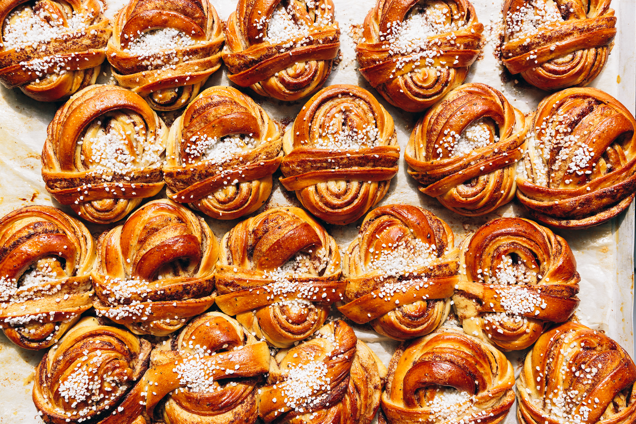
3. SAMPLES AND TASTINGS
What to Prepare
Small, safe, easy-to-hold portions
A clean and inviting display (paper napkins, trays, toothpicks)
Business cards, price list, or menu nearby
A short “pitch”. One sentence about what they’re tasting and why it’s special. Something like: “Hi! Would you like to try a bite of our handmade spice cake? It’s my grandmother’s recipe from Aleppo.”
Costs can add up, so plan your budget carefully and spend on samples and tastings where it brings the most value.

Slide 60
4. RECIPE CARDS
Don’t just sell a product , show people how to enjoy it.
Recipe cards and serving tips turn your food into an experience.
Why It Works
Helps customers feel confident using your product
Adds personality and culture to your packaging or market stall
Encourages repeat purchases when customers use your product at home
What to Include
A simple recipe or serving tip (1–3 steps max)
Ingredients and how to use your product
A personal note or memory — “This dip reminds me of family dinners in Lagos”
Your social media handle or website link
Optional: QR code to a video or full recipe
Example:
Try our rose harissa with roasted vegetables or stirred into couscous, a bold North African flavour boost in under 5 minutes.

Slide 61
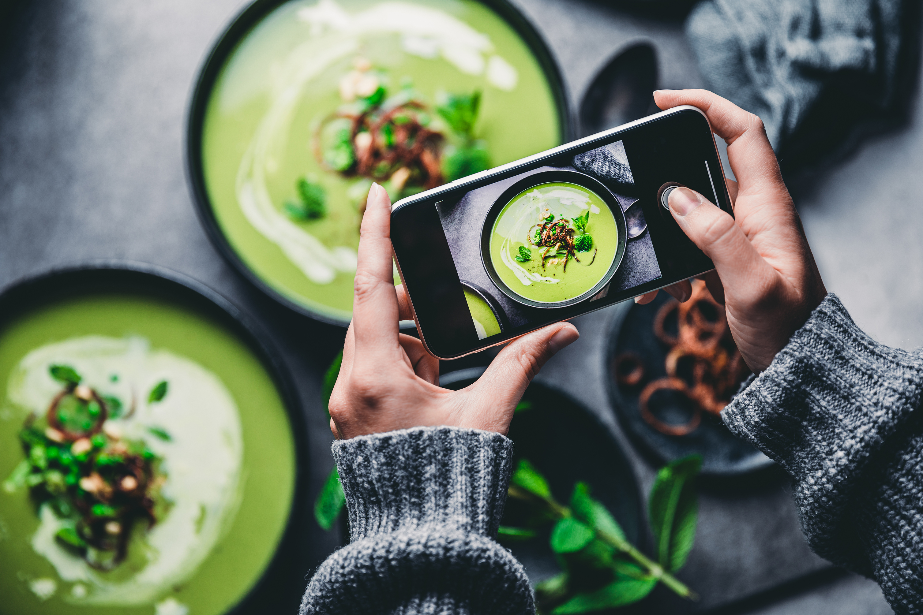
5. PHOTOGRAPHY
People eat with their eyes first.
Strong visuals grab attention and build a professional image
Helps customers imagine your food at their table
Ideal for Instagram, menus, flyers, and websites
What to Photograph
Your finished dish or product in natural light
You in action — cooking, plating, or selling
Ingredients, spices, tools
People enjoying your food (with permission!
Tips for Powerful Food Photos
Use natural light near a window, no flash
Keep the background simple and clean
Take close-ups with texture and colour
Use your phone — you don’t need fancy equipment

Slide 62
6. FARMERS MARKETS & STREET FAIRS
Markets and fairs are where customers see, taste, and trust your brand. They offer a chance to sell, connect with people, and build your presence in the community.
Why Markets Work
You speak directly with customers. People can try your food on the spot
You build name recognition and word of mouth
You learn what people love (and what they ask for)
What to Bring
A clean and attractive table setup
Signage with your name, story, and prices
Business cards, flyers, or product lists
Tasting samples (safe and small)
Card reader or QR code for mobile payments
Tips for Market Days
Greet everyone who walks by — a smile invites conversation
“Would you like to try a free sample?
Take notes on what products sell well
Take photos and post them to your social pages

Slide 63
7. PRINTED MATERIALS – WHAT YOU NEED MOST
Even in our digital age, printed items still matter, when they’re useful, beautiful, and mindful. Use them to leave a lasting impression without leaving a heavy footprint.
Business Cards They may be old school but they are an important marketing tool to
build your credibility as a business owner, network and make
connections (You can get 500 business cards for less than €20)
Press Release For local newspapers – journalists and local news writers are always
interested in local news stories. By now you know your USP, have the
start of a brand story and maybe even have a business launch date –
pull all these together into a press release and you are sure to get
something printed

Slide 64
8. SOCIAL MEDIA TOOLS
It’s free. It’s flexible. It works.
You don’t need a big budget — just time, care, and consistency.
It helps you connect with local customers or even reach people globally.
Social media lets you show your real voice, culture, and behind-the-scenes, which builds trust.
Why It Works for Food:
People love food content — it’s visual, emotional, and shareable
You can post photos of your dishes, ingredients, family recipes, or market days
You can use stories, videos, or reels to show how your food is made and why it matters
Social Media is one of the best marketing tools for start-up food businesses. Why?

Slide 65
8. SOCIAL MEDIA TOOLS
Build Relationships, Not Just Reach
Social media isn’t about being everywhere. It’s about showing up where it matters. Start with one platform where your audience already is (like Instagram or Facebook). Focus on posting consistently, replying warmly, and telling your story one post at a time.
People follow people. Show the human side of your food adventure
It’s okay to start small: one post a week is better than silence
Focus on connection, not perfection — real stories build loyal followers
Use your posts to invite conversation: “Would you try this dish?” or “What’s your favourite comfort food?”

Slide 66
01
FACEBOOK
Facebook is still one of the most powerful platforms to grow your business.
Many people already use it daily, which makes it a natural space to build visibility and trust.
Create a Business Page to:
Post photos of your food
Share your story and values
Announce pop-ups, deliveries, or markets
Build a loyal community
It’s free to use and a great way to stay in touch with current customers and attract new ones.
SPOTLIGHT ON FACEBOOK AS A MARKETING TOOL…

Slide 67
01
01
FACEBOOK
HOW IT WORKS IN BUSINESS
Facebook rewards engagement. the more people interact with your posts, the more visibility you get.
The more often your fans engage with you, the more often your posts will be pushed out into their News Feed. Encourage followers to engage in 4 ways
SPOTLIGHT ON FACEBOOK AS A MARKETING TOOL…
like it
Click on a link
Share it with others
Leave a comment

Slide 68
SPOTLIGHT ON FACEBOOK AS A MARKETING TOOL…
01
FACEBOOK
MAKE A GOOD IMPRESSION
Your cover photo and visuals say a lot about your brand. Make them beautiful, welcoming, and easy to understand.
Use free tools like:
Canva.com – design posts, covers, menus with your brand colours
Pagemodo.com – for Facebook-specific cover templates (optional)
Show your food, your face, or your mission right away. Keep your page design fresh with seasonal updates.

Slide 69
01
FACEBOOK - BE SMART
Make your time on Facebook work for you by using simple tools that save effort and grow visibility.
Schedule Posts Write posts in advance and schedule them at good times.
Experiment With Frequency Start small: 1–2 times a week. Test what gets attention (photos, recipes, behind-the-scenes content?).
Use Facebook Ads (if ready) Even €1–€2 per day can go far if you target the right audience. Try:
Page Likes Ads – to grow followers
Boosted Posts – to spread a popular post further
Local Area Targeting – great for food delivery or events
SPOTLIGHT ON FACEBOOK AS A MARKETING TOOL…

Slide 70
01
VIDEO STRATEGY OVERVIEW – LIVE vs REELS vs STORIES
Feature | Facebook Live (also Instagram) | Reels | Stories
Length | Up to 4 hours | Up to 90 seconds | 15 seconds per slide (disappears in 24 hrs)
Style | Real-time, unedited, conversational | Edited, quick, catchy | Casual, spontaneous, behind-the-scenes
Best For | Q&A, demos, events, launches | Food prep, step-by-step, reactions, cultural tips | Daily updates, specials, quick news
Visibility | Seen by followers who are online right now | Shown in Explore tab, high discovery potential | Shown to followers, high engagement if posted daily
Editing | Not possible during stream (can save later) | Full editing: music, text, effects | Add stickers, polls, text, GIFs
Time Invested | Medium (plan what to say) | High (editing, posting with intention) | Low (post in the moment)
Example Use | “Watch me prep for the weekend market” | “3 ways to use our tamarind chutney” | “Today’s menu at the stall”
SPOTLIGHT ON FACEBOOK AS A MARKETING TOOL…

Slide 71
Suggested Strategy for Food Entrepreneurs
01
Use Reels to attract new followers (show your food, your process, your energy)
Use Stories to build daily connection (quick updates, real moments, polls)
Use Live occasionally for launches, Q&As, or when you want to talk directly with people
TIP: You can reuse your Live recordings as Reels. One piece of content can serve multiple purposes.
SPOTLIGHT ON FACEBOOK AS A MARKETING TOOL…
ACTION Upskill via Free Online Training
Meta Blueprint offers a comprehensive suite of free, self-paced courses to help you build your marketing skills across Facebook, Messenger, Instagram, and WhatsApp. These courses cover topics such as creating a business page, posting content, and advertising. https://www.facebook.com/business/learn

Slide 72
02
INSTAGRAM
Instagram is a powerful platform for creating visual content It is said to be 15 times more powerful than Facebook and is made for showing off beautiful food, behind-the-scenes moments, and your story as a founder. It’s built for:
Photos of your dishes and packaging
Short videos of how you cook, prep, or serve
Real stories — your culture, mission, personality
Instagram has built-in editing tools and filters that help even beginners make posts look polished and professional.
SPOTLIGHT ON INSTAGRAM AS A MARKETING TOOL…
CLICK TO VIEW

Slide 73
02
INSTAGRAM, what to post
Here are some easy, effective ways to get started:
Connect Your Channels Link Instagram to your Facebook to save time and reach more people.
Post What Feels Real You don’t need polished food shoots. Share:
Market prep
Your kitchen setup
Cultural food rituals
Packaging orders
Use Short Videos Reels and stories perform better than static photos. Think 15–30 seconds: "How I serve my favourite dish" or "A tip for folding perfect dumplings."
SPOTLIGHT ON INSTAGRAM AS A MARKETING TOOL…

Slide 74
INSTAGRAM, build connection, not just content
02
Make Instagram a two-way street, it’s a relationship tool.
Respond to Comments. Say thank you, reply with emojis, or ask a question back.
Invite Your Followers In. Ask people to share how they use your product. Use simple polls to boost engagement.
Share Your Voice and Vision. Let your personality shine — your audience wants to know who’s behind the food.
Use Hashtags Wisely. Hashtags help new people discover your posts. Mix broad tags (#homemade, #streetfood, #plantbased) with specific/local ones (#dublinbakers, #syriansweets, #africanfoodlove).
Use 5–10 relevant hashtags max per post. Create a branded hashtag (e.g. #TasteWithAmina) for people to tag you back.
SPOTLIGHT ON INSTAGRAM AS A MARKETING TOOL…

Slide 75
02
INSTAGRAM
Tag People & Places. Tag your location on every post (especially if selling locally). Tag customers, partners, or markets when relevant. This boosts visibility and encourages shares
Use Reels. Reels get pushed more by the algorithm than photosEasy ideas: pouring sauce, flipping flatbread, packaging an order, plating a dish
Write Captions That Tell a Story. Share short, warm stories: “This chutney is made just like my grandmother taught me.” “We’re up at 5am for the market – wish us luck!” End with a question or call to action: “Have you tried this combo before?” “Tag someone who needs this!”
Post Consistently (Not Constantly). 2–3 times a week is enough to stay visible Pick the same days or times if possible (Instagram rewards regularity). Use a content calendar or reminders to help build the habit.
SPOTLIGHT ON INSTAGRAM AS A MARKETING TOOL…

Slide 76
02
INSTAGRAM
Example of a woman in food excelling on Instagram
Cloë - Bon Puf Cotton Candy original artisanal cotton candy puff
SPOTLIGHT ON INSTAGRAM AS A MARKETING TOOL…
CLICK TO VIEW

Slide 77
X (formally TWITTER) Is it right for you?
03
X (formerly known as Twitter) is still used by some communities, especially journalists, food writers, and niche networks, but it’s not essential for most food startups.
When X can be useful:
You want to connect with media, bloggers, or activists
You’re part of a food justice, cultural, or political movement
You enjoy writing quick thoughts, tips, or links
But for most small food brands, Instagram or WhatsApp are more effective for reaching and engaging customers.
If you use X, treat it as a networking tool and not a sales platform.
SPOTLIGHT ON X AS A MARKETING TOOL…

Slide 78
YOUTUBE, A POWERFUL TOOL FOR FOOD BRANDS
04
YouTube is the world’s second-largest search engine and it’s perfect for showing off your food in longer-form video.
Why YouTube Matters:
People search for how to cook, eat, or use new foods
Great for storytelling: origin, culture, purpose
Videos stay visible for months or years, not just hours
You can link videos in your website, WhatsApp, Instagram bio, or even QR codes on packaging
What to Post:
How to make or serve your dish, products or service
Behind the scenes of a prep day
Market day: what we sold and learned
My story: why I started this food business
SPOTLIGHT ON YOUTUBE AS A MARKETING TOOL…

Slide 79
04
YOUTUBE, GETTING STARTED
YouTube helps build trust, not just likes. It’s your chance to teach, inspire, and connect.
Open a YouTube channel using your Gmail account
Give your channel a name that matches your business
Upload short videos (1–5 minutes to start)
Add a thumbnail, short description, and a few keywords (like: “homemade hummus” or “vegan Ghanaian snacks”)
Edit Your Videos with:
YouTube Studio (basic editing & music for uploaded videos)
CapCut (mobile & desktop video editing, great for Reels/Shorts)
InShot (simple mobile app for trimming, music, text, exporting)
Canva (easy drag-and-drop video templates, animations, branding)
Tip: End each video with a call to action: “Order here”, “Follow us on Instagram”, “Subscribe for more recipes!”
SPOTLIGHT ON YOU TUBE AS A MARKETING TOOL…

Slide 80
05
TIKTOK
TikTok is one of the most powerful platforms to get noticed fast. While it's known for its trends (especially for foods) and music, it’s also an excellent tool for small food businesses with no budget to connect with new audiences.
Why TikTok Works:
Short videos = fast engagement
The algorithm shows your content to people who don’t already follow you
It’s great for explaining what you do in a way that’s real, simple, and human
Posting ideas:
Behind-the-scenes clips from the kitchen
Step-by-step mini recipes
Customer reactions and testimonials
Your brand story in under 60 second
You don’t need to dance or follow trends? Be authentic, consistent, and show the heart behind your food.
SPOTLIGHT ON TIKTOK AS A MARKETING TOOL…
CLICK TO VIEW

Slide 81
05
TIKTOK: Turning Followers into Customers
Getting views is great, but your goal is real relationships and sales. Here's how to move from likes to loyal buyers:
Engage Actively:
Reply to comments and messages. Show you're listening
Like and comment back to build trust and community
Ask questions in captions: “Would you try?” or “What’s your favourite?”
Make Your Profile Work for You
In bio, state what you offer e.g. Handmade vegan snacks, DM to order
Include links to your website, WhatsApp, or order form
Use a recognisable logo or photo as your profile picture
SPOTLIGHT ON TIKTOK AS A MARKETING TOOL…

Slide 82
05
TIKTOK: Turning Followers into Customers
Add Calls to Action
In your video captions, guide people:“Order in bio 🔗” “Follow for more easy recipes” “DM to book for events”
Be Consistent
TikTok recommends 1–4 posts per day, but even 3–5 per week builds momentum
Getting Started on TikTok – Simple Steps for Food Entrepreneurs
1. Download the App & Set Up Your Profile
Use your business name or something short and memorable
Add a profile photo (your face, food, or logo)
Write a short bio: What you offer + how to order (e.g. “Homecooked Sri Lankan meals. DM to book!”)
Link to your Instagram, website, or WhatsApp
SPOTLIGHT ON TIKTOK AS A MARKETING TOOL…

Slide 83
05
TIKTOK: Turning Followers into Customers
2. Follow Other Food Creators
Search for others making and selling food. Follow, like, and comment to learn and connect
Use hashtags like #smallbusiness, #foodtok, #veganfood, #diasporakitchen
3. Make Your First Video
Keep it simple: “Here’s what I made today” “This is why I started my business” “What’s in this sauce?”
Use natural light, smile, and speak as if talking to a customer
4. Use Hashtags & Captions
Add 3–5 hashtags to help people find your video
Include a call to action: “Follow for more”, “Order in bio”, “Tag someone who’d love this”
SPOTLIGHT ON TIKTOK AS A MARKETING TOOL…

Slide 84
9. LOCAL INFLUENCERS & CULTURAL AMBASSADORS
You don’t need a celebrity. just someone trusted in your community. A kind word from the right person can do more than any paid ad.
Who they are:
A respected chef
A well-known stallholder
A food writer, blogger, or activist
Someone who shares your culture or values and already has a loyal audience
What they can do:
Collaborate on a recipe, tasting, or live event
Post about your product on Instagram or Facebook
Invite others to try your food
Tell their followers why they love what you make

Slide 85
10. WORD OF MOUTH & WHATSAPP GROUPS
Your network is your first (and often best) marketing channel. Friends, neighbours, and customers can help grow your business faster than you think.
How to activate word of mouth:
Ask satisfied customers to share your info in local WhatsApp or Facebook groups
Create a “menu of the week” image you can send easily
Offer a “bring-a-friend” or referral bonus (even a small thank-you counts)
WhatsApp Tips for Food Entrepreneurs
1. Set up a Broadcast Channel
Create a WhatsApp Broadcast List (not a group chat!)
Add regular customers who agree to receive updates
Send menus, specials, or delivery alerts — they’ll get your message privately, like a direct text
Use WhatsApp Business
Download the free WhatsApp Business app
Set up auto-replies for when you're busy
Add a product catalogue, business hours, and quick responses (like “Thanks for your order!”)

Slide 86
11. DID YOU KNOW EMAIL MARKETING IS A POWERFUL TOOL?
Email lets you speak directly to your customers, in their inbox, on their time.
Why It Works:
High-impact with little cost
You own your contact list, not social media
Easy to track opens, clicks, and signups
Helps you build a loyal, returning customer base
Great Free Tools:
Mailchimp.com – free for up to 500 subscribers
MailerLite.com – clean design, great support
Brevo.com (formerly Sendinblue) – multilingual, good for EU businesses
Also try: aweber.com, constantcontact.com

Slide 87
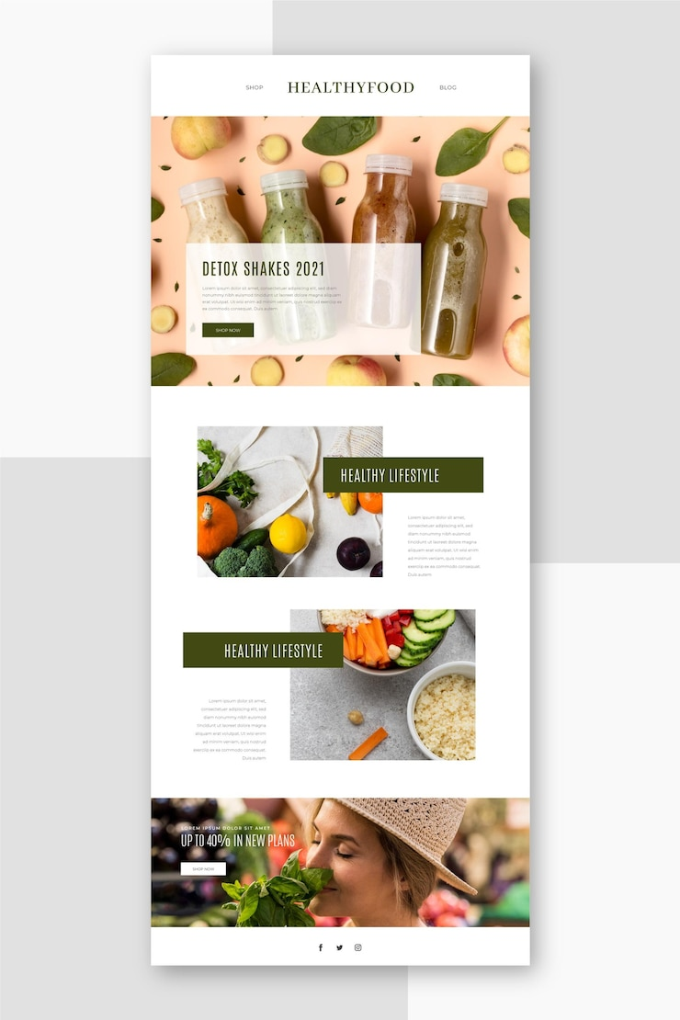
11. EMAIL MARKETING – start in 3 easy steps
Create a List
Start by adding people you already know: past customers, friends, family, or people from markets.
You can also import sign-ups from events or WhatsApp.
This list becomes your email community — people who want to hear from you.
2. Design a Sign-Up Form
Use your email platform (like Mailchimp or MailerLite) to create a sign-up form.
Invite the form to your website and share on Instagram, WhatsApp, or via a QR code
Keep registering simple: just name, email, and permission to send them updates

Slide 88
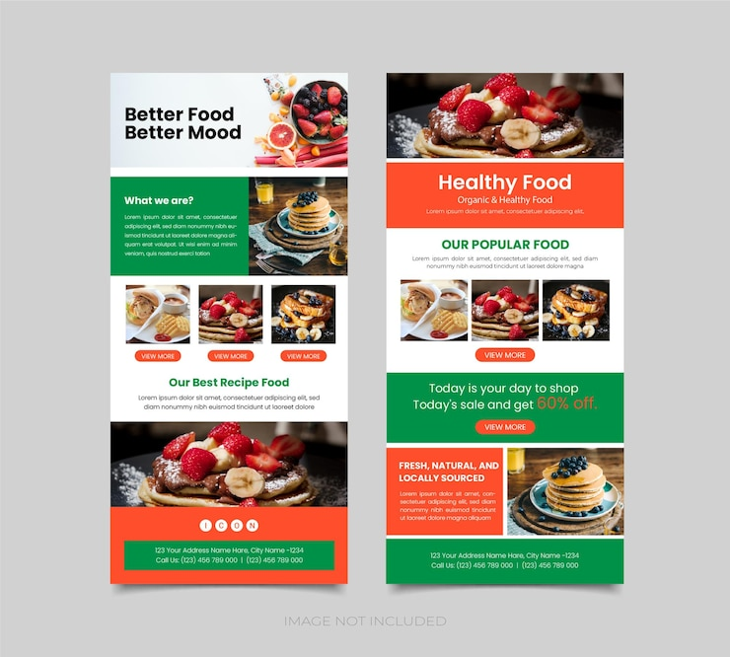
11. EMAIL MARKETING – start in 3 easy steps
Offer something small in return for signing up, e.g. a recipe, free tasting, or early access to your menu.
3. Send a Campaign
A campaign is simply an email you send to your list.
You can include: A photo of your product or stall, a short story or cultural insight, a weekly menu, a special offer and a “thank you” for recent support
Make sure it is interesting and personal; write as if you're writing to a customer you know.
Start with one email per month, then build from there.

Slide 89
THE MOST IMPORTANT TOOL IS ACTION.
Your Toolbox Is Ready — Now Pick Your Tools
You don’t need to use every marketing tool at the start.
Begin with the ones that feel doable, natural, and right for your business.
Ask Yourself:
Where are my customers already spending time?
Which tool feels exciting or easy to try first?
Can I commit to one small step this week? And build from there.
Now make a plan of the tools that best suit your business, what you are going to start with and put your plan in writing

Slide 90
Next - Step 6
Sales are the engine of your food business
www.3kitchens.eu

