Slide 1
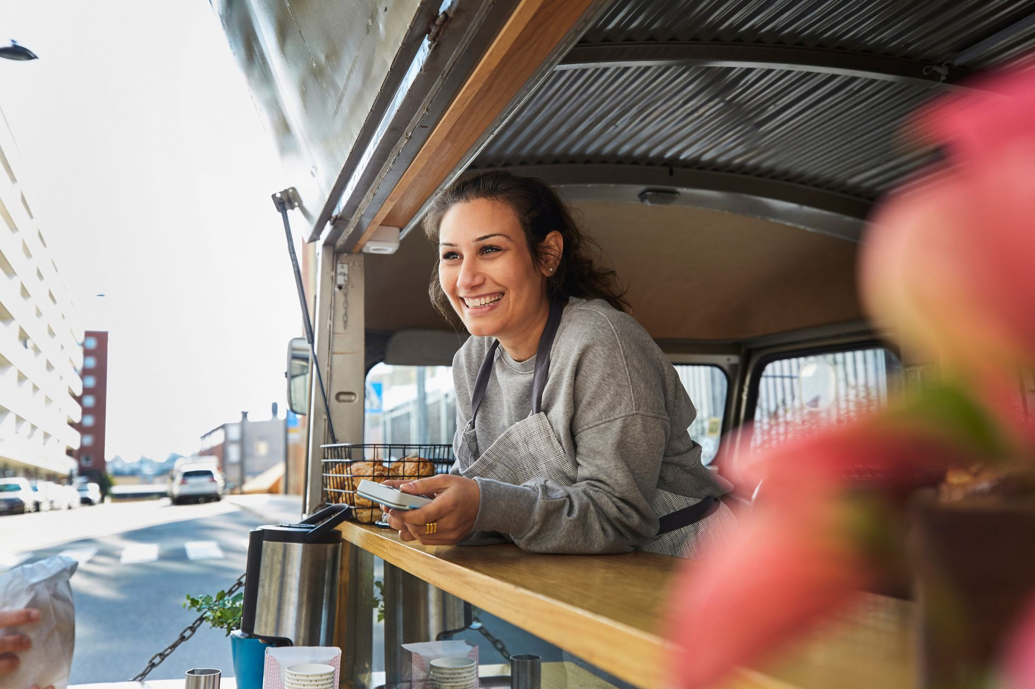
STEP 3.
GETTING YOUR BUSINESS STARTED
www.3kitchens.eu

Slide 2
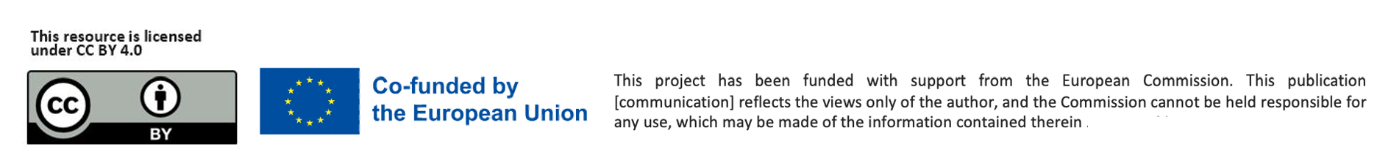
Contents
01
Being in Business - Making Products Vs. Delivering A Service
02
Operations - The ‘How’ of Being in Business
03
The Legal Part of Getting into Business
04
Start through an Online Business
05
Start up in business with your own website

Slide 3
Learning Objectives – Step 3: Getting your Business Started
By the end of Step 3, you will be able to:
By the end of this step, you will be able to:
Understand the difference between selling a food product and offering a food-related service and choose which path fits you best.
Plan the key operational steps for running your food business including kitchen setup, equipment, sourcing, and packaging.
Understand your legal options (sole trader, partnership, or limited company) and know how to register your business.
Explore ways to sell online, including using platforms like Etsy or Amazon, and understand what you need to get started.
Recognise the value of having your own website and know your options for building one on a small budget.
Be aware of alternative business models like social enterprises and collectives that align with community and purpose-driven goals.
​

Slide 4


01
Being in Business …
Making Products Vs. Delivering A Service

Slide 5
BEING IN BUSINESS – YOUR CHOICES
In this section, we take you through the different and accessible ways of starting and being in business.
Manufacturing a food product or providing a service
Part-time or seasonal basis
  And then take you on an adventure of the possibility
  of starting an online food business

Slide 6
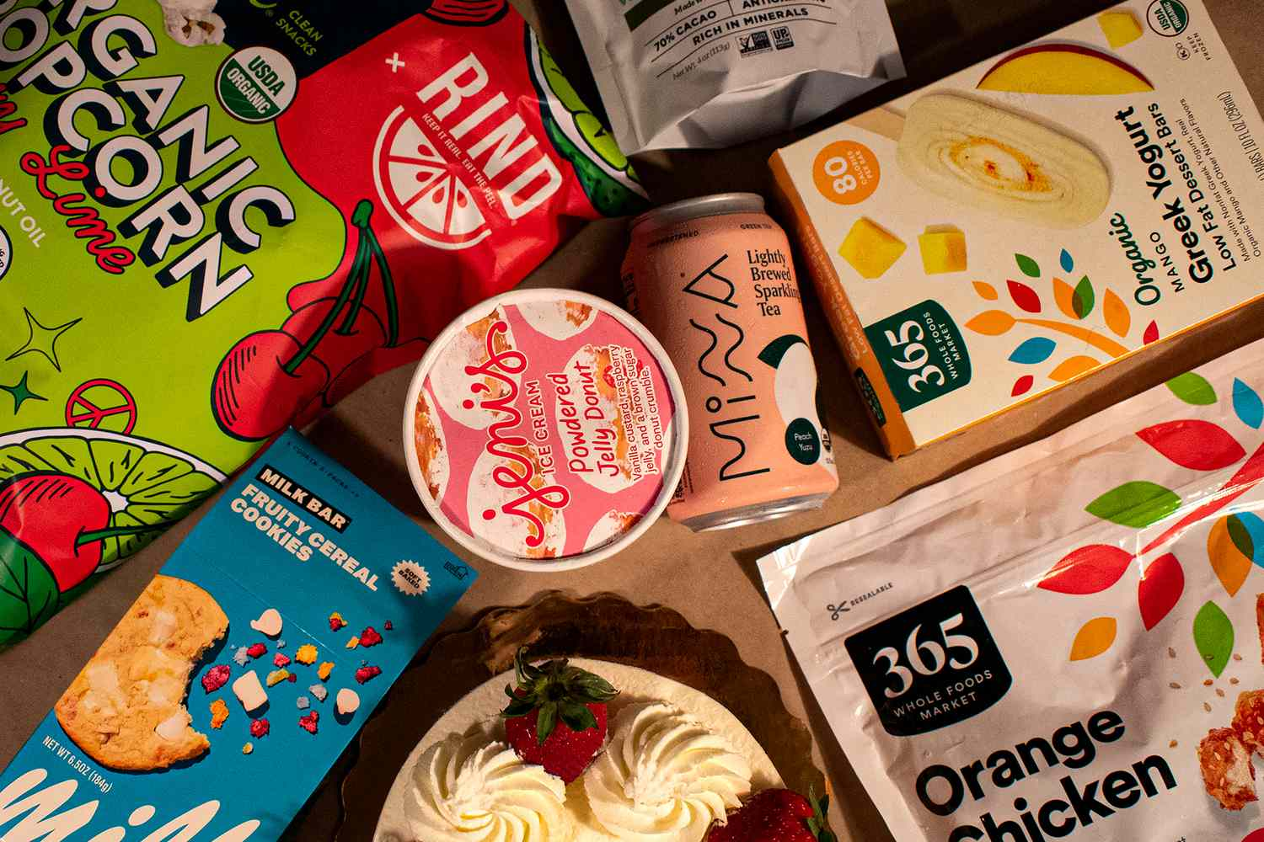
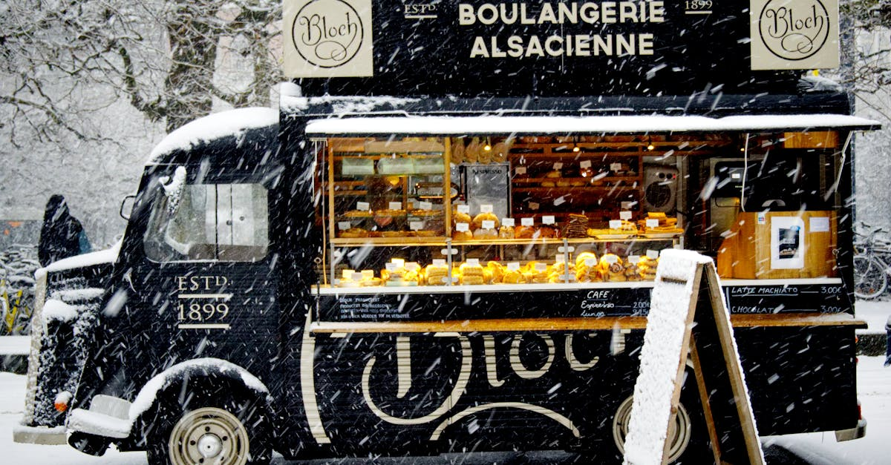
MAKING FOOD PRODUCTS/ DELIVERING A SERVICE
A food product is something your customers can see, touch, taste, or take home — like a jar of homemade chutney, a tray of baklava, or packaged spice mixes. These are items you make or prepare and then sell, often with packaging, labels, and clear pricing. Many migrant women begin here — cooking from home, selling at local markets, or supplying to shops or cafes.
A food service, on the other hand, is built around your skills and hospitality. It could be private catering for events, a food cart, running pop-up dinners, offering cooking classes, or creating custom meal preparation. Customers are buying your time, talent, and care, not something they can touch before they commit. Here, your ability to build trust, communicate well, and offer a great experience matters just as much as the food itself.

Slide 7
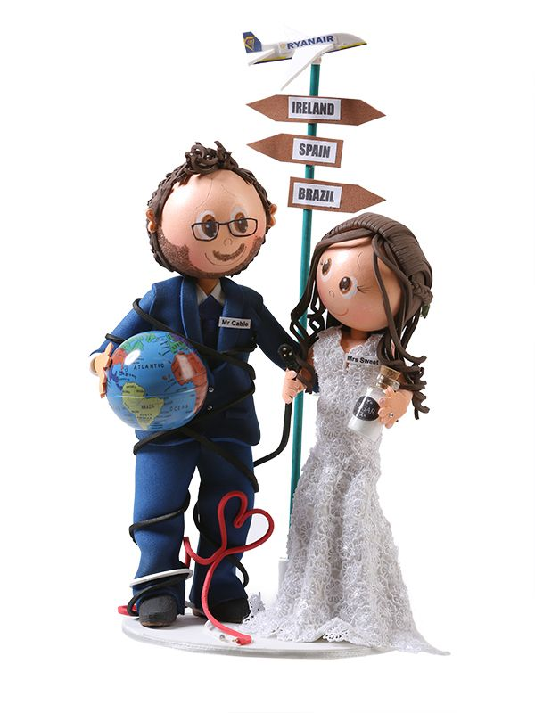
MAKING PRODUCTS - AN EXAMPLE
www.soyou.ie
Ana Tereza Rodrigues came Dublin/Ireland from Goiânia, Brazil. She was ready for new opportunities. Ana spent few years struggling to learn the language while working a few jobs. One day, encouraged by her friend So You was born making amazing cake Toppers for all occasions e.g. Weddings, Birthdays, Christenings.
The toppers are very unusual and unique. Ana sold through her website www.soyou.ie
Her story was featured in the Irish Times. Read and be inspired Migrant women’s ‘determination and grit’ find form in start-ups (irishtimes.com)

Slide 8
Ana Tereza shares her experience…
Ana Tereza has since moved on from the business, but her learning is insightful for new entrepreneurs.
“It was not very easy because the language barrier is the first difficulty,” said Ms Rodrigues. “We need to search for everything, and we don’t know the terminology for everything.”
Ana encountered barriers, such as when she applied for a €10,000 loan for materials. “I tried once, but it wasn’t approved, and I never tried again,”
She hopes one day to have her own premises where she can both work and show off her products.
“I would love a little shop. That would be my dream.”

Slide 9
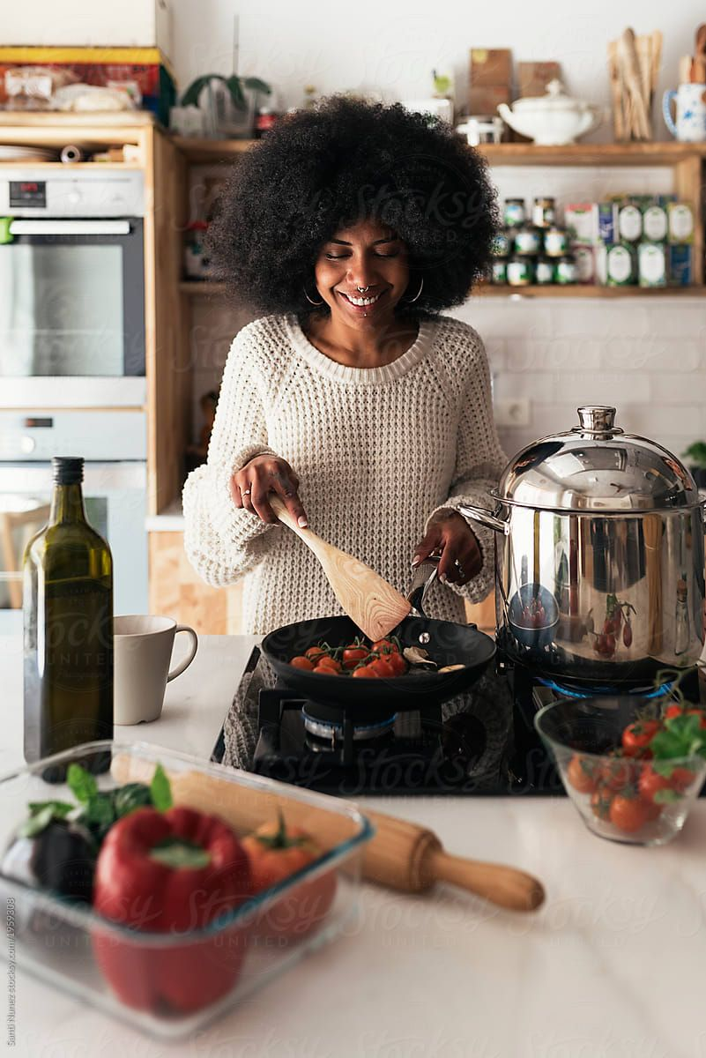
SERVICES WHEN THE BUDGET IS TIGHT
When money is tight, the most powerful thing you have is your big idea and your skills.
Many food-based service businesses are ideal for starting with little or no money.
They often don’t need a physical shop, expensive equipment, or large inventory. Instead, they rely on your experience, your culture, and your ability to create meaningful connections through food.
Even if your dream is to sell a packaged product one day, starting with a service business can be a smart first step, helping you build a reputation, test your ideas, and earn money as you grow.

Slide 10
SERVICES WHEN THE BUDGET IS TIGHT
Examples of Food Service Businesses You Can Start on a Budget:
Home catering in your community and at events
Meal prep or home delivery (e.g. traditional dishes)
Cooking classes — in person or online, sharing your culture and recipes
Pop-up dinners or supper clubs
Street food stalls or food carts (seasonal or event-based)
Private chef services for small events or families
Food styling or photography if you love presentation
Food tours or cultural storytelling through cuisine
These kinds of businesses can often begin in your own kitchen, using your own tools, and grow step by step.

Slide 11
SERVICES WHEN THE BUDGET IS TIGHT
Whether it’s your cooking, hospitality, knowledge of traditional recipes, or the way you bring people together around food, every woman has something valuable to offer. Most likely, you already have skills, recipes, techniques, knowledge, or experience that others will pay for.
Setting up a food service business is one of the most flexible ways to earn an income if:
You only want to work part-time or seasonally
You need to work from home
You’re just getting started in a new country
You have no previous business experience or formal qualifications
Your culture, your food, your care, these are not small things. They are the heart of your business.

Slide 12
SELF ASSESSMENT
Ask yourself: “What food-related skill do I have that others might pay for?”
It could be:
Cooking or baking for others
Teaching a traditional dish from your culture
Organising small events or hosting people
Preparing meals for busy people or elders
Creating spice blends, sauces, or preserves
Storytelling and sharing food heritage
Write down as many as you can. Start with what you know and love, build on your market research, and that's where your business can begin.
Download and complete our Kitchens: Food Service Business Self-Assessment
Double click icon to open

Slide 13

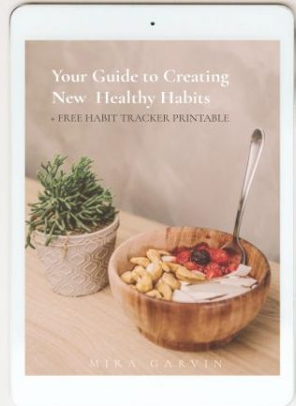
SELLING A PERONAL SERVICE- AN EXAMPLE
Mira Garvin lives in Dublin, but is originally from Mauritius, and turned a passion for food in her adopted home into a business as a health and nutrition coach.
Wellbeing challenges led Mira to start a food blog and to train as a nutritionist. An example of one of her services, she runs a 10-week programme called Project Me for mothers with newborns to help them make easy, healthy meals.
Click to Read

Slide 14
STARTING PART TIME COULD BE AN OPTION
PART-TIME BUSINESS
For many women, especially when starting in a new country or juggling other responsibilities, beginning a food business part-time is a smart and empowering choice. This approach helps:
Lower your financial risk — no need for a big investment upfront
Test the waters — find out if self-employment fits your life and personality
Build confidence — try out your idea while learning as you go
Earn while you learn — even small steps can bring in money and open new opportunities
You can always grow later, adding more time, services, or customers when you’re ready.
SEASONAL BUSINESSES
Another flexible option is to run a seasonal food service business, working around holidays, school schedules, or cultural events. These can be full-time during certain months or part-time throughout the year. Examples include:
Cooking or catering for religious or cultural celebrations
Selling street food or snacks during summer festivals or markets
Offering holiday meal prep or special event menus
Running pop-ups or food stands in busy seasons (like Ramadan, Christmas, etc.)
Again, you don’t have to do everything at once. Your kitchen, your timing, your way.

Slide 15

SETTING UP A PART TIME BUSINESS - AN EXAMPLE
Mabel Chah arrived in Ireland from Cameroon in 2013. While living in a direct provision centre in Sligo, she was one of the driving forces behind Sligo Global Kitchen, giving asylum seekers an opportunity to cook their own dishes in the kitchen of The Model Arts Centre and invite the local community to share a meal.
Mabel set up her own part time business Chah’s Hot Sauce which she was able to combine with her studies and her singing/songwriting.

Slide 16
04
OPERATIONS – THE ‘HOW’ OF BEING A FOOD BUSINESS

Slide 17
GETTING OPERATIONAL!
This is the practical side of starting your food business where you figure out how everything works in real life. It’s about the daily decisions and physical tools you’ll need to make, serve, and sell your food , whether from home, a shared kitchen, or a market stall.
You’ll need to plan for:
Where you prepare your food — home kitchen, shared space, pop-up location
What equipment and tools you need — pots, packaging, refrigeration, delivery containers
Where you get your ingredients and supplies — sourcing locally, sustainably, or culturally
How to stay safe and legal — food hygiene, traceability, cleanliness, and compliance
How you package and store your food — for markets, online orders, or delivery
How your process works — from cooking to selling to receiving payment
Choosing the right space to cook is one of the most important and practical decisions you’ll make. This affects your legal setup, hygiene standards, equipment needs, and how you scale over time. Let’s look at some options..

Slide 18
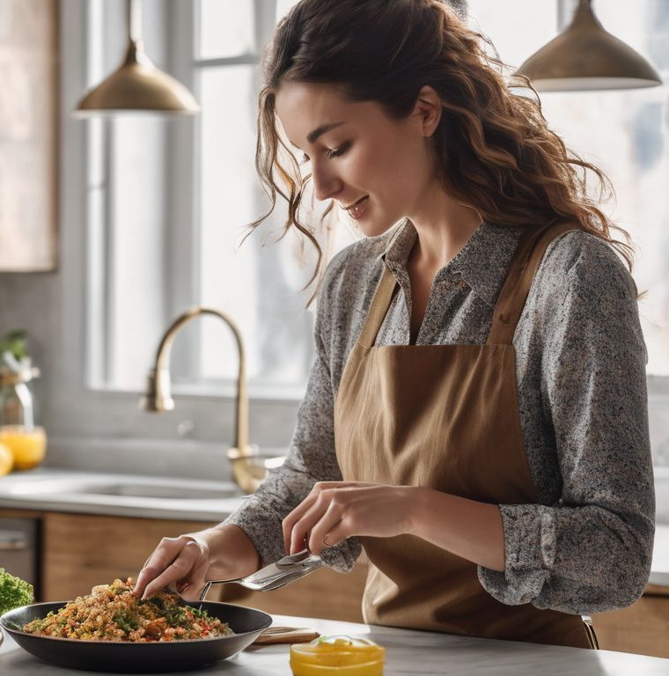
1. Where will you prepare your food?
Do your personal living circumstances allow you to produce from a home kitchen?
#
In many EU countries, you can legally prepare food from home, but only if your kitchen meets certain health and safety standards. It’s often permitted for non-perishable, low-risk foods (such as jam, spice blends, or baked goods) or for small-scale catering.
Things to consider:
Do you have separate storage for business ingredients and equipment?
Is your kitchen kept very clean and clutter-free?
Can you ensure no pets or children interfere with production?
Do you need to register your home kitchen with local food authorities?
💡 Check with your local municipality or food safety agency (they often have guidelines in multiple languages).

Slide 19
1. Where will you prepare your food?
Are you allowed to produce food from home legally?
Each EU country, and often each city, has different rules. You will need to:
Register your food business with the local authority
Complete a food safety course or hygiene certificate
Be open to health inspections at home
Clearly separate personal and business cooking space
If in doubt, start by contacting:
Your municipality office
The local food safety agency or public health department
A local women’s enterprise or migrant support group — they often have info in your language

Slide 20
1. Where will you prepare your food?
Shared or Community Kitchens/Incubators
If your home isn’t suitable or permitted, you can rent time in a registered kitchen that’s designed for small businesses. These are great options because they already meet food safety standards and will have the professional equipment you need.
What are they?
Shared kitchens: Commercial kitchens where multiple small food businesses rent by the hour/day. Often used by caterers, bakers, or pop-up chefs.
Community kitchens/incubators: Usually run by non-profits or local councils, these kitchens support micro-businesses with space, training, and mentorship.
They often include storage, cold rooms, delivery areas, and sometimes packaging support.
Benefits:
No need to invest in expensive equipment up front
Access to clean, legal, professional space
Opportunities to connect with other small food producers
Search terms: “commissary kitchen,” “food incubator,” “co-working kitchen”

Slide 21
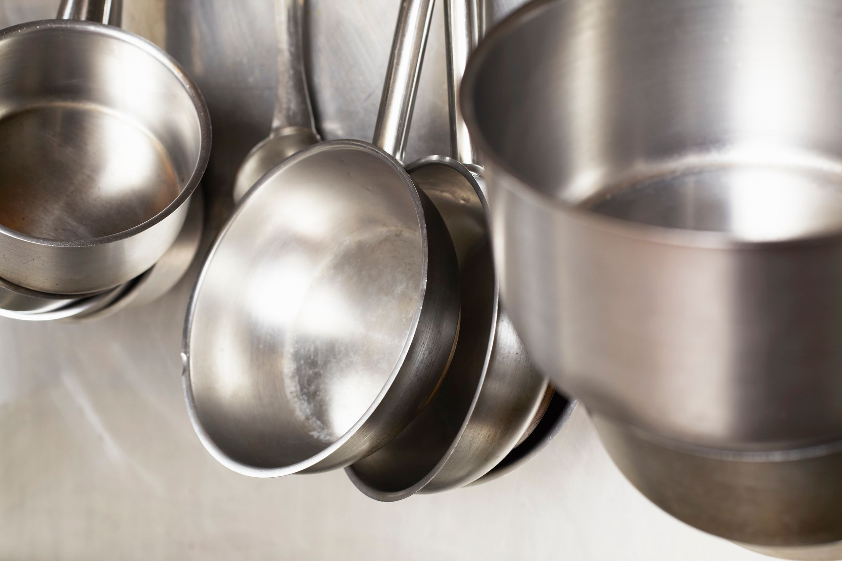
2. WHAT EQUIPMENT DO YOU NEED?
Starting a food business doesn’t mean you need a professional kitchen on day one. Many women start with what they already have and gradually invest as their business expands. This section helps you think through the tools, equipment, and supplies you’ll need to safely and efficiently produce, package, and sell your food without overspending.
Start with what you already own. Before you buy anything new, take stock:
What pots, pans, baking trays or knives do you already use?
Do you have a blender, stove, or oven that works well?
Can you use your dining table for prep or packing?
Are your tools in good condition and easy to clean?
Tip: Keep business use separate when possible — dedicate certain utensils or containers just for your food business.

Slide 22
2. WHAT EQUIPMENT DO YOU NEED?
Different types of food require different tools. Here are common categories:
For dry food or preserves (e.g. spice blends, chutneys, sauces):
Large pots for boiling or preserving
Weighing scale for portioning
Blender or grinder (for spices, pastes, etc.)
Funnel, ladles, mixing bowls
Glass jars, bottles, or resealable food-safe pouches
Labels (handwritten or printable)
For baking:
Baking tins, trays, piping bags, spatulas
Electric hand mixer or stand mixer Measuring cups, digital scale
Oven thermometer
Cooling racks
Airtight containers or boxes for transport

Slide 23
2. WHAT EQUIPMENT DO YOU NEED?
Different types of food require different tools. Here are common categories:
For catering or hot food:
Large cooking pots, tandoors, rice cookers, slow cookers
Heat-proof containers for delivery
Thermometers (to ensure food stays hot/cold)
Reusable or compostable packaging
Large prep boards, serving utensils
Insulated food bags (for delivery or markets)
Useful:
Label printer or inkjet printer
Vacuum sealer (for freshness)
Delivery scales (for calculating postage)
Storage shelving or racks
Laminator

Slide 24
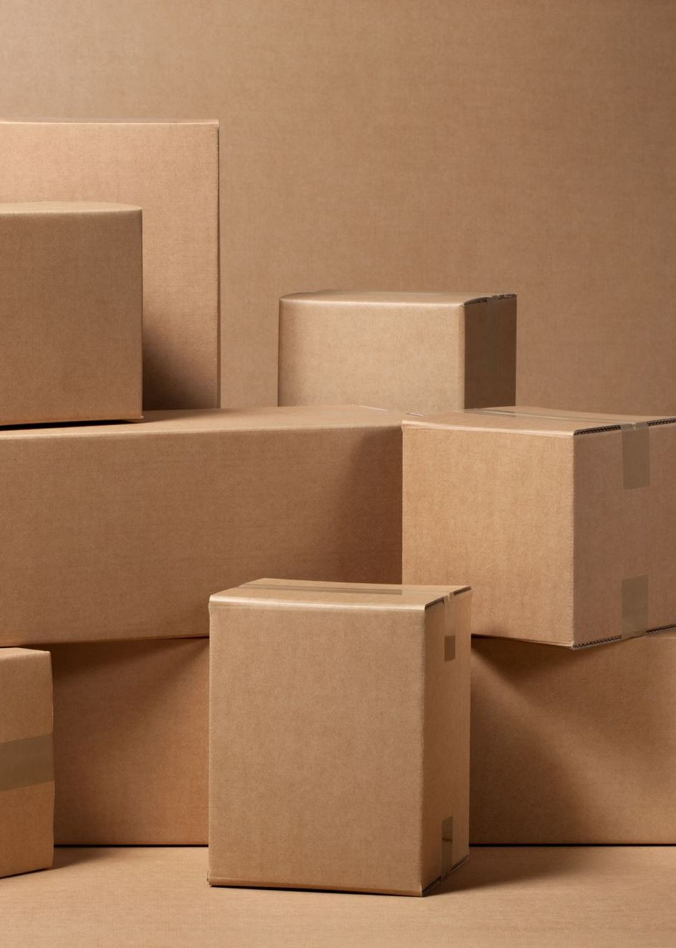
2. WHAT EQUIPMENT DO YOU NEED?
Packaging
Packaging is a crucial part of your food business for protecting your product, building trust, expressing your cultural identity, and standing out in the market.
Why Good Packaging Matters
Food Safety: Keeps your product fresh, clean, and uncontaminated
Legal Compliance: Helps meet food safety laws (e.g. labelling, sealing)
Branding: It tells your story before someone even tastes your food
Transport-Ready: Strong enough to survive delivery or a market day
Customer Experience: Looks professional and builds trust

Slide 25
2. WHAT EQUIPMENT DO YOU NEED?
Types of Packaging Based on Product
Hot/Prepared Food (Catering/Delivery)
Eco-friendly takeaway containers (cardboard, compostable plastic)
Thermal bags or foil lining for heat retention
Tamper-evident stickers for customer trust
Separate compartments for sauces, bread, rice, etc.
Baked Goods
Cardboard boxes with inserts (for pastries/cakes)
Compostable bags or clear biodegradable wrappers
Greaseproof paper inside to prevent oil stains
Strong base for stacking or display
Spice Blends, Dry Mixes, Teas
Resealable kraft paper pouches with a window
Zip-lock foil bags
Small glass or PET jars with screw lids
The label area should be flat and visible
Jams, Chutneys, Sauces
Glass jars with airtight lids
Heat-sealed lids for shelf safety
Safety labels/tamper-proof seals

Slide 26
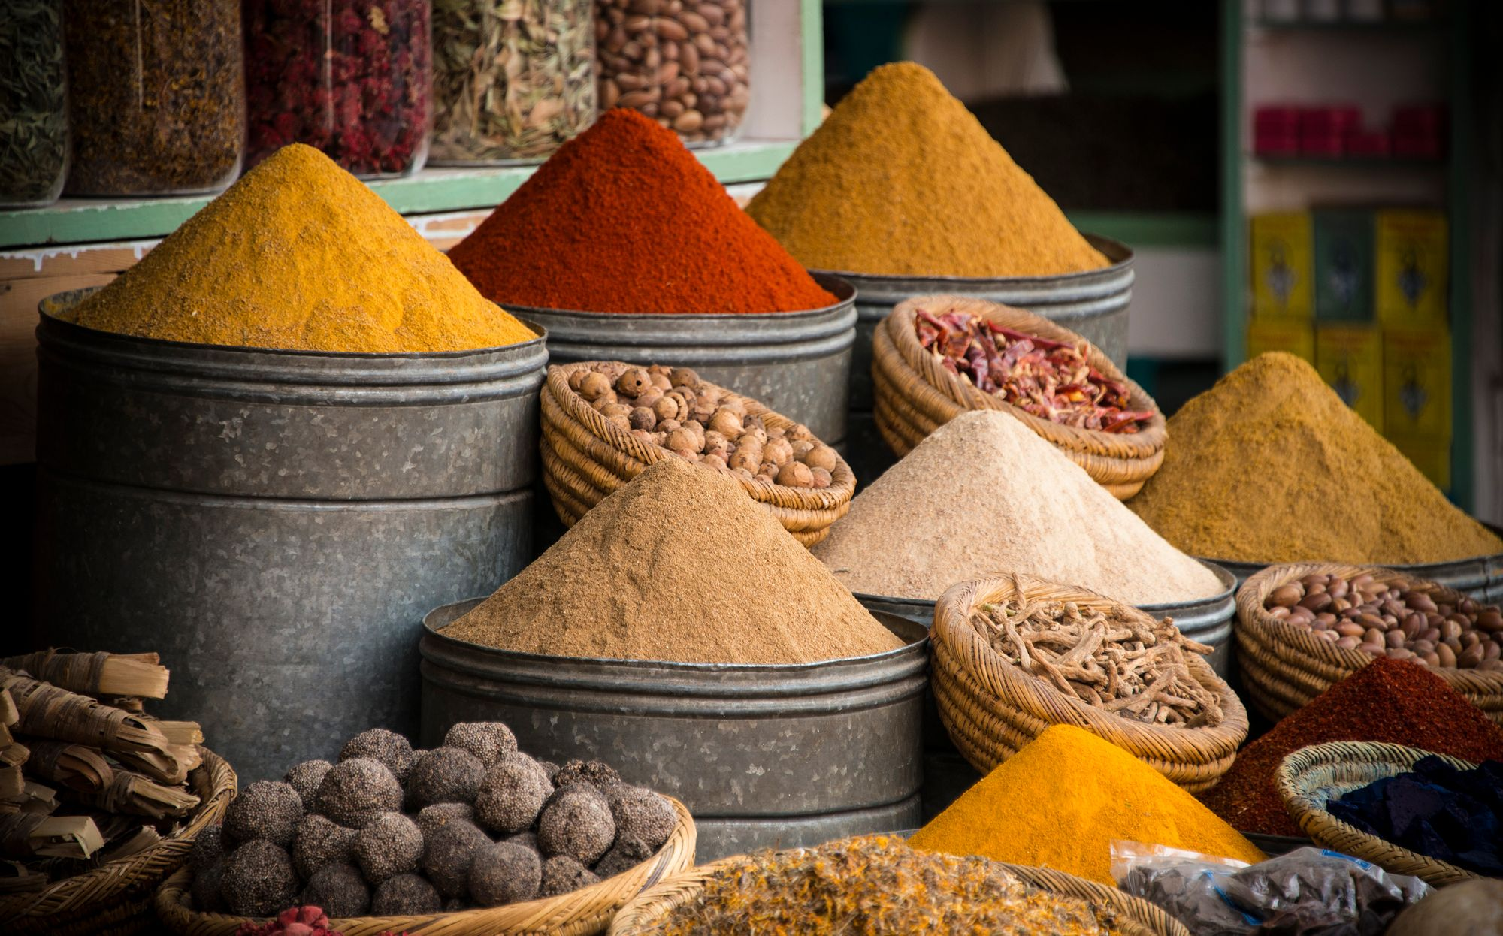
3. Where to get your ingredients and supplies
Sourcing Locally, Sustainably, or Culturally
What you cook is shaped by what you can access and how you choose to source it. Whether you're making food from your homeland or creating a fusion of local and traditional ingredients, how and where you shop is part of your business story.
Key Goals When Sourcing:
Reliable quality - Fresh, safe, and consistent
Fair pricing - Affordable now and scalable as you grow
Authenticity and Trustworthy Suppliers -True to your cultural roots or chosen cuisine
Sustainability — If possible, lower waste and support local ecosystems

Slide 27
3. Where to get your ingredients and supplies
Types of Suppliers You Can Consider
1. Local Markets & Farmers
Great for fresh produce, herbs, eggs, and even honey or grains
Often more flexible for small orders
Builds connections in your local area
Ask about bulk discounts or "imperfect" items at a lower price
2. Ethnic Grocery Stores
Essential for cultural ingredients (e.g. injera flour, tamarind paste, plantains)
Help keep your recipes authentic
Many also supply packaging or spices in bulk
3. Wholesale Cash & Carry Shops
Larger quantities at lower prices (like Metro, Makro, Suma, etc.)
Need a business registration to access some
Good for dry goods, oils, baking ingredients, packaging
4. Online Food Suppliers
Useful if local access is limited (especially for rare ingredients)
Watch shipping costs — bulk may save money
Always check for EU-approved food safety practices

Slide 28
3. Where to get your ingredients and supplies
Questions to Ask When Choosing Suppliers
Is this product safe and allowed to be used in my country for resale?
Will the quality be consistent (taste, texture, freshness)?
What are the minimum order amounts? Is it available in small amounts, or must I buy large quantities?
Can they order specific products for you on request?
Does this ingredient match the story I want to tell with my food?
Can I trust this supplier with delivery and reliability?
Are prices fair — and stable over time?
Do they offer credit terms or payment flexibility?(Can you pay a week later if needed? Are they open to small business arrangements?)
Are they friendly and supportive of small, migrant-led businesses? Will they treat you with respect and be open to learning about your ingredients?
Can you build a good relationship over time?

Slide 29
4. How Will You Stay Legal and Safe?
When people eat your food, they are trusting you with their health. Your job is to keep that food safe, from your kitchen to their hands. You must prepare for
Food Hygiene & Safety Training
Most EU countries require you to complete a basic food safety course, often called a “Food Handler’s Certificate” or “HACCP training.” These are usually available online, low-cost or free, and in multiple languages. Some councils or migrant centres even offer them for free to small business starters.
Search “food safety course + your city/country” to find local options
Registration of Your Food Business
You must register your food business with the local authority, even if you work from home or do it part-time. This is usually free or low-cost but must be done before you start selling. Authorities may inspect your kitchen, it’s not to catch you out, it’s to keep you safe and guide you.
In Sweden, this is done through Swedish Food Agency (Livsmedelsverket): France, through the DDPP; Ireland, through the HSE; and Netherlands through the Netherlands Food and Consumer Product Safety Authority (NVWA)

Slide 30
4. How Will You Stay Legal and Safe?
When people eat your food, they are trusting you with their health. Your job is to keep that food safe, from your kitchen to their hands. You must prepare for
Food Hygiene & Safety Training
Most EU countries require you to complete a basic food safety course, often called a “Food Handler’s Certificate” or “HACCP training.” These are usually available online, low-cost or free, and in multiple languages. Some councils or migrant centres even offer them for free to small business starters.
Search “food safety course + your city/country” to find local options
Registration of Your Food Business
You must register your food business with the local authority, even if you work from home or do it part-time. This is usually free or low-cost but must be done before you start selling. Authorities may inspect your kitchen, it’s not to catch you out, it’s to keep you safe and guide you.
In Sweden, this is done through Swedish Food Agency (Livsmedelsverket): France, through the DDPP; Ireland, through the HSE; and Netherlands through the Netherlands Food and Consumer Product Safety Authority (NVWA)

Slide 31
4. How Will You Stay Legal and Safe?
Food Labelling Rules
If you package your food (jars, bags, boxes), your label must include:
Product name
Full list of ingredients (in order of quantity)
Allergens clearly marked (e.g. contains: milk, wheat)
Best before or use-by date
Net weight
Your name/business name & contact info
Country of origin (if not local)
Optional but helpful: storage instructions, reheating tips, a small cultural story.

Slide 32
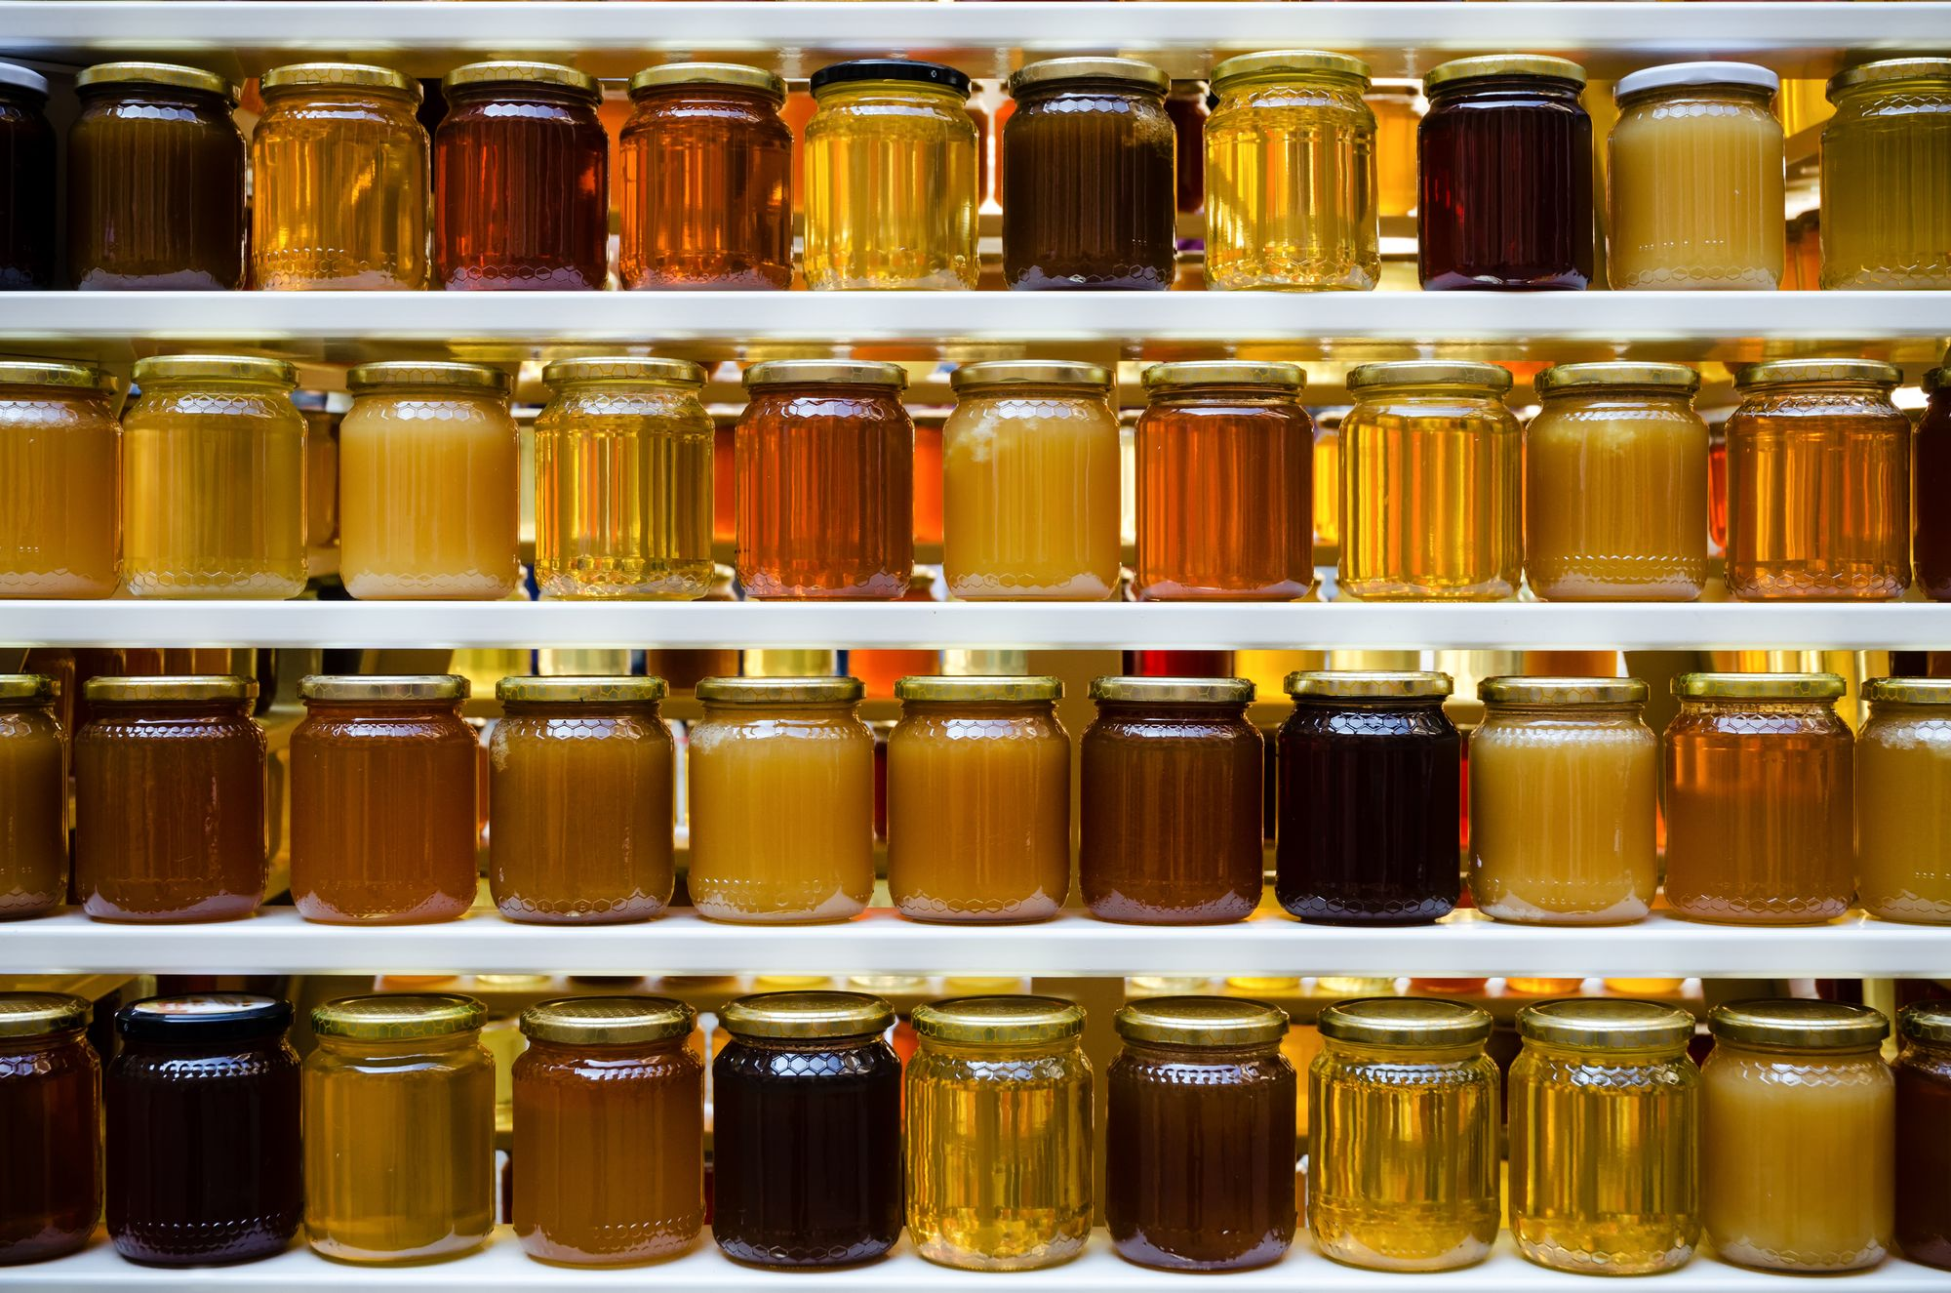
5. How Will You Package & Store Your Food?
Once your food is made, it needs to be protected, presented, and preserved, whether it’s being sold at a market, delivered to a neighbour, or shipped across borders. The right packaging and storage plan helps your food stay safe, legal, and appealing to customers.
Why It Matters:
Protection — Prevents spoilage, spills, and damage
Compliance — Meets EU food safety and labelling laws
Branding — Makes your product look professional and special
Storage — Keeps your food fresh and organized until it’s sold
Packaging Considerations. Choose packaging that is:
Food-safe, Sturdy enough for handling and delivery
Attractive and brand-appropriate
Suitable for the type of food (dry, liquid, fragile, etc.)
Eco-conscious if possible (recyclable, compostable)

Slide 33
6. How Your Process Works
Planning Your Food Supply Chain and Daily Operations
Once you know what you’re selling and where you’re selling it, you need a clear plan for how it all happens , step by step. This is your supply chain and production plan, from sourcing ingredients to cooking, packaging, and delivering.
This section helps you stay organised, save time, and prepare for surprises.
Your Food Supply Chain
Includes everything that happens from the moment you buy your ingredients to the moment your customer receives the final product. A simple example:
Buy ingredients from a supplier
Prepare the food in your kitchen
Package and label it safely
Store it in a cool, clean space
Deliver it to the customer or where you will sell it
Get feedback and payment
Ask yourself:
What steps happen each day/week?
Where could there be delays or bottlenecks?
Do you rely on any one supplier or tool too much?
Production Timeline
How long does it take to produce your food? This includes:
Sourcing ingredients (1–2 days?)
Prep and cooking time (2 hours? 8 hours?)
Cooling, packaging, and labelling
Delivering or storing
You should also plan for:
Rush orders: Can you increase production quickly?
Delays: What if your key ingredient is out of stock?
Scaling up: What if you get a large order, can you handle it?

Slide 34
6. How Your Process Works
Planning Your Food Supply Chain and Daily Operations
Production Feasibility
Link this to your market research:
Does the product match what customers said they wanted?
Can you make enough to meet demand without burning out?
Is your pricing realistic for your production time and costs?
If something takes too long or costs too much to make, it may not be feasible, or you may need to simplify.
Vulnerability: What Could Go Wrong?
Think ahead about potential problems:
Supplier doesn’t deliver on time
Oven or fridge breaks
Packaging runs out
A personal emergency keeps you from cooking
Ask yourself:
How would I manage the risk? (Back-up supplier? Emergency batch?)
Would it stop me completely or just slow me down?
How can I explain delays professionally to customers?
💡 Have a simple Plan B ready for your most important steps.

Slide 35
STOCK & MATERIALS - WHAT YOU NEED TO CONSIDER
Stock Turn-Over: At what rate will you need to restock your supplies? This is an important figure used in assessing the sales strength of your business.
Special Stock Requirements: Do you have a plan for dealing with stock requirements seasonally?
This includes a plan for lead-time ordering.
Stock Control: You will have to establish a plan for monitoring and controlling stock. Do not forget stock = your cash so be very careful to manage this very tightly.
Payment Terms: Be very clear of the basis of the supplier-purchaser relationship. What are their terms of payment? What are their terms of delivery?
Back-Up Plan:
It is important to have a back-up plan in the event you lose a supplier or the supplier is unable to meet your requirements. This could include options of alternative suppliers.

Slide 36

QUALITY – A HIGH PRIORITY
Because your food is your reputation.
In a small food business, quality is everything. People won’t just remember how your food tastes — they’ll remember how it made them feel.
When customers feel that they can count on the consistent quality of your products, they're more likely to give you their repeat business.
Consistent quality takes hard work, attention to detail and systems for monitoring and assessing whether your products meet the standards you have set.
Quality control is an ongoing process that touches everything from purchasing to production to distribution.

Slide 37
TERMS OF BUSINESS - WHAT YOU NEED TO THINK THROUGH
This is a really important area to get right from the start. Your terms of business outline the important details that you share with customers before they purchase to ensure mutual understanding.
  Sometimes called T&C (terms and conditions) - they cover
PAYMENT TERMS - your decisions on when a customer pays- is it on a prepayment basis, cash on delivery, 15- or 30-days credit, any late payment penalties ?
DELIVERY ARRANGEMENTS - free delivery or delivery costs ?
GUARANTEE - on your work offers reassurance, even if it is broad. E.g. we offer a 30 day money back guarantee on all nonperishable items. Perishable items may not be returned.

Slide 38
TERMS OF BUSINESS - WHAT YOU NEED TO THINK THROUGH
  Sometimes called T&C (terms and conditions) - they cover
DELIVERY TIMELINES – Set out your expected dates of delivery from the time of order
REFUND OR RETURN POLICIES –
- Ecommerce sites usually give this policy its own webpage. If you
sell products online, you can place these policies in your T&C too.
- Retailers normally maintain separate return or refund policies.
- For service businesses, a return or return policy depends on
your service
PRIVACY STATEMENT - If you handle personally identifiable information, you need a Privacy Policy. It is still recommended to reference confidentiality in your T&C, but you'll still need a separate Privacy Policy as well. This section does not have to be long.

Slide 39
NEED HELP?
  While you may be setting up your business as a one woman show, you may need to plan for taking on key staff to help you in the business. This might be a staff member or a freelancer or independent contractors to help you carry out business functions.
If you need staff from the outset, think about your Startup Team:
Who is part of your startup team?
What will be their primary area of responsibility? Describe what you understand their role and duties to be and explain how they are qualified or competent for these duties.
What will they cost your business and can you afford to take them on?

Slide 40
05
The Legal Part of Getting into Business

Slide 41
CHOOSING HOW YOU SET UP YOUR BUSINESS IS AN IMPORTANT STEP..
  In this section, we introduce you to key enterprise structures and your options. It is important you understand the laws at local, state, and federal level when setting up your new business.
  Business ventures can be structured in several ways, but typically there are three legal forms.
  Sole Proprietorship
  Partnership
  Limited Company
  We then introduce you to some interesting and emerging business structures.

Slide 42
SOLE TRADER
  Most women starting a food business begin as a sole trader — the simplest and most flexible legal setup. You can run your business on your own, from your kitchen or a market stall, without needing partners or a company structure.
  What Is a Sole Trader?
  Being a sole trader means:
  You own and run the business yourself
  You keep the profits
  You are personally responsible for the business (debts, taxes, etc.)
What You Need to Do (Depending on Your Country)
You usually need to:
Register as a sole trader with your local business authority
Apply for a tax number or VAT number (if your income is above the limit)
Register your food business with your local food safety office
Keep track of your income and expenses
Report earnings once a year (simple tax declaration)
REGISTER ..
Sweden: verksamt.se
Netherlands: www.kvk.nl
Ireland: ROS Registration
France: Guichet des formalités des entreprises | Service-Public.fr

Slide 43
SOLE TRADER
  What About Taxes?
  As a sole trader:
  You pay tax on your profits (not on your total sales)
  You can deduct business costs (ingredients, packaging, labels, etc.)
  You may need to charge VAT if you pass the income threshold
  You are responsible for keeping receipts and records
  Risks to Know
  If your business has debts or problems, you are personally responsible — there’s no legal separation like with a limited company
  You should keep business money separate from your personal money
  Get product liability insurance

Slide 44
A BUSINESS PARTNERSHIP
A partnership is when two or more people run a business together and share the profits. You might consider starting a food business with a friend, a relative, or someone who has skills you don’t. For example:
One of you loves cooking, the other is good at managing money
One speaks fluent local language, the other knows the recipes and traditions
One wants to sell in person, the other builds an online shop
When it works well, a partnership can bring support, energy, and shared success.
Why Start a Partnership?
You can share the costs, risks, and responsibilities
You bring together different talents (e.g. marketing, cooking, design)
You don’t have to do everything alone, it can feel safer and stronger
You may be able to grow faster with two people’s time and ideas

Slide 45
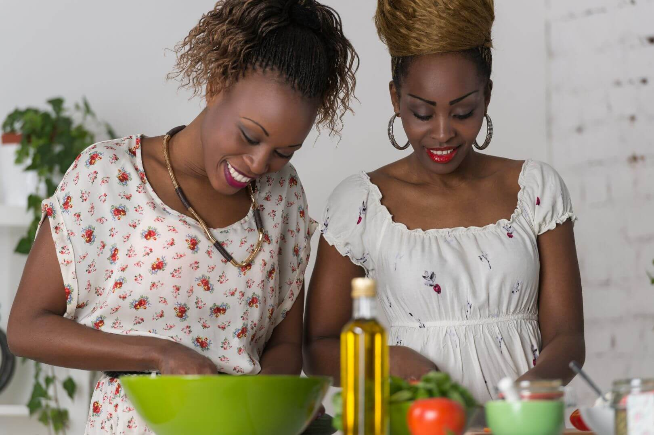
A BUSINESS PARTNERSHIP
But Choose Carefully. Not every partnership is a good idea.
Many small businesses fail because the partners did not agree, on money, on direction, or on effort. Ask yourself:
Do we have the same values and goals?
Can we talk honestly when there’s a problem?
Are we both ready to work hard and commit?
What happens if one person wants to leave?
Protect Yourself with a Partnership Agreement
Before starting, write down:
Who does what
How profits (and costs) are shared
Who decides on pricing, suppliers, or big changes
What happens if one person wants to stop or the business closes
This is called a Partnership Agreement. You don’t need a lawyer, but it’s wise to put your agreement in writing, even for friends or family.

Slide 46
LIMITED COMPANY- a separate legal entity
A limited company is a type of business that is legally separate from you as a person. This means the company has its own name, its own bank account, and its own responsibilities.
If something goes wrong, like the business owes money or is sued, only the company’s assets are at risk, not your personal money or belongings (as long as you followed the law and didn’t give a personal guarantee).
  Why Choose a Limited Company?
  Your personal money, house, or belongings are protected
  It can make your business look more professional and trustworthy
  Some large customers or shops will only work with companies
  It may help if you want to grow, hire staff, or attract investors
  What You Need to Know
  It’s more work than being a sole trader; you must file accounts every year and follow more rules
  You must register the company officially (with your country’s business register)
  You will need to open a business bank account
  You may need help from a bookkeeper or accountant

Slide 47
OTHER INTERESTING WAYS TO GET INTO BUSINESS
1. Social Enterprise
A business that sells goods or services (like any other business) but uses its profits to do good in the community or for a social cause. Food Examples:
A catering company that trains migrant women e.g Marie Curry - Traiteur et Restaurant Solidaire
A food stall that donates meals to families in need
A business that supports farming co-ops in your home country
2. Community Enterprise
Often run by a group of people to meet the needs of their neighbourhood or town. It may involve food, services, or local events, and profits are typically reinvested into the local area.
Examples in food:
A shared kitchen for local cooks
A food hub that connects migrant producers to buyers
A low-cost community café run by volunteers
  Here are some interesting business structures that may support your business start-up in a more creative way:
  Social Enterprise
  Community Enterprises
  Collectives
  Social Innovation

Slide 48
OTHER INTERESTING WAYS TO GET INTO BUSINESS
3. Collectives
A group of people working together with shared values and equal say, no bosses, just joint decision-making.
In food, this might look like:
A team of women from different cultures sharing one market stall
A group kitchen with shared tools and booking times
A storytelling + food pop-up event created by many voices
4. Social Innovation
Social innovation means using new ideas to solve old problems, especially in creative or cultural ways.
In food, this could be:
A “pay-what-you-can” food box
A recipe club that teaches language and cooking at the same time
  Here are some interesting business structures that may support your business start-up in a more creative way:
  Social Enterprise
  Community Enterprises
  Collectives
  Social Innovation

Slide 49
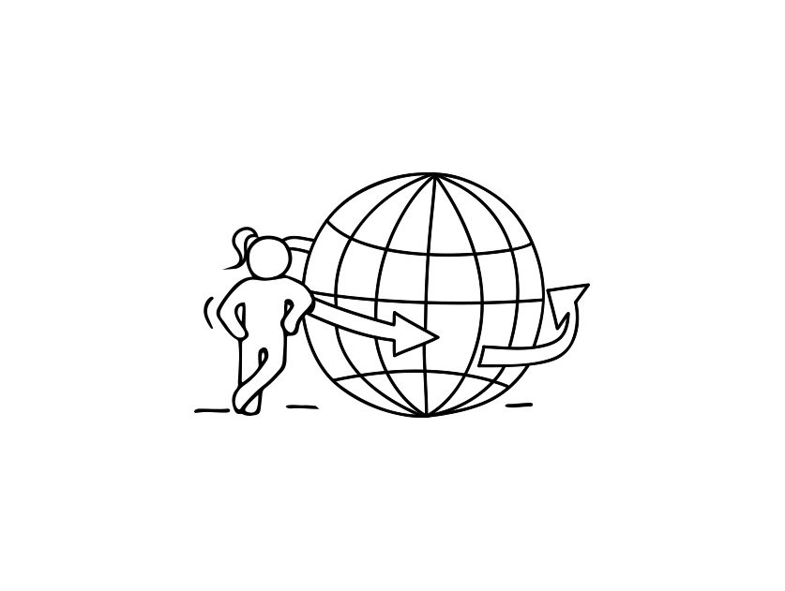
02
Start through Online Marketplaces

Slide 50
START THROUGH ONLINE MARKETPLACES
These Platforms Work Well For:
Preserved food products - items that are shelf-stable, easy to package, and safe to ship such as:
Jams and preserves, pickles and fermented vegetables
Spice blends and dry rubs
Baking mixes or traditional dry snacks
Online cooking classes or virtual food experiences
Sell your knowledge instead of a product! These can be:
One-off or recurring online cooking classes
Workshops focused on a dish or festival food
Virtual cultural food experiences — storytelling, recipes, and cooking together
Cultural storytelling through food
Platforms like Etsy and Instagram are perfect for:
Sharing your heritage through recipe cards, digital cookbooks, or downloadable meal plans
Selling food-related crafts or gifts (e.g. spice kits + recipes)
We are living in an exciting time for food entrepreneurs. The way people buy and discover food has evolved, more customers are looking online for unique, homemade, and culturally rich food experiences.
This means you don’t need a shop or a market stall to begin. From your own kitchen, you can start small and reach customers both locally and across the EU.
Platforms make it possible for a woman in Portugal to sell her handmade hot sauce or spice blends to a customer in Belgium — all from home.
Make sure to follow your country’s food safety and labelling regulations.

Slide 51
ONLINE MARKETPLACES
In this section, you will:
Learn what is an Online Marketplace
Explore the benefits of Online Marketplaces and how they differ from independent ecommerce sites.
Spotlight on the main Online Marketplaces and the Pros/Cons of each
What you need to sell through an Online Marketplace

Slide 52
WHAT IS AN ONLINE MARKETPLACE AND WHY IT MIGHT WORK FOR YOU?
An online marketplace is a website where many different sellers can list and sell their products or services, like a digital version of a market or bazaar. You don’t need your own website or tech skills. You simply create a profile, list your product, and the platform connects you with potential buyers.
Why Use an Online Marketplace?
Benefits:
Low cost to get started — no need to build your own website
Access to ready-made audiences who are already browsing and shopping
Built-in tools for shipping, payments, and customer messages
You can start small and grow at your own pace
Compared to Independent Ecommerce Sites:
Online marketplaces give you visibility right away, while a personal website takes time (and money) to attract visitors
Marketplaces handle some of the technical details for you (payment, listings, etc.)
Your shop is part of a larger ecosystem, which helps build trust with customers

Slide 53
SPOTLIGHT ON MARKETPLACES FOR TO CONSIDER
Platform | Good For | Pros | Cons
Etsy | Handmade and specialty food products | Easy to use, strong community, good for storytelling | Fees, limited to certain food types
Amazon Handmade/FBA | Scalable, shelf-stable packaged foods | Huge customer base, optional shipping support | High competition, strict food compliance requirements
Facebook Marketplace | Local dry goods or promoting food experiences | Free to list, great for testing ideas locally | Limited to your region, self-managed orders/logistics
eBay | Non-perishable food items | Well-known platform, global reach | Less focused on artisanal food, buyer trust can vary
Local/National sites | Regional specialty products | May support local food makers (e.g. Marktplaats NL) | Varies by country and food laws

Slide 54
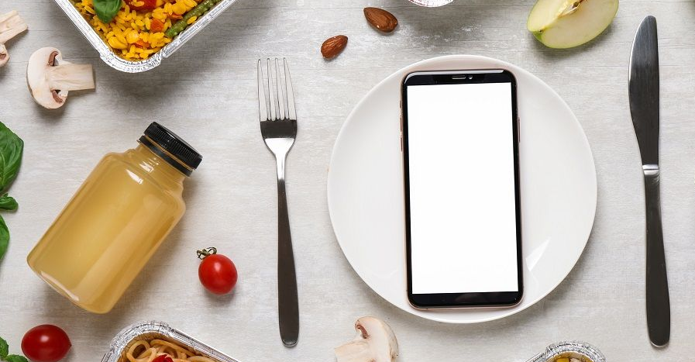
SELLING ON MARKETPLACES
Before listing your product or service, make sure you have:
✅ A product that’s legal and safe to ship (check local food laws!)
✅ Clear labels with ingredients, allergens, and expiry dates
✅ Good photos that show your product in an appealing way
✅ A short but warm story or description — people love to know where the food comes from and who made it
✅ A way to package and post your product safely and affordably

Slide 55

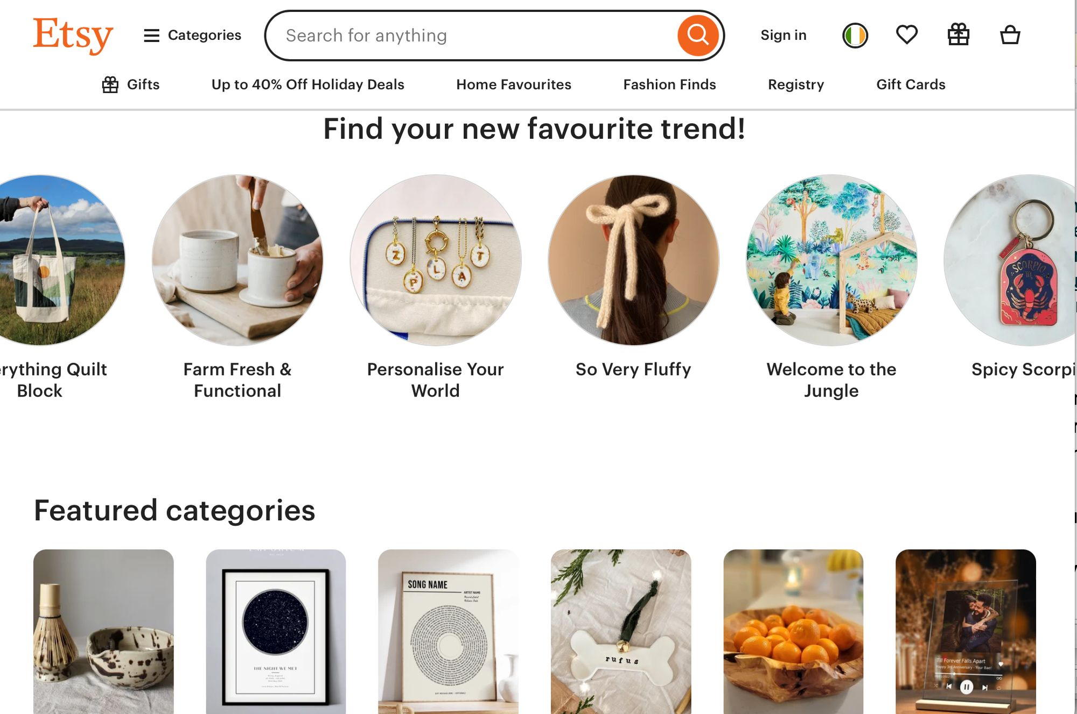
Etsy
Etsy is a global online marketplace that celebrates handmade, small-batch, and creative goods. It’s designed for people who want to buy and sell with meaning, products with stories, culture, and personal connection.
For women starting out in food, Etsy can become the heart of your business. Etsy says it best: “We help our community of sellers turn their ideas into successful businesses.”
Millions of buyers visit Etsy in search of something unique, something crafted with care, not mass-produced. They want:
Flavours with a story
Hand-labelled jars and spice kits
Beautiful food gifts that feel personal and thoughtful
Click to View

Slide 56
Etsy
  Esty Advantages
  Supports Handmade & Cultural Product - Perfect for jams, spice blends, teas, baked goods, and dry snacks that reflect cultural roots.
  Low Cost to Start - Listing fees are minimal (around €0.20 per item).
  No need to build a website - Etsy provides the shopfront.
  Your Story Matters - Etsy is built for creatives and storytellers, your food’s origin, family recipe, or tradition becomes part of the product.
  Niche Audience - That values quality over mass production. People shop on Etsy to find things they can’t get in big shops. You can sell across the EU, as long as you comply with food and shipping regulations.
  Etsy Disadvantages
  Food Must Be Shelf-Stable - No fresh, frozen, or perishable food is allowed. Only dried or preserved goods are accepted. You must check if your product qualifies.
  You Handle Shipping & Packaging - You’re responsible for safe, attractive, and regulation-compliant packaging.
  Shipping costs can affect your profit margins.
  Fees Add Up - Etsy charges listing fees, transaction fees, and payment processing fees, it’s important to price carefully.
  EU food safety, hygiene, and labelling laws (ingredients, allergens, shelf life, etc.).This can vary slightly depending on your country.
  Visibility Can Be a Challenge at First - As a new seller, you need to stand out.

Slide 57
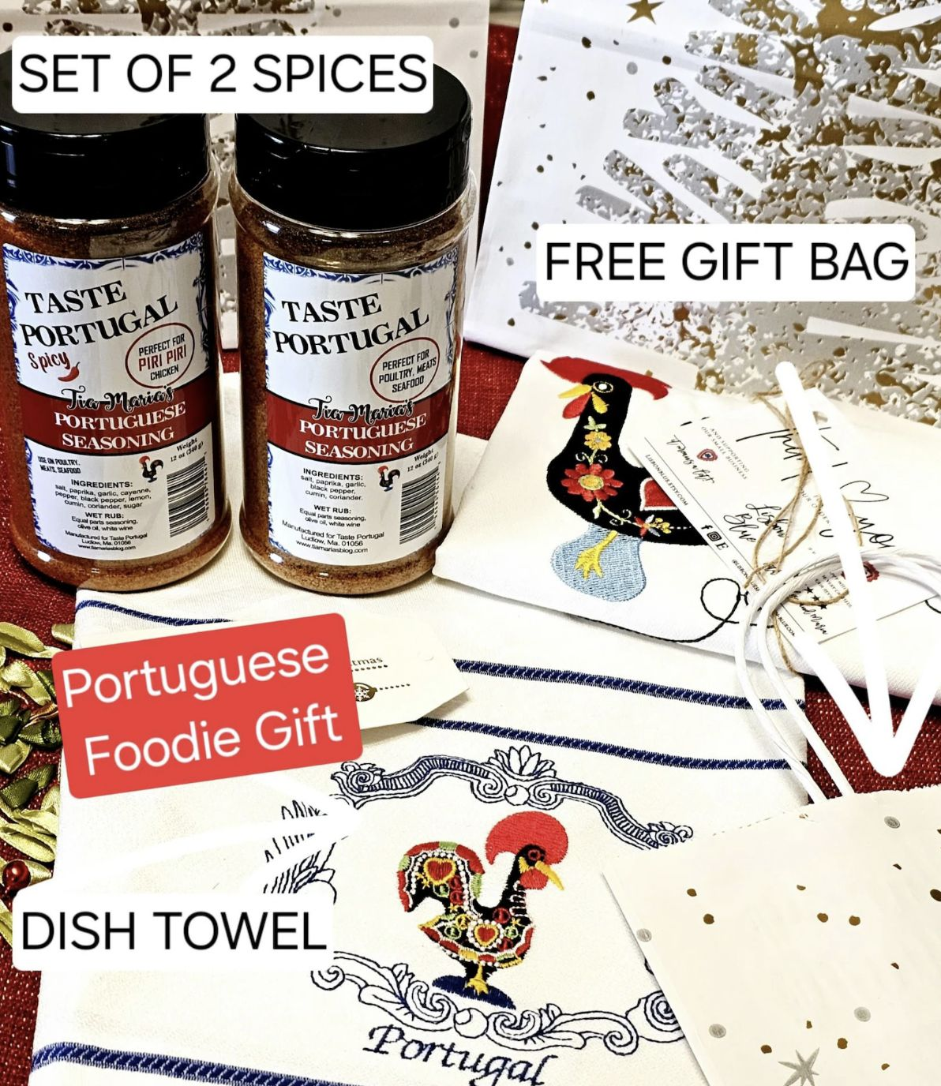
Etsy - An Example
Portuguese Piri Piri Spice Mix
This handcrafted spice blend brings the fiery flavors of Portugal to kitchens across Europe. Made with traditional ingredients, it's perfect for seasoning meats, vegetables, or adding a kick to sauces.
Portuguese Spice Seasonings, Piri Piri Chicken Spice Mix, Spicy Portuguese Blend, Portugal Spices, European Spices, Portugal Dish Towel – Etsy
READ: How to Sell Spices on Etsy - Marketsy
Afghan Refugee Women – Etsy Uplift Makers Program
Although not food, this is very interesting. Etsy's Uplift Makers Program has supported Afghan refugee women in launching over 20 Etsy shops featuring home textiles created using traditional Afghan needlework techniques. Asila, a mother of two and a member of the collective, expressed her gratitude: “I am so thankful for this opportunity to sell my products online. As my business grows, I hope to teach and employ other refugee women to make their own products and support themselves.”
READ MORE Etsy Welcomes Afghan Refugees to the Uplift Makers Program

Slide 58
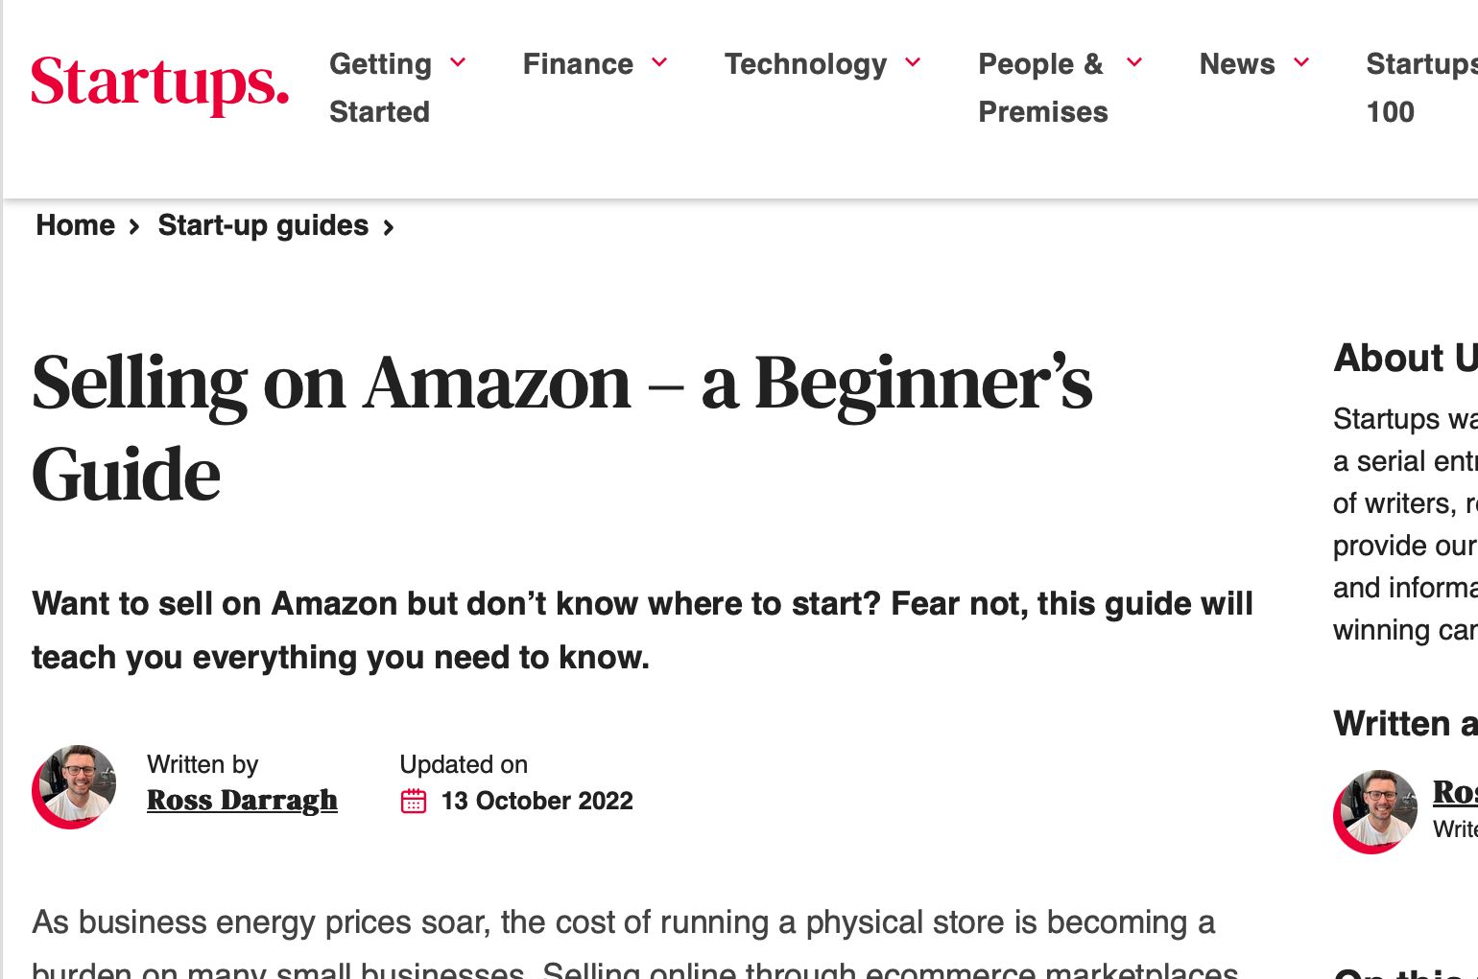
AMAZON MARKETPLACE
  The power of the Amazon.com e-commerce platform is hard to absorb. Millions of third-party sellers use Amazon Marketplace as a platform to facilitate anyone to sell directly to the end-user or online customer.
  Amazon takes a referral fee from each sale. The seller takes on merchandising responsibilities and manages their prices.
  FIND OUT MORE- How to start an Amazon Marketplace business
Click to View
  TIP - Amazon is best suited for those who want to scale up. If you're just starting out, consider testing your product on local platforms or Etsy first

Slide 59
AMAZON MARKETPLACE
  Amazon advantages
  Massive Customer Reach - Amazon has millions of active users across the EU. Ideal for shelf-stable or scalable food products (e.g. tea blends, sauces, dry snacks).
  Fulfilment by Amazon (FBA) handles packing, shipping, and customer service. Saves time and removes the pressure of managing logistics alone.
  Built-in Trust & Infrastructure - Customers trust Amazon for fast, reliable service. The platform provides seller dashboards, data, and tools to track sales and performance.
  International Reach- Your food product can be sold across different EU countries (with correct labelling and compliance).
  Amazon challenges
  Free membership features are limited and come with high listing fees
  Major competition. Amazon has a lot of merchants you’ll have to compete with.
  Depending on the situation, you won’t get your money for 14 to 90 days after selling an item.
  Lack of brand development - Individual seller names are not emphasized when purchasing items on Amazon

Slide 60
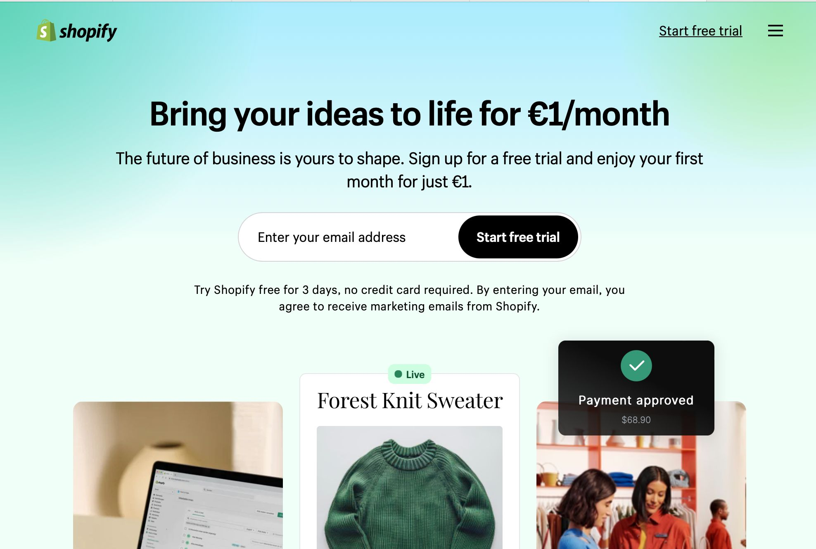
SHOPIFY, an alternative path
  If you are ready to build your own branded food shop online, Shopify is a unique online marketplace because it’s a website builder, but for businesses that want to sell directly to consumer.
With Shopify, you can:
Sell directly to your customers without competing sellers
Design your own shop with templates (no coding needed)
Manage payments, marketing, checkout, and shipping in one place
Start from around €9/month
Explore real food shop examples at:
🌐 www.shopify.com/examples and click food and drink
Click to View

Slide 61
SHOPIFY
  For a monthly fee, the advantages of selling on Shopify are:
  Sell on your website versus a marketplace
  With Shopify, you get a website built for ecommerce companies. For example, you can choose from ecommerce web design templates, which make creating a website and transitioning to selling your site easier.
  Create an online store fast, without a development background
  The design templates, both free and paid, available from Shopify make it possible for anyone to launch an online store. Even if you don’t have a development background, you can confidently create and publish a store for your business.
  Launch Google and Facebook ads from within the platform
  Shopify also includes a built-in feature for advertising your products. Whether you want to launch ads on Facebook or Google, you can do it from within Shopify.

Slide 62
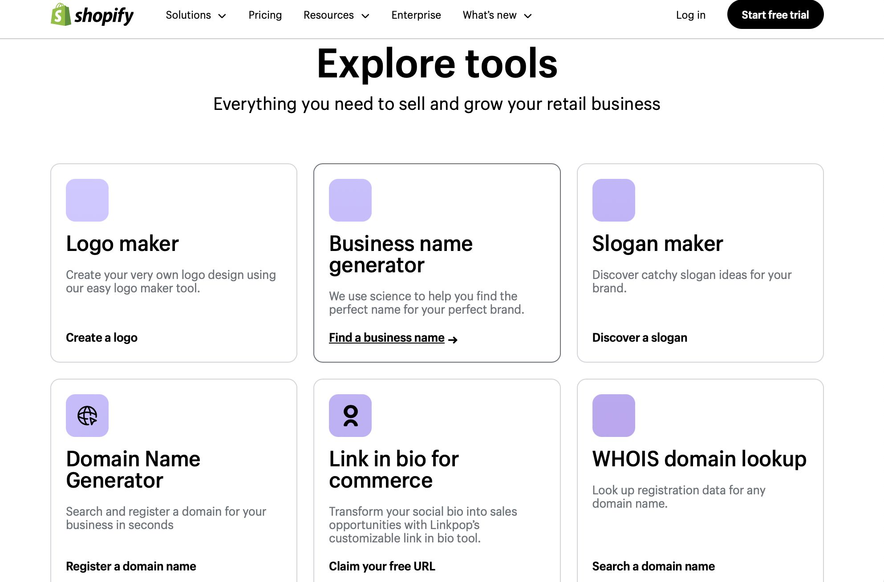
SHOPIFY
  There are many tools in Shopify that will help you launch your business.
Click to View

Slide 63
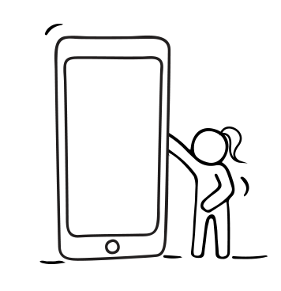

FACEBOOK MARKETPLACE FOR BUSINESS
Has potential — but with limitations.
Why it could work:
It’s free, local, and easy to use.
Good for promoting dry food products, cooking workshops, or meal kits (within legal limits).
You can start with just a phone and Facebook account.
Limitations:
No built-in checkout — you must manage payments and shipping yourself.
Not designed specifically for food — more general.
Trust and visibility are lower compared to Etsy or Amazon.
3 Kitchens Verdict:
A good testing ground for local interest or promoting offers. Can be part of a multi-platform approach, especially for women more comfortable using Facebook.

Slide 64
03
Start up in business with your own website

Slide 65
IMPORTANCE OF YOUR OWN WEBSITE
As your food business grows having your own website becomes a powerful step.
At first, you might sell on Etsy, use Instagram, or deliver to your community. But over time, having a website of your own means:
You Own Your Space: No algorithms, no competition from other sellers on the same page. Your name, your story, your food, in one place.
Builds Trust: Customers feel more confident when they can visit a professional-looking site.It shows you’re serious, organised, and easy to contact.
Tells Your Story: You can share your culture, recipes, photos, and journey, not just a price and product. This is especially powerful when selling cultural or heritage food.
Gives You More Control: You decide the design, the pricing, the shipping, and how customers buy. You can link your website with other platforms, like social media or Etsy, or use it as your main shop.
Better Profit Margins: Selling through your website means no middle platform fees (like Etsy or Amazon charges). You keep more of the money from every sale
Flexible for the Future: Want to add an online cooking class? A blog? A recipe section? You can grow your website as your business grows.

Slide 66
SETTING UP YOUR OWN WEBSITE
1. Use a Website Builder (DIY – beginner friendly)
Create your own website or online store using drag-and-drop tools, no coding needed. Perfect for first-time users or those on a budget.
Examples:
Shopify (great for selling food products)
Wix
Squarespace
WordPress.com
It offers
Low-cost startup
Control your design and content
Step-by-step tutorials available
READ: Top Website Builders for Beginners
  There are
  three main ways to set your website

Slide 67
SETTING UP YOUR OWN WEBSITE
2. Hire a Professional
If you have a budget, you can pay a web designer to build a custom website for you. This option provides a polished, branded site without requiring you to learn the technical aspects. It can be
Time-saving
Tailored to your business goals
Great for growing brands
READ: How to Hire a Web Designer: The "All You Need to Know" Guide
3. Start With a Social Media “Website”
Instagram or Facebook Pages can act like a mini website, a place to promote your food, take orders, and link to other platforms like Etsy.
Free to set up
Great for testing your idea
Builds visibility while you prepare a full site
  There are
  three main ways to set your website
Tip: Start where you are comfortable. You can always grow into a full website later.

Slide 68
6 KEY SECTIONS OF YOUR WEBSITE
This checklist is designed to you prepare content for a warm, effective, and culturally-rich food business website.
1. Homepage
✓ Clear business name and logo
✓ A warm, friendly welcome message
✓ A brief summary of who you are and what you offer
✓ One or two beautiful food or product images
2. About Me/Us
✓ Your story — why you cook, what your food means to you
✓ Cultural or personal background
✓ What makes your business special or different
✓ A friendly photo of you (optional, but builds trust)

Slide 69
6 KEY SECTIONS OF YOUR WEBSITE
3. Products or Services
✓ List of what you sell (e.g. spice blends, preserves, tea)
✓ Short description for each item or service
✓ Pricing and how to order
✓ Product photos — clean, clear, natural light
4. Contact Info
✓ WhatsApp, email, or contact form
✓ Social media links (Instagram, Facebook)
✓ Short response time promise (e.g. 'I’ll reply within 24 hours')
5. Testimonials or Reviews
✓ Quotes from happy customers
✓ A ‘What customers say about us’ section

Slide 70
6 KEY SECTIONS OF YOUR WEBSITE
6. Add Value
✓ Blog or recipe page sharing cultural food stories
✓ Calendar for events, markets, or classes
✓ FAQ section (e.g. ‘Do you ship across the EU?’ ‘Is your food halal/vegan?’)

Slide 71

Next.. Step 4
www.3kitchens.eu

