Slide 1
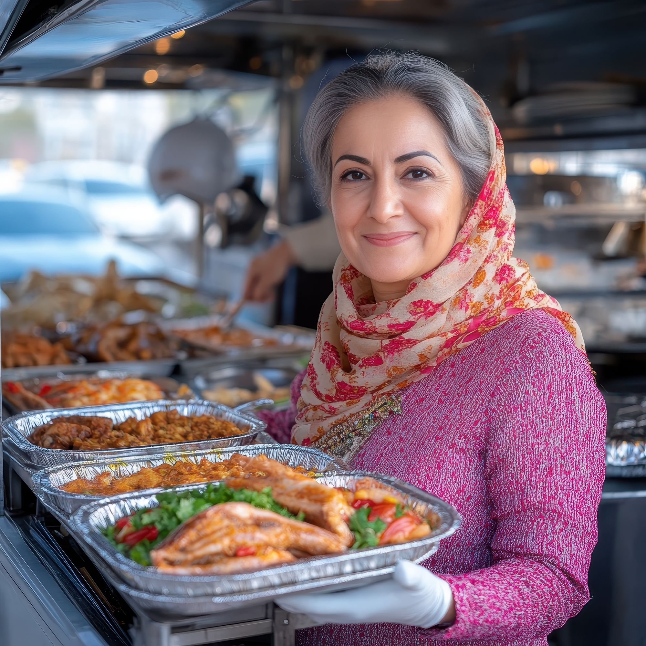
STEP 2.
RESEARCH IN ACTION – PROVE YOUR FOOD BUSINESS IDEA
www.3kitchens.eu

Slide 2
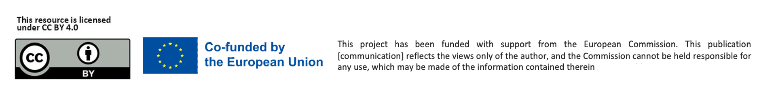
Contents
Why Research Matters
Learn how research helps you avoid mistakes and build a food business that meets real needs.
Your 4 Steps to Test and Qualify Your Food Business Idea
Follow a simple, practical process to shape, test, and refine your idea.
Introduction to Market Research – Practical Approaches
Discover easy ways to learn what your future customers want and need.
Check Out Your Competition
Find out who else is in your space and how your food offer can stand out.
01
02
03
04

Slide 3
Learning Objectives – Step 2: Explore and prove your idea
By the end of Step 2, you will be able to:
By the end of this module, you will be able to:
Understand the value of food-focused market research
Learn how research helps avoid common mistakes, save resources, and create food products that people truly want.
Explore existing solutions in your food niche
Learn how to identify similar businesses and understand what makes your idea different and needed.
Apply practical research methods
Gain hands-on knowledge in using surveys, interviews, focus groups, and observation to collect useful feedback.
Test and refine your food business idea in real life
Discover ways to start small, try your product with real customers, and make changes based on what you learn.
Define your target market
Identify the specific group of people who are most likely to buy and enjoy your food and tailor your offer to them.
Assess if your idea is strong enough to grow
Use everything you've learned — from customer feedback to competitor insight — to decide if your food business idea is ready to move forward, or if it needs adjustments.
​

Slide 4

01
Researching and testing your food business idea is crucial to its success.

Slide 5

WHY RESEARCH MATTERS
Researching and testing your business idea is a very important step.It gives you the chance to make sure your food idea is really needed, and that customers will want and pay for what you offer. Taking time to do this now can save you from difficult problems later on in your adventure.
Research helps you avoid wasting time, money and energy.
Many businesses fail because they rush ahead without checking if there is a real need. Careful research shows you what customers truly want and helps you create something they will value.
Skipping research is like travelling without a map.
If you move forward without testing your idea, you risk getting lost or spending a lot of time and resources going in the wrong direction. Research gives you clear guidance and confidence.

Slide 6

DON’T SKIP THIS STEP
In Step 1, you explored your first food business ideas.
Before moving forward, you now need to validate that your idea is valuable and could become profitable. Think about how you arrived here:
You uncovered a gap in the market — no one is offering the food or food service that you have in mind, in the way you propose
You spotted opportunities through personal experience and observation.
As your idea takes shape, always ask yourself:
What need am I fulfilling?
Will people pay for my solution?
But remember: A gap might exist because no one wants that product. Good research will help you find out if the opportunity is real. It is also important to take into account that each culture has its own, customs, approaches and practices, and it might take time to research and learn how to approach potential clients and target groups in your host country.

Slide 7
EXPLORE WHAT EXISTS
Before you go too far with your food business idea, take time to explore what’s already on the table. You might find that other businesses are offering something similar — and that’s actually a good sign. It means there’s a market for what you’re thinking about, and it gives you a chance to do it differently — or better.
Start by searching online for food products or services like yours. Use simple keywords on Google, YouTube, and social media.
Check out food businesses, pop-ups, food trucks, delivery menus, catering services, and local food brands. Pay attention to what they offer and how they speak to their customers. If something similar already exists, don’t be discouraged.
Ask yourself:
Can I make it tastier, healthier, more affordable, or more convenient?
Could I offer better service, local ingredients, or a new twist on a traditional dish?
Is there a different group of people I could serve, a niche that others have missed?

Slide 8

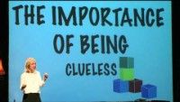
START SMALL, DREAM BIG
Be inspired by Sahar Hashemi, who co-founded Coffee Republic after seeing an opportunity to bring coffee culture to the UK. She had no business experience — just an idea, passion, and the courage to start.
You don’t need to be an expert.
Like Sahar, you can succeed by seeing a need and taking the first step.
Start small, learn as you go.
Success comes from action, not perfection.
Watch her TEDxYouth
talk for more inspiration! ➔

Slide 9

START SMALL, DREAM BIG
RECOMMENDED READING
In Anyone Can Do It, Sahar shares how she turned an idea into Coffee Republic, all without any prior business experience. Her story is a powerful reminder that passion and action can go a long way. It's full of valuable entrepreneurial lessons and real-world insight for anyone starting from scratch.
One standout lesson from Sahar is this: “If you wait until you feel ready, you’ll never do it.”
This mindset helped her take bold steps, even when things felt uncertain, and is a useful reminder for any aspiring food entrepreneur.

Slide 10

02
YOUR 4 STEPS TO TEST AND QUALIFY YOUR FOOD BUSINESS IDEA

Slide 11


4 STEPS TO TEST AND QUALIFY YOUR BUSINESS IDEA
Shape and clearly define your food business idea
Understand why testing your food business idea matters
Test and evaluate your food business idea in real life
Identify and define your target market

Slide 12

STEP 1: SHAPE AND CLEARLY DEFINE YOUR BUSINESS IDEA
Before you can test or develop your food business idea, you need to clearly define it. A strong idea is one you can explain simply and confidently in just a few sentences. Being able to talk about your idea clearly is a key skill for any entrepreneur.
The clearer your idea, the easier it will be for others to understand it and support it. As your business grows, you’ll need to describe it to many different people: customers, suppliers, mentors, banks, and maybe even potential investors.
Want to learn more? Explore The Recipe for a Great Business Pitch: Tips for Food Entrepreneurs, which offers practical advice on presenting your food business idea effectively.

Slide 13
STEP 1: SHAPE AND CLEARLY DEFINE YOUR BUSINESS IDEA
7 KEY TIPS
Keep it short
Identify the problem
Explain your solution
Show the benefit
Describe your food idea in a few clear sentences. Make every word count.
What food need or gap are people in your new community facing?
In one sentence, how does your dish or food service meet that need?
What will your customers gain? A taste of home? Something healthy?
1
2
3
4
Personalise it
Tell your story
Think visually
Link your food idea to your culture, story, or passion. Make it feel real.
Share the story behind your food idea. A true, personal story builds trust.
Use simple graphics, images or examples to make your idea easier to understand.
5
6
7

Slide 14

STEP 1: SHAPE AND CLEARLY DEFINE YOUR BUSINESS IDEA
Simple Approaches to Define Your Business Idea
Try this one-sentence pitch format (from Founder Institute):
My [business name] is developing [food product or service], to help [target group] solve [food-related problem], with [what makes it special or unique].”
Example: “My company, Taste of Home Berlin, is developing a line of freshly prepared Syrian lunch bowls to help office workers in Berlin find quick, healthy meals, with recipes created and inspired by traditional Middle Eastern home cooking.”

Slide 15
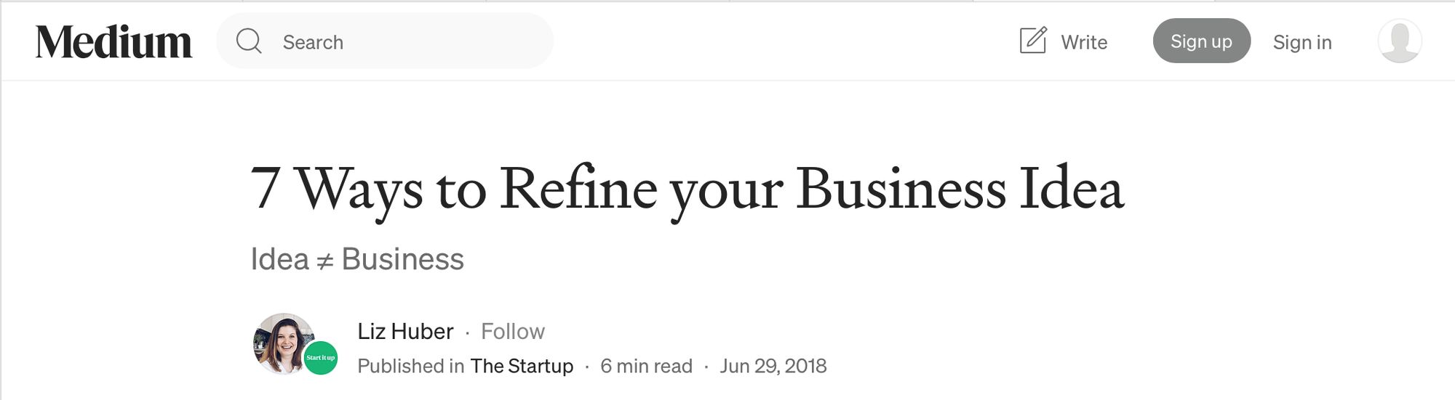

7 Ways to Refine your Business Idea by Liz Huber
Click to View
If you want to explore more ways to shape and strengthen your business idea, this article offers seven clear and practical tips to help you reflect, refine, and move forward.
It’s a useful read before you take your next step.
➔

Slide 16
STEP 2: UNDERSTAND WHY TESTING YOUR IDEA MATTERS
Testing helps you:
See if your idea really meets a need in your community
Learn what people like and, importantly, what they don’t like
Build confidence and improve your offer before investing more
Don’t be afraid to make changes.
Adapting, improving, or starting again isn’t failure. it’s smart. It shows you’re listening, learning, and growing stronger.
Dream big — but test first.
Protect your time, energy, and confidence. A wise food entrepreneur knows
when to say yes, and when to say not yet.
EXAMPLE
In the UK, a group of Syrian migrant women developed a rose cordial inspired by traditional Syrian recipes.
They began by producing small batches and offering samples at local markets and community events to gauge customer interest and gather feedback. This approach allowed them to refine their product based on real-time responses. Their initiative received support from a UK refugee business project, which provided them with resources and mentorship to further develop their business. Through this support, they were able to transition from small-scale testing to a more structured business model, ultimately expanding the availability of their product.

Slide 17
STEP 2: UNDERSTAND WHY TESTING YOUR IDEA MATTERS
  A strong idea is just the beginning…
  What matters next is finding out whether people truly want it and whether they’ll pay for it. This process is called qualifying your idea. It helps you move forward with greater certainty, rather than spending months (or even years) building something that no one needs.
  Ask yourself:
  Who exactly is this for? Who exactly am I cooking or creating this food for? Is it people craving food from home? Curious locals?
  Have I spoken directly to those people and asked what they want? Have I shared samples, listened to feedback, or observed what they buy?
  Is anyone else offering something similar and how is mine different? Am I offering a unique flavour, healthier ingredients, better service, or a cultural story that others aren’t?
  Can this food business bring in enough income to support me — even in a small way at first? What will it take to break even or turn a small profit?

Slide 18
STEP 3: TEST AND EVALUATE YOUR IDEA IN REAL LIFE
There are many practical ways to explore whether your business idea could succeed in the real world. Start by building a clear picture of your customers, your product, and the market around you.
Think about:
Who your paying customer will be.
Where you plan to sell.
What your competition is doing.
How your offer compares.
What makes your food product or service valuable.
What do they need, value or struggle with?
What culinary features or benefits will matter most to your customer?
Define the geographic area you’ll focus on in your first year.
Who else is selling in the same area? What do they charge?
Can you stay competitive on uniqueness?
Why would customers choose you?

Slide 19

STEP 3: TEST AND EVALUATE YOUR IDEA IN REAL LIFE
The clearer and more honestly you can answer these questions, the more confident and ready you'll be to move forward.
You'll be able to spot risks early, make smarter decisions, and explain your idea to others with clarity and purpose.
Do you want more support?
Download this free step-by-step guide from the Local Enterprise Office (Ireland) to help you evaluate your idea in a practical, structured way.
➔ Download the guide

Slide 20
STEP 4: IDENTIFY AND DEFINE YOUR TARGET MARKET
What is a target market?
A target market is a group of people who share similar needs, interests or characteristics that your business is designed to serve.
These are usually the people most likely to buy your food product or use your service.
Focus your time and energy on the customers who are most interested in what you offer
Shape your product or service to better match their real needs and preferences
Create marketing messages that speak directly to the people you want to reach
The more specific you can be about your target market, the better.
You don’t need to and don’t have to reach everyone.
Focusing on a specific group doesn’t mean you’re excluding others… It simply means you’re directing your energy where it’s most likely to lead to sales success.

Slide 21
Mass Market or Niche ?
When starting your business, it helps to understand what kind of market you're entering:
You could be targeting a mass market, which means a very broad group of people who all buy similar, widely available products.
Most new food businesses, especially small or personal ones, start with a niche market. A niche is a smaller, more specific group of customers with particular needs or tastes.
Example: Handmade chocolate using traditional recipes, organic ingredients, or flavours from your home country such as cardamom, rose water or chilli.
Example: A plain chocolate bar sold in supermarkets.
These are made in huge quantities and sold by global brands like Cadbury, Nestlé or Mars.
These products don’t need to please everyone, just the right people.
If your idea connects to your culture, story or skills, that’s your strength. You’re not competing with big factories. You’re offering something unique that comes from you.

Slide 22


FINDING YOUR NICHE
This short video gives a clear and practical introduction to niche markets and why they matter.
It’s especially helpful if you’re at the beginning of your business journey and looking for ways to focus your idea.
The video explains how serving a smaller, well-defined group of customers can actually lead to stronger, more sustainable business growth.
➔ Watch the video

Slide 23

FINDING YOUR NICHE – look at the trends
The narrower you can define your target market, the better.
Fruit of the moment…
Yuzu reduces inflammation and helps heart health. It has powerful antioxidants and it’s vitamin-packed like mandarins. You can look at how to introduce them to your menu in recipes. Perhaps in a dessert or sauce? Be innovative!
Butter is your best friend again
Think about using different kinds of milk or substitutes besides cow milk. Maybe you can create a butter board with new unique items to dip into your original creations. Use your imagination to make savoury or sweet versions.
➔ Visit this website for further reading!

Slide 24
IDENTIFY YOUR TARGET MARKET
You can sell your food product or service in one of two main directions. One is to individuals – this is called Business-to-Consumer, or B2C. The other is to other businesses, which is known as Business-to-Business, or B2B.
Understanding the difference will help you decide who you want to reach and how to speak to them.
Potential customers base
Who do you see as your customers?
Check out your competition
Who are your competitors trying to reach?
Analyse your product or service
Make a list of the key features and benefits you offer.
Do you believe they would choose your food product or service? Why?
Look for common interests, habits or situations.
Which group is most likely to benefit and to buy?
What type of customers do they serve?
Don’t try to copy them.
Instead, look for a smaller market they may be missing, a niche you can focus on.
Then list the types of people who would need or want these.
Describe them in more detail
Consider their age, location, income, occupation, background and lifestyle.

Slide 25




MARKET RESEARCH - WHY IT IS NEEDED?
To understand the potential of your market
It shows you if there is real interest in what you want to offer and what kinds of products or services people are looking for.
To guide your decisions with real information
Instead of guessing, you can make choices based on facts, trends and real customer needs.
To find practical ways to improve your idea
Research can help you adjust your food product or service so it fits better with what your customers actually want.
To hear directly from your potential customers
Their feedback helps you solve real problems and focus your efforts where they matter most.

Slide 26

RESEARCH THE BIG PICTURE FIRST
Ask yourself:
How big is the market you want to enter?
Who else is already doing something similar?
Use free tools such as:
Google Trends,
Google Alerts,
Google Ads
Keyword Planner
to find out what people are searching for in terms of food and culinary and what topics are popular right now.
Try searching for industry reports or market overviews using terms like “[your product] market” or “[your service] demand”. Look at the related searches at the bottom of the results page — they can give you new ideas.
Take a close look at one or two businesses like yours. Who are their customers? What do they do well? What could you do differently?

Slide 27


YOUR TARGET MARKET
Before you move forward, check if your food business idea is built on real demand and opportunity.
Is your food idea part of a trend or growing demand?
Are more people looking for the kind of food you want to offer like international flavours, home-cooked meals, healthy snacks, or plant-based dishes?
Can you find other food businesses doing well in this space?
Are there successful market stalls, cafés, or delivery services offering something similar showing that people are willing to pay for it?
Is your food offer clearly different or special?
Does your product stand out with a unique recipe, story, cultural background, price point, or personal touch that others don’t offer?
If you can say yes to most of these questions, you're on the right track. If not yet, that’s okay. You’re still early, and asking the right questions is how smart food businesses start.

Slide 28

IDENTIFY YOUR TARGET MARKET
Understand Your Customers Deeply
To connect with the right people, try to understand more than just their age or location.
Think about what kind of person they are – their values, habits, lifestyle, interests and behaviours.
These things influence how and why they choose to buy food products and services.

Slide 29
IDENTIFY YOUR TARGET MARKET
How Well Do You Meet Their Needs?
When and how will they use your food product or service?
Take a Moment to Evaluate
Are there enough people like this to build a business around?
What makes it useful, exciting or meaningful to them?
Where do they get their information – online, in local shops, through friends?
What kind of messages would speak to them best?
Will they benefit from what I offer? Can they see its value?
Do I understand what influences their choices?
Can they afford my food product or service?
Can I reach them in a way that feels real and respectful?
Remember: You do not need to reach everyone. You can even serve more than one niche group – just make sure each group is clear and reachable.

Slide 30

FINDING YOUR CUSTOMERS
Here are five simple steps to help you get clearer about who your ideal customer is and how to connect with them in a meaningful way:
Step 2
Choose where to focus
Step 3
Understand how your customer sees the world
Step 4
Bring your insights together
Step 5
Check if your idea fits and is ready
Step 1
Create a customer wish list

Slide 31
DEFINE YOUR TARGET MARKET
01 CREATE A CUSTOMER WISH LIST
Think about the kinds of people you’d love to serve with your food. Be specific. Imagine their lives, needs, and tastes.
Ask yourself:
Who would be excited to try my food?
What kinds of meals or food experiences are they missing right now?
Are they families, office workers, parents, or elders?
TIP:
Write down 3–5 “ideal customer” types. Give them names and describe their routines. This will help you connect more personally to the people you want to reach.

Slide 32
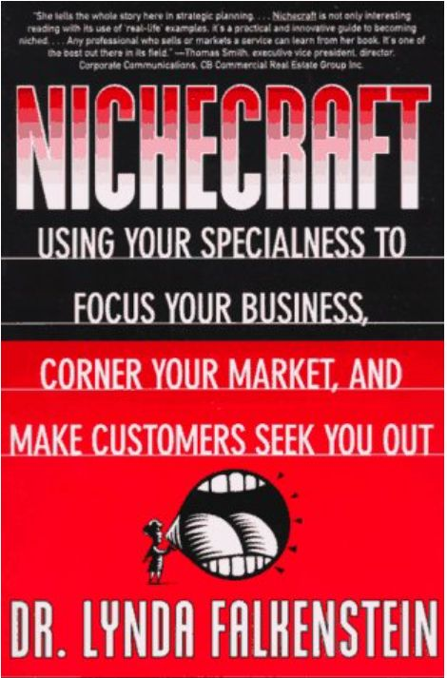
DEFINE YOUR TARGET MARKET
01 CREATE A CUSTOMER WISH LIST
This approach comes from business coach Lynda Falkenstein, author of
Nichecraft: Using Your Specialness to Focus Your Business, Corner Your Market and Make Customers Seek You Out.
In her book, she shares a practical way to identify your strengths, focus your energy and attract the right customers for your business.
If you would like to explore her method in more detail, you can read more about the book on Goodreads. It is a helpful resource for anyone trying to build a purpose-driven business with clarity and direction.

Slide 33
DEFINE YOUR TARGET MARKET
02 CHOOSE WHERE TO FOCUS
You can’t serve everyone and that’s okay. Now it’s time to narrow it down and focus on your most realistic, reachable customers.
Ask yourself:
Who do I have easy access to right now?
Who can afford my food and is likely to buy soon?
Where do these people live, shop, or gather?
TIP: Start with one small group. You can always grow later. Focusing helps you build stronger relationships and learn faster.
Find the people who need (and want) your food
TIP: Start close to home.
Look around your own community, neighbourhood, or networks. Who’s already craving the kind of food you make? Focus on where you already have access and trust.
Check if your idea fits
TIP: Match your food to their needs.
Does your product solve a real food problem? Is it priced right for your audience? Can you easily reach them? If something doesn’t match, tweak and test again.

Slide 34
DEFINE YOUR TARGET MARKET
02 CHOOSE WHERE TO FOCUS
Lessons
Patterns
Look for patterns in how you solve problems. These can show how you approach challenges. Be aware of where you may need support or new skills, in business, production, sales etc..
Passion
Your niche often comes from your personal or cultural background, interests and what you are naturally good at. Follow what feels meaningful and true to you.
Identify the important lessons you have learned through your life experience, culture and work. Use them to shape your food business idea and build on your strengths.

Slide 35
DEFINE YOUR TARGET MARKET
03 UNDERSTAND HOW YOUR CUSTOMER SEES THE WORLD
To build a meaningful food business, it’s not about what you want to cook, it’s about what your customer wants to eat. Think about how your food fits into their daily life. Many people today are eager to try global dishes but don’t know where to start — or who to trust.
That’s where you come in.
You bring a unique culinary heritage. Whether it’s Syrian flatbreads, West African stews, Filipino snacks, or Romanian pastries, you have something special to offer. But to succeed, you must first understand what your customer is really looking for.
Ask questions like:
“Are you open to trying new dishes from other cultures?”
“What flavours or food experiences do you miss or wish you had access to?”
“What stops you from trying food from other parts of the world?”
When you listen deeply, you’ll find opportunities to connect.
Maybe it’s offering milder versions of traditional dishes, explaining ingredients clearly, or sharing a personal story that builds trust.

Slide 36
DEFINE YOUR TARGET MARKET
03 UNDERSTAND HOW YOUR CUSTOMER SEES THE WORLD
LEARN FROM Ihsaan’s Moroccan Catering Business (UK)
Ihsaan, originally from Morocco, moved to the UK to join her husband. After years spent raising her children and managing the home, she decided to follow her long-held passion: sharing the rich flavours of Moroccan cuisine through her own catering business.
Through conversations, research, and mentorship, Ihsaan discovered that many in her area were eager to try authentic Moroccan food, but didn’t know where to find it. She shaped her offer to meet that gap, offering flavourful, home-cooked meals with cultural roots.
What can we learn from Ihsaan?
She listened to her community before launching.
She used training to build confidence and business skills.
She didn’t try to serve everyone — she focused on those who truly valued her offer.
She proved that with passion, preparation, and support, a personal dream can become a real business.
From Homemaker to Business Owner: Ihsaan’s Culinary Journey - 3 Kitchens

Slide 37
DEFINE YOUR TARGET MARKET
04 BRING YOUR INSIGHTS TOGETHER
Now it’s time to shape everything you’ve learned about yourself, your food, and your customers into a real business idea that’s both meaningful and practical.
A strong food business idea often has these five qualities:
You’ve thought through how your idea works: how you’ll cook, sell, deliver, price, and grow even on a small scale to start.
It moves you towards your long-term goals and the life you want to build
It has room to grow, so you can expand or adapt without losing what makes it special
It solves
a real food need. Your food must offer something people care about and are happy
to pay for.
1
3
5
It offers something unique that makes people choose you
2
4

Slide 38

DEFINE YOUR TARGET MARKET
05 CHECK IF YOUR IDEA FITS AND IS READY
Now, take a step back and assess your idea using the five qualities from the previous slide.
If the food niche you've chosen seems too difficult to develop at this time, it may not be the right fit. That is not a failure, it is part of the process.
Let it go and focus your energy on the next idea with stronger potential.

Slide 39

QUALIFY YOUR BUSINESS IDEA
Exercise
Ask Yourself These Questions.
Use this list to check if your idea is ready or if it still needs work.
This is where your business plan truly begins!
What food problem are you solving?
Example: Are people too busy to cook? Missing flavours from home?
What clear benefits does your food offer?
Does it save time, taste like home, use fresh ingredients, and support wellbeing?
Can you describe your food or service in simple words?
One or two sentences a customer would understand immediately.
Who else is offering similar food?
Think about market stalls, takeaways, caterers, or social media sellers in your area.
What makes your food special or hard to copy?
Is it your personal story, your recipe, your cultural twist, or the way you serve customers?
Do you have access to what you need to start?
Kitchen space, ingredients, packaging, support network, time?

Slide 40

03
INTRODUCTION TO
MARKET RESEARCH

Slide 41


The Business Value of Curiosity
There's a belief that success in business stems from a deep curiosity about others.
Market research embodies this curiosity. It's a skill that can be learned and applied.
“We didn’t start a food business to just sell products. We started it to nourish communities and create opportunities.”
– Jennie Dundas, Co-founder of Blue Marble Ice Cream
MISSION — Blue Marble All Natural Ice Cream and Sorbet | Retail and Wholesale
Blue Marble has supported women-led food businesses globally, including post-crisis areas like Rwanda and Haiti.

Slide 42
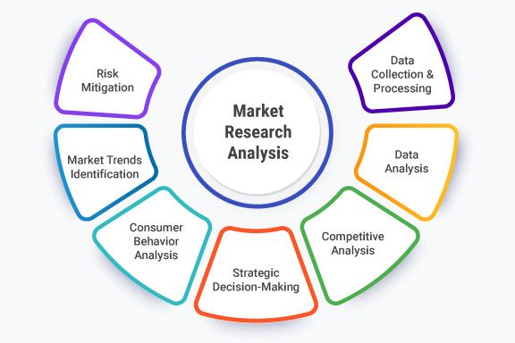
MARKET RESEARCH – WHAT YOU NEED TO KNOW
Market research helps you learn about your potential customers. It shows you what they need, what they prefer, when and where they buy, and how they use what they buy.
Understanding this will help you shape a food business that truly fits the people you want to serve.
Further Reading:
How to Do Market Research for Small Business – Salesforce
This guide shows you clear steps to find out who your customers are and how to build a business around their needs.

Slide 43
MARKET RESEARCH – WHY IT IS NEEDED ?
Market research is a structured way to search for useful information that can guide your business decisions. It plays a key role in helping you:
Understand the risks involved…
Discover who your ideal customer is…
Spot opportunities for improvement…
…so you can decide whether or not your idea is worth pursuing.
…and who is most likely to buy from you, so you can shape your food product or service to meet their real needs.
…or innovation by learning what people are missing or unhappy with in current food products or services.
Remember: Asking your audience specific questions
will get you valuable and honest feedback directly!

Slide 44


MARKET RESEARCH – THE DIFFERENT TYPES
There are two main types of market research. Most businesses use both types of research to get a full picture of their market. Both are useful, and they give you different kinds of information:
Quantitative research
Qualitative research
This gives you numbers, facts, and statistics. It helps you understand what people do, how many people do it, and what trends are forming.
This helps you understand why people do what they do. It focuses on feelings, opinions, and motivations.
Explore this guide to see how numbers and stories can work together to help you make better decisions: Market Research and Competitive Analysis – SBA
This guide explains the basics of both types of research and how to use them in your business.

Slide 45

MARKET RESEARCH
QUANTITATIVE RESEARCH – UNDERSTANDING THE WHAT
Quantitative research gives you numbers, facts and data that help you make smart decisions for your business. It helps you find out what people do, how many people are interested, and which ideas have the most potential.
You can collect this kind of information by:
Doing desk research (searching online, reading reports)
Creating simple surveys or questionnaires
Looking at statistics and trends in your market
Once you collect the data, your job is to organise it, look for patterns, and explain it clearly. These facts help you answer questions like:
How many people want this?
What are they buying?
What are they searching for?

Slide 46


MARKET RESEARCH
How to Conduct Market Research
This website offers practical steps for conducting market research, including using questionnaires, interviews, and reviewing industry publications, highlighting the importance of verifying demand for your product or service.
Use this guide to start your market research and validate your business idea.
Let’s talk business!

Slide 47

QUANTITATIVE RESEARCH - FIND BUSINESS DATA
Business data is information that shows what is happening in your market: what people are buying, what they are paying, and how things are changing.
Once you know what kind of data you need, the next step is finding it. Not all sources are equal, and not all information is useful. What matters is learning where to look and what to trust.
Here’s what helps:
Use reliable sources like national statistics offices, trade associations or industry publications
Trace data back to its original source whenever possible
Focus on information that directly connects to your idea, your product, your audience, your market
Good data is not just collected – it is filtered, checked and applied with care!

Slide 48
RESEARCH & TEST TARGET MARKET ANALYSING THE DATA
Collecting information is just the beginning. Analysing it is where it gets interesting.
Take a close look at the answers you gathered.
Do you see patterns, gaps or unexpected results?
Look for clues that show you what your customers really want or need.
Good analysis will help you make smarter, more confident decisions for your business.
Now ask yourself:
What does this mean for my business?
Does anything need to change?
What is worth keeping?
Exercise
Turn your research into your next step!
Write a short summary (one page or less) that says what you learned and how your idea will respond to that.
You can start with the sentence: “One change I will make based on what I learned…”

Slide 49
QUANTITATIVE RESEARCH – MAIN TECHNIQUES
Starting a food business in a new country means learning about new customers, new habits, and new opportunities. You do not need to create everything from scratch – much of the information you need is already out there. Here are good places to start:
Look at food magazines, local news or community publications — but always check where the information came from
Visit websites from local government, business agencies or migrant support organisations linked to food, catering or hospitality
Search online using terms like “demand for traditional food Sweden” or “home bakery market Ireland”

Slide 50

QUALITATIVE MARKET RESEARCH – THE WHY
Qualitative research helps you go deeper into understanding your customers. It shows you why people make choices – why they like or dislike something, what they think about a food product or experience, and what truly matters to them.
This is the „WHY" behind their decisions.
You discover it by speaking with people, observing them, or gathering honest opinions in small groups, interviews or informal conversations.
Listening carefully to real stories and experiences gives you a clearer picture of how your idea fits into their lives.

Slide 51
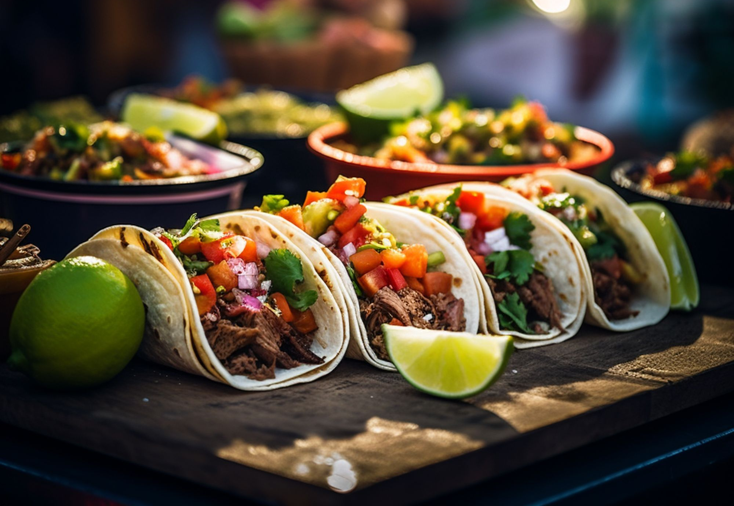

REAL INSPIRATION – LILY RAMIREZ-FORAN
Lily Ramirez-Foran moved from Mexico to Ireland and saw a gap in the market for authentic Mexican food.
She founded Picado Mexican – a grocery shop and cookery school – by listening to her new community and sharing her culture in a way that connected locally.
    Listen to her podcast episode: From Potatoes to Tacos – Curious Broadcast
    Visit Picado Mexican's website to see her business in action.
Explore how listening to your new community and staying true to your roots can build a strong and meaningful business!

Slide 52


QUALITATIVE MARKET RESEARCH
This kind of research is based on your own observations and conversations. It is not statistically valid, but it gives you valuable insight into hearts, minds, opinions, motivations, and attitudes.
Ask questions like:
Does anyone want what I am offering?
Will they actually buy it?
What do they think about it?
How do they see or understand my product or service?
What is their opinion or attitude toward it?

Slide 53

MARKET RESEARCH - QUALITATIVE RESEARCH
In this short video, serial entrepreneur Steve Blank explains why so many startups fail:
They wait too long to find out if real customers are interested.
He shows how talking to people early – before spending too much time and money – helps you build something people actually want.
WATCH THE VIDEO:.
Steve Blank: Want Your Startup to Succeed? Get Out of the Building

Slide 54

QUALITATIVE MARKET RESEARCH
Qualitative research helps you understand how people feel about products and services, not just what they buy.
Ask if they use a competitor's product.
Why or why not?
When do they use it?
What frustrates them?
Their answers show whether they are your real customers and where gaps might exist.
Explain your idea simply, ask "What do you think?" and listen carefully.
If they like it, always ask why. Deeper answers reveal real needs.

Slide 55
MAIN TECHNIQUES of QUALITATIVE - RESEARCH
Depth interviews
One-to-one conversations to explore opinions and feelings
Focus groups
Small group discussions to gather shared views and ideas
Market Research Online Communities
Groups like LinkedIn or Facebook for informal feedback
There are many simple ways to explore what people think and feel about your idea. Choose the method that fits your time, resources and customers best.

Slide 56
MAIN TECHNIQUES of QUALITATIVE - RESEARCH
Listening platforms
Blogs, forums or social spaces where you observe conversations
Surveys or questionnaires
Structured questions to collect quick answers
Observation
Watching how people behave in shops, markets or events
There are many simple ways to explore what people think and feel about your idea. Choose the method that fits your time, resources and customers best.

Slide 57

ONE TO ONE INTERVIEWS
One-to-one interviews are a powerful way to really listen and learn from just one customer at a time.
Here is what you need to know:
Conduct a one-to-one interview by asking open, flexible questions, usually face-to-face. Let the conversation flow naturally but keep your main questions in mind.
Good listening and interpersonal skills are important: stay patient and curious.
Advantages: You have flexibility and can gather a lot of rich, personal information from one person.
Be careful of your own bias — stay open and let the person’s real thoughts come through.

Slide 58
FOCUS GROUPS
Focus groups are a great way to hear different opinions about your food, all in one relaxed and friendly setting. They help you understand what people really think about your dishes, your idea, and your presentation. Here’s how to prepare:
Invite people from your target customer group: e.g. local families, food lovers, or people from your cultural community
Choose a comfortable, familiar place and time: a community centre, a café, or even online — ideally where food can be shared!
Prepare a simple plan: think about what you want to learn: taste preferences, price expectations, packaging ideas, or how your story connects.
Create a warm, welcoming environment: Start by sharing your purpose and, if needed, kindly ask for permission to record the session.
Encourage open, honest sharing: Offer small samples or tasters to get real-time reactions. Keep the tone positive and curious
Thank everyone and give a small thank-you: This could be a food sample, a discount, or a personal thank-you note.
Collect feedback and ask for permission to use any quotes: If something helpful is said, check if you can use their words in your business story or planning.

Slide 59

MARKET RESEARCH THROUGH ONLINE COMMUNITIES
Online platforms like LinkedIn, Instagram Facebook can be great places to learn what people are thinking and talking about in your area of interest.
Join groups linked to your food business idea or sector
Observe what people are posting, asking, and discussing
Look for common questions, frustrations, or trends
Ask respectful questions if allowed, focus on learning, not selling
Notice the language people use to describe their needs or problems

Slide 60

LISTENING PLATFORMS FOR MARKET RESEARCH
Blogs, forums and online communities are great places to quietly observe real conversations and discover what people truly care about.
Read blogs or articles related to your product, service, or sector
Visit online forums and community spaces like Reddit, Quora or local food forums
Pay attention to common problems, needs, or frustrations people mention
Notice what questions come up again and again
Look for gaps or opportunities that could match your business idea

Slide 61

SURVEYS AND QUESTIONNAIRES FOR QUICK FEEDBACK
Surveys and questionnaires help you collect quick, structured feedback from many people, giving you a wider view of your potential market.
Use simple, clear questions that are easy to answer
Keep surveys short – focus on what you really need to know
Choose the best way to reach people (online, face-to-face, phone)
Start with easy questions, then move to more detailed ones
Respect people's time and privacy – only ask what is necessary

Slide 62

UNDERSTANDING CUSTOMERS THROUGH OBSERVATION
Observation means quietly watching how people behave in real places like shops, markets or events to better understand their habits and choices.
Visit places where your future customers spend time
Watch what products or services they choose and why
Notice what catches their attention or what they ignore
Look for patterns in behaviour, not just individual actions
Take simple notes – focus on what is useful for your idea

Slide 63
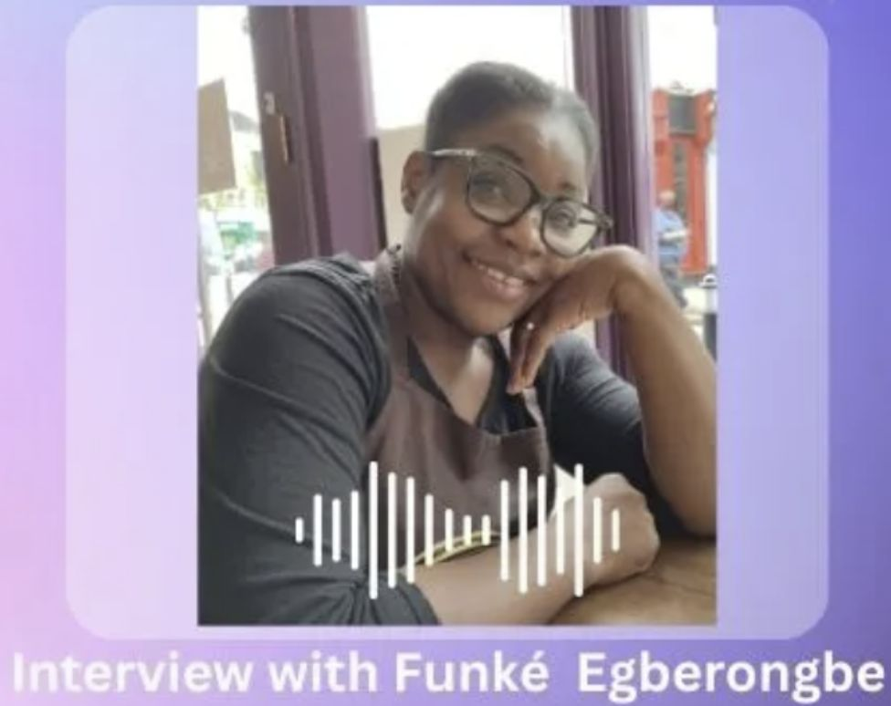
REAL INSPIRATION - Meet Funke
A resilient woman who, after arriving in Ireland, transformed her passion for cooking into a thriving food business. Through dedication and community support, Funke preserved her cultural heritage and enriched the culinary landscape of her new community.
Key Takeaways:
Cultural Preservation: Funke's dishes offer a taste of her homeland, keeping traditions alive.
Community Engagement: She built connections by sharing her food at local events and markets.
Entrepreneurial Spirit: Funke navigated the challenges of starting a business in a new environment with determination and adaptability.
Discover Funke's story:
Celebrating World Refugee Day: 3 Kitchens is Inspired by Funké – 3 Kitchens

Slide 64


THE POWER OF QUESTIONNAIRES IN MARKET RESEARCH
Questionnaires are a simple and powerful tool to collect clear information from a large number of people. They help you quickly understand customer needs, opinions and buying habits.
Benefits of using questionnaires:
Gather a wide range of views quickly and easily
Spot patterns, needs and opportunities in your market
Test new ideas before investing time or money
Build real knowledge to guide your decisions
Reach people in different locations through online or paper forms
A good questionnaire gives you real insight about what your customers want.

Slide 65

SIMPLE TOOLS TO SUPPORT YOUR MARKET RESEARCH
Depth interviews – Otter.ai or phone recorder:
Use a free app like Otter.ai or your phone’s recorder to capture the conversation so you can listen carefully without worrying about taking notes.
Focus groups – Zoom or Google Meet:
Set up a free Zoom or Google Meet call to bring your small group together and record the session (with permission) for review later.
Online communities – Facebook Groups or LinkedIn Groups:
Join relevant groups and spend time reading posts and comments to understand what people in your field are asking, sharing or struggling with.

Slide 66
SIMPLE TOOLS TO SUPPORT YOUR MARKET RESEARCH
Listening platforms – Reddit, Quora, Blogs:
Search for forums or blog comments about your sector and quietly observe the questions, advice and common problems discussed.
Surveys or questionnaires – Google Forms or SurveyMonkey:
Create a short, easy-to-answer survey using Google Forms or SurveyMonkey and share it through email, WhatsApp groups or social media.
Observation – Google Keep or notes app:
Spend time in local markets or food fairs, watch customer behaviour, and quickly jot down what you notice about choices and habits.

Slide 67

HOW TO FIND PEOPLE TO INTERVIEW
Use your network and your network’s network.
Reach out to contacts, friends, and community members who can connect you to people worth speaking with.
When you invite someone to an interview, be clear:
Tell them when you would like to meet, how long it will take, and what you would like to talk about.
Set appointments as early as possible, and if you can, arrange to meet some people in person. Personal conversations often lead to deeper and more useful insights.

Slide 68

BUILDING THE QUESTION SET
Questions are at the heart of great market research
The questions you ask (and how you ask them) will shape what you learn.
Unlike a scientific survey, your goal is not just to gather facts, but also to evoke emotions. You want to understand what your target customers feel, what drives them, and what could motivate them to buy.
Focus on open-ended questions that help people share how and why they make decisions.
Whether you are validating your market or testing your idea, one essential question to ask is:
What’s your biggest daily struggle with food or meals?
The answer will show you what matters most to your customer when making any decision.

Slide 69
BUILDING THE QUESTION SET
Use these questions to better understand people’s food habits, needs, and interests especially when introducing meals, snacks, or products inspired by your culture.
Everyday Food Habits
What do you usually eat for lunch or dinner during the week?
How often do you cook at home compared to buying ready-made food?
Where do you normally get your meals, from supermarkets, restaurants, street food, or other places?
2. Food Challenges
What is your biggest struggle when it comes to preparing or accessing good food?
Are there any meals, ingredients, or flavours you miss from your childhood or country of origin?
Do you find it hard to find authentic food from other cultures?
3. Openness to Global Cuisine
Are you interested in trying home-cooked or traditional dishes from different countries?
What might make you hesitant to try a food that’s unfamiliar to you?
What would help you feel more comfortable trying new dishes?

Slide 70
BUILDING THE QUESTION SET
4. Price and Expectations
How much would you expect to pay for a freshly prepared, traditional meal from another culture?
What makes a food product feel valuable or worth the price to you?
Would you pay more for food that is handmade, locally sourced, or has a cultural story?

Slide 71
TESTING THE QUESTION SET
It is important to test your set of questions before starting fully. It is difficult to get everything right the first time. After a few initial interviews, you will probably realise there is other important information you also want to gather.
A good approach is to run three to five test interviews, then review your questions and answers carefully. Make sure you are getting the kind of insights you need to guide your business idea.
The following are some things to consider during this review:
Are the questions open-ended enough to start a dialog?
Are some questions unnecessary?
Is this the right target market?
How long are the interviews taking?
Have I uncovered something in these interviews that I need to ask for more details about?
Which questions were misunderstood and how can they be reworded?

Slide 72


04
CHECK OUT YOUR
COMPETITION

Slide 73

QUALIFYING YOUR BUSINESS IDEA
Next Step: Check Out the Competition
Knowing about your competitors will help you to communicate with your target audience, distinguish your business from competitors, improve your processes, and navigate challenges in your market.
Understand your competitors. Knowing who your competitors are, and what they are offering, can help you to make your products, services and marketing stand out.
You can use this knowledge to create marketing strategies that take advantage of your competitors' weaknesses and improve your own business performance. Using the keywords of your business description, Google them, interrogate their websites, what is different about your approach.

Slide 74

FOR EACH COMPETITIOR CONSIDER
Generic information; year established, size (employees, locations)
Target Customers/Sectors (typically listed on website)
Marketing & Sales approach (website news & events)
Strengths & Weaknesses; check out reviews for patterns what they are good and not so good at
USPs (Unique Selling Proposition); what makes them unique that convinces customers to buy
Compare; e.g. visual table with columns comparing their different offerings feature by feature
Exercise
Why do you have competitive advantage? Write a summary paragraph

Slide 75

Next: Step 3
Getting your Business Started
www.3kitchens.eu

