Slide 1
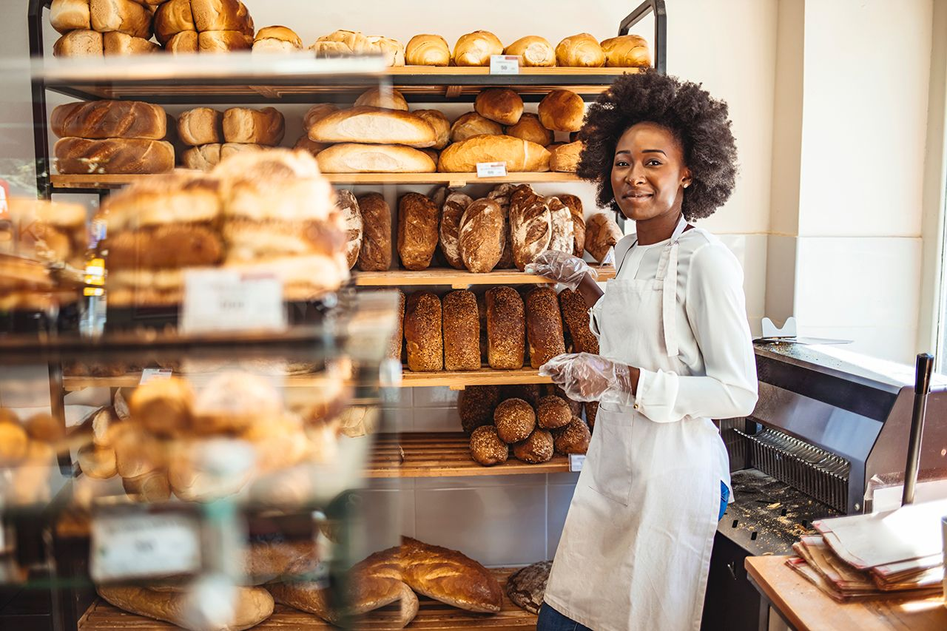
STEP 1.
GETTING STARTED
ON YOUR ENTREPRENEURSHIP ADVENTURE
www.3kitchens.eu

Slide 2
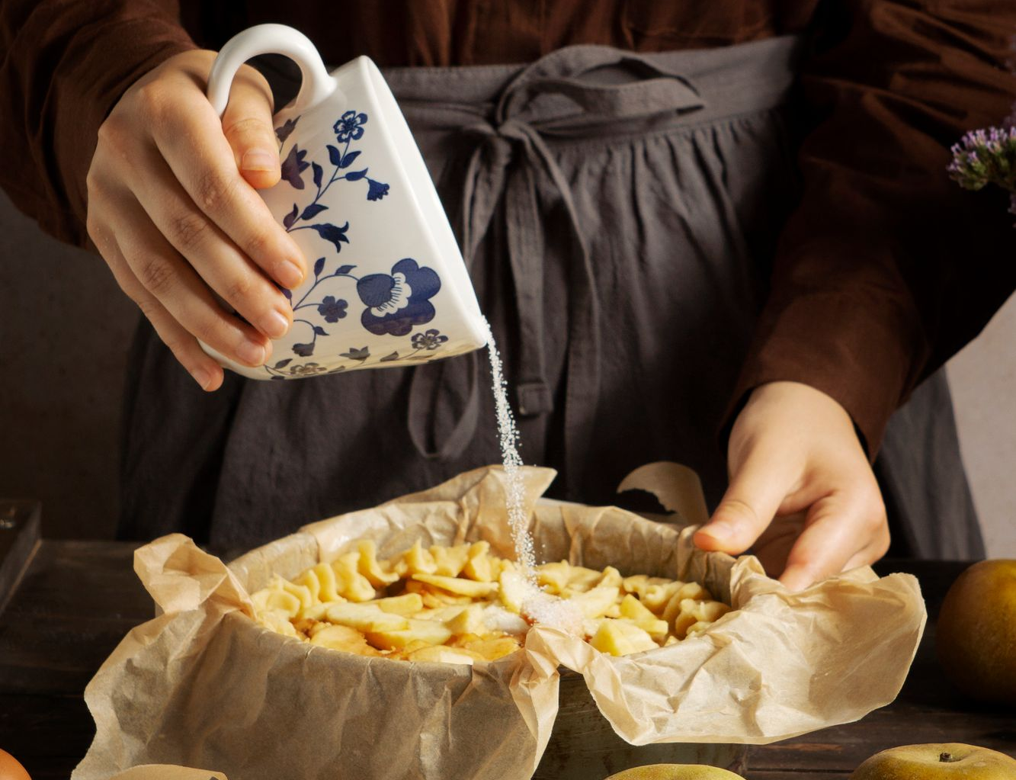
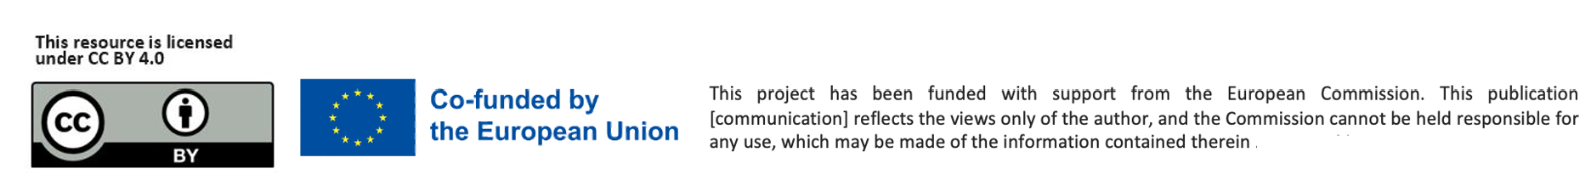
3 Kitchens aims to empower female migrant entrepreneurs to start their own food businesses.
We want to share this course with you to help you build your skills, knowledge, and confidence in establishing and successfully running your own food business. Can you? Of course, you can!
Open your mind and let us bring you on a Food Entrepreneurship Learning Adventure…….
​

Slide 3
Who is 3 Kitchens specially designed for ?
You may have arrived in a new country full of questions. But you also brought your culture, strength, and skills. That’s what 3 Kitchens is here to support.
Through entrepreneurship, women migrants can create their own jobs. Women have been described as ‘silent contributors’ to our economies, but as a migrant woman, you have life experience, resilience and many of the skills that are needed to be a successful female entrepreneur.
Many children of migrants, born in their adopted homeland, have successfully set up in business.
You have a new way of looking at things, often blending the best of cultural background and opportunities for unique and innovative business success.
Refugees enter unknown lands, not only seeking a safer life for themselves, but also striving to make an impact and a contribution.

Slide 4
Learning Objectives – Step 1: Starting Your Food Business Adventure
By the end of Step 1, you will be able to:
Recognise your strengths
Understand how your background, culture, and life experiences can become assets in food entrepreneurship.
Connect your story to your passion
Identify the personal stories, traditions, and hobbies that can inspire a meaningful food business.
Understand what entrepreneurship involves
Learn what it takes to be a food entrepreneur and develop the mindset needed to begin.
Explore business ideas with confidence
Discover realistic food business ideas based on your skills, interests, and your community’s needs.
Choose the right path for you
Use brainstorming tools and inspiring examples to begin shaping your food business idea. Decide whether you’d enjoy making food, offering services, teaching others, or combining these options.
​

Slide 5
Contents
01
02
03
04
You and Your Strengths - Explore who you are, your cultural background, life experiences, and the unique strengths you bring to food entrepreneurship
Using Your Passion and Story - Get inspired by real-life case studies and consider how your story, interests, and passions can shape your business.
Understanding Entrepreneurship - Learn what entrepreneurship really means, what it takes, and how to build confidence, purpose, and resilience through business.
Exploring Food Business Ideas - Start to generate food business ideas that are realistic and reflect your skills, community needs, and everyday food experiences.
What kind of food business should I start- Explore trends and imagine the next steps on your adventure.
05

Slide 6


01
You and Your Strengths

Slide 7
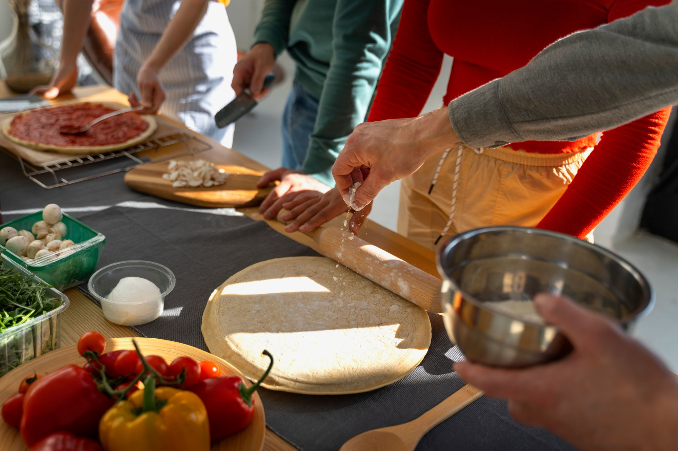

WHAT IS AN ENTREPRENEUR?
An entrepreneur is commonly seen as an innovator, a source of new ideas, goods, services, and business. They are someone who turns an idea into action—creating something of their own, like a service, product, or small business.
Some entrepreneurs are born but many others are self-made – you just need to find and unlock your secret SUPERPOWER and a practical business idea that you are passionate about!
Our course will help you with this.
“I started by cooking for neighbours. One dish led to one event. Now I cater weddings.”
– Halima, community chef in Malmö

Slide 8
WHAT IS ENTREPRENEURSHIP?
Entrepreneurship is for You!
You don’t need permission to be an entrepreneur—just a small idea and the courage to start.
At 3 Kitchens, we believe your culture, skills, and life experience are powerful tools.
Food entrepreneurship, in particular, can take many accessible and low-barrier formats. From selling homemade goods at local markets to launching a food truck, pop-up restaurant, or online business. You don’t need a fancy kitchen or a business degree, you need heart, hustle, and a community to support you.
Here’s how to start (and what we cover in this course) :
Identify your “why.” What drives your passion for food?
Start small. Test recipes, share with friends, get feedback.
Build your story. Your background is part of your brand, own it.
Find your market. Who loves what you make? Where do they shop or eat?
Lean on community. Join food collectives, attend local events, and ask for help.

Slide 9

DID YOU KNOW MIGRANT WOMEN TEND TO BE GREAT ENTREPRENEURS ?
Starting over in a new country, learning a new language, finding work, and supporting their families. Life can be challenging, and resources like time or money may be limited.
But these experiences also build strength, creativity, and resilience—the same qualities that make great entrepreneurs!
Let’s look at 6 reasons why…
  Migrant women often face more obstacles than others…

Slide 10
DID YOU KNOW MIGRANT WOMEN TEND TO BE GREAT ENTREPRENEURS ?
1. You’re strong and adaptable
2. You understand people
3. You’re a great communicator
Facing change and finding solutions is already part of your everyday life. These are key skills for running a business.
Many migrant women have strong social awareness. You can often sense what others need and how to connect with them. That’s the heart of good business.
Not only with words, but by listening, empathising, and making people feel understood. Customers value this more than you might think.
  You have what it takes!

Slide 11
DID YOU KNOW MIGRANT WOMEN TEND TO BE GREAT ENTREPRENEURS ?
4. You think ahead
5. You support others
6. You’re creative!
You’ve had to plan for your future and your family’s. This forward-thinking mindset helps you spot opportunities and avoid risks.
Women typically work well together. When one woman rises, we all rise. That’s the spirit of community and collaboration.
Whether it's cooking, problem-solving, or making the most out of what you have, creativity shows up in many forms. It’s also the starting point of many successful businesses.
  You have what it takes!

Slide 12
WHY SHOULD YOU THINK ABOUT FOOD ENTREPRENEURSHIP AS A CAREER CHOICE?
Being an entrepreneur takes qualities like patience, determination, and the courage to try something new. Many migrant women already have these strengths, often from life experience.
Have you ever thought:
“I love cooking—could I do something with it?”
“People say my food is amazing—maybe I could sell it?”
Starting a small food business doesn’t have to be big or complicated. It can be something you grow step-by- step.
Working for yourself can give you more freedom, flexibility, and a chance to build your own path. It can also be a way to connect with your new community, share your culture, and meet people who support you.
…

Slide 13
BE INSPIRED BY this article!
The article Turning a Love for Cooking into a Career for Refugee Women highlights the inspiring journey of a group of migrant women who transformed their passion for cooking into a professional venture called "Meet My Mama.“
This initiative empowers refugee women by providing them with employment opportunities allowing them to share their cultural heritage through food. By leveraging their culinary skills, these women have created a platform that fosters integration, economic independence, and cultural exchange.
The success of Meet My Mama exemplifies how personal passions can be harnessed to overcome challenges and build meaningful careers, especially for those navigating the complexities of displacement and resettlement.
Gaining experience through initiatives like this empowers women with the skills, confidence, and networks that can serve as a strong foundation for launching their own food businesses.

Slide 14
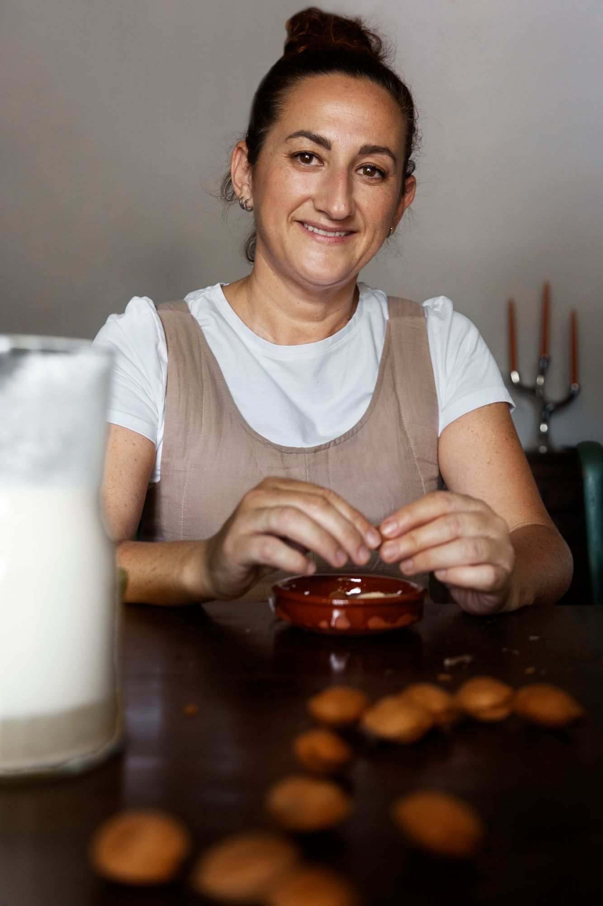
EVERY MIGRANT WOMAN ENTREPRENEUR HAS THEIR OWN STORY
As you move forward on your 3 Kitchens ENTREPRENEURSHIP LEARNING adventure - start thinking about what your story is?
What is unusual or different about your story?
What area of food are you passionate about?
What are your hobbies?
What are you good at?
Do you have a secret talent? A star quality?
You might not have thought about it before, but you might already possess a foundation to start your own food business!

Slide 15

02
USE YOUR PASSION and STORY
(CASE STUDIES)

Slide 16
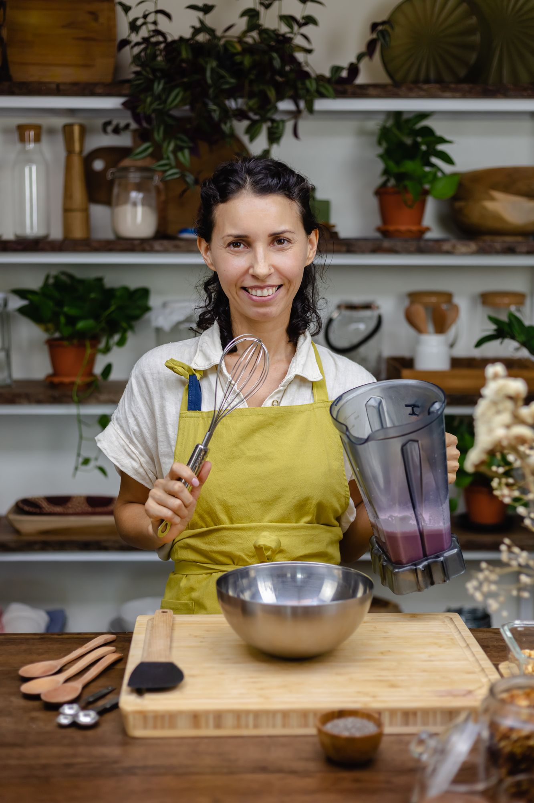

RISE OF WOMEN ENTREPRENEURS
Across the world female entrepreneurs are launching and operating new enterprises at a faster pace than ever. But did you know, that women are nearly one-third more likely to start businesses out of necessity than men.
Many small and very small businesses start and develop incrementally, through a process of trial and error. And this is a great foundation from which to grow.
Read this for more information!

Slide 17

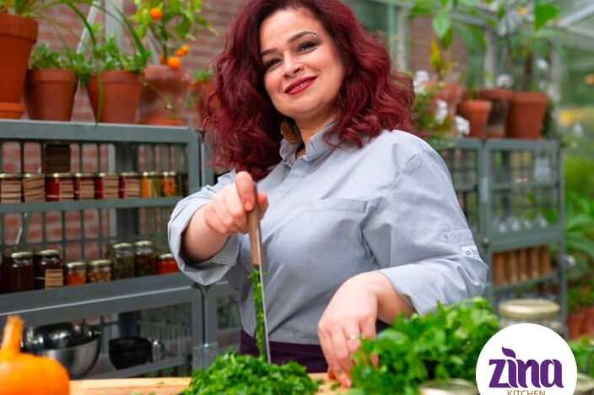
USING YOUR PASSION - CASE STUDIES
Zina Abboud: From refugee to entrepreneur
Zina is one of the first Syrian refugees to register her own business in the Netherlands.
In 2013, she had to leave Syria because of the war.
After a difficult journey, she arrived in the Netherlands in 2015.
Life in a new country was hard. Zina felt alone. But she found comfort in something familiar—cooking. She began volunteering in a refugee centre kitchen. Cooking helped her feel better.
It gave her a sense of purpose and connection.
Read her full story here!

Slide 18
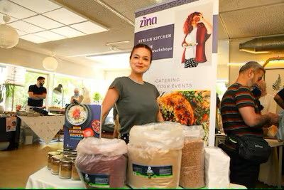
USING YOUR PASSION CASE STUDIES
Zina Abboud: From refugee to entrepreneur
After getting her residency permit, Zina took the next step: She started her own catering business.
Now, Zina is known as an ambassador for Syrian food in the Netherlands.
She shares her delicious dishes at parties, weddings, events, and festivals.
Check out her business in this video ➔
“Don’t keep your beautiful ideas inside your mind. Show the world what you can do.”

Slide 19
USING YOUR PASSION CASE STUDIES
A Food Truck of Many Cultures – Bologna, Italy
In Bologna, a group of refugee women from different countries came together to do something simple but powerful—cook and share the food they love.
With the help of a local project, they launched a multi-ethnic food truck, serving dishes from Syria, Nigeria, Afghanistan, and beyond. Each woman brings her own story and flavours, turning the truck into a place of culture, community, and pride.
This project gave these women:
A chance to earn income using skills they already had
A way to feel proud and visible in their new home
A platform to build something together as a team
➔ Check out their full story here!

Slide 20
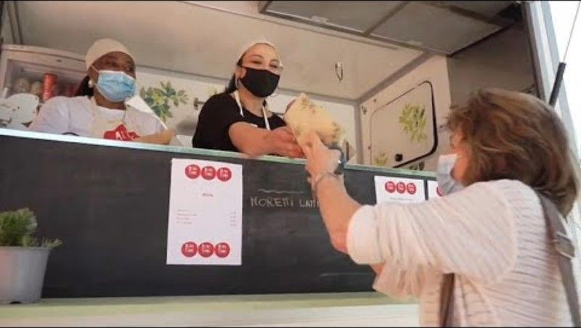
USING YOUR PASSION CASE STUDIES
What could this look like in your community?
Could you join forces with other migrant women to run a pop-up food stall or café?
Do you have recipes or dishes that people around you would love to taste?
Could your story be the next one shared?
Start with one dish.
One idea.
One small step.
That’s how journeys like this one begin—and we’re here to walk with you.

Slide 21
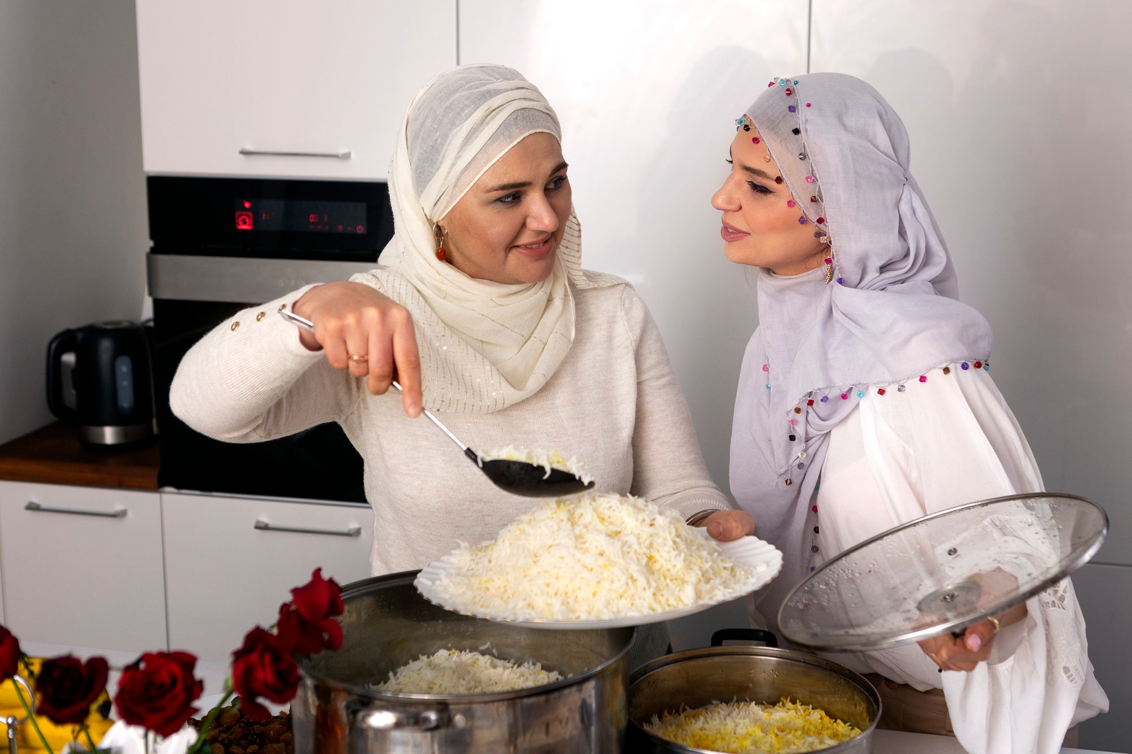
“For many migrant women, entrepreneurship is not just about making money. It’s about belonging, confidence, and having a voice.”
— Natasha Webster

Slide 22


RISE OF WOMEN ENTREPRENEURS
Natasha Webster – Stories of Migrant Women Entrepreneurs in Sweden
Dr. Natasha Webster is a researcher in Sweden who has spent years studying the lives of migrant women who start small businesses, especially in rural areas.
She interviewed over 40 women who moved to Sweden from different parts of the world. Many of these women had low incomes and faced significant challenges, including learning a new language, adapting to a different culture, and navigating the job market.
But despite all this, they still found ways to create something of their own.
Some started with small food businesses from home, making and selling cakes, preserves, or ready meals. Others began by offering cooking classes or pop-up dinners that shared their culture with local people.

Slide 23

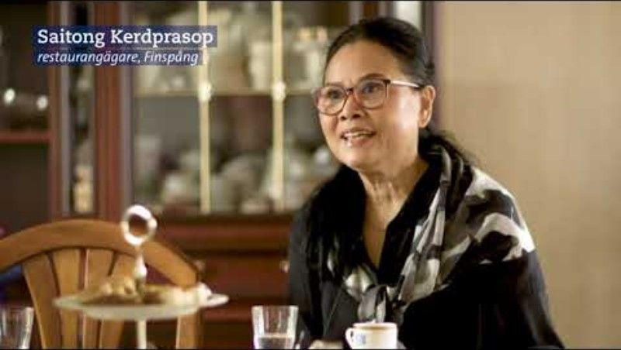
USING YOUR PASSION CASE STUDIES
Natasha Webster – Stories of Migrant Women Entrepreneurs in Sweden
What Dr. Webster found is powerful:
These women used their life experiences and cultural knowledge to build businesses.
They often started very small, with little money, but a lot of heart.
Most importantly, they created work that fit their lives and families, on their own terms.
She also found that support and encouragement from the local community such as volunteering, women’s networks, or training groups made a big difference.
3 Kitchens has lots of resources to help in these areas - How To Benefit - 3 Kitchens
Check out this video for more information!

Slide 24

TIME TO THINK!
Role models are so important in influencing decisions to become self-employed , we cannot be what we cannot see.
How many different migrant women food business owners do you know?
Make a list of the names of all the different local businesses you know that are run by women from different nationalities
Do you have a food business idea from your culture that keeps coming back to you—something that feels close to your heart?

Slide 25

LISTEN - START UPS WITH NO BORDERS PODCAST
Check out this inspiring podcast series about migrant entrepreneurship.
Some of it can be a little high level, but dig deep, it provides interesting information and stories from other entrepreneurs with migrant and refugee backgrounds, many of whom are female, that can serve as role models and case studies for aspiring entrepreneurs.
New episodes are aired every week.
Go to this website
Click on the Podcast button to listen to any episode you would like
Click on the News & Stories to browse through other relevant and interesting information presented in short story and news posts.
1
2
3

Slide 26
03
UNDERSTANDING ENTREPRENEURSHIP

Slide 27
ENTREPRENEURSHIP - IT’S WITHIN YOU ALREADY
Being Flexible and Solving Problems
Things don’t always go as planned. Entrepreneurs need to find new ways to solve problems.
As a migrant woman, you’ve already learned how to adapt to new places, new languages, and new systems. That’s a powerful skill.
Working Hard and Taking Initiative
Starting something new means putting in effort and taking action. You might be used to working to support your family or building a life in a new country. That same strength helps you move forward in business.

Slide 28
ENTREPRENEURSHIP - IT’S WITHIN YOU ALREADY
Being Creative and Finding New Ideas
Creativity means finding new ways to do something, like cooking a meal from a few ingredients or making your own way when resources are limited.
Doing What You Love
It’s easier to stay motivated when you enjoy what you’re doing.
Many successful businesses start from a simple idea or skill that someone turned into something special.
When you love cooking, teaching, or helping others, people feel that. It makes your business stronger and more meaningful.

Slide 29
ENTREPRENEURSHIP - IT’S WITHIN YOU ALREADY
Staying Strong Through Challenges
Every business has ups and downs. But you’ve already overcome many hard things.
Being Positive About the Future
You don’t have to have everything figured out to start.
Resilience means not giving up when things are difficult. It means trying again and learning as you go.
If you believe in yourself, even just a little, you’re already on the way.
Each small step counts.

Slide 30
BUSINESS SKILLS YOU ALREADY HAVE BUT MIGHT NOT REALISE IT!
BUSINESS SKILLS
PROBLEM SOLVING | CREATIVITY | PLANNING | NETWORKING
PERSONAL LIFE | Finding ingredients or substitutes on a tight budget | Creating a meal from leftovers or limited ingredients | Planning meals for the week or a family gathering | Talking to someone at a community event or food fair
COMMUNITY WORK | Solving issues around shared kitchen or cooking spaces | Organising a cultural food-sharing event | Planning a community meal or cooking class | Collaborating with others for a local food event
BUSINESS | Finding a way to keep cooking when ingredients or equipment aren’t available | Developing a new recipe or food product | Preparing for a market stall, pop-up, or delivery schedule | Attending a start up entrepreneurs networking event

Slide 31
Now, your turn …
Throughout this course, you will see how valuable the skills of problem solving, creativity, planning, and networking are when applied in a business setting. Now it’s your turn:
Can you make your own list of activities from your personal life, community, or work that show you’ve used these skills?
My example
BUSINESS SKILLS
PROBLEM SOLVING | CREATIVITY | PLANNING | NETWORKING
DOWNLOAD FOR LOTS OF EXAMPLES TO GET YOU STARTED (double click icon to download)

Slide 32
THE MINDSET OF A WOMAN ENTREPRENEUR
Of course, money matters. But for many migrant women who start their own businesses, it’s not just about income—it’s about purpose. It’s about showing that your talent matters, that your ideas can make a difference, and that you deserve to shape your own future.
Does any of this feel familiar?
Working a 9-to-5 job doesn’t fit your life — or your spirit. You want the freedom to do things your own way.
You’re determined, full of ideas, and ready to take action — even if that means pushing forward when others hesitate.
You dream of having more control over your time, your energy, and your future — for yourself and your family.
If this sounds like you, then entrepreneurship might not just be an option—it might be your path.

Slide 33
ESSENTIAL TRAITS FOR SELF EMPLOYMENT
Here are some of the most essential traits you need when being self-employed…
Use this as a checklist—and see how many already describe you!
Self-reliance
High motivational levels
The desire and willingness to take the initiative
Driven by a strong need to achieve
Enough self-confidence
Good physical health and great energy levels
Vision
Perseverance
Competitiveness
Knowledge of your chosen industry
Organisational skills
Resourcefulness
Problem solving
Great people skills
Remember: You don’t need all of these right away.
But if you see yourself in some of these traits—you already have the heart of an entrepreneur.

Slide 34


SELF ASSESSMENT
Exercise
Make a list for each of these 4 areas
Before starting something new, it helps to understand what matters to you.
Take a few minutes to think about these four questions.
You can write down simple words or short sentences.
What do you hope to get from your business? (money, freedom, purpose, confidence?)
What are you good at? (skills, talents, things people often ask you for help with?)
What do you enjoy doing? (hobbies, interests, everyday tasks that bring you joy?)
What do you need right now to feel ready? (support, training, time, tools?)
We’ll use your answers to help shape your next steps in this journey.

Slide 35

FACING CHALLENGES
Starting a business in a new country isn’t always easy, especially as a migrant woman. You might face extra challenges, and that’s completely normal.
But here’s the good news:
When you can name the challenge, you can start to find a solution.
That’s what entrepreneurs do—they don’t have all the answers, but they keep going. They find creative ways to move forward, and they ask for support when they need it.
You don’t have to face challenges alone.
3 Kitchens is here to help you learn, grow, and find your way.

Slide 36
CHALLENGES FACED
We understand that many of the barriers you face are real, and often connected. They can make starting something feel overwhelming, but can move forward, step by step.
Here are some of the common challenges we hear from participants:
Not knowing how the local food market works or what customers might want
Not having a network—people who can support, advise, or connect you
Not understanding the rules, permits, or steps to start a food business
Finding it hard to access money or even a kitchen space to begin
Struggling with the language or adjusting to a new culture
These are real barriers, but they’re not permanent. Build on the strengths you already possess, including your food traditions, life experiences, and determination. You can learn how to navigate local systems, build connections, and take meaningful steps toward your food business goals.

Slide 37

GOOD NEWS
Across the EU, there are many great supports for women migrants who want to start or grow a food business in their new country.
Throughout this course, we’ll show you some of the best examples to inspire and guide you."

Slide 38
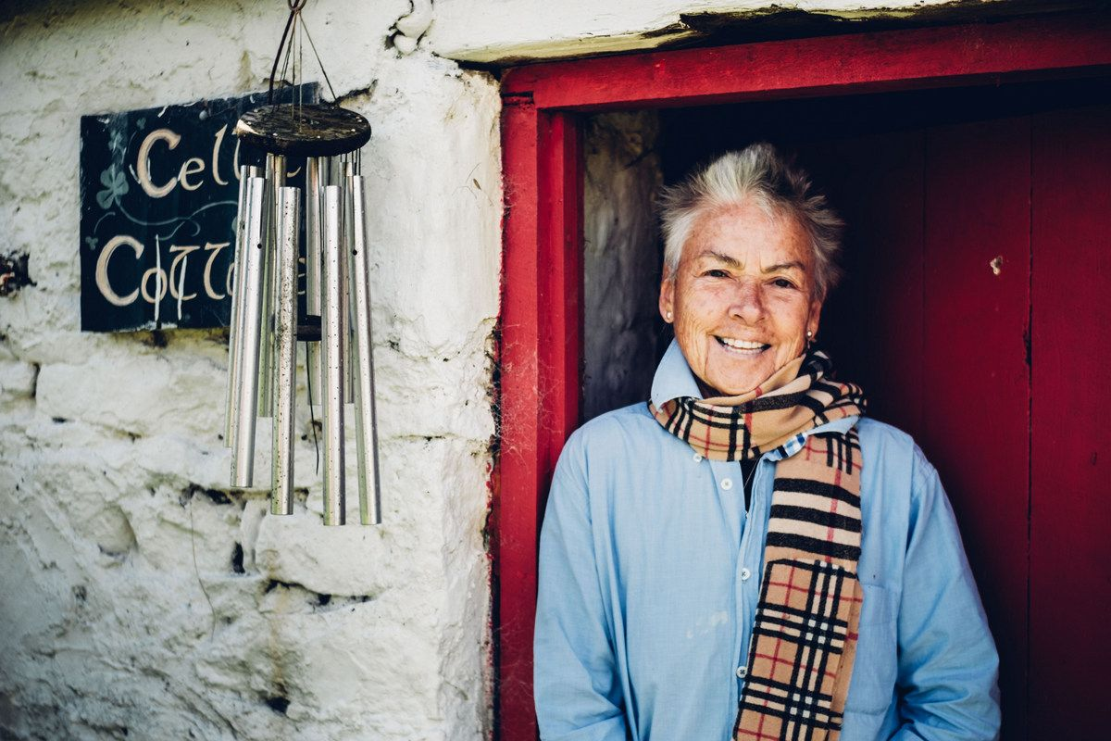

CASE STUDY
Entrepreneur: Lisa Gifford
Business: Leitrim Hill Creamery
Location: Ireland
CASE STUDY
Lisa grew up in New York and moved to Ireland in 2016. At 75, she moved to Leitrim. She got some goats and threw herself into making cheese. Her motto is “making something out of nothing” which led to her creation of Leitrim Hill Creamery, a micro-creamery in a converted hay shed that produces small-batch artisanal dairy products.
Visit their website for more information!

Slide 39

CASE STUDY
Entrepreneur: Lisa Gifford
Business: Leitrim Hill Creamery
Location: Ireland
CASE STUDY
Lisa’s words of advice?
“The challenges of a small business are ongoing and require education, intuition, honesty, patience, and rapid response, each and all used appropriately”.

Slide 40
04
EXPLORING FOOD BUSINESS IDEAS + CULTURE

Slide 41


IDEAS - IDEAS - IDEAS….
That’s completely normal! Business ideas can pop up anytime, so it’s good to stay open and curious.
It’s okay to feel unsure at the start.
Coming up with ideas might not feel easy right away, that’s completely normal!
Focus on dreaming big, not on limitations.
For now, don’t worry about time, money, or obstacles. This is your moment to imagine freely.
Give yourself space to explore.
Stay open, have fun, and let your ideas grow — you never know where they might take you!
By the end of this module, you’ll have tried out different creative techniques to help you find a business idea that feels right for you.
You’re starting to feel excited about the idea of creating your own food business but maybe you’re wondering… where do I even start?

Slide 42
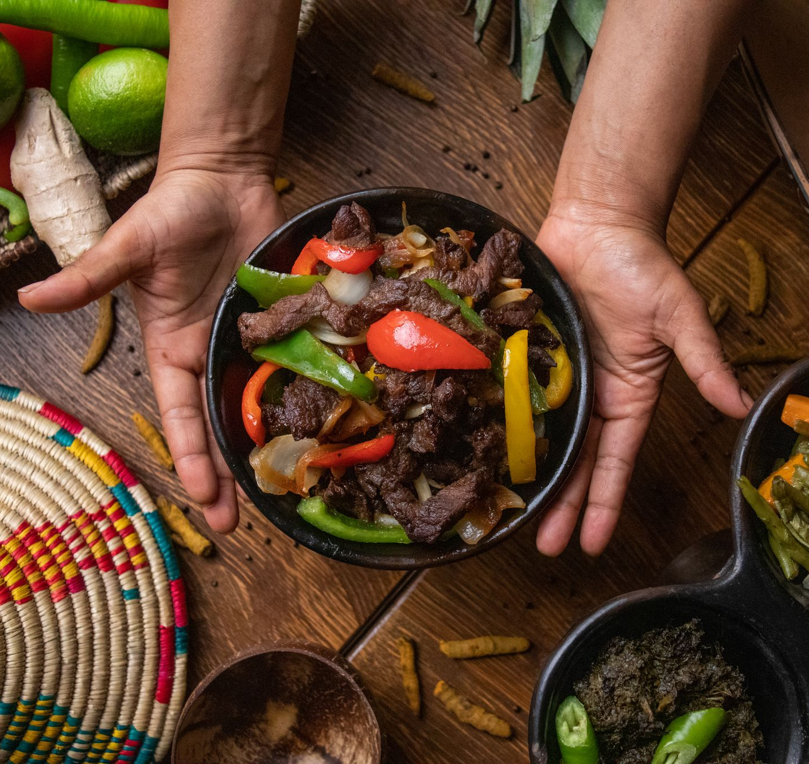
GETTING STARTED WITH IDEA GENERATION
Doing What You Love
Starting a successful new food business takes time. Lots of time…
So, as you begin to think about compelling new business ideas, none are more important than those related to your areas of passion.
When we do what we love, it makes the long hours easier, and that passion naturally translates into every aspect of your food business. Passionate entrepreneurs have an edge.

Slide 43
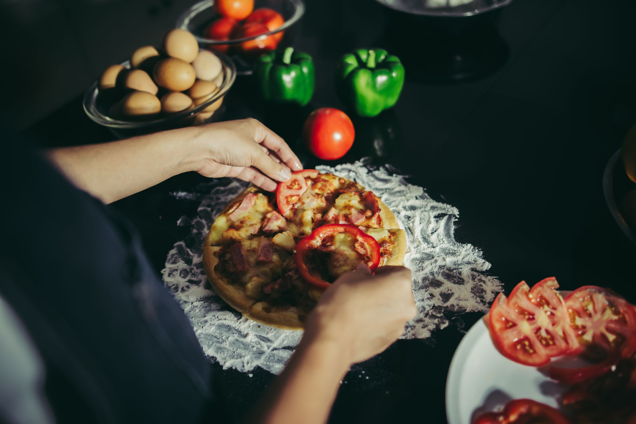
WHAT ARE YOU GOOD AT?
WHAT DO YOU LOVE DOING?
When considering your future food business, many parts of your life can spark a business idea. Your previous work experience, practical skills, hobbies, community connections, and even your family traditions can all inspire great food business ideas!
Family traditions: Recipes passed down through generations, holiday foods, or cultural cooking styles that others might love to try
Work experience: Cooking for events, working in restaurants or kitchens, or even organizing meals for large groups
Practical skills: Budgeting, meal planning, food preservation, growing your own ingredients, or making your own packaging
Hobbies: Baking, fermenting, foraging, or creating unique spice blends or snacks
Community connections: Cooking for church groups or helping with community meals
Everyday problem solving: Finding creative ways to make meals stretch, substitute ingredients, or cook without all the tools

Slide 44
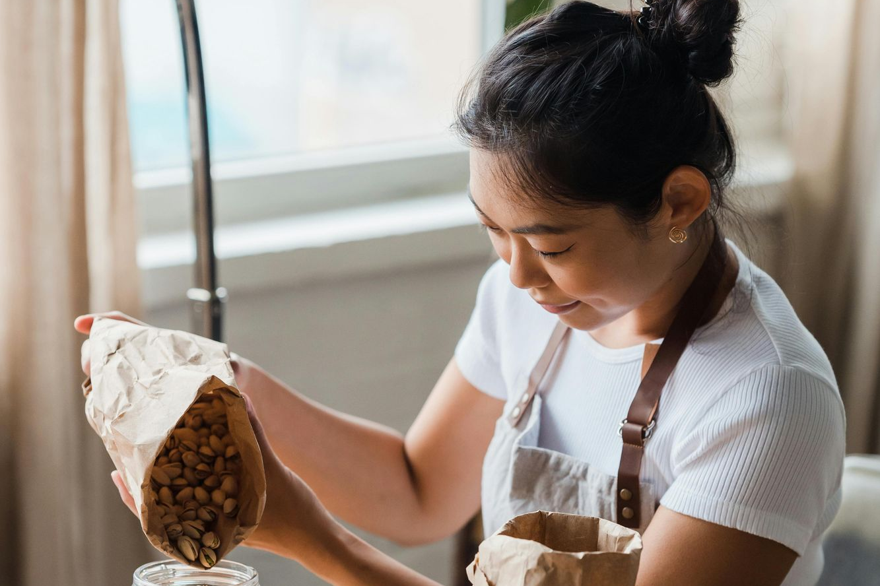
BUSINESS IDEA GENERATION
Now that you’ve explored your skills, passions, and life experiences, it’s time to start thinking about what kind of food business you could create.
Here are some questions to help you brainstorm:
What foods do you love to make and feel proud of?
Do friends or family always ask you for a certain dish?
Are there flavours from your culture that you don’t see in local shops or restaurants?
Could you offer something homemade, seasonal, or unique that fills a gap in your community?
Do you enjoy cooking, baking, preserving, catering, or something else?
Download worksheets (double click icon to access):
📝 Business Skills Worksheet (direct use) 📄 Business Idea Generation Worksheet (classroom facilitators and group work)

Slide 45
ASK YOURSELF
The food you make has meaning, and it can meet a real need in your community.
Who am I cooking for? Newcomers missing the taste of home Busy parents who want home-cooked meals Elders who enjoy traditional dishes but can’t cook anymore People curious to try food from other cultures | What are they struggling with? Not enough time to cook Limited cultural food options nearby Wanting something affordable, healthy, or freshly made Feeling disconnected from their food traditions | How can my food help? Offering comfort food from a familiar culture Making healthy, ready-to-eat meals for families Sharing special dishes during holidays or events Creating something unique that brings people together
Tip: A great business idea often starts when you notice:“Other people need this too.”

Slide 46

BUSINESS PLANNING ACTIVITY
This activity helps you think about everyday struggles around food, and how your experience and skills could offer a solution.
Step 1: What challenges (pain points) do people face?
Think about things you’ve noticed in your own life or community, especially as a migrant.
Write down 2–3 difficulties people face around food or daily meals. Example: “It’s hard to find traditional breads from my country at local shops.”
Step 2: What can you do or make that helps?
Think about the food you love to cook, your cultural knowledge, or what friends and neighbours ask you to make. Example: “I bake bread the traditional way from my region.”
Step 3: What’s your small business idea?
Now, try to connect a challenge with something you’re good at. Example: “I could sell fresh, traditional breads once a week at the local market.”

Slide 47

BUSINESS IDEA GENERATION
Steve Johnson, the author of “Where Good Ideas Come From,” has spent years researching and writing about this subject.
He believes that you are more likely to develop great ideas when:
You explore and experiment in different areas
You allow your idea to develop slowly, over time
You are exploring & open to the idea of serendipitous connections
You make mistakes
You look for new uses for old inventions
You build on platforms that have come before

Slide 48

FIND INSPRIRATION
There are numerous websites that collect and share innovative business ideas. One of our favourites is Trend Hunter, the world’s largest and most popular trend community. It's a great place for aspiring entrepreneurs and curious minds to discover fresh ideas!
➔ Visit Trend Hunter and use the search bar to explore sections that are especially useful for food entrepreneurs:
Trend Hunter Eco – for ideas about sustainable packaging, local ingredients, and zero-waste food practices
Social Business – for food projects that support community wellbeing, cultural sharing, or food access
You'll find ideas organised by themes spanning plant-based foods, cultural street food, food delivery, low-cost meals, packaging design, and more. From flatbreads to food boxes, from spice blends to supper clubs, see how others are turning everyday cooking into opportunity.
Inspirational websites

Slide 49


FIND INSPIRATION
Looking for Even More Inspiration? Check These Out!
Here are some more great places to find business ideas, tips, and success stories:
Inspiration News & Topics – Entrepreneur.com
➔ Explore articles about starting, running, and growing your business – full of real-world advice and fresh ideas.
1,001 Smart Business Ideas – Inc.com
➔ Browse this huge list of creative ideas – you might find one that sparks something exciting for you!
Business Ideas Lab
➔ Discover start-up stories and creative business concepts from entrepreneurs around the world.
Take your time, explore, and let yourself be inspired. Your idea could be just one click away!

Slide 50
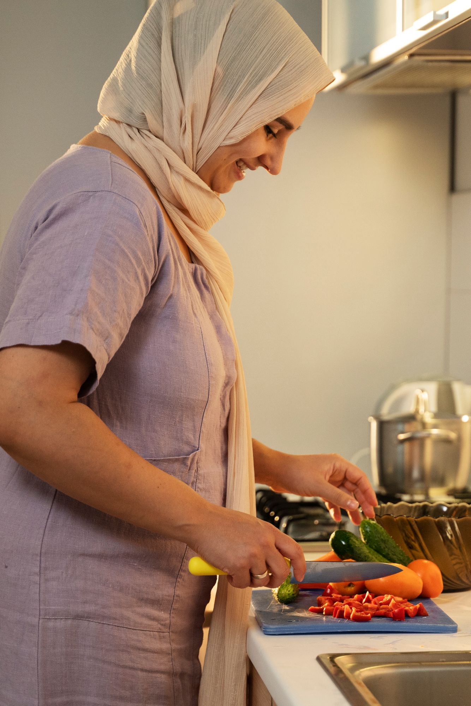
BUSINESS IDEA GENERATION
Bring a Piece of Your Culture to Your New Community
Your food traditions are powerful—they carry memories, meaning, and the potential to build a business.
Think about the breads, spices, snacks, street food, home-style meals, or celebration dishes from your country or region.
Could you adapt or “recycle” a food idea from your culture and share it with people in your local area?
You don’t need to invent something completely new
You can start with a dish or food product you already know and love
You can improve it, give it a personal twist, or adjust it for local tastes or ingredients
You can combine your food heritage with your new surroundings to create something meaningful

Slide 51
BUSINESS RECYCLE ACTIVITY
Brainstorming Your Food Business Idea
Let’s take some time to explore inspiring stories!
➔ Search online for entrepreneurs who have started interesting food businesses in other countries.
As you read about their journeys, ask yourself:
What food need are they solving for their community?
Would people in my new community also appreciate something like this?
Could I bring a similar idea here – with my own cultural twist?
Remember:
Your unique background and love for food can bring something beautiful and needed to your community. Trust your instincts — you are building something special!
If you find a business idea that feels exciting or meaningful, make a note of it on the next slide!

Slide 52
BUSINESS RECYCLE ACTIVITY
Make a note of the following when you come across a business or an idea that strikes you as interesting and high potential
What food products or services are they selling?
How could I improve on what they are doing?
Who in my community/location would be my target market?
Name of Business: …...................................
Location: …..................................................
Website: …..................................................
➔ Read this inspiring article and discover how simple ideas became amazing business journeys!

Slide 53

DEVELOPING YOUR BUSINESS IDEA
Ask Around — Good Ideas Grow in Conversation
You don’t have to come up with every idea by yourself. Often, the best ideas are found when we talk to others and really listen.
Brainstorming together is a powerful way to discover new possibilities. If you’re not sure where to begin, try reaching out to people around you:
Ask family and friends - What kind of food do you miss?
Listen carefully to what your community needs or wishes for. What foods do people talk about with love or nostalgia?
Stay open and curious! Simple conversations could lead to a powerful idea.

Slide 54
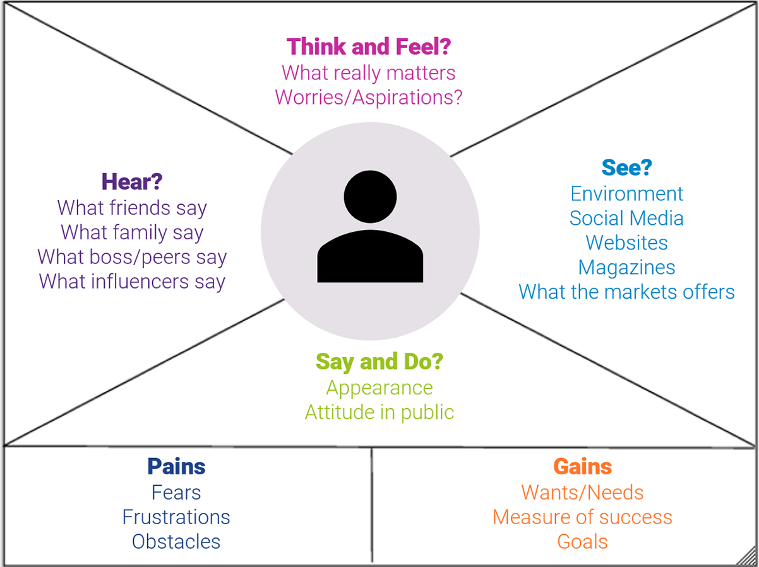
EMPATHY – A WEALTH OF NEW BUSINESS IDEAS
Empathy is our ability to see the world through other people's eyes, to see what they see, feel what they feel, and experience things as they do. Earlier, you learnt that the best business ideas come from responding to a customer’s pain point.
Therefore, empathy is an important tool to help us gain a deeper appreciation and understanding of people's emotional and physical needs, and how they see, understand, and interact with the world around them.
The better you can understand people’s needs, the more prepared you will be for designing food products or services to meet those needs.
➔ Read more about Empathy Mapping!

Slide 55

DESIGNING A FOOD PRODUCT OR SERVICE FOR A SPECIFIC GROUP OF PEOPLE
When you are empathetic — when you truly put yourself in someone else’s shoes — you can start to notice problems or needs that a food business could help solve.
The group of people who would benefit most from your business is called your target market.
You can describe your target market by different characteristics, such as:
Age
Gender
Profession
Interests
Location
And as you’ll see in the next section, you should also think about cultural aspects, such as ethnicity, nationality, or traditions. These can offer rich opportunities to create a food business that feels personal and meaningful.
➔ Read more about the importance of empathy in this article!

Slide 56

CULTURE IS A POWERFUL PART OF WHO YOU ARE
Culture shapes who we are. It influences how we think, how we act, and how we see the world. Culture is more than where you come from—it’s what you cook, how you share, and the stories that live in your food.
In 3 Kitchens, we believe your culture is a strength. It shapes what you make, how you serve others, and how you connect with your community.
Culture can show up in:
Recipes passed down through generations
Spices, flavours, and ways of cooking
Family rituals, holiday meals, or community celebrations
Tools, techniques, and food traditions unique to your region
Cultural diversity is a strength.Your roots, your memories, and your cooking traditions can inspire a food business that brings comfort, curiosity, and connection to others.
My culture is a rich source of new business ideas

Slide 57
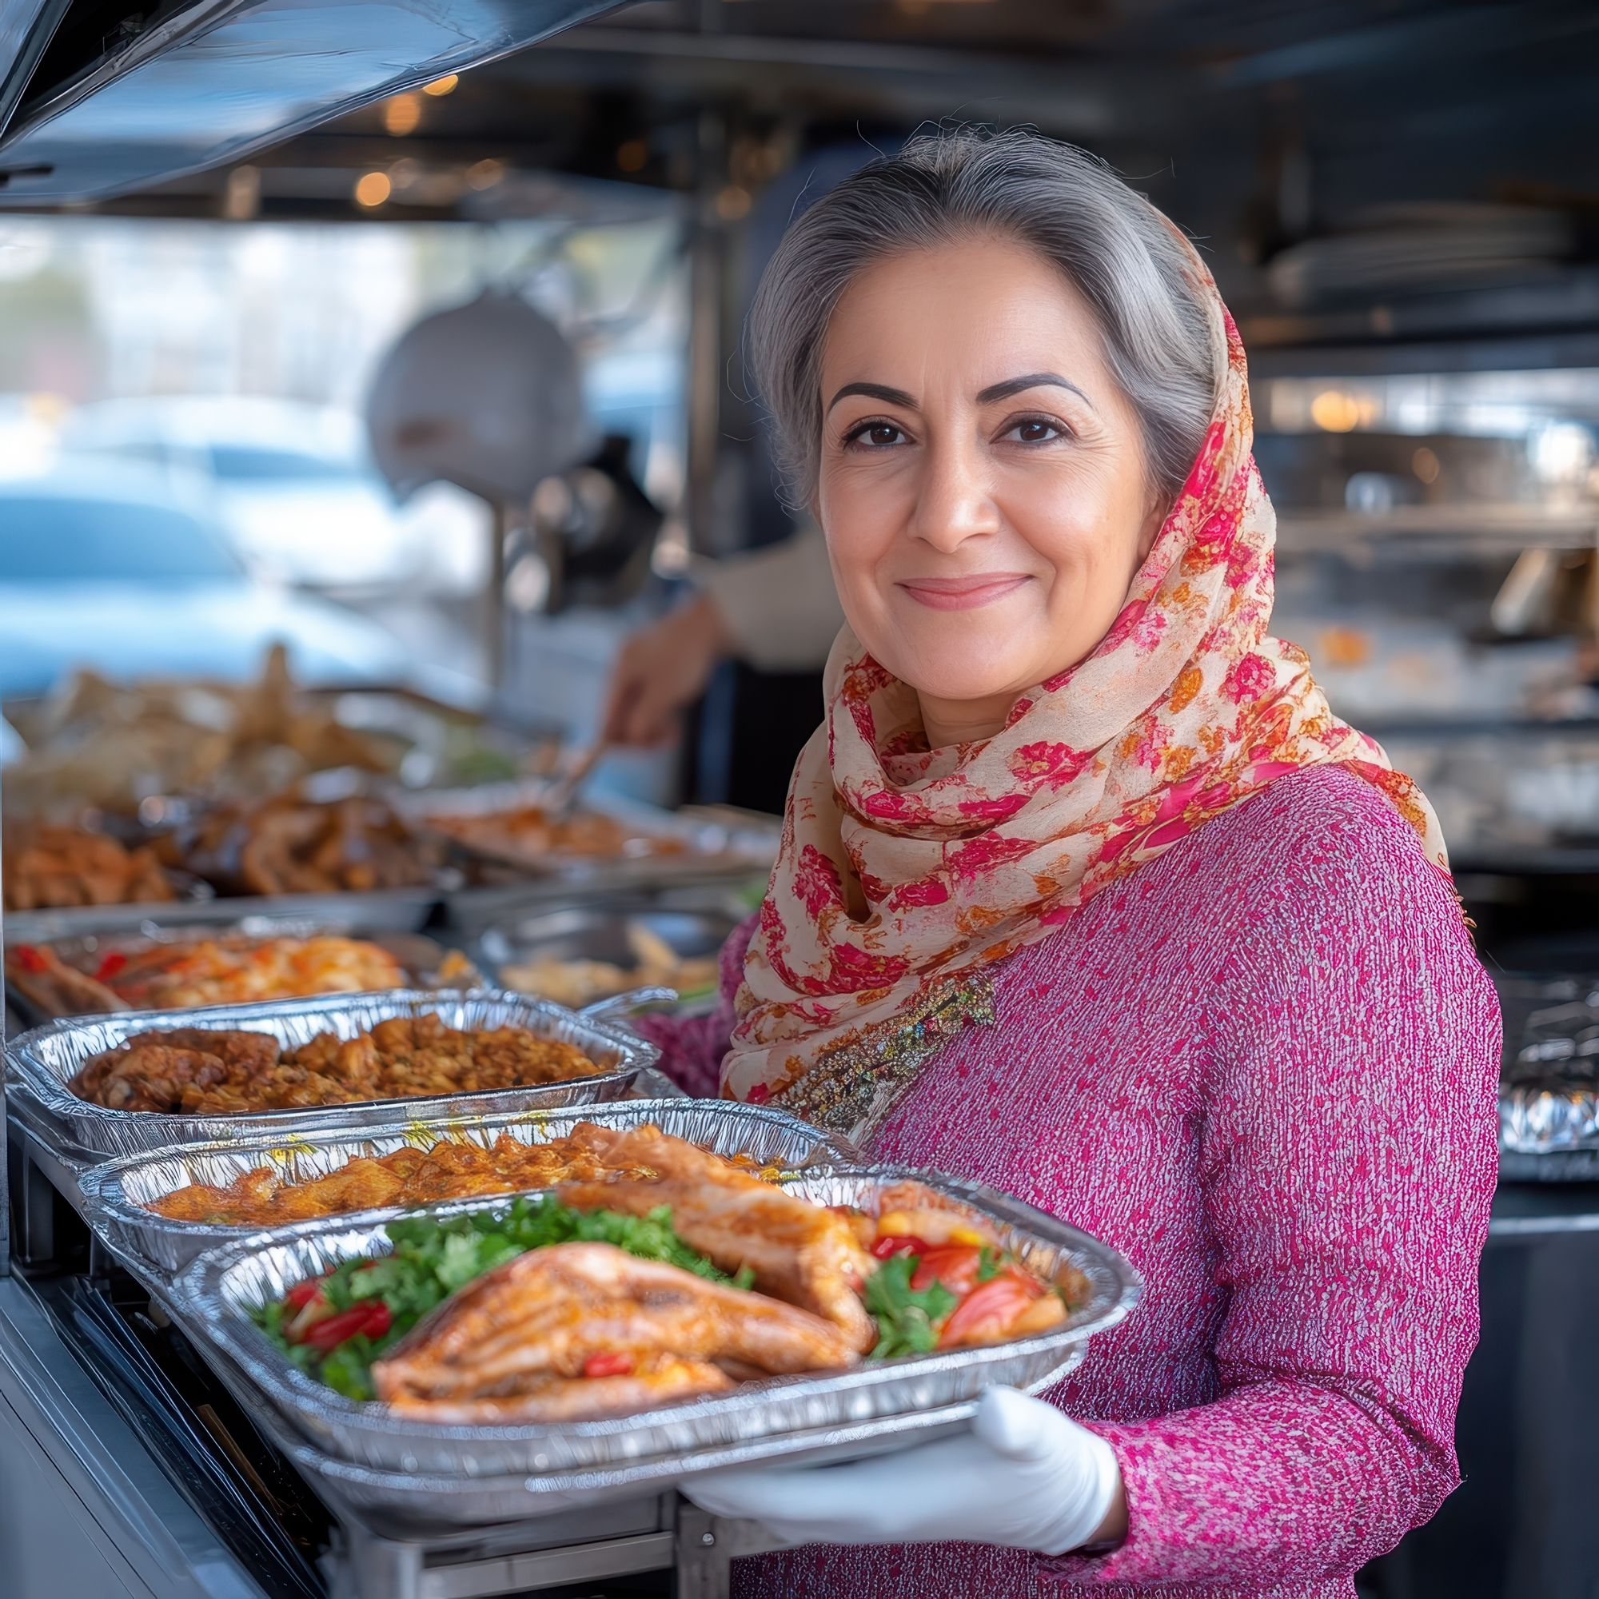
A FOOD BUSINESS INSPIRED BY YOUR CULTURE
Eritrean Cuisine – Rich Flavours with Deep Roots
Your business could prepare injera with lentils, spicy stews, or a vegan meal box based on fasting traditions. Many people are looking for plant-based food options, this is a way to meet that need while sharing something meaningful from your culture.
Pakistani Street Snacks – Big Flavour in Small Bites
Crispy samosas, spicy pakoras, or chana chaat (chickpea salad) are perfect for markets, festivals, or home delivery. These snacks are vegetarian-friendly, and full of flavour, great for curious eaters
Ukrainian Meals - Authentic Recipes with Market Appeal
Dishes like deruny (potato pancakes), borscht, Holubtsi (stuffed cabbage rolls) could be offered as a weekly takeaway service, frozen meal packs, or catering for community events, giving people a taste of Ukraine’s hospitality.

Slide 58
WHAT ABOUT A BUSINESS INSPIRED BY YOUR CULTURE?
North African Spices – A Flavorful Journey
Many dishes from North Africa feature bold spices and colorful flavors. A spice shop, cooking classes, or a street food stand could introduce people in your community to the richness of this cuisine.
Middle Eastern Coffee Traditions – A Business Around Connection
Coffee plays an important social role in many Middle Eastern countries. Opening a coffee cart or coffee house that shares traditional brewing methods and fosters a sense of community could offer something new and welcoming in your town.

Slide 59

IDEAS GENERATION TECHNIQUES – BRAINSTORMING
Try these exercises on your own or with a group — they can really help you!
What is brainstorming?
Brainstorming is a way to break out of your usual way of thinking.
It helps you come up with lots of ideas – even ones that might seem a little crazy at first.
But sometimes, it’s those unexpected ideas that can turn into brilliant, creative solutions for real problems.

Slide 60
IDEAS GENERATION TECHNIQUES – BRAINSTORMING
Getting Started with Brainstorming
Brainstorming works best when you have clear instructions and a time limit.
Remember: during brainstorming, there are no bad ideas — no judging yourself or others.
Focus on the quantity of ideas, not the quality.
Let your mind wander and explore — you might be surprised where it leads!
Some of the best business ideas started as wild, "crazy" dreams — stay open to the unexpected.
➔ Read more about Brainstorming in this article!

Slide 61
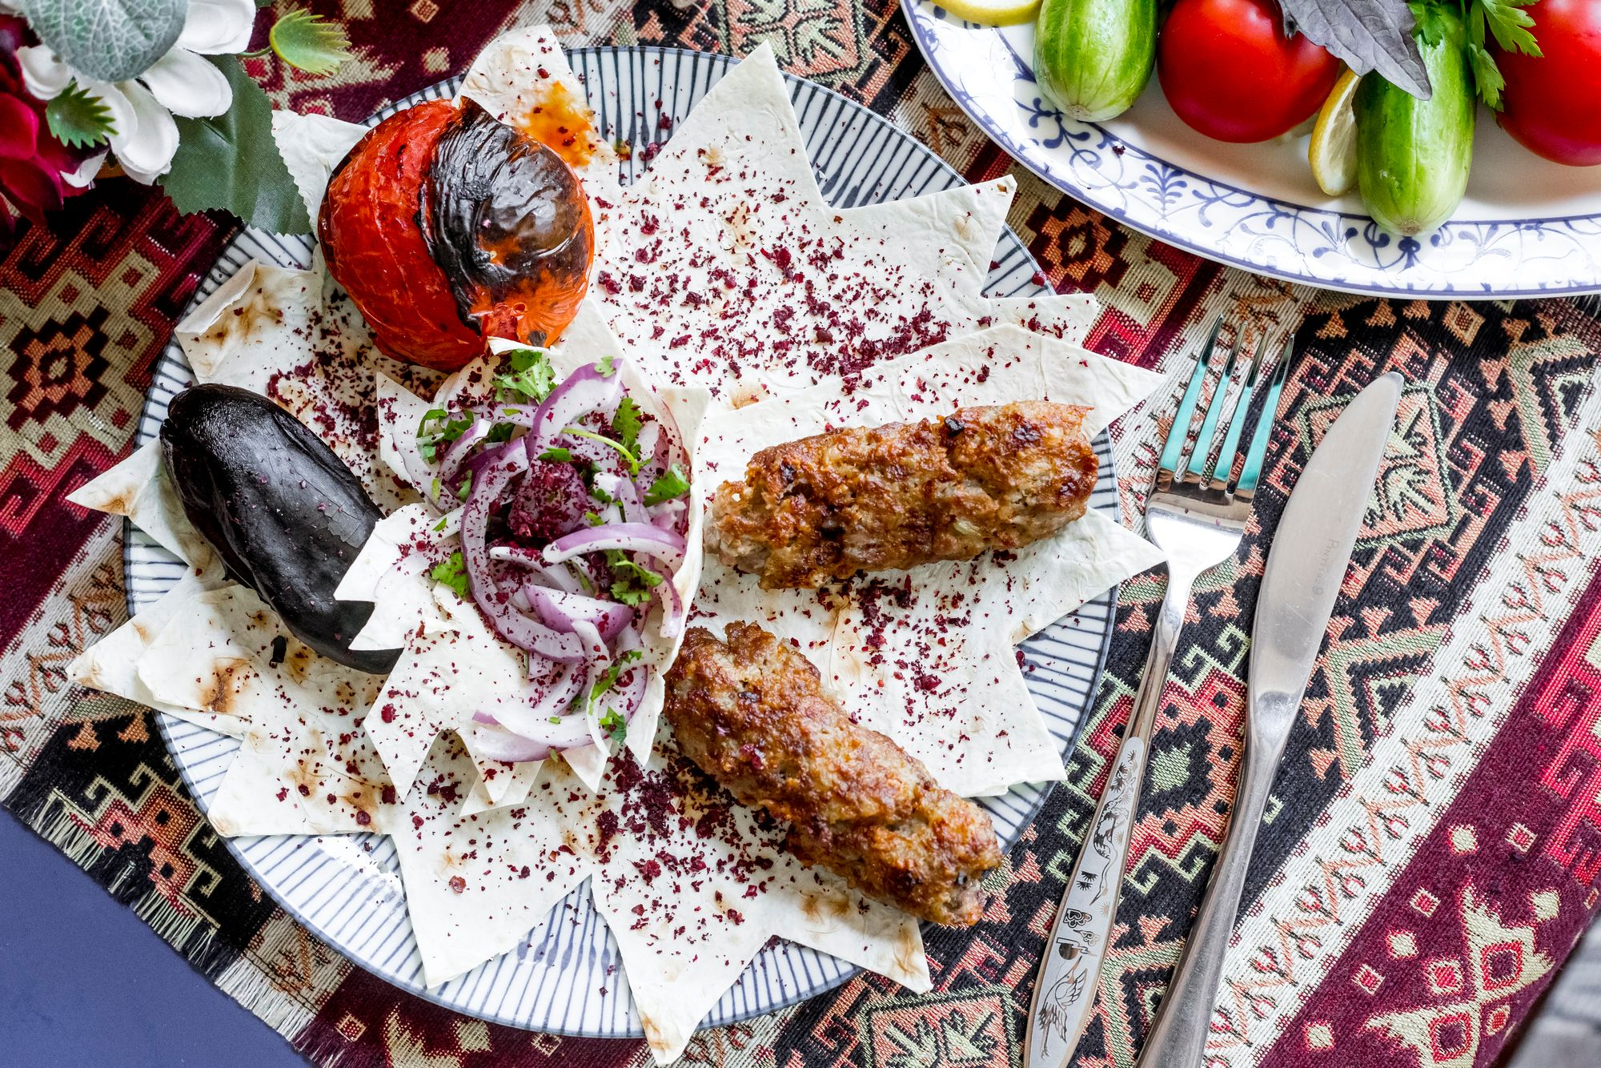
“Step out of the history that is holding you back.
Step into the new story you are willing to create.”
- Oprah Winfrey

Slide 62
WHAT IF ACTIVITY - BUSINESS IDEA BRAINSTORM
Don't be afraid to let your imagination run free.
Ask yourself:
What if people could subscribe to fresh bread deliveries?
What if I could make affordable vegan food using the flavours from my culture?
What if I cooked for people during holidays from home—so they didn’t feel alone?
What if I could send a food box to someone who misses our cooking?
What if my neighbours could taste a dish from my country each week?
➔ Read more about this method in this interesting article!

Slide 63
WHAT IF ACTIVITY - BUSINESS IDEA BRAINSTORM
The more you practice thinking creatively, the easier it becomes to dream up products and services that make people's lives better.
Think about two food-related items, habits, or needs.
Could you combine them to create something useful, fun, or unique?
Examples:
Combining a spice mix and a recipe card to sell as a meal starter pack
Combining a bread delivery service with a WhatsApp ordering system
Combining leftovers with preserving techniques to create a zero-waste snack
Combining a home kitchen with community catering to offer meals for cultural events
Combining traditional recipes with local ingredients to create a fusion menu

Slide 64
05
WHAT FOOD BUSINESS SHOULD I START?

Slide 65

EXPECTED GROWTH AREAS IN FOOD ARE
Focus on health and wellness (e.g. plant-based meals, low-sugar snacks, allergy-friendly options)
Offer convenience (e.g. meal kits, ready-to-eat foods, home delivery services)
Celebrate cultural identity (e.g. regional cooking, traditional dishes, fusion cuisine)
Support sustainability (e.g. zero-waste cooking, reusable packaging, local ingredients)
Build community (e.g. shared kitchens, pop-up events, food clubs or supper circles)
You don’t need a restaurant to start a food business. You can begin with:
Home-based catering or meal prep
Market stalls or festival booths
Special orders for events and holidays
Subscription or delivery models
Teaching, workshops
Recipe kits

Slide 66
WHAT FOOD BUSINESS SHOULD I START? LET’S LOOK AT SOME OPTIONS …
Home-Based Cooking: Prepare meals, snacks, or baked goods from your home kitchen for friends, neighbours, or local orders.
Market Stall or Pop-Up: Sell traditional dishes, street food, or speciality products at farmers’ markets, festivals, or temporary events.
Catering or Special Orders: Cook for birthdays, weddings, or other cultural events. You can also take pre-orders for holidays or community gatherings.
Meal Kits or Subscriptions: Create and deliver recipe kits, spice packs, or ready-made meals on a weekly or monthly basis.
Teaching and Food Skills: Conduct small classes or workshops that teach bread-making, traditional recipes, or cultural cooking techniques.
Preserves, Pickles, or Snacks: Create shelf-stable products, such as sauces, chutneys, or dried snacks that can be sold online or in local shops.
You don’t have to choose just one, start where you feel confident, and grow from there. What could you try first?

Slide 67
LET’S LOOK AT SOME OPTIONS …
Storefront or Non-Storefront Business
To sell your products, you may need a "storefront" – either a physical space like a shop or café, or an online store through a website or social media.
Many businesses today use both, reaching local and online customers at the same time.
You can also start small by selling at food markets or events.
Starting small and simple helps you build experience and grow without taking big risks.
Product or Service (or Mix of Both)
You could focus on:
Making and selling your food – at farmers markets, online, or through local shops (e.g., sauces, baked goods, ready meals).
Catering small gatherings
Personal chef services – cooking in clients’ homes or delivering ready-made meals.
Pop-up dinners or food events – curated, intimate dining experiences.
Meal prep for convenience – offering weekly meal packages or custom diet plans.

Slide 68

Next.. Step 2
RESEARCH – DEEP DIVE INTO YOUR BUSINESS IDEA
www.3kitchens.eu

