Slide 1
Employability Programme -Food Industry Skills
M2.5
Overcoming Sexism
www.3kitchens.eu

Slide 2
01
Contents
Understanding sexism in the kitchen
02
Your rights to face sexism in the workplace
03
Support networks

Slide 3
01
Understanding sexism in the kitchen

Slide 4
Understanding sexism in the kitchen
In this sensitive module, we will explore what sexism looks like in the kitchen, provide practical examples, and offer strategies to handle these situations effectively.
Sexism in the culinary industry can manifest in various and insidious ways. The aim of this module is to help you recognize theses behaviours and address them.
We will also cover the legal framework in place to protect you. Each section includes a quiz to test your knowledge,

Slide 5
Understanding sexism in the Kitchen
Unequal treatment
01
Women may be given less important tasks or fewer opportunities to advance compared to their male colleagues.
For instance, while men might be assigned to the grill or sauté stations, women may be relegated to the salad station, which may be perceived as less prestigious or challenging.

Slide 6
Understanding sexism in the Kitchen
Unequal treatment
01
How to face it :
By promoting yourself:
If you are given less challenging tasks compared to your male colleagues, you need to speak up.
Politely ask your supervisor for more responsibilities and explain how you can handle them.
You could say, "I’ve noticed that I’ve been working on the salad station for a while. I’m confident in my skills and would love the opportunity to work on the grill station."

Slide 7
Understanding sexism in the Kitchen
Inappropriate comments
02
Comments about a woman's appearance or abilities based on gender are unfortunately common.
For example, a male chef might tell you, "Are you sure you can handle that? It’s pretty heavy for a girl," implying that women are not strong enough for certain tasks.

Slide 8
Understanding sexism in the Kitchen
Inappropriate comments
02
How to face it :
- Addressing the comment:
If someone makes this kind of comment, you can respond by saying, "That comment is not appropriate and makes me uncomfortable. Please stop."
Another one, if a colleague says, "You’re pretty good for a girl," you could respond, "I’d prefer if you judged my work based on its quality, not my gender."

Slide 9
Understanding sexism in the Kitchen
Exclusion
03
Being left out of team meetings or networking social events can impact a woman’s career.
It seems small but after-work drinks or social events are crucial to develop your network and get to know your colleagues better. But perhaps this is not part of your culture. If this applies
How to face it :
Express your desire to be included to your supervisor or HR, by putting spotlighton how your participation is beneficial for the team. You might say, "I think my input could be valuable. Can we ensure I’m included in future discussions?"

Slide 10
Quiz : Understanding sexism in the kitchen

Slide 11
Question 1:
What is an example of unequal treatment in the kitchen?
a) Women being given fewer opportunities to advance
b) Equal task distribution among all staff
c) Men receiving less important tasks

Slide 12
Answer to Question 1:
What is an example of unequal treatment in the kitchen?
Answer: a) Women being given fewer opportunities to advance

Slide 13
Question 2:
Inappropriate comment
How might you respond to an inappropriate comment?
a) Stay silent and ignore it
b) Politely ask them to stop the inappropriate comment
c) Make a similar inappropriate comment back

Slide 14
Answer to Question 2:
Inappropriate comment
Answer: b) Politely ask them to stop the inappropriate comment

Slide 15
Question 3:
Exclusion
What should you do if you are excluded from important meetings?
a) Complain to your colleagues
b) Speak to your supervisor about being included
c) Stop attending meetings altogether

Slide 16
Answer to Question 3:
Exclusion
Answer: b) Speak to your supervisor about being included

Slide 17
02
Your rights to address sexism in the workplace

Slide 18
Your rights to address sexism in the workplace
Across EU countries, there are laws and regulations in place to protect you from sexism and discrimination in the workplace.
Find in the next slides, examples of laws and directive created to protect you.
This legal framework serves as a shield, empowering you to advocate for yourself and others in the culinary industry.

Slide 19
Your rights to address sexism in the workplace
The Gender Equality Directive The Gender Equality Directive
The Gender Equality Directive (2006/54/EC) ensures that men and women are treated equally at work, including in job opportunities, promotions, and working conditions. It stops any unfair treatment based on sex, especially concerning pay.
By knowing this directive, you can recognize if you are being treated unfairly compared to male coworkers. It empowers you to challenge unfair practices and seek justice for any gender-based inequality at work.

Slide 20
Your rights to address sexism in the workplace
The Victims’ Rights Directive
The Victims’ Rights Directive (2012/29/EU) sets rules to support and protect victims of crime, ensuring they are treated with respect. This includes victims of gender-based violence and harassment at work.
If you have faced sexism or harassment in the culinary industry, this directive helps you get the proper support and protection. It also ensures you can access justice and gives guidelines for employers on handling such issues.

Slide 21
Your rights to address sexism in the workplace
The Work-Life Balance Directive
The Work-Life Balance Directive (2019/1158) aims to improve access to family leave and flexible work arrangements. It recognizes the challenges faced by working parents and caregivers, promoting equal opportunities and treatment in the job market.
This directive helps you, especially if you juggle multiple roles. It supports your right to request flexible work schedules and take family-related leave without the fear of discrimination or losing your job.

Slide 22
Your rights to face sexism in the workplace
Harassment Policies
Your employer should have policies that protect you from harassment. These policies should clearly define what constitutes harassment and outline the steps to report it.
Familiarize yourself with your workplace’s policies on discrimination and harassment.
Ask employer/HR for a copy of the employee handbook

Slide 23
Your rights to face sexism in the workplace
Reporting Mechanisms
Keep a record of incidents, including dates, times, and details of what happened. This can be crucial if you need to provide evidence to support your claims.
There should be a clear process for reporting incidents of discrimination or harassment. This might include contacting your employer, speaking to a designated compliance officer and filling out a report form.
If you experience or witness sexism, report it to your employer/HR department or a trusted supervisor. Be clear about what happened and provide as many details as possible.

Slide 24
QUIZ

Slide 25
Multiple Choice Questions
1 . What is the Gender Equality Directive (2006/54/EC) focused on?
a) Ensuring equal treatment of men and women at work
b) Protecting against workplace violence
c) Providing maternity leave
d) Promoting flexible work arrangements

Slide 26
Multiple Choice Answer
1 . What is the Gender Equality Directive (2006/54/EC) focused on?
Answer: a) Ensuring equal treatment of men and women at work

Slide 27
Multiple Choice Questions
2. What does the Victims’ Rights Directive (2012/29/EU) ensure?
a) Access to justice and support for victims of crime
b) Equal pay for equal work
c) Gender equality in promotions
d) Availability of family-related leave

Slide 28
Multiple Choice Answer
2. What does the Victims’ Rights Directive (2012/29/EU) ensure?
Answer: a) Access to justice and support for victims of crime

Slide 29
Multiple Choice Questions
3. What is the purpose of the Work-Life Balance Directive (2019/1158)?
a) To stop gender-based violence
b) To improve access to family leave and flexible work arrangements
c) To ensure equal pay
d) To provide training programs

Slide 30
Multiple Choice Answer
3. What is the purpose of the Work-Life Balance Directive (2019/1158)?
Answer: b) To improve access to family leave and flexible work arrangements

Slide 31
Multiple Choice Questions
4. Which of the following is a step you should take if you experience discrimination or harassment at work?
a) Ignore the incident
b) Report it to your HR department or a trusted supervisor
c) Complain to colleagues
d) Quit your job

Slide 32
Multiple Choice Answer
4. Which of the following is a step you should take if you experience discrimination or harassment at work?
Answer: b) Report it to your HR department or a trusted supervisor

Slide 33
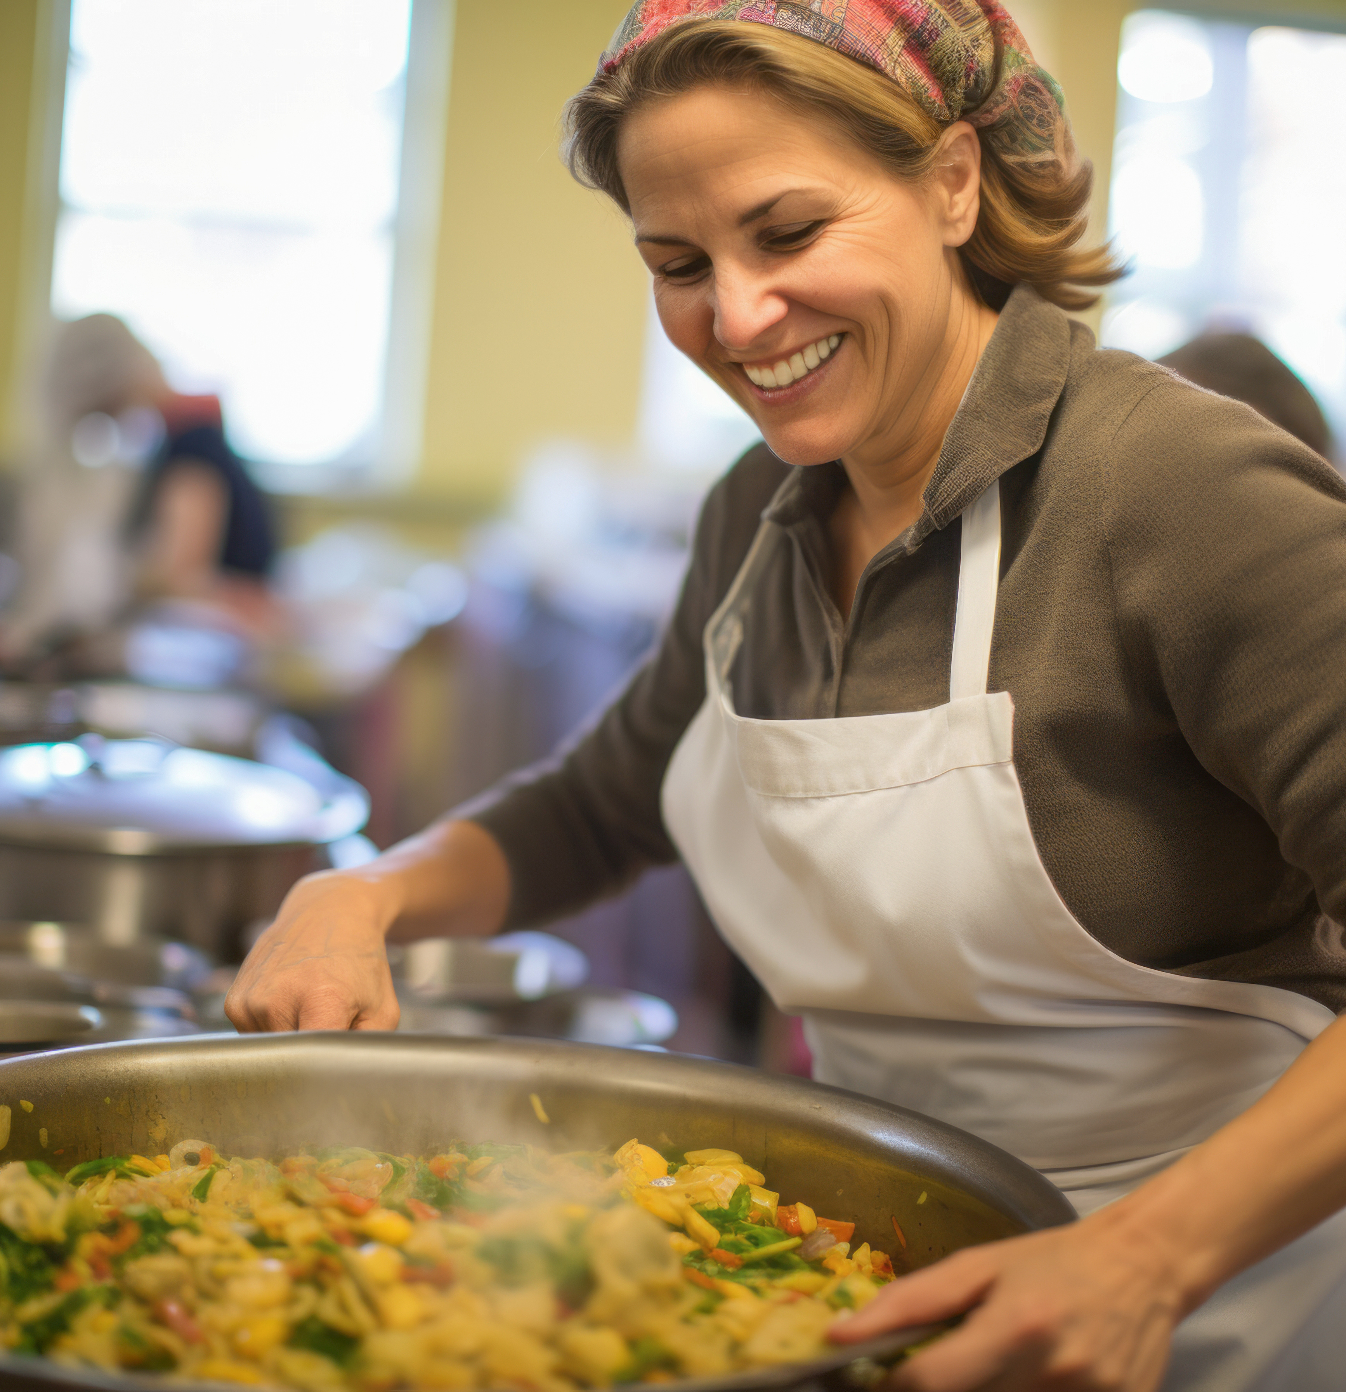
Multiple Choice Questions
5. Why is it important to keep a record of incidents of discrimination or harassment?
a) To inform your colleagues
b) To provide evidence to support your claims
c) To write a blog post
d) To file a lawsuit

Slide 34
Multiple Choice Answer
5. Why is it important to keep a record of incidents of discrimination or harassment?
Answer: b) To provide evidence to support your claims

Slide 35
03
Support networks

Slide 36
Support networks
Being part of networks can help you to remember that you are not alone and that there are resources available to support you. Indeed, you can contact local and online organizations and people outside your workplace to have an outside perspective.
You can join networks such as European Network of Migrant Women (ENoMW) to strengthen your rights. This network aims to empower you through advocacy, networking, and capacity-building. Click and take a look at ENoMW’s website.
If you need support services, such as a helpline, counselling, and legal assistance, you can contact the network Women Against Violence Europe (WAVE).WAVE Network Website

Slide 37
Support networks
In addition, find below a list of networks you can contact,
France Fédération Nationale Solidarité Femmes (FNSF): This organization coordinates a network of shelters and support services for women victims of violence. Visit FNSF
Netherlands Mama Cash: Provides funding and support to feminist and women's rights groups working on issues such as gender-based violence and discrimination. Visit Mama Cash

Slide 38
Support networks
Sweden
Swedish Gender Equality Agency: Promotes gender equality in all areas of society and ensures that a gender equality perspective is brought into policymaking. Gender Equality Agency Website
Ireland
National Women’s Council of Ireland (NWC): Conducts campaigns to raise awareness and combat sexism, including targeted sexist and racist attacks on women in public life. NWC Website
Immigrant Council of Ireland: Provides legal services and leads integration and policy campaigns benefiting trafficked migrant women, including those exploited in the sex industry or through forced marriages. Immigrant Council of Ireland Website

Slide 39
Thank you
www.3kitchens.eu

