Slide 1
Employability Programme - Self-Improvement Skills
M2.4
PUBLIC SPEAKING SKILLS
www.3kitchens.eu

Slide 2
This module outline helps participants understand the fundamental public speaking skills while offering practical tips and activities to enhance their confidence and effectiveness

Slide 3
PUBLIC SPEAKING
01
Essential Public Speaking Skills
02
A Few Strategies to Help You
03
Useful Videos

Slide 4
01
Essential public speaking skills

Slide 5
Essential public speaking skills
Public speaking is a valuable skill that can enhance your personal and professional life.
Whether you ever speak in public or not, the skill gained will enhance your communication skills and also boost your confidence, help you network effectively, and even help in sharing your culinary stories and heritage.

Slide 6
Essential public speaking skills
Here are some essential skills and tips to become a confident and engaging public speaker:
Know your audience
Structure your speech
Practice and preparation
Effective Communication
Body Language
Overcoming nervousness
Use of visual aids.
Engage and Interact
Handle questions and feedback
Continuous Improvement

Slide 7
01
Know your audience
Tailor your message to connect with your audience.
Ask questions, encourage participation, and make eye contact to create a connection with your listeners.
02
Structure your speech
Start with a strong opening that grabs attention. Introduce the main points you will cover.
Use clear transitions to guide your audience through your speech.
Summarise your key points and end with a memorable closing statement that reinforces your message.

Slide 8
03
Practice and preparation
Practice your speech multiple times. Rehearsing helps you become familiar with the content and improve your delivery.
Ensure your speech fits within the allotted time. Practice pacing to avoid speaking too fast or too slow.
Use brief notes or an outline to stay on track without reading directly from them.
04
Effective Communication
Speak clearly and avoid using unnecessary jargon. Keep your message concise and to the point.
Vary your pitch, tone, and volume to maintain interest and emphasise key points.

Slide 9
05
Body Language
Stand up straight, with shoulders back, and avoid fidgeting. A confident posture conveys authority and confidence.
Use natural hand gestures to emphasise points. Avoid overusing gestures, which can be distracting.
Use appropriate facial expressions to convey emotions and connect with your audience.
06
Overcoming nervousness
Practice deep breathing exercises to calm your nerves before speaking.
Build your confidence by practicing in smaller, less intimidating settings before larger audiences.

Slide 10
07
Use of visual aids
Use slides, charts, or props to support your message. Ensure visuals are clear and relevant to your speech.
Don’t overcrowd slides with text or images. Use bullet points and simple graphics to enhance understanding.
08
Engage and Interact
Encourage audience interaction by asking questions or inviting comments.
Personal stories can make your speech more relatable and engaging.
If possible, address individuals by name to create a more personal connection.

Slide 11
09
Handle questions and feedback
Anticipate potential questions and prepare thoughtful responses.
Handle unexpected questions or feedback calmly and professionally. If you don’t know the answer, it’s okay to admit it and offer to follow up later.
10
Continuous Improvement
Ask for constructive feedback from peers or mentors to identify areas for improvement.

Slide 12
Essential public speaking skills
By developing these public speaking skills and practicing regularly, you can become a more confident and effective speaker. The ability to communicate clearly and persuasively in front of an audience is a powerful tool that can open many doors in both your personal and professional life.

Slide 13
02
A Few Strategies to Help You

Slide 14
A Few Strategies to Help you
Breathe
Admit that you are nervous
Use a minimum amount of notes
Become comfortable with "The Pause"
Be aware of your hand gestures
Move around some, but not too much
Incorporate visual prompts
Practice, Practice, Practice…Then practice some more
Record yourself speaking

Slide 15
01
Breathe
When you're nervous, your heart rate speeds up, you begin to sweat, and if you're not careful you can easily work yourself into an anxiety attack. To help control all of these responses, take a few minutes before delivering your speech to close your eyes and take a couple of deep breaths. Calm your body so you can enter the stage (or speaking area) with a certain level of peace and not feeling all frenzied.

Slide 16
02
Admit that you are nervous
Even the most experienced public speaker can feel nervous on stage. The harder you try to hide this nervousness, the more obvious it will be.
03
Use minimum amount of notes
If public speaking makes you anxious, you may be minded to write your speech out word for word so you can look at it if you forget your next statement. If you read from a script you will lose your audience. Instead, keep your notes to a minimum, using only one or two-word prompts for each point you want to make. This will help you keep your place without detracting from your audience.

Slide 17
04
Become comfortable with "The Pause"
One of the biggest distractions is when a speaker who constantly says "uh" or "um." A well-timed break in speaking can even be used to help strengthen a point, letting it sit with the audience before moving on to the next topic. Become more comfortable with this pause and you will become a better public speaker

Slide 18
05
Be aware of your hand gesture
Have you ever talked to someone who is all worked up and noticed that their hands are flying wildly? Some people naturally speak with their hands. While some hand movement is a great way to emphasise certain points, it's also important to not let these movements distract from what you're trying to say. So, pay attention to your hands when you're speaking.
06
Move around some, but not too much
People often pace when they're nervous. If this is you, you may have a tendency to walk back and forth across the stage when public speaking.

Slide 19
07
Incorporate visual prompts
If the idea of having all eyes on you makes you nervous, visual prompts are a good way to divert the audience's attention yet still stay on topic. These prompts can include slides.
08
Practice, Practice, Practice…
Then practice some more
One way to overcome your nerves, is to practice, practice, and practice some more.

Slide 20
09
Record yourself speaking
This final public speaking tip is intended to help you recognise how you may come across to an audience. When you record yourself speaking and watch it back, you may notice that you do things that you didn't even realise. This provides the opportunity to correct these issues before being in front of a live audience.

Slide 21
Public speaking is a common fear
The good news, however, is that this fear doesn't have to stop you from delivering an amazing speech. These public speaking tips can help you feel some calmness while also better connecting with your audience…making you a more impactful public speaker.

Slide 22
03
Useful videos

Slide 23
Useful videos
Click to View

Slide 24
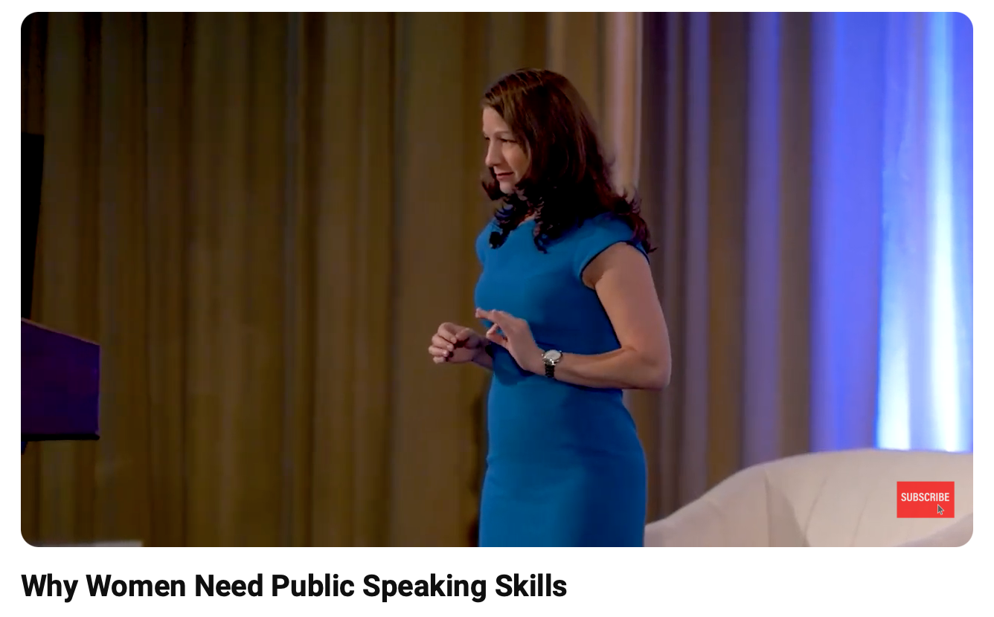
Useful videos
Click to View

Slide 25
Useful videos
Click to View

Slide 26
Well done, you have completed.
M2.4 PUBLIC SPEAKING SKILLS
www.3kitchens.eu

