Slide 1
Employability Programme - Self-Improvement Skills
M2.2
Personal Balance, Health & Self-Leadership
www.3kitchens.eu

Slide 2
This module provides learning and reflection on improving personal balance, health and self-leadership.
We explore personal balance in terms of physical and mental health and what influences your health. We look at the harmful effects of alcohol, drugs and tobacco and the positive effects of sleep, exercise and healthy food. Use it to purposely take steps to take care of yourself and your closest environment.

Slide 3
01
Health - Eating Habits
Personal Balance, Health & Self-Leadership
02
Health - Physical Exercise
03
Health - Sleep
04
Health - Alcohol
05
Stress and Traumatic Events
06
How can I Improve my Mental Health?
07
Self-Leadership & Empowerment

Slide 4
01
Health - Eating Habits

Slide 5
Eating Habits
We are what we eat.
What you eat and drink has a major impact on your health and how you feel.
A balanced diet not only helps in maintaining physical health but also enhances mental clarity and overall energy levels.

Slide 6
Nutrition
Nutrition involves consuming the food necessary for the health and growth of our bodies. As women, we need balance in our diet of
carbohydrates for energy,
proteins for muscle repair,
fats for energy and vitamin absorption.
vitamins and minerals for body functions.
Carbohydrates for Energy
Why It’s Important: Carbohydrates are the primary energy source for the body. Women, especially those who are active or have demanding daily routines, need a steady supply of carbohydrates to maintain energy levels throughout the day.
What to Eat: Opt for complex carbohydrates like whole grains, fruits, and vegetables which provide sustained energy without the rapid sugar spike that comes from processed sugars.

Slide 7
Nutrition
Proteins for Muscle Repair and Health
Why It’s Important: Protein is crucial for muscle repair, but it also plays a key role in other bodily functions, such as hormone production and immune response, which are vital for women’s health.
What to Eat: Include a variety of protein sources like lean meats, fish, eggs, dairy, beans, and legumes to support overall health and facilitate muscle repair.
Fats for Energy and Vitamin Absorption
Why It’s Important: Fats are not only a rich source of energy but are also necessary for the absorption of fat-soluble vitamins (A, D, E, K), which are crucial for various functions including bone health, immune function, and reproduction.
What to Eat: Choose healthy fats found in avocados, nuts, seeds, and oily fish like salmon, which provide omega-3 fatty acids beneficial for heart and hormonal health.

Slide 8
Nutrition
Vitamins and Minerals for Body Functions
Why It’s Important: Vitamins and minerals support a wide range of bodily functions from bone strength to blood health, essential for women at all stages of life.
What to Eat:
Calcium and Vitamin D: Critical for bone health, especially important for women to prevent osteoporosis. Found in dairy products, fortified foods, and leafy greens.
Iron: Essential for blood health, more so for women of reproductive age due to loss during menstruation. Rich sources include red meat, beans, and fortified cereals.
Folic Acid: Especially important for women who are pregnant or planning to become pregnant, as it helps prevent neural tube defects during pregnancy. Available in leafy greens, citrus fruits, and fortified foods.

Slide 9
Practical Tips
Migrant and refugee women might face barriers such as limited access to fresh and affordable food. Try to use local markets and community gardens, if available, to access fresh produce.
While adapting to new environments, it’s important to find ways to incorporate traditional foods into your diet. This is comforting but can also be a source of nutritional value if those foods are prepared healthily.
Difficulty in understanding food labels and health information due to language differences can be a significant barrier. Use apps like Google Translate.
Regular Eating Schedule: Maintain regular meal times to help stabilize metabolism and energy levels throughout the day.
Hydration: Adequate water intake is crucial. Aim for 1.5-2 liters per day, as it helps in nutrient transport and digestion.

Slide 10
02
Physical Exercise

Slide 11
Physical Exercise
Why exercise?
Our bodies were designed to move. This applies to all ages. Exercising more and sitting still less brings many positive effects. You will feel better and increase your chances of living a long life if you are physically active.
Many diseases and conditions can be improved with exercise. It can also ease pain and improve your mood. It is never too late to start exercising.

Slide 12
Physical Exercise
How much and what kind?
Adults need to exercise every day. A good way is to take a fast walk for 30 minutes, five times a week. Other good options include dancing, running, or going to a gym.
Your health will improve if you train your muscles – twice a week is a good amount. It is important to do balance training too, particularly for people over the age of 65.

Slide 13
03
Sleep

Slide 14
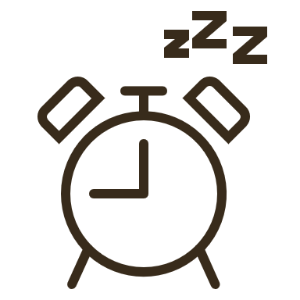
Sleep
Why sleep?
It is important to sleep well if you want to feel good. An adult normally needs to sleep for between six and nine hours per day.
If you have trouble sleeping, it may be due to many different things, such as anxiety and stress, smoking, alcohol, snoring, or illness.

Slide 15
Sleep
How can I improve my sleep?
You can improve your sleep if the room you sleep in is dark, quiet, and cool. You may find it easier to sleep if you don’t eat just before going to bed. And avoid technology for at least one hour before bed.
If you go to bed and get up at around the same time every day, that might also improve your sleep.
Relaxation exercises can also help when you have difficulties sleeping. There are also Apps that can help – check out free versions like Loóna: Bedtime relax & Sleep - Apps on Google Play. If your sleeping problems continue for a long time, it may be a good idea to seek medical care.
.

Slide 16
Reflection
Questions to reflect and discuss
What are your eating and drinking habits today?
Can you change any of them to improve your health?

Slide 17
04
Alcohol, Drugs and Tobacco

Slide 18
Alcohol, Drugs and Tobacco
Alcohol
Drinking alcohol for a long period can lead to depression, anxiety and sleep problems.
If you drink a lot of alcohol, there is a risk of you becoming addicted. There is also a risk that you will develop diseases or injuries.

Slide 19
Alcohol, Drugs and Tobacco
Cigarettes
Smoking can cause many diseases and can make people die earlier than they would have if they had not smoked. Cancer, lung diseases, cardiovascular diseases, and ulcers are some of the diseases you can get from smoking. When you are in the same room as someone who is smoking, you are also inhaling their smoke. This is known as passive smoking and can cause you to get the same diseases you would risk getting if you yourself smoked.

Slide 20
Alcohol, Drugs and Tobacco
Hookah or shisha and snus
Smoke from hookahs or shishas contains poisonous substances just like the smoke from cigarettes. It can be addictive, and can cause cancer and lung diseases. Since the tobacco used in hookahs or shishas is sweet, many people think it is less harmful, but it is not.
Snus is tobacco that is placed under the lip. Snus can cause injuries and diseases of the mouth and can lead to cancer.

Slide 21
Alcohol, Drugs and Tobacco
E-cigarettes
An e-cigarette/’vape’ is an electronic cigarette consisting of a mouthpiece, a battery, a heating element, and e-liquid. E-cigarettes is a way of absorbing nicotine without smoking tobacco but contains several other substances besides nicotine that can harm your health.
Smoking e-cigarettes affects your airways, harm your mouth health, and increase the risk of heart disease.

Slide 22
Alcohol, Drugs and Tobacco
Questions to reflect on
Do you have any other habits that may be harmful to your health?
Can you change any of them to improve your health?

Slide 23
05
Stress and Traumatic Events

Slide 24
Stress and Traumatic Events
Stress
Moving to a new country is a big change. Perhaps you were forced to flee your homeland. It is normal to feel anxious, sad, or stressed.
All stress is not bad, though – stress can be helpful too. Stress can give you extra strength to cope with difficult situations. But being stressed for an long period of time can be bad for your health. If you feel stressed, it is good to try to understand why. If you do, you can also try to change your situation.

Slide 25
Stress and Traumatic Events
Stress
Too much stress can make you sleep badly and feel sad. It can also make it harder for you to concentrate, make your memory worse, and give you stomach problems, headaches, or aches in other parts of your body. A lot of stress over a long period of time can lead to depression.

Slide 26
Stress and Traumatic Events
Traumatic events
If you have experienced or seen frightening events, such as accidents, war, or sexual or physical violence, you may get nightmares, have difficulties concentrating, or become irritable. This condition is known as post-traumatic stress disorder, or PTSD. If you have PTSD, it is common that you get recurring strong memories of what happened – this is called flashbacks. It may feel as if you are experiencing the frightening situation again. With the right treatment, many people with PTSD recover. Contact a medical care centre if you have experienced terrible events and do not feel well.

Slide 27
Stress and Traumatic Events
Dealing with difficult memories
Having difficult memories of war or of fleeing can affect your health. You may find it hard to concentrate and to sleep. Those are problems that have an impact on your everyday life, and even though they may not be easy to tackle

Slide 28
Stress and Traumatic Events
Here are things you can do
Try to see other people.
Try to have a schedule for your days – getting up at the same time every day and having breakfast, lunch, and dinner.
Do not watch films or video clips of war and violence.
Do not watch the news from your homeland too often, particularly not at night.
Do not use your computer or watch TV just before going to bed. Doing that makes it harder to fall asleep.

Slide 29
Stress and Traumatic Events
Here are things you can do
Talk to a professional whose job it is to listen about the things you think about.
It may not help straight away, but after a while, it can.
You will not forget the events, but thoughts about them will become less difficult.

Slide 30
06
How can I improve my mental health?

Slide 31
How can I improve my mental health?
There are many things you can do yourself to feel better. It is important to sleep and eat well and to be physically active every day.
When to seek help
You may feel bad once in a while without needing medical care, but if you feel bad for a long time and have difficulties coping with everyday life, you need to seek help. If you feel that you do not want to live any longer, you also need to seek help.

Slide 32
How can I improve my mental health?
Give yourself enough sleep and rest
It is easier to deal with stress and anxiety if you sleep well. Try to be awake and active during the day and to sleep at night. Remember to wind down before you go to bed and try not to think of things that worry you when you are in bed.

Slide 33
How can I improve my mental health?
Do things that make you feel good
When you are feeling bad, it can seem as if everything is boring and meaningless. Even if it feels difficult, it is good to do things and to see people. Do things you remember liking before and which have made you feel good.

Slide 34
How can I improve my mental health?
Take care of your body
How you physically feel, affects how you feel mentally. It is important to eat healthy food and to exercise often. When you exercise enough for your pulse to increase, your body releases a substance that calms you and makes you feel better. It is a good idea to exercise outdoors, in daylight. Being outdoors in sunlight is also good for you. Habits and routines can help you manage stress and improve your mood.

Slide 35
How can I improve my mental health?
A sense of meaning and connection
It is common for people to avoid other people when they feel bad. It can feel difficult to meet other people when you are not feeling well. We all need to be alone sometimes, but it should not be for too long, otherwise you miss out on the support and joy that other people can provide.
A feeling of connection with family, friends and our communities and shared interests in associations or internet groups can all help and support you and create meaning in your life.

Slide 36
How can I improve my mental health?
Questions to reflect on
Can you think of examples of when stress is good?
Can you think of examples of when stress is bad for your health?
Can you think of examples of when someone has been helped by the medical care services?
Can you think of examples of when someone needed help but did not get it

Slide 37
07
Self-leadership & Empowerment

Slide 38
Self-leadership & Empowerment
Self-leadership - being able to lead oneself. To know who we are, what we are good at and what we need to improve.
Motivation
Self-leadership is making conscious decisions, based on the values ​​and beliefs we personally have. What is needed is an understanding of what the current situation is, what the desired situation is and what the path there might look like. Almost everyone has a goal, a meaning or something that motivates us. Try to find out what you want to achieve and what is important to you in your private life and work life.

Slide 39
Self-leadership & Empowerment
Empowerment
Empowerment means that you as an individual has:
Ability to take the initiative
Ability to see the whole and possibilities
A feeling that what you are facing is manageable

Slide 40
Self-leadership & Empowerment
Your sense of empowerment
Questions to ask yourself
Do you feel that you can influence your work situation? How?
Do you get feedback and encouragement from someone else, close to you?
Can you make decisions in your everyday life and at your workplace?
How do you develop your knowledge and skills?
How do you balance your private life and interests with your need for work?

Slide 41
Self-leadership & Empowerment
Recovery and personal balance
It is also important to understand how to best recover in order to function as your best self.

Slide 42
Self-leadership & Empowerment
Mindfulness Exercise:
Body Scan
Standing up is just as good as sitting or lying down.
Start in a comfortable position, keeping your back and neck straight.
Click to view

Slide 43
Self-leadership & Empowerment
Exercise Body Scan
Go through the different parts of your body. Stop at each body part and feel how it feels.
Notice the feelings or sensations, but don't act on them.
Try to plan to do the exercise regularly, because then you are consistently training your subconscious in conscious presence.

Slide 44
Self-leadership & Empowerment
The Wheel of Life
Start working on your wheel of life. What areas are most important in your life? Start by drawing a circle with, for example, eight pieces of cake, it can be more or it can be less for you. In each piece of cake, write down parts of your life that are important to you.
Click to view

Slide 45
Self-leadership & Empowerment
Exercise The Wheel of Life
Then put a target image, a number on a scale of one to ten, on each individual part. If everything is perfect, 10 out of 10, what would it be like?
Take one category at a time, for example, work. If you got the job of your dreams, what would it be like?
Then you mark where you are today - your current state - in relation to your dream state. If the dream state is 10 - where are you right now? Then continue to do the same and place the current situation on a scale of one to ten in all parts of your life.

Slide 46
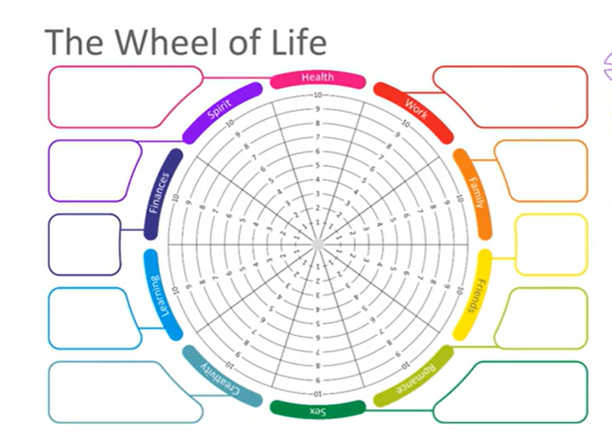
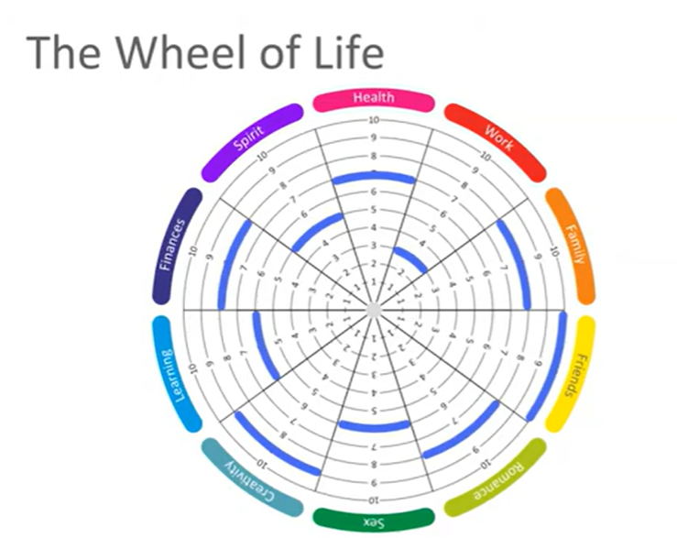
Self-leadership & Empowerment
Exercise The Wheel of Life

Slide 47
Well done, you have completed.
M2.2 Personal Balance, Health & Self-Leadership
www.3kitchens.eu

