Slide 1
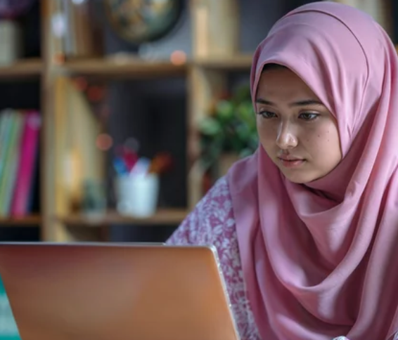

Employability Programme - Self-Improvement Skills
M2.1
Introductory Digital Skills for the Workplace
www.3kitchens.eu

Slide 2

Overall, digital skills are foundational for navigating and succeeding in a digitally-driven world, impacting nearly every aspect of personal and professional life. Are you mystified by computers? Intrigued by their power; yet hesitant to use them? Learning to use the computer doesn’t have to be a frightening prospect. This module will help you work through the basics of understanding computers. We will help you test your knowledge through tests and answers exercises.
The module is split into five sections, each covering a different aspect. Work through one section at a time. After completing each section, move over to the test booklet and complete the corresponding test questions.

Slide 3

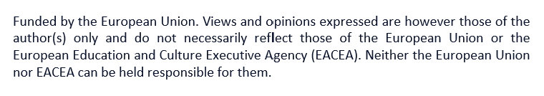
DIGITAL SKILLS
01
Computer Components
02
Computer Basics
Ideal as a starter introduction to digital skills in the workplace
03
Desktop
04
World Wide Web
05
Email

Slide 4

Why are digital skills important
Digital skills are essential in today's world for several reasons:
Workplace Competence
Most jobs require at least basic digital skills, such as using a computer, email and office software. Advanced digital skills improve productivity and efficiency in tasks like data analysis, project management, and communication.
Economic Participation
The growing digital economy demands a workforce proficient in digital technologies. Digital skills enable individuals to start and run online businesses, access global markets, and use e-commerce platforms.

Slide 5
Access to Information and Services
Many services, including banking, healthcare and government services, need to be accessed online.
Education and Lifelong Learning
Access to online courses and educational resources expands opportunities for learning and skill development. Digital skills facilitate your professional development through webinars, tutorials, and online training programs.
Social Connectivity and Communication
Digital skills enable effective use of social media to connect with others, share information, and build professional networks.

Slide 6
Safety and Security
Understanding digital security helps protect personal
and professional data from cyber threats. Knowledge
of privacy settings and safe online practices
ensures better control over personal information.
Empowerment and Inclusion
Promotes inclusivity by enabling people from diverse backgrounds to access and participate in digital
platforms. Digital skills support participation in social
and political activities, facilitating advocacy and
community involvement.

Slide 7
01
Computer Components

Slide 8

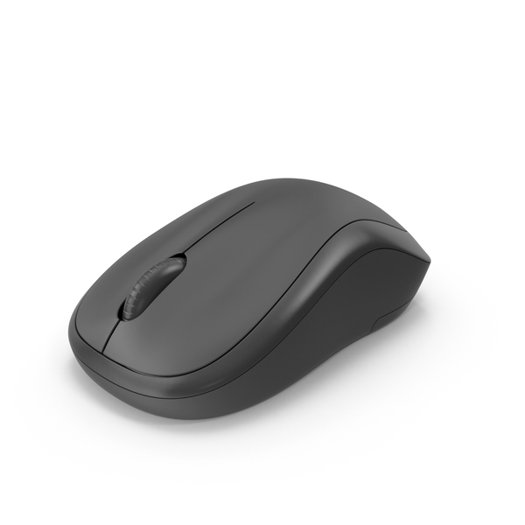
01
Let’s refresh our knowledge.
Computers have four basic components
Monitor - A monitor looks like a television screen. It’s main purpose is to allow you to see the information which you are either typing in or the computer is processing.
Mouse - The mouse is used as an input device. It lets you tell the computer what to do.
Computer Components

Slide 9
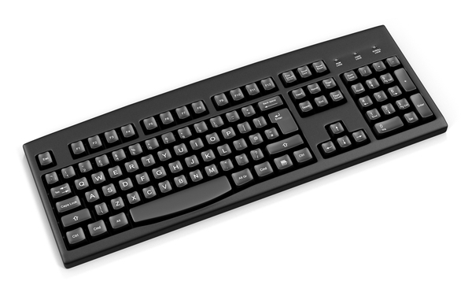

01
Computers have four basic components
Computer Components
Keyboard - The keyboard is also known as an input device. It is like a typewriter. You can use to enter text or commands into the computer.
System Box - System box is the unit contain all the electronic parts that make the computer. It contains a Central Processing Unit (CPU); the brain of the computer.

Slide 10

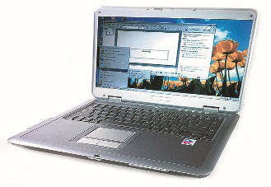
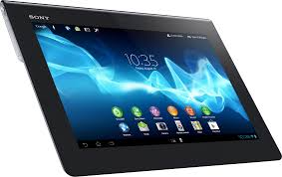

01
Computers sometimes called PC’s (Personal Computers) come in all shapes and sizes but they all work in the same way.
Computer Components
Desktop Laptop Tablet
Exercise 1

Slide 11

01
The following questions will test what you have learned so far
What are the four basic components of a computer?
What is this?
What is the primary function of a monitor?
What is mouse used for?
What is another name for the keyboard?
What is the ‘brain’ of the computer called?
What does PC stand for?
Why is it important for a computer to have both input and output devices?
Can you name two input devices used with computers?
Name three types of Personal Computers?

Slide 12
02
Computer Basics

Slide 13
02
Types of Computers
Desktop - a personal computer small enough to fit conveniently in an individual workspace.
Laptop - a portable computer small enough to use on your lap.
Computer Basics

Slide 14

02
More about the Mouse
The mouse is used as an input device. A cursor is the visible shape of the pointer on a screen You will see many shapes of the cursor. Below is list of different type of cursors that you will most commonly see.
Computer Basics
Pointer cursor indicates, system is idle, ready for use.
Click here to enter text.
Cursor turns this shape when placed over a hyperlink, once clicked it takes you to that website.
System is busy doing something. You will see this cursor when you open a new program.

Slide 15
02
More about the Mouse
Mouse normally has two buttons, a left and a right button. In order to select an item, you must click the left button. In order to open a menu from an item, click on the right mouse button. To open an item, double click using the left hand button.
Computer Basics

Slide 16
02
More about the Keyboard
Some keys have special functions, or uses:
Shift Key - There are two of these. To make a capital letter, hold this key down and press the letter.
F1 - F12 (Function Keys) - Group of 12 keys that perform special functions.
Space Bar - This is a long key and its function is to make a space between words when you press it.
Enter Key - Pressing this key gives you a new line.
Computer Basics

Slide 17
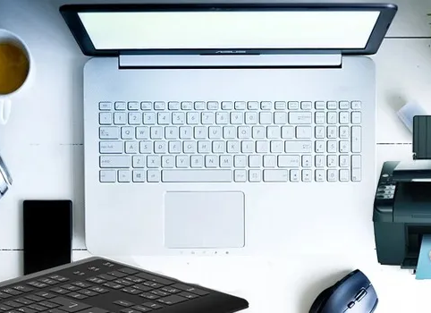
02
Peripherals.
A Peripheral is a device that is connected to a computer such as a printer, modem, mouse or a keyboard.
Computer Basics

Slide 18

02
How do you turn ON the computer?
Technology is a fantastic marvel, constantly changing. Computers are no different, but do not allow this to put you off. Although computers are changing the basic functions remain the same.
You may struggle to find the ON button, but don’t panic. If you struggle, just ask someone.
Computer Basics
Exercise 2

Slide 19
02
The following questions will test what you have learned so far
What are the differences between a desktop and a laptop computer?
What is the main function of a mouse?
How many button does a mouse have?
Which of the following indicates that the system is buy or idle?
A hand
An hourglass
An I beam
What is a peripheral?
Name two common peripherals used with a computer?
What is the purpose of the Function keys on a keyboard?
What does pressing the Enter key do when typing?
What does the space bar do when pressed on a keyboard?
How do you use the Shift key to type capital letters?

Slide 20
03
Desktop

Slide 21
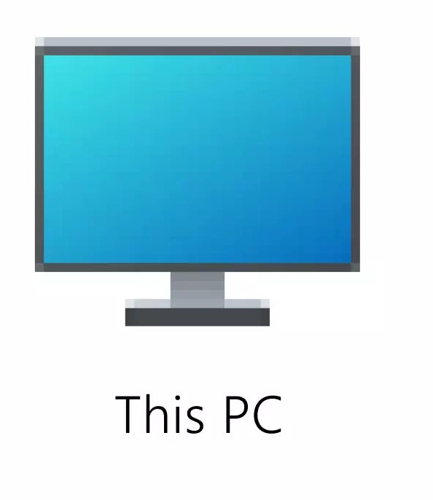

03
The desktop is the entire area of your screen on your computer. You will find various small pictures called icons on the desktop. These include:
My Computer / This PC
This icon opens up My Computer / This PC window. In this window you can see all the parts of the computer.
My Documents
My Documents is a folder that you can place any files that you may create.
Desktop

Slide 22

03
Recycle Bin
Recycle bin is like a litre bin. Everything you delete ends up in the recycle bin. Until you empty the recycle bin just like your litre bin, documents deleted will remain in the recycle bin. It can be a very useful tool in cases when you may delete something by a mistake, you can retrieve it back before you permanently delete by emptying the recycle bin.
Desktop
The Taskbar
Taskbar is the name given to the grey bar at the bottom of the screen. It contains number of shortcuts to various programmes. The taskbar contains the start button on the left-hand side, which allows you to start programmes and also shut down the PC.

Slide 23
03
It also contains amongst other icons
the clock on the far-right hand side.
Every time you open an application (i.e. Word, Chrome, etc), it is launched in a ‘window’. These appear in the taskbar. You can have more than one window open at any given time and you can move between them by clicking on the name of window in the taskbar.
You can only work in one window at any given time.
Desktop
Exercise 3

Slide 24
03
The following questions will test what you have learned so far
What are the images on the desktop called?
What does the ‘My Computer / This PC’ icon allow you to do?
What is the purpose of the ‘My Documents’ folder?
What happened to the files that are deleted from your computer?
What is the Recycle Bin?
Where is the taskbar located?
What does the taskbar contain?
What is the function of the start Button?
Can you work in multiple windows at the same time?
How do you manage multiple windows?

Slide 25
04
World Wide Web

Slide 26

04
What is World Wide Web?
The Internet is a set of computers all joined together in a network. The information they hold can be shared from one computer to another.
Internet is like a library because you can find information on any subject you can imagine. This is referred to as World Wide Web.
Information on the Internet is divided into parts called websites.
World Wide Web

Slide 27
04
What is a website?
A website is a set of pages called web pages. These can include text, pictures, sound and videos. They contain information about different topics such as your business, life-style, films and so on.
Anyone can make a website. Your business can benefit from a website on the Internet. A website can consist of single page or all singing, all dancing multiple pages site.
In order to connect your computer to the Internet, you will need a device called a modem. A modem needs to be plugged into a telephone line.
World Wide Web

Slide 28
04
What else do I need?
Your computer will also need special software called a web browser on your PC. This is usually located on your computer when you buy the computer. There are number of web browsers including Internet Explorer, Chrome, Firefox…
World Wide Web
How does this work?
When you open the web browser, the first web page you see is called the homepage. This can be changed to the homepage of your choice.

Slide 29
04
What is a Web Address?
Every webpage has its own special address. This is called a Universal Resource Locator (URL). A URL is split into four sections. These consist of:
World Wide Web
http://www.3Kitchens.eu
http:// | www. | 3Kitchens | .eu
Hypertext Transfer Protocol: This part tells the computer how to send information to and from your computer. | World Wide Web | Site name: This is the name of your website | This is the domain name. This part tells you the kind of website and sometimes the country it comes from.
When you move your cursor around the webpage, sometimes you will see it changes its shape to a hand which indicates that you have found a link to another website. This is called a hyperlink.

Slide 30
04
What is a hyperlink?
A hyperlink is another page. This is shown by a word or few words, usually in a different colour and underlined.
When you place your mouse pointer over a hyperlink, the address of the URL appears in the status bar at the bottom left-hand corner of the screen. This can sometimes be very long. You need not worry as you will not need to remember this. When you click on the hyperlink, this will open up a new page on your screen.
You can move around the website using the navigator tool bar.
World Wide Web

Slide 31
04
What is a Navigator Tool Bar?
A tool bar is a set of pictures or icons that are displayed across the top that allows you to move around the website. The navigator tool bar will be covered in greater details in the next edition.
Website is a page or group of pages on the World Wide Web. This is an area dedicated to a particular person or company’s area.
When you load the web browser, the system will load your homepage. A website you have chosen to be your default.
World Wide Web

Slide 32



04
What is a Navigator Tool Bar?
You can move around the website using the navigation toolbar.
This will take you back to the last page you have visited.
The forward button brings you forward again.
This opens up a folder where you can save all your favourite sites, which you can access with ease.
You can download files from the Internet. When you click on the link, a window will open asking you where you want to put the file.
World Wide Web

Slide 33


A Typical Address
http://www.3Kitchens.eu
Every page of the website has its own address, to ensure that we can find it. This is called the Universal Resource Locator or URL for short.
Click to View

Slide 34
04
When you are browsing through the internet, some WebPages will have some words or phrases in a different colour or underlined. When you move your mouse over these words, phrases and even pictures, your mouse pointer turns into a hand shape and the address for a new page appears in the status bar. These words or phrases are called hyperlinks.
Hyperlinks contain an address to another page or another website. Clicking on these links takes you to another webpage.
World Wide Web
Exercise 4

Slide 35
04
The following questions will test what you have learned so far
What World Wide Web?
What is a website?
What device is needed to connect your computer to the Internet?
What is a web browser?
Can you name few web bowsers?
What is a web address?
What is a URL?
How does a hyperlink function and how can you recognise one on a webpage?
What happens when you click on a hyperlink?
What is the purpose of the back and forward button in the navigation bar?

Slide 36
05
Email

Slide 37
05
Email stands for Electronic Mail. This is another form of communication, like writing letters but a lot faster from one computer to another. Emails allow you to send documents and pictures as attachments. Attachments are very useful, but you need to be careful as large files take a long time to send and receive.
The following section covers the use of electronic mail software to send and receive messages, to attach documents or files to a message and to organise and manage message folders or directories within electronic mail software.
As with all new technology, there are always dangers that you need to be aware of. Viruses are programmes that may be sent via email. These can cause severe damage to your computer, and sometimes, even a total breakdown of your computer.
Email

Slide 38
05
You can protect your computer by taking basic precautions:
Never open emails from people you don’t know
If you receive an attachment from someone you know but were not expecting the attachment - be wary. Emails can be sent without the sender even knowing about them
Email
An email address is like a postal address
The above email address can be broken down into four segments.
Name of person at Organisation name Domain name
Info @ gwaeu .com
Email addresses can contain letters, numbers, underscores and dots.

Slide 39

05
Most email applications share some common features. Below is an explanation of some of them.
Compose - You select this button to open up a screen to create a new email.
Inbox - This is where all the new messages are received.
Sent - This folder holds all the messages sent from your computer.
Address Book - This folder contains email addresses you have developed.
Email

Slide 40
05
Getting started with Email
Create a Message
Insert a mail address
Insert a subject
Type in the message
Message Size
Sending a message
Staying Safe
Deleting a message
Email

Slide 41
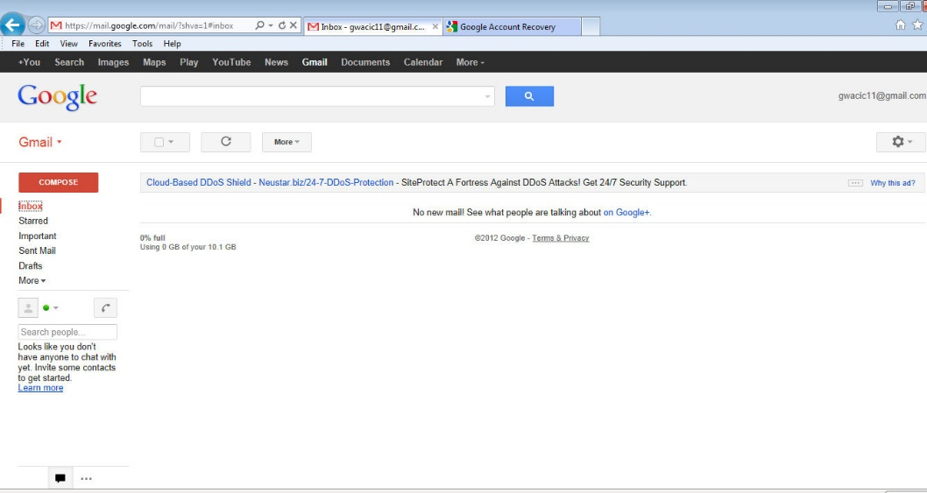
05
1. Create a Message
To open up Google mail, login to Google, using www.google.com and then into gmail.
Email

Slide 42
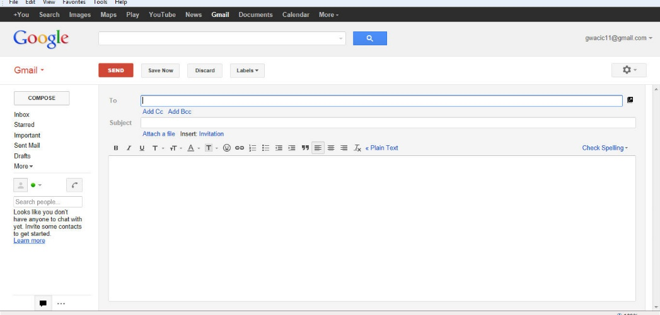
05
1. Create a Message
To create a new mail message, click on the Compose button.
The New Message window will be displayed. When you are composing and sending an email, you will need complete the following tasks.
Email

Slide 43
05
2. Insert a mail address
Firstly, insert a mail address in the To: field.
The Add CC: field is used to specify email addresses for individuals to whom you would like to send a copy of the email to.
The Add BCC: field is used to specify email addresses for individuals to whom you would like to send a copy of the email to but would do not want others to see.
Email

Slide 44
05
3. Insert a subject
Insert a title in the subject field. This will appear on the recipient’s Email program.
Email

Slide 45
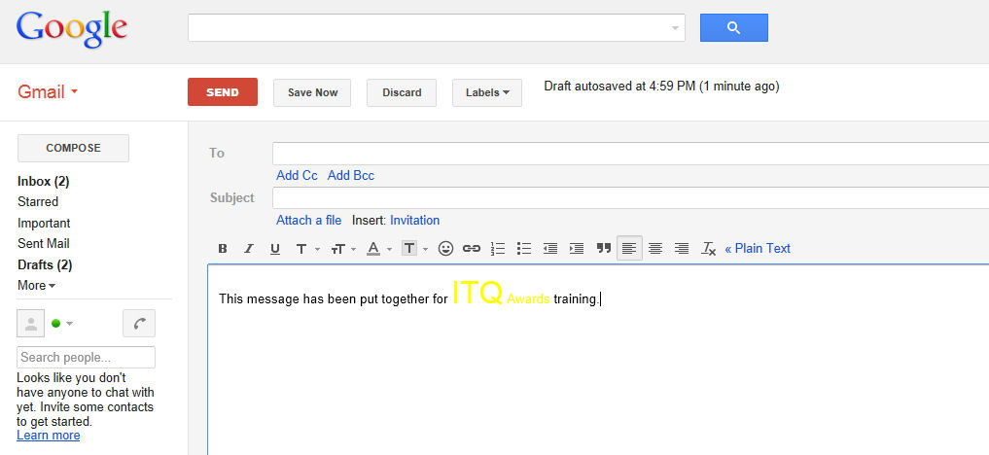
05
4. Type in the message
Type in the body of the email message.
The message can be formatted e.g. changing the font size, or the colour. You can insert bullet points, numbers etc. You can perform all the tasks on the text that you would do in a word document.
Email

Slide 46
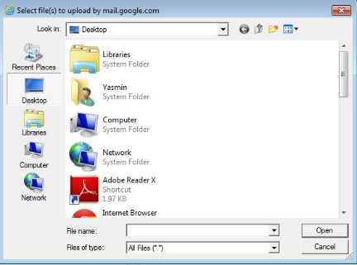
05
5. Message Size
Attaching a file to a message.
To attach a file, click on
The Select File(s) dialog box will be displayed.
Select the file(s) that you wish to attach. Click on Open once you have elected the file(s).The files will be attached to your email message.
Email

Slide 47
05
5. Message Size
Storage space" is a measure of how much disk space your email occupies on your email provider's servers. It is usually measured in MB or "megabytes". A small text only email might occupy just a few KB of storage space whereas a large email with attachments, such as a video or MP3 file, might take up several MB.
Because the type of email and the size of attachments can vary so much, it's hard to predict an "average" amount of space that you'll need for storing your emails. However, if you mainly send and receive text emails, you could probably store around 200 messages per MB of storage space. If you send a lot of attachments and files, you should count on being able to store 1-2 messages per MB or less.
Email

Slide 48
05
5. Message Size
Most email providers offer between 5MB and 100MB of storage space, which is ample for normal use but which can quickly get used up if you receive large files. Some providers will let their users pay to upgrade their storage space, leaving much more room for messages in a user's mailbox.
You will need to keep an eye on how large your files are, as emails with large attachments will be rejected.
Email

Slide 49
05
6. Sending a message
When you are sending an email, you can send a copy of the message to another recipient simply by entering their email address in the cc: field.
Using a blind copy (bcc)
When you are sending an email to a group of people, each recipient will be able to see who the email has been sent to. However, there may be occasions when you do not wish to reveal this information.
The solution is to use the Blind Copy tool.
To add a recipient to the Blind Copy list, select the recipient’s name and click on . When this email is sent, the To: recipient will not be aware that the email has been sent to the Bcc: recipient. However, the Bcc: recipient will be aware of the recipients that the email has been sent to.
Email

Slide 50

05
6. Sending a message
Reply to a Message
To reply to an email message, double-click to open it or highlight the message in the message panel and click on the icon on the toolbar.
The reply window will be displayed. The recipients original email message will be displayed at the bottom of your email message. Type in the text for the reply. You will notice that the To: and Subject: fields are already populated. Click on Send to send your reply.
Reply to All function
The reply to all function is useful when you receive an email that is sent to a group of recipients, for example is you are asked to review a document or arrange a meeting. The To: field will contain many email addresses.
Email

Slide 51
05
6. Sending a message
Forwarding a message
To forward a message to another
recipient, click on the downward
arrow and select ‘Forward’.
The Forward email screen will be displayed.
Type in the email address of the new recipient in the To: field. The Subject field will include the original title prefixed by Fw:, which indicates that the message has been forwarded.
You can also type in a message when you forward an email. When you have completed this click on to send the email.
Email

Slide 52
05
7. Staying Safe
Staying safe is important in this age of new technology. There are simple precautions that will help to prevent being targeted by fraudsters.
Using Passwords
A good practice to follow is to password protect your computer. Many computers have a function, which prompts you to put in a password once the machine is switched on. This is known as the power on password.
There are other password protection practices that can be used. For example, a screen saver password is very useful. If you leave your computer for a set amount of time, which you can set, then the screen is locked and blanked out. You can select various graphical items to be displayed during this time. This protects your work when you are absent from your computer, without having to power down.
Email

Slide 53
05
8. Deleting a message
When you are working with your Inbox, you can delete any unwanted email messages, simply by clicking in the box on the left-hand side of the message. This will bring up new icons at the top.
Email

Slide 54
05
Managing Emails
Emails are instant, the minute you click on Send, the email is sent and within seconds is received by the recipient. Email is now the most popular method of communicating messages not only in business but also in our personal lives. It is quick, inexpensive, flexible and convenient.
Email is being used as a main form of communication for businesses. The government is encouraging everyone to get online, and the main form of communication is email.
Due to the informal nature of email, it is easy to forget that it is a permanent form of written communication and that material can be recovered even when it is deleted from computers. Therefore, emails should be drafted with care.
Email

Slide 55
05
Managing Emails
You must not make any derogatory remarks in emails as this may constitute libel. You should regularly delete unnecessary emails to prevent over-burdening the system.
Always obtain email confirmation of receipt of important messages. This may not always be possible and may depend on the external system receiving your message.
Remember that emails can be recovered, even after deletion and could be used as evidence in legal proceedings.
Email

Slide 56
05
Managing Emails
Netiquette
The word netiquette is a combination of ’net’ (from internet) and ’etiquette’. It means respecting other users’ views and displaying common courtesy when posting your views to online discussion groups.
Email

Slide 57
05
It is a term referring to good behaviour while connected to the Internet. Some examples of netiquette are listed below,
Don’t use someone else's name and pretend to be them.
Do not try to obtain someone else's password.
Do not try to obtain personal information about someone.
Don’t post or distribute material that is deemed illegal.
Do not post copyrighted material to which you do not own the rights to. Sites vary in how strict they are about this, but as well as facing the possibility of legal action by the rights holder, you may also get the site sued.
Don’t use abusive or threatening language.
You may express robust disagreement with what someone says, but don't call them names or threaten them with personal violence.
Don’t post racist remarks regarding people’s sex, race or gender.
Email

Slide 58
05
It is a term referring to good behaviour while connected to the Internet. Some examples of netiquette are listed below,
Use clear and simple language.
On a site that has many non-native English speakers, avoid using slang they may not understand.
No spamming. Don't repeatedly post the same advertisement for products or services. Most sites have strict and specific rules about who is allowed to post ads and what kind of ads they are.
Pay for what you use. If you use shareware, pay for it. This will encourage more people to write shareware.
Respect other peoples time. We live in a fast moving world. When you send email or post to a discussion group, you're taking up other people's time. It's your responsibility to ensure that the time they spend reading your posting isn't wasted.
Email

Slide 59


05
Reading Emails
When you first open up any email software, the program will display the messages that have already been downloaded. To ensure that you have downloaded all of the recent messages, click on the icon or Refresh depending on which software you are using.
This will ensure that all new messages are received and any that are stored in your outbox are sent.
Email

Slide 60
05
Reading Emails
The Inbox unread count will be automatically updated to indicate the number of unread messages that are present.
Opening and Saving a file attachment
When you receive an Email containing attachments, a paper clip symbol appears next to the email message as shown below.
Click on the email message to open it.
The attached file can be found at the bottom of the email.
To open this attachment, click on ‘View’ to open the file.
BEWARE: Attachments can contain viruses. Only open the file if you are expecting it and can be sure that it will not be infected.
Email

Slide 61
05
Responding to e-mail problems
There is number of common problems that individuals will encounter. These could include:
Loss of the internet connection - Check connections to ensure you have Internet.
Receiving emails with viruses - There are simple steps that you can take to ensure that computer is not infected with viruses. Creating filters will move emails affected into Spam / Junk folder.
Receiving emails from unknown user - Never open messages from senders that you do not recognise.
'Mailbox Full’ message - You will normally get this error if you have too many old emails in your Inbox. Delete any messages especially with large attachments.
Email
If you have lots of attachments that you want to keep then try saving somewhere else on the computer. This will help cut down the size of your mailbox

Slide 62


05
The following questions will test what you have learned so far
  How would you start a new email message, once you’ve opened gmail (Google) email program? Choose from one of the icons below. (tick the right icon)
  Compose an email to Jane (jane@gmail.com) with the following information.
  ‘Hi Jane, The IT course will start on Monday at 9.30 at The Light House.’
  Insert ‘Training’ in the Subject box.
  Your email to Jane has gone, but you want to check to make sure you have typed the correct venue. Which folder would you look in? (Circle the correct answer)
  Inbox
  Deleted
  Sent

Slide 63
05
The following questions will test what you have learned so far
  Send the following email to ‘Training’ group.
  ‘Hi All, The training group is planning a consultation meeting on Wednesday 29th March. Please can you all respond back whether morning or afternoon will suit?’
  Insert ‘Training’ in the Subject box.
  Which of the following action will help to keep you safe online?
  Using Passwords
  Opening Spam e-mails
  Install latest version of anti-virus software

Slide 64
Well done, you have completed.
M2.1 Introductory Digital Skills for the Workplace
www.3kitchens.eu

