Slide 1
Employability Programme -Food Industry
Technical Skills
M1.3
Eco-Responsibility
www.3kitchens.eu

Slide 2
01
The Importance of Eco-Responsibility
in the Culinary Industry
Contents
02
A Better Understanding of Waste Reduction
03
Exploring Energy Efficiency
04
Fun activities

Slide 3
01
The Importance of
Eco-Responsibility
in the Culinary
Industry

Slide 4
The Importance of Eco-Responsibility in the Culinary Industry
Being eco-responsible has many benefits for your employability and your own cooking.
Save money by using less energy and reducing waste can lower your costs.
Attract customers who care about the environment.
Feel good about your impact. Helping the planet is rewarding and makes your work more meaningful.

Slide 5
The Importance of Eco-Responsibility in the Culinary Industry
01
The culinary industry affects the environment a lot, from how ingredients are sourced to how waste is managed.
Eco-responsibility means making choices that are good for the environment while cooking and serving food.
By being eco-responsible, you can stand out when searching for employment. It can be an interesting candidate by showing how important eco-responsibility is important to you, and you bring positive approaches and ideas to reduce pollution and save resources.

Slide 6
Use simple Eco-Responsible Practices
As we know resources are valuable and limited. By being eco-responsible you become valuable for hiring employers. Here are some simple practices to adopt ...
Reduce waste
1- Use all parts of ingredients e.g.
Don't throw away the greens
Use carrot tops to make a tasty pesto sauce.
2 - Recycle :
Use recycling bins in your kitchen
Reuse empty jars and bottles instead of tossing them out.
3 – Compost :
Collect vegetable peelings, coffee grounds and eggshells
Use compost to create your own herbs garden.
02

Slide 7
Simple Eco-Responsible Practices
Save energy
02
1 - Use energy-efficient appliances
A +++ applicances will help you reduce utility bills and save energy
2 - Turn off equipment when not in use
3- Turn off the oven few minutes early to use left over heat
4 – Smart plugs with energy monitoring

Slide 8
Simple Eco-Responsible Practices
Source sustainably
02
Local ingredients reduce transportation and related carbon emissions. Plus this helps to support local economies.
Seasonal ingredients are fresh, less expensive, and align with the planet cycles, improving taste and nutritional value.
Using local and seasonal ingredients is essential for sustainable sourcing.

Slide 9
Simple Eco-Responsible Practices
Source sustainably
02
You can develop new habits of buying fresh and sustainable ingredients :
- You can either buy from local farmers and producers
Plus, this will help you build long term partnerships and create a community.
- Buy seasonal products e.g.
Spring: Asparagus, peas, strawberries
Summer: Tomatoes, courgettes, berries
Autumn: Pumpkins, apples, mushrooms
Winter: Root vegetables, kale, citrus fruits

Slide 10
Simple Eco-Responsible Practices
Source sustainably
02
Ensure traceability:
Know where your ingredients come from.
List the farms and/or region where ingredients are sourced on the menu,
Use a variety of ingredients for biodiversity
Choose products with certifications like Organic or Fairtrade.
Find below a list of certifications relevant in Three Kitchens’partners countries.

Slide 11
Classification | Certification | Country | Description
Animal Welfare | Label Rouge | France | High-quality meat with strict welfare guidelines.
Animal Welfare | Beter Leven | Netherlands | Humane conditions for meat and dairy.
Organic & Animal Welfare | KRAV | Sweden | Organic food with a focus on welfare and sustainability.
Animal Welfare & Quality | Bord Bia | Ireland | High standards for animal welfare and food quality.
Organic Farming | Agriculture Biologique | France | Organic certification without synthetic chemicals.
Organic Farming | EKO | Netherlands | Organic products with environmental and welfare standards.
Organic Farming | Organic Trust | Ireland | Organic food certification without synthetics.
Food Safety & Quality | AOP | France | Protection of regional foods with unique characteristics.
Food Safety | FSSC 22000 | Netherlands | Ensures food safety management systems.
Food Safety | ISO 22000 | Sweden | Standard for food safety management.
Fair Trade | Fairtrade International | France, Netherlands, Sweden, Ireland | Fair prices and labor conditions for farmers.
Sustainable Sourcing

Slide 12
Support biodiversity: Use
A variety of ingredients. Example: include ancient grains like quinoa and farro, and a variety of heirloom vegetables.
Diverse Proteins: Expand your protein sources to include not just common meats and fish, but also legumes, nuts, and seeds. These protein sources are often less resource-intensive to produce than traditional meats.
Foraged Foods: Whenever possible, include foraged foods such as wild berries, mushrooms, and herbs in your cooking. These foods are typically gathered from their natural environment, supporting the local ecosystem's health.
Guidelines for Sourcing Sustainable Products
05

Slide 13
QUIZ

Slide 14
Question 1:
Sustainable Certifications
Which of the following certifications ensures that seafood is sustainably harvested?
a) Certified Humane
b) USDA Organic
c) Marine Stewardship Council (MSC)
d) Fairtrade International

Slide 15
Answer 1:
Sustainable Certifications
Which of the following certifications ensures that seafood is sustainably harvested?
c) Marine Stewardship Council (MSC)

Slide 16
Question 2:
Animal Welfare
When sourcing animal products, which certification should you look for to ensure humane treatment of animals?
a)MSC
b) Aquaculture Stewardship Council (ASC)
c) Certified Humane
d) USDA Organic

Slide 17
Answer 2:
Animal Welfare
When sourcing animal products, which certification should you look for to ensure humane treatment of animals?
c) Certified Humane

Slide 18
Question 3:
Supplier Evaluation
What should you do to ensure that your suppliers follow sustainable practices?
a) Conduct supplier assessments
b) Visit farms and production facilities
c) Look for certifications such as organic, fair trade, and other sustainability labels
d) All of the above

Slide 19
Answer 4:
Certification
What does organic certification ensure about the production of ingredients?
a)Ingredients are produced without synthetic pesticides and fertilizers

Slide 20
Question 5:
Biodiversity
How can you support biodiversity in your menus?
a) Using a diverse range of ingredients
b) Including ancient grains like quinoa and farro
c) Incorporating heirloom vegetables
d) All of the above

Slide 21
Answer 5:
Biodiversity
How can you support biodiversity in your menus?
d) All of the above

Slide 22
02
A Better Understanding of Waste Reduction

Slide 23
Waste Reduction
As we shared in the introduction, food waste is a significant issue worldwide, with approximately one-third of all food produced for human consumption being wasted yearly.
By being more aware of waste reduction tactics, you become more employable as you can make better use of the resources at your disposal.

Slide 24
How to Reduce Food Waste in the Kitchen
Portion Control: Carefully read, plan and control portions to minimize waste. Remember to use the technical sheet for each recipe. Plus, use measuring cups and scales to ensure consistent portion sizes and to deliver the same dish to every customer. This helps prevent over-preparation and reduces food waste.
Stock Management: Regularly check and rotate stock to prevent spoilage. Incorporate a first-in, first-out (FIFO) system, where older ingredients are used before newer ones. FIFO, meaning "First-In, First-Out," ensures that the oldest inventory is used first, reducing the risk of spoilage and waste.

Slide 25
How to Reduce Food Waste in the Kitchen
Creative Use of Leftovers: Develop recipes that use leftovers or surplus ingredients. You can use leftover roasted vegetables in a frittata or turn stale bread into croutons or bread pudding.
Donations: Suggest your company partner with local food banks or apps like Too Good to Go to donate excess food. Arrange for pickups or drop-offs of surplus prepared foods that are still safe to eat but not needed.
Sustainable Packaging for Takeaway: Buy packaging that is biodegradable or compostable for takeaway food or doggy bags.

Slide 26
QUIZ

Slide 27
Multiple Choice Questions
Which of the following is a practical way to control portions and reduce food waste?
a) Guessing portion sizes
b) Using measuring cups and scales
c) Preparing large batches without planning
d) Ignoring portion sizes

Slide 28
Multiple Choice Answer
Which of the following is a practical way to control portions and reduce food waste?
Answer: b) Using measuring cups and scales

Slide 29
Multiple Choice Questions
How can you make use of leftover roasted vegetables?
a) Throw them away
b) Use them in a frittata
c) Ignore them
d) Leave them in the fridge indefinitely

Slide 30
Multiple Choice Answer
How can you make use of leftover roasted vegetables?
Answer: b) Use them in a frittata

Slide 31
Multiple Choice Questions
What does the FIFO system in inventory management stand for?
a) First-In, First-Out
b) Fast-In, Fast-Out
c) Fresh-In, Fresh-Out
d) Free-In, Free-Out

Slide 32
Multiple Choice Answer
What does the FIFO system in inventory management stand for?
Answer: a) First-In, First-Out

Slide 33
03
Exploring Energy Efficiency

Slide 34
Energy Efficiency
Energy consumption is another area where the culinary industry can make a significant impact. Commercial kitchens or production units are often energy-intensive environments, with large ovens, refrigerators, and other appliances running continuously. By adopting best practices for energy conservation, you can increase your employability and add value to your employer to reduce your personal and business energy consumption and lower your environmental footprint.
In the next slides, we will explore practical tips to develop your skills to do this.

Slide 35
Tips for Conserving Energy in the Kitchen
New/Less Energy Using Cooking Methods:
Switch to new cooking methods like steaming, microwaving, and induction cooking. You will consume less energy than traditional cooking methods.
Use induction cooktops that are more energy-efficient than gas and electric stoves. Plus this equipment offers precise temperature control.

Slide 36
Tips for Conserving Energy in the Kitchen
Maintenance for sustainable equipment : Suggest the culinary business undertakes regular service and maintenance of kitchen equipment to ensure they are running efficiently. Small actions like cleaning refrigerator coils every six months and replacing oven seals will help you save energy.
Lighting change : When it is possible use natural light or LED lighting. LEDs use up to 80% less energy than traditional incandescent bulbs and can last up to 25 times longer. Replacing five of the most-used light fixtures with LED bulbs can save up to €100 annually.

Slide 37
Tips for Conserving Energy in the Kitchen
Temperature Control: For food quality preservation, you should maintain and set temperatures at 4°C for refrigerators and -18°C for freezer.
Water Conservation: You can easily save water by making two small changes :
Install water-efficient faucets to reduce water usage up to 50%
Fix leaks
Let’s see what you have learned from this session with a quiz !

Slide 38
QUIZ

Slide 39
Multiple Choice Questions
What is one benefit of using LED lighting in the kitchen?
a) It uses up to 80% less energy than incandescent bulbs.
b) It increases the brightness of the kitchen.
c) It consumes more energy than traditional bulbs.
d) It has a shorter lifespan compared to incandescent bulbs.

Slide 40
Multiple Choice Answer
What is one benefit of using LED lighting in the kitchen?
Answer: a) It uses up to 80% less energy than incandescent bulbs.

Slide 41
Multiple Choice Questions
How often should you clean refrigerator coils to maintain efficiency?
a) Every month
b) Every six months
c) Every year
d) Every two years

Slide 42
Multiple Choice Answer
How often should you clean refrigerator coils to maintain efficiency?
Answer: b) Every six months

Slide 43
Multiple Choice Questions
What temperature should you set your refrigerator to for optimal energy efficiency?
a) 0°C
b) 4°C
c) 8°C
d) 12°C

Slide 44
Multiple Choice Answer
What temperature should you set your refrigerator to for optimal energy efficiency?
Answer: b) 4°C

Slide 45
Multiple Choice Questions
What is a practical example of optimizing cooking methods to save energy?
a) Boiling vegetables on a stove
b) Cooking vegetables in the microwave
c) Frying food in a pan
d) Using a traditional oven for all meals

Slide 46
Multiple Choice Answer
What is a practical example of optimizing cooking methods to save energy?
Answer: b) Cooking vegetables in the microwave

Slide 47
Multiple Choice Questions
How much can you save annually by replacing five of your most-used light fixtures with LED bulbs?
a) €25
b) €50
c) €75
d) €100

Slide 48
Multiple Choice Answer
How much can you save annually by replacing five of your most-used light fixtures with LED bulbs?
Answer: d) €100

Slide 49
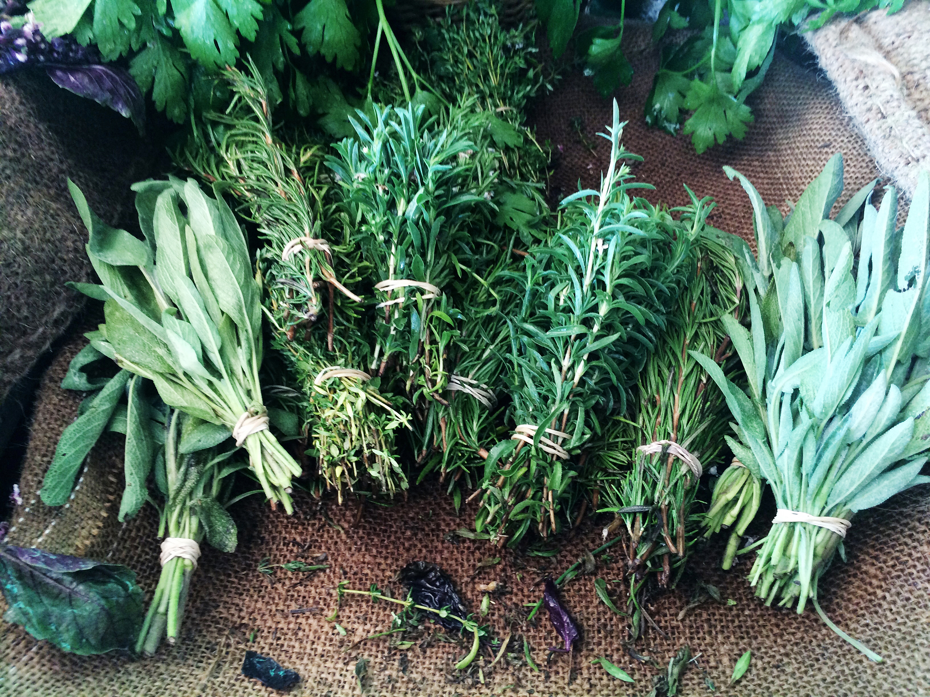
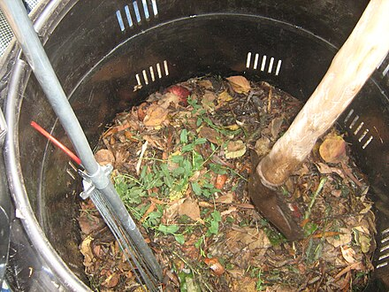
Activities for Eco-Responsibility
Find below two simple and enjoyable activities you can do alone. These activities are related to cooking and caring for our environment. They are designed to be fun.
Activity 1: Creating a Mini Herb Garden
Activity 2: Making a Compost Bin

Slide 50
Activity 1: Creating a Mini Herb Garden
We suggest that, if can can, grow your own herbs at home. It is a great way to connect with nature and use fresh ingredients in your cooking. Here’s how you can start:
1- Get some small pots or use empty cans or plastic bottles with holes at the bottom for drainage.
2 - Buy some herb seeds like basil, parsley, or mint.
3 - Fill the pots with soil and plant the seeds.
4 - Follow the instructions on the seed packet for how deep to plant them.
5 - Place the pots in a sunny spot and water them regularly. Be careful not to overwater!
Watch your herbs grow!
You can start using them in your cooking once they have grown enough leaves.

Slide 51
Activity 2: Making a Compost Bin
This activity will increase your skills and reduce kitchen waste. In addition, compost is also a way to create nutrient-rich soil for your plants or herbs.
1 - Find a container or bin with a lid. You can use a large plastic container or a trash can.
2 - Drill or poke some holes in the sides and bottom of the container for airflow.
3 - Start adding kitchen scraps like fruit peels, vegetable scraps, coffee grounds, and eggshells. (Do not put meat, dairy or oily foods),
4 - Add some dry leaves, cardboard or newspaper to balance to prevent the compost from getting too wet and smelly.
5 - Mix or turn the compost every week to break down.
Et voilà! In a few months, you’ll have rich, dark compost that you can use on your plants!

Slide 52
Conclusion
We hope this module helped you to gain skills when it comes to sustainability in the kitchen!

Slide 53
Thank you
www.3kitchens.eu

