Slide 1
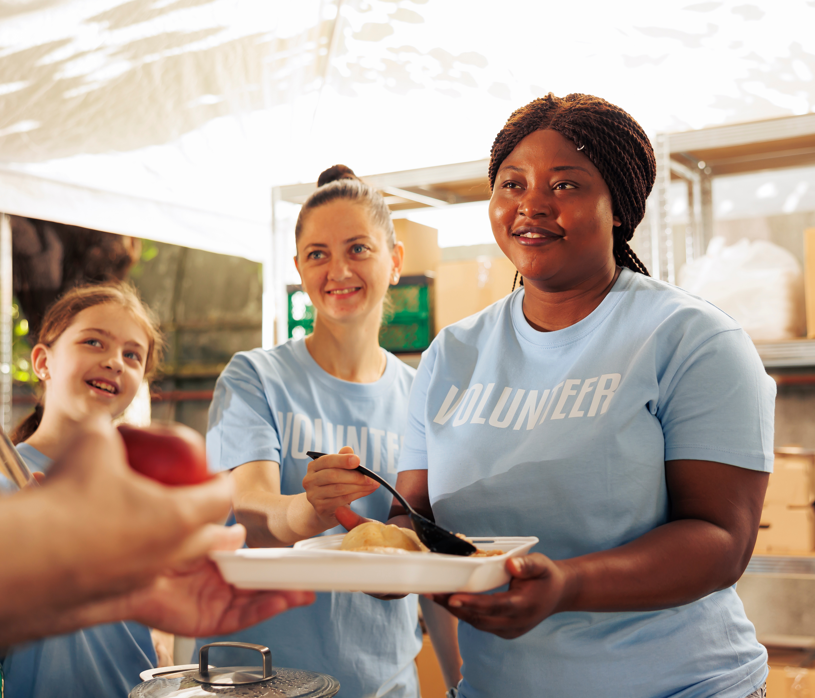

Employability Programme -Food Industry
Technical Skills
M1.2
Culinary Skills to Succeed
www.3kitchens.eu

Slide 2



01
Contents
Introduction to Culinary Skills
02
DAY 1 - Basic hygiene, safety, maintenance and organization in the kitchen
03
DAY 2 - Preparation terms and techniques, Utensils and equipment
04
DAY 3- Kitchen management, nutrition and creativity
05
DAY 4 – Let’s get technical! Basic pastry-making techniques

Slide 3
01
Introduction to
Culinary Skills

Slide 4
Introduction to culinary skills
The culinary skills module is a key part of the employability programme. To be delivered in adult education settings, it is designed to equip migrant women with the fundamental culinary skills and knowledge that are essential in the food industry.
This section will introduce participants to the basics of the culinary arts, including understanding recipes, the functions of ingredients and the importance of flavor and texture in creating dishes.

Slide 5

Training in culinary techniques
35 hours (4 days)

Slide 6
DAY1
Basic hygiene, safety, maintenance and organization in the kitchen

Slide 7
Introduction to the working environment, HACCP principles and basic recipes
Welcome to the first day of our culinary journey! Today we'll be familiarizing ourselves with the kitchen environment and laying the foundations for safe and effective culinary practices. Adopting HACCP principles from the outset ensures food safety and quality in all our culinary activities. Introducing the trainer and the trainees.
Content
A- Basic hygiene rules
B- Safety rules for handling kitchen tools
C- How to maintain your workstation
D- How to organise your workstation

Slide 8

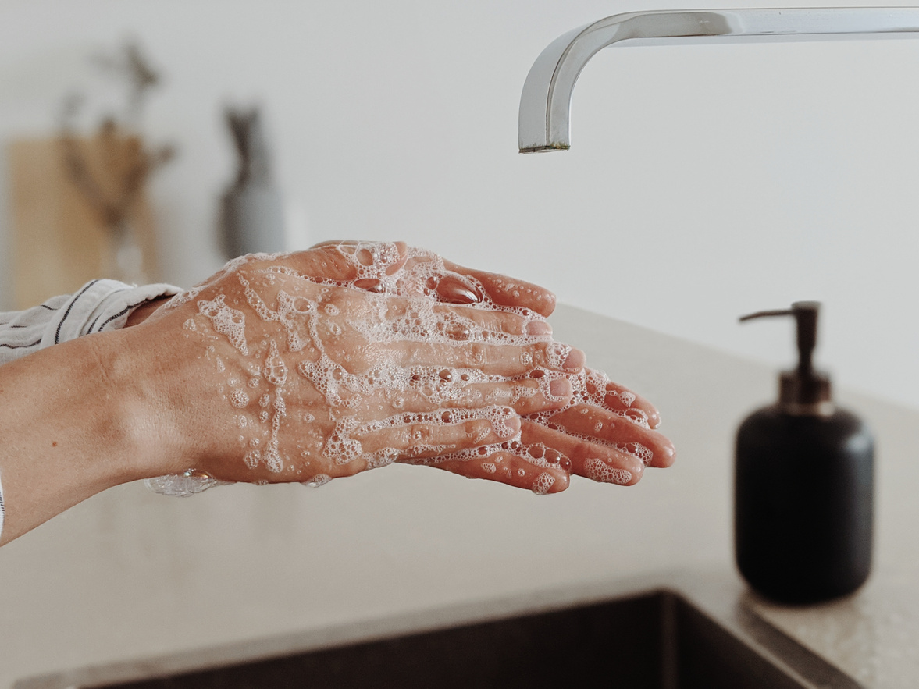
A - BASIC HYGIENE
RULES
Basic kitchen hygiene rules are essential to prevent food contamination and ensure consumer safety. Here are the main rules to follow:

Slide 9
Personal Hygiene
1.Hand washing
    Wash your hands regularly with soap and warm water for at least 20 seconds, especially after handling raw food, touching your face, using the toilet or handling rubbish.
2. Workwear
    Wear clean, appropriate clothing (apron, cooking jacket).
    Use gloves when necessary, especially when handling ready-to-eat food.
    Wear a hair cap or hair net to prevent hair from falling into the food.
3.Employee Health
    Do not work if you are ill (gastroenteritis, flu, etc.).
    Report any wounds and cover them with a waterproof dressing and a glove if necessary.

Slide 10
Food Hygiene
1.Food storage
    Store food at appropriate temperatures: refrigerated products at 0-4°C, frozen products at -18°C or below.
    Keep raw food separate from cooked food to avoid cross-contamination.
2.Food handling
    Use clean utensils and equipment.
    Avoid touching ready-to-eat food with bare hands.
3.Cleaning and disinfection
    Regularly clean and disinfect work surfaces, chopping boards, utensils and kitchen equipment.
    Use appropriate detergents and disinfectants.

Slide 11
Temperature Control
1. Cooking
    Cook food to safe temperatures to destroy bacteria: for example, cook poultry to an internal temperature of 74°C, minced meat to 71°C.
2. Cooling
    Cool cooked food quickly: from 60°C to 21°C in less than 2 hours, and from 21°C to 4°C in less than 4 hours.
3. Reheating
    Reheat food to a minimum temperature of 74°C before serving.

Slide 12
Environmental Health
1. Maintenance of premises
    Keep the kitchen clean and tidy.
    Dispose of waste regularly and properly.
2. Pest Control
    Implement preventive measures against insects and rodents (mosquito nets, traps, etc.).

Slide 13
Documentation and Training
1. Recordings
    Keep temperature registers for fridges and freezers.
    Record the dates on which food products are received and used.
2. Staff training
    Regular staff training in good hygiene and food safety practices.
    Updating knowledge and practices in line with new regulations and scientific discoveries.
By following these basic hygiene rules, you will contribute to food safety and customer satisfaction.

Slide 14
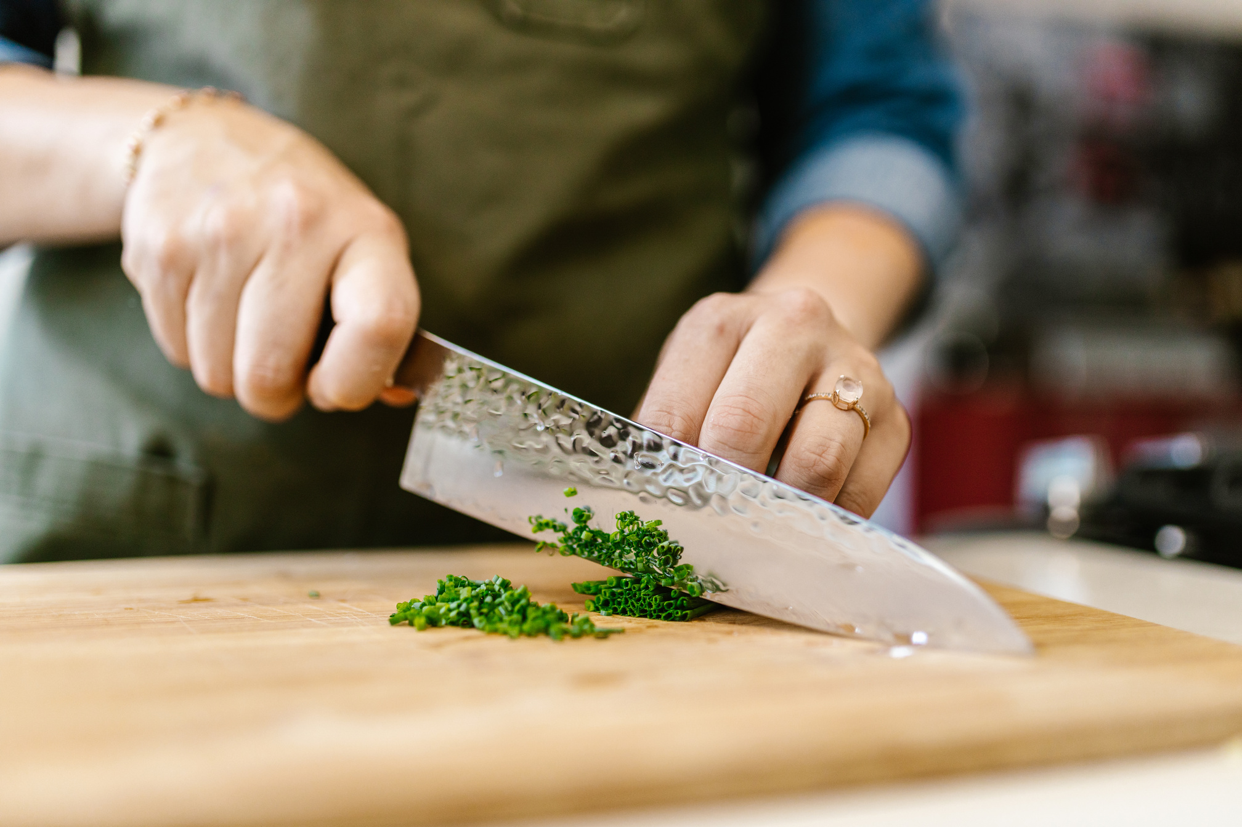
B - SAFETY RULES FOR HANDLING KITCHEN TOOLS
Safety when handling kitchen tools is crucial to preventing accidents and injuries. Here is some detailed advice on how to handle different types of kitchen tools and equipment safely:

Slide 15
Knives
  Choosing the right knife
    Use the appropriate knife for each task (e.g. chef's knife for chopping, boning knife for removing bones).
  Handling the knife correctly
    Hold the knife by the handle with a firm grip.
    Use a safe cutting technique: the fingers of the non-dominant hand should be folded back to avoid cuts ("claw technique").
  Sharpening and maintenance
    Keep knives sharp for more precise and safer cutting.
    Store knives in a block or on a magnetic strip to prevent accidental injury.
  Cutting on a Safe Surface
    Use a stable chopping board, preferably made of wood or plastic.
    Place a damp cloth under the board to prevent it from slipping.

Slide 16
Food processors and mixers
1.Pre-use check
    Make sure that the appliance is in good working order before using it.
    Read the instruction manual to understand the functions and safety instructions.
2.Correct use
    Never insert your hands or utensils into the appliance while it is running.
    Use the accessories supplied to push food through the food processors.
3.Unplug after use
    Always unplug the appliance before cleaning it or changing the blades/accessories.

Slide 17
Ovens and hobs
1.Using adapted utensils
    Use oven gloves or potholders to handle hot food.
    Use heat-resistant utensils.
2. Precautions for use
    Check the temperature and condition of food regularly to avoid burns.
    Do not let the handles of pots and pans extend beyond the edges of the cooker to prevent them from being knocked over.

Slide 18
Deep fryers and fry pans
1.Preparation and Monitoring
    Fill the appliance with the correct amount of oil to avoid spillage.
    Keep an eye on the fryer at all times during use.
2.Splash Precautions
    Dry food before immersing in hot oil to avoid splashing.
    Use long tools to immerse and remove food from hot oil.

Slide 19
Slicing machines
1.Safety Before Use
    Ensure that safety devices are in place.
    Make sure the machine is switched off before adjusting the settings.
2.Secure handling
    Use the pusher to guide the food towards the blade.
    Never remove trapped food with your bare hands.

Slide 20
Other equipment (juicers, immersion blenders, etc.)
1.Secure use
    Read and follow the manufacturer's instructions.
    Check that the appliances are correctly assembled before using them.
2.Cleaning
    Unplug appliances before cleaning.
    Use suitable brushes or tools to clean hard-to-reach areas.

Slide 21
General Rules
1.Organisation and tidying
    Keep workstations tidy to avoid accidents.
    Store tools and equipment in an orderly fashion after use.
2.Training and Vigilance
    Regular staff training in safety rules.
    Remain vigilant and attentive when handling tools and equipment.
By following these tips, you can help to create a safe working environment and reduce the risk of injury in the kitchen.

Slide 22
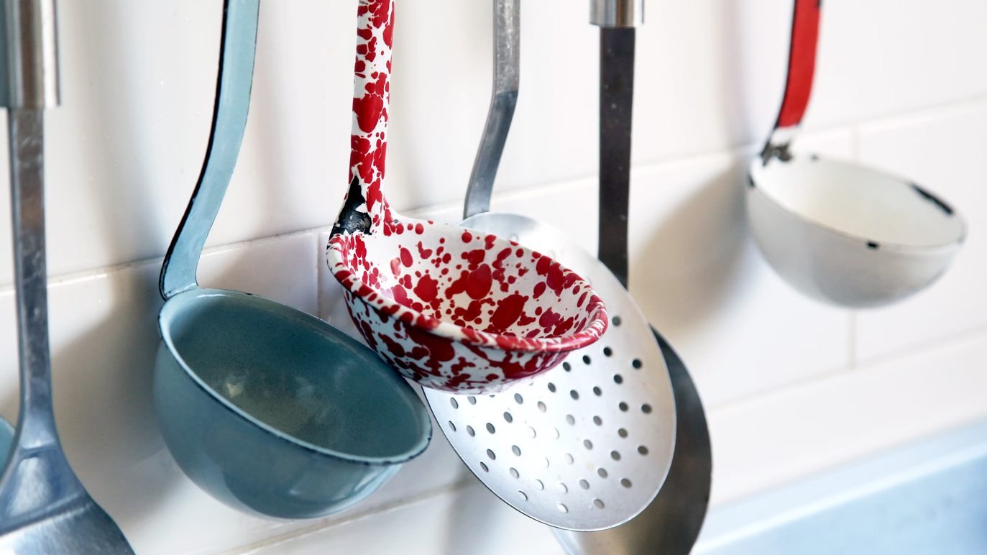
C- HOW TO MAINTAIN YOUR WORKSTATION
Correctly maintaining your kitchen workstation is essential for ensuring food safety, efficiency and the durability of your equipment. Here are a few steps and tips for optimum maintenance:

Slide 23
1. Daily cleaning
a. Work plan
Disinfection: Use an approved food disinfectant after each service.
Wiping: Wipe with a clean damp cloth, then dry with a dry cloth.
b. Utensils and equipment
Washing: Wash knives, chopping boards and other utensils in hot soapy water.
Disinfection: Use a disinfectant solution for utensils.
Storage: Store clean utensils in appropriate places to avoid contamination.
c. Soil
Sweeping: Sweep the floor to remove debris.
Cleaning: Wash with a suitable cleaning solution, then rinse and dry.

Slide 24
2. Weekly maintenance
a. Kitchen appliances
Fridges and freezers: Clean the shelves and inside walls with a disinfectant solution.
Ovens and hobs: Clean grills and surfaces with a suitable detergent.
Extraction hoods: Degrease filters and external surfaces.
b. Sinks and taps
Descaling: Use an anti-scale product to remove deposits.
Disinfection: Apply a disinfectant solution to all surfaces.

Slide 25
3. Monthly maintenance
a. Machinery and Specialised Equipment
Maintenance: Check and maintain equipment such as slicers, mixers and grinders.
Deep cleaning: Deep clean seldom-used equipment.
b. Storage
Organisation: Reorganise stocks to ensure product rotation and avoid products going out of date.
Cleaning Storage Areas: Wash shelves and containers.

Slide 26
4. General Good Practice
a. Food safety
Temperatures: Check refrigerator and freezer temperatures regularly.
Labelling: Label all food correctly with the date of preparation.
b. Training and awareness-raising
Staff training: Ensure that all staff are trained in cleaning and maintenance protocols.
Regular inspections: Carry out regular inspections to ensure that standards are being met.
c. Use of Appropriate Products
Certified products: Use cleaning products certified for food use.
Protective equipment: Wear gloves and aprons when using chemicals.
By following these steps, you will not only ensure a clean and safe working environment, but also a longer life for your equipment and greater efficiency in your day-to-day operations

Slide 27
D - HOW TO ORGANISE YOUR WORKSTATION
Organising your kitchen workstation efficiently is essential to optimising productivity, ensuring food safety and maintaining a clean and tidy working environment. Here are a few steps and tips for optimum organisation:

Slide 28
1. Planning and Layout of the Workstation
a. Dedicated work areas
Preparation: Gather together the utensils and equipment you need to prepare your food (knives, chopping boards, bowls).
Cooking: Keep cooking utensils (saucepans, frying pans, spatulas) close to the cooker or oven.
Assembling and setting up: Create an area for assembling dishes, with the necessary ingredients and garnishes close at hand.
b. Ergonomics
Working height: Make sure that working surfaces are at a comfortable height to avoid fatigue.
Easy access: Place heavy equipment at easy-to-reach levels to reduce the risk of injury.

Slide 29
2. Storage and Shelving
a. Utensils and equipment
Frequently used utensils: Keep the tools you use often within easy reach.
Vertical organisation: Use hooks or bars to hang utensils, freeing up space on the worktop.
Drawers and shelves: Organise the drawers and shelves with dividers for small utensils and containers for ingredients.
b. Ingredients
FIFO (First In, First Out) system: Organise ingredients so that those stored first are used first.
Hermetically sealed containers**: Use hermetically sealed containers to store dry ingredients and avoid contamination.
Labelling: Clearly label containers with the name of the ingredients and the use-by date.

Slide 30
3. Working procedures
a. Installation
Upstream preparation: Prepare all the necessary ingredients before you start cooking.
Organisation: Arrange the ingredients in the order in which they will be used for quick and easy access.
b. Workflow
Movement optimisation: Organise your workstation to minimise unnecessary movement.
Logical sequence: Arrange the equipment and ingredients according to the sequence of tasks to be carried out.

Slide 31
4. Health and Safety
a. Separation of Zones
Clean Areas and Contaminated Areas: Separate areas where raw food is handled from areas where cooked food is prepared.
Disinfection: Regularly clean and disinfect work surfaces and utensils.
b. Personal Protection
Protective equipment: Use gloves, aprons and headgear to maintain strict hygiene.
Hand washing: Wash your hands frequently to avoid cross-contamination.

Slide 32
5. Continuous improvement at all times
a. Regular Review
Evaluation: Regularly assess the effectiveness of your organisation and adjust it as necessary.
Feedback: Ask team members for feedback to identify areas for improvement.
b. Innovation
New tools: Adopt new tools and technologies to improve efficiency.
Training**: Regularly train staff in new organisational practices and techniques.
By applying these principles, you will be able to maintain a well-organised kitchen workstation, helping to improve the quality and speed of your work, while ensuring safety and hygiene.

Slide 33
Quiz
Day 1: Basic Hygiene, Safety, Maintenance, and Organization in the Kitchen
1. What is the recommended duration for washing hands with soap and warm water?
- a) 10 seconds
- b) 20 seconds
- c) 30 seconds
- d) 40 seconds
2. What is the appropriate storage temperature for refrigerated products?
- a) 0-4°C
- b) 5-10°C
- c) 11-15°C
- d) 16-20°C

Slide 34
Quiz
Day 1: Basic Hygiene, Safety, Maintenance, and Organization in the Kitchen
3. Which cutting technique is used to obtain vegetables in thin strips a few centimeters long?
- a) Brunoise
- b) Julienne
- c) Slicing
- d) Chopping
4. What should you do if you have a wound while working in the kitchen?
- a) Ignore it
- b) Cover it with a waterproof dressing
- c) Use a band-aid
- d) Continue working without any protection

Slide 35
Quiz
Day 1: Basic Hygiene, Safety, Maintenance, and Organization in the Kitchen
5. What is the safe internal cooking temperature for poultry?
- a) 60°C
- b) 71°C
- c) 74°C
- d) 80°C

Slide 36
Answers
Day 1: Basic Hygiene, Safety, Maintenance, and Organization in the Kitchen
1. What is the recommended duration for washing hands with soap and warm water?
- b) 20 seconds
2. What is the appropriate storage temperature for refrigerated products?
- a) 0-4°C
3. Which cutting technique is used to obtain vegetables in thin strips a few centimeters long?
- b) Julienne
4. What should you do if you have a wound while working in the kitchen?
- b) Cover it with a waterproof dressing
5. What is the safe internal cooking temperature for poultry?
- c) 74°C

Slide 37
DAY2
Preparation terms and techniques + Utensils and equipment

Slide 38
Culinary terms: Learn and use them effectively.
Content
A - Preparation techniques
B - Types of cooking
C - Specific terms
D - Finishing techniques and presentation
E - Utensils
F - Technical sheet + production based on the technical sheet

Slide 39
A - Preparation techniques
1. Thinly slice an onion.
2. Chop the parsley: Use a knife or chopper to chop the parsley into small pieces.
3. Make a julienne: Cut the vegetables into thin strips a few centimetres long.
4. Make a brunoise: Cut the vegetables into small, regular cubes about 2 mm square.
5. Chop a shallot: Cut into small, very fine pieces, often used for herbs or onions.
6. Crushing tomatoes: To crush coarsely, often used for tomatoes.
7. Blanching green beans: Plunge a food into boiling water for a few minutes, then cool it immediately in iced water.
8. Poaching pears: Cook gently in a liquid at a temperature just below boiling point.
9. Sautéing vegetables: Cook quickly over a high heat with a little fat.
10. Grilling meat: Cooking on a grill over a source of direct heat.

Slide 40
B - Types of cooking :
1. Roasting vegetables in the oven: Cook in the oven at a high temperature using fat.
2. Braised fennel: Cook slowly in a liquid, partially covering the food.
3. Basic simmer: Cook slowly over a low heat, often in a liquid.
4. Frying: Cooking in a large quantity of hot oil.
5. Sauté: Cook quickly over a high heat with a little fat, often stirring.
6. Steam cooking: Cooking with steam from a boiling liquid without the food touching the liquid.

Slide 41
C - Terms Relating to Ingredients
1. Marinate: Soak a food in a flavoured liquid to season and tenderise it.
2. Zester: To remove the coloured part of the citrus peel to extract the essential oils.
3. Deglaze: Leave a food to rest with salt to extract the water.

Slide 42
D- Finishing and Presentation Techniques
1. Glaze: Cover with a glossy glaze, often sugar or sauce based.
2. Lustrer and Napper: To cover a food with a sauce or coulis.
3. Dressing : To arrange food aesthetically on a plate.
4. Sprinkle: Sprinkle fine particles (such as icing sugar or chopped herbs) over a dish.

Slide 43
Other Useful Terms
1. Reduce: Evaporate a liquid to concentrate the flavours.
2. Deglaze: Add a liquid (often wine or stock) to a hot pan to dissolve the cooking juices and create a sauce.
3. Roux: A mixture of flour and fat (butter, oil) cooked to thicken sauces.
4. Bouquet garni: A collection of aromatic herbs tied with string and used to flavour simmered dishes.
These terms are fundamental to understanding recipes and cooking techniques, and are commonly used in both professional and amateur environments.

Slide 44
E - Basic utensils: Recognition and use.
When it comes to cooking, it's important to have the basic utensils you need to prepare a variety of dishes while saving time. Here's a list of essential kitchen utensils:

Slide 45
Cutting utensils
1. Knives
- Chef's knife: Versatile for chopping, mincing and mincing.
- Office knife: Ideal for small cutting jobs.
- Bread knife: For slicing bread and hard-crusted foods.
- Boning knife : To separate the meat from the bones.
2. Peeler
- For peeling vegetables and fruit.

Slide 46
Measuring utensils
1. Cups and spoons Measurements
- Essential for measuring liquid and dry ingredients.
2. Kitchen Scale
- For precise measurements, especially in pastry-making.

Slide 47
Mixing utensils
1. Mixing bowls
- Different sizes for mixing ingredients.
2. Whips
- To beat the eggs, mix the sauces and incorporate air into the mixtures.
3. Silicone spatulas
- Scrape the bowls and stir gently.
4. Wooden Spoons
- For mixing without damaging non-stick surfaces.

Slide 48
Cooking utensils
1. Stoves
- Non-stick frying pan: For eggs, pancakes and delicate foods.
- Cast iron frying pan : For searing and grilling.
2. Saucepans
- Different sizes for cooking sauces, soups and pasta.
3. Stockpot or Dutch oven
- For soups, stews and casseroles.
4. Baking tray
- For baking biscuits, roasting vegetables, etc.
5. Roasting Dish
- For cooking roasts, poultry and vegetables.

Slide 49
Serving utensils
1. Ladle
- For serving soups and sauces.
2. Spaghetti spoon
- For serving pasta.
3. Kitchen Tongs
- For turning food and serving.
4. Skimmer
- To remove food from oil or boiling water.

Slide 50
Miscellaneous utensils
1. Cutting board
- Wooden or plastic: For cutting vegetables, meat, bread, etc.
2. Sieve or strainer
- For draining pasta, washing vegetables, etc.
3. Grater
- For grating cheese, vegetables, citrus fruit, etc.
4. Kitchen Brush
- For basting pastries, meats, etc.
5. Blender
- For making smoothies, soups and sauces.
6. Kitchen thermometer
- For checking the doneness of meats and pastries.

Slide 51
F - Technical sheet: Understanding and following instructions.
A kitchen data sheet is a detailed document describing the preparation of a specific dish. It is essential in a professional environment, as it enables recipes to be standardised, dish quality to be maintained, costs to be managed and staff to be trained. Here are the key elements generally found on a kitchen data sheet:

Slide 52
Name of the dish
- Title: Exact name of the dish as it will appear on the menu.
Ingredients
- List of Ingredients : All the ingredients you need, including spices, herbs and garnishes.
- Quantities: Precise quantities for each ingredient, often in grams, litres or specific units.
Preparation
- Steps : Detailed description of each stage of preparation, from cutting the ingredients to cooking and final assembly.
- Techniques: Information on the specific techniques to be used (blanching, sautéing, braising, etc.).
- Time: Time required for each stage of preparation.

Slide 53
Cooking
- Cooking method: Type of cooking (oven, frying pan, grill, etc.).
- Temperature: Precise cooking temperature.
- Time: Cooking time for each stage.
Dressage and Presentation
- Dressing instructions: How to arrange the food on the plate.
- Trim: Decorative elements or trims to be added.
- Presentation: Tips for the final presentation to make the dish aesthetically pleasing.
Portions and yield
- Number of servings: Number of servings the recipe produces.
- Portion size: Size or weight of each portion.
Nutritional Value
- Nutritional information: Calories, proteins, lipids, carbohydrates, etc., per portion (often used in establishments that focus on health and nutrition).

Slide 54
Cost of Ingredients
- Ingredient prices : Cost of each ingredient to calculate the total cost of the dish.
- Cost per portion: Total cost divided by the number of portions to determine the unit cost.
Photos and Illustrations
- Images: Photos of the finished dish and any key stages in its preparation.
Advice and comments
- Chef's tips: Advice on how to improve the dish or possible variations.
- Specific remarks: Information on potential allergies, dietary adaptations, etc.

Slide 55
Case study:
Creating a typical French menu
Ratatouille online technical file with video
Haddock and cucumber salad
Roast chicken
Gratin of potatoes
Ratatouille
Lemon upside-down tart

Slide 56
Case study: Creating a typical French menu
Kitchen Data Sheet
Dish: Ratatouille
- Ingredients:
- Eggplant: 200g
- Zucchini: 200g
- Bell peppers: 200g
- Tomatoes: 300g
- Onion: 1 large
- Garlic: 3 cloves
- Olive oil: 50ml
- Salt and pepper: to taste
- Fresh basil: for garnish

Slide 57
Case study:
Creating a typical French menu
Kitchen Data Sheet
Preparation Steps:
1. Slice the eggplant, zucchini, and bell peppers into thin strips.
2. Dice the tomatoes and onion.
3. Mince the garlic.
4. Sauté the onion and garlic in olive oil until translucent.
5. Add the eggplant, zucchini, and bell peppers, and cook until tender.
6. Add the tomatoes and cook for another 10 minutes.
7. Season with salt and pepper.
8. Garnish with fresh basil before serving.
- Cooking Method: Sautéing and simmering
- Cooking Time: 30 minutes
- Portion Size: Serves 4

Slide 58
Quiz
Day 2: Preparation Terms and Techniques, Utensils, and Equipment
1. What is the main function of proteins in the diet?
- a) Source of energy
- b) Tissue repair
- c) Regulation of bodily processes
- d) Formation of bones and teeth
2. Which cooking method involves cooking quickly over high heat with a little fat?
- a) Roasting
- b) Braising
- c) Sautéing
- d) Poaching

Slide 59
Quiz
Day 2: Preparation Terms and Techniques, Utensils, and Equipment
3. Which utensil is used for precise measurement of ingredients, especially in baking?
- a) Silicone spatula
- b) Kitchen scale
- c) Whisk
- d) Paring knife
4. What is the purpose of blanching vegetables?
- a) To cook them thoroughly
- b) To soften them
- c) To preserve their color and texture
- d) To add flavor

Slide 60
Quiz
Day 2: Preparation Terms and Techniques, Utensils, and Equipment
5. What is the term for cutting vegetables into small, regular cubes about 2 mm square?
- a) Julienne
- b) Brunoise
- c) Chopping
- d) Slicing

Slide 61
Answers
Day 2: Preparation Terms and Techniques, Utensils, and Equipment
1. What is the main function of proteins in the diet?
- b) Tissue repair
2. Which cooking method involves cooking quickly over high heat with a little fat?
- c) Sautéing
3. Which utensil is used for precise measurement of ingredients, especially in baking?
- b) Kitchen scale
4. What is the purpose of blanching vegetables?
- c) To preserve their color and texture
5. What is the term for cutting vegetables into small, regular cubes about 2 mm square?
- b) Brunoise

Slide 62
DAY3
Culinary identity

Slide 63

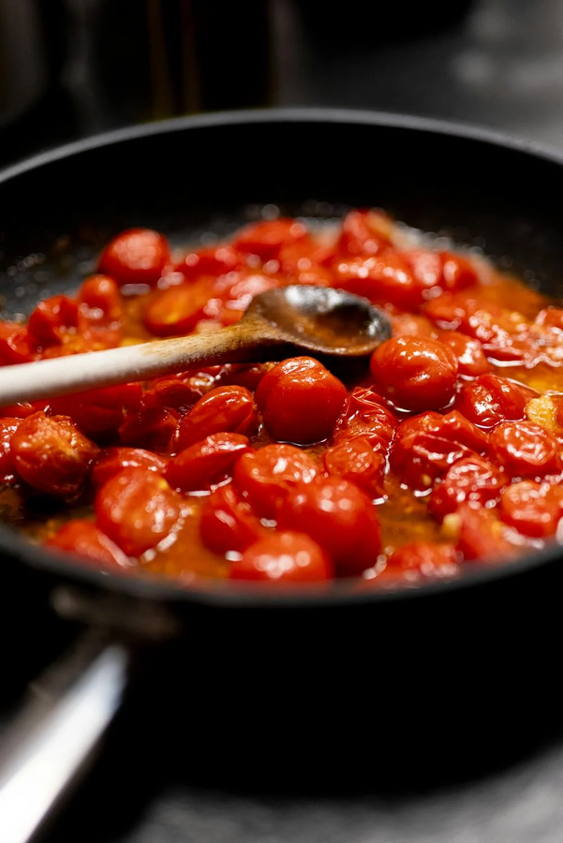
The search for your own culinary identity is a personal and professional journey that involves exploration, experimentation and reflection. You bring an abundance of culinary culture and heritage. Use that with new learning to discover and develop your unique culinary identity. This section will help in that process.
Title One
Title Two

Slide 64
1. Exploration and inspiration
a. Analyse your Culinary Roots
  Personal Origins: Explore the culinary traditions of your family and region. What flavours, techniques and ingredients are familiar and dear to you?
Local culture: Study the cuisine of your region or country. What historical, geographical and cultural influences shape it?
b. Travelling and discovering
  Gastronomic travel: Travelling to discover other culinary cultures. Taste local dishes, observe cooking techniques and talk to local chefs.
  Global Influences: Drawing inspiration from cuisines from around the world, incorporating elements and techniques that resonate with you.

Slide 65
2. Experimentation and Creativity
a. Playing with ingredients
  Local ingredients: Use local, seasonal produce to create unique dishes.
  Innovative combinations: Experiment with unexpected flavour combinations and fusion techniques.
b. Developing unique recipes
  Signature Dishes: Working on signature dishes that represent your style and influences.
  Feedback and adjustments: Test your creations on friends, colleagues and customers, and adjust recipes based on feedback.

Slide 66
3. Reflection and Philosophy
a. Define your Culinary Vision
  Values: Think about the values you hold dear, such as using sustainable products, supporting local producers, or promoting health and well-being.
  Mission: Formulate a culinary mission to guide your work and your choices in the kitchen.
b. Document your journey
  Recipe Book : Keep a notebook of recipes and ideas, in which you record your experiences, successes and failures.
Cooking Diary: Write about your inspirations, discoveries and thoughts on cooking.

Slide 67
4. Continuing Training and Education
a. Taking part in courses and workshops
  Advanced techniques: Take cooking classes to learn new techniques and develop your skills.
  Specific themes: Taking part in workshops on specific cuisines or techniques.
b. Reading and studying
  Cookery books: Read cookery books, chefs' memoirs and books on gastronomy to broaden your knowledge.
  Articles and Reviews: Follow culinary publications and blogs to keep abreast of trends and innovations.

Slide 68
5. Collaboration and networking
a. Working with other chefs
  Internships and apprenticeships: Take part in internships in renowned kitchens to learn from the best and broaden your experience.
  Collaborative events: Participate in culinary events, pop-ups and collaborations with other chefs to exchange ideas and techniques.
b. Building a network
  Culinary community: Get involved in culinary associations and groups to share knowledge and experience.
  Mentoring: Find or become a mentor to help guide and be guided through the culinary journey.

Slide 69
6. Putting it into practice and sharing
a. Launch your own project
  Restaurant or Food Truck: Open a restaurant, food truck or other culinary business that reflects your culinary identity. See our Entrepreneurship Training Materials
  Catering and Events : Offering catering services and organising culinary events to share your creations with a wider audience.
b. Using Social Media
  Culinary Blog: Keep a blog where you share your recipes, experiences and thoughts on cooking.
Social networking: Use Instagram, YouTube or other platforms to show off your creations, give out tips and engage with a community of cooking enthusiasts.

Slide 70
Conclusion
The search for your culinary identity is an ongoing and evolving process. It's about combining your personal influences, your experiences and your creativity to develop a style that suits you. Be curious, stay open to new ideas, and above all, have fun in the kitchen. Your culinary identity will strengthen and refine over time, reflecting your background and your passion for gastronomy.

Slide 71
Exercise
Apply your learning by starting your own recipe book :
  Write 3 savoury recipes inspired by your own culture
  Write 3 sweet recipes inspired by your own culture
  Write a recipe for a specific juice
  Share which spices you use most often
  Start drafting the technical data sheets for each recipe written

Slide 72
Quiz
Day 3: Culinary Identity.
1.What is the first step in discovering your culinary identity?
a) Experimenting with new recipes
b) Analyzing your culinary roots
c) Traveling to different countries
d) Reading cookbooks.
2. What is the purpose of gastronomic travel in developing your culinary identity?
a) To learn new languages
b) To discover other culinary cultures and techniques
c) To find new ingredients
d) To take a break from cooking

Slide 73
Quiz
Day 3: Culinary Identity.
3. What should you document in your cooking diary?
a) Only successful recipes
b) Your inspirations, discoveries, and thoughts on cooking
c) The cost of ingredients
d) The number of guests served
4. What is the role of collaboration in developing your culinary identity?
a) To reduce workload
b) To exchange ideas and techniques with other chefs
c) To find new job opportunities
d) To increase social media followers

Slide 74
Quiz
Day 3: Culinary Identity.
5. What is the importance of using local, seasonal produce in your culinary creations?
a) It is cheaper
b) It supports local farmers and ensures freshness
c) It is easier to find
d) It reduces cooking time

Slide 75
Answers
Day 3: Culinary Identity
1. What is the first step in discovering your culinary identity?
- b) Analyzing your culinary roots
2. What is the purpose of gastronomic travel in developing your culinary identity?
- b) To discover other culinary cultures and techniques
3. What should you document in your cooking diary?
- b) Your inspirations, discoveries, and thoughts on cooking
4. What is the role of collaboration in developing your culinary identity?
- b) To exchange ideas and techniques with other chefs
5. What is the importance of using local, seasonal produce in your culinary creations?
- b) It supports local farmers and ensures freshness

Slide 76
DAY4
Kitchen management, nutrition and creativity

Slide 77
1. Planning and preparation
a. Menu and recipes
  Menu design: Creating a balanced menu adapted to the target clientele. Take account of the seasons and product availability.
  Technical Data Sheets: Prepare detailed technical data sheets for each dish, including ingredients, quantities, preparation steps, cooking times and costs.
b. Inventory management
  Inventory: Carry out regular product inventories to avoid stock-outs and overstocking.
  Orders: Place orders based on forecast requirements, taking into account delivery times and product freshness.
  Storage: Organise storage areas (cold rooms, freezers, shelves) to ensure optimum accessibility and rotation of products (FIFO: First In, First Out).

Slide 78
2. Installation
a. Preparing the ingredients
  Vegetables and fruit: Wash, peel, cut and store vegetables and fruit according to recipe requirements.
  Meat and fish: Boning, portioning, marinating (if necessary) and storing meat and fish correctly.
  Sauces and stocks : Prepare the basic sauces, stocks and broths in advance and reserve them in the appropriate portions.
b. Workstation organisation
  Task allocation: Assign specific tasks to each team member according to their skills and workflow.
  Workstations: Organise the workstations so that each chef has everything they need within easy reach. Provide separate areas for preparing vegetables, meats, pastries, etc.
  Utensils and equipment: Ensure that all the necessary tools and equipment are clean, functional and in the right place.

Slide 79
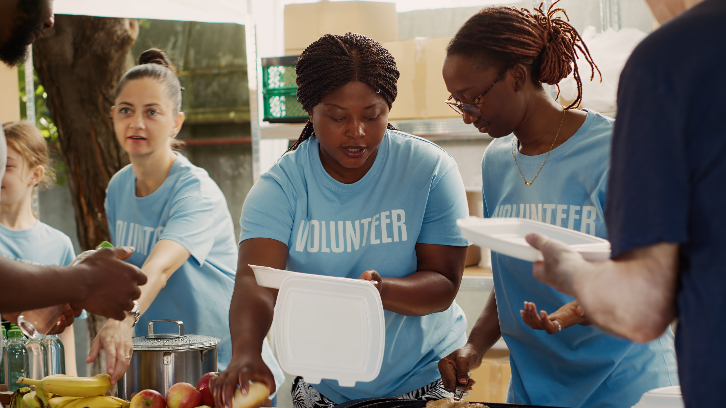
B- The concept of nutrition
According to the Academy of Nutrition and Dietetics, “Food is essential—it provides vital nutrients for survival, and helps the body function and stay healthy. Food contains macronutrients including protein, carbohydrate and fat that not only offer calories to fuel our bodies and give us energy, but also play specific roles in maintaining health.
Food also supplies micronutrients (vitamins and minerals) and phytochemicals that don’t provide calories but serve a variety of critical functions to ensure our bodies operate optimally.”

Slide 80
1 - Macronutrients
a. Proteins
  Functions: Tissue repair, production of enzymes and hormones, support for the immune system.
  Sources: Meat, fish, eggs, dairy products, pulses, nuts and seeds.
  Recommendations: Approximately 10-35% of daily calorie intake.
  Plant protein special:
    Pulses: Soya and its derivatives (tofu, tempeh, etc.), lupins, lentils, beans (kidney, pinto, black), chickpeas, split peas, white beans, peas, etc.
    Cereals: wheat, quinoa, buckwheat, amaranth, oats, bulgur, rice, maize, barley.
    Oilseeds and seeds: hemp seeds, pumpkin seeds, peanuts, pistachios, sunflower seeds, almonds, flaxseeds, chia seeds, cashew nuts, Brazil nuts, etc.
‍Other options may soon be on the menu, or already are in some parts of the world and in innovative restaurants. These include insects such as crickets, locusts, caterpillars and grasshoppers, or macro-algae such as spirulina and chlorella, which have a protein content of up to 70% of dry matter.

Slide 81
1 - Macronutrients
b. Carbohydrates
  Functions: Main source of energy, support for brain and muscle function.
  Sources: Cereals, vegetables, fruit, pulses, dairy products.
  Types : Simple (sugars) and complex (starch, fibre).
  Recommendations: Approximately 45-65% of daily calorie intake.
c. Lipids
  Functions: Energy storage, organ protection, absorption of fat-soluble vitamins (A, D, E, K).
  Sources: Oils, butter, nuts, avocados, oily fish.
  Types : Saturated, unsaturated (monounsaturated and polyunsaturated), trans.
  Recommendations: Approximately 20-35% of daily calorie intake.

Slide 82
2. Micronutrients
a. Vitamins
  Functions: Regulation of bodily processes, support for the immune system, energy production.
  Sources: Fruit, vegetables, animal products, enriched cereals.
  Types : Liposoluble (A, D, E, K) and water-soluble (C, group B).
b. Minerals
  Functions: Formation of bones and teeth, regulation of body fluids, muscle and nerve function.
  Sources: Meat, fish, vegetables, fruit, dairy products, nuts and seeds.
  Main minerals: Calcium, iron, magnesium, potassium, sodium, zinc.

Slide 83
3. Water
  Functions: Maintains water balance, regulates body temperature, transports nutrients and waste products.
  Recommendations: Around 2 to 3 litres a day, depending on age, sex and physical activity.

Slide 84
4. Fibre
  Functions : Improves digestion, prevents constipation, regulates blood sugar levels.
  Sources: Vegetables, fruit, wholegrain cereals, pulses.
  Recommendations: Approximately 25-30 grams per day.

Slide 85
5. A balanced diet
a. Balanced meals
  Proportions: Compose meals with adequate portions of proteins, carbohydrates and fats.
  Diversity: Include a variety of foods to obtain a wide range of nutrients.
  Moderation: Avoid excess sugar, salt and saturated/trans fats.
b. Menu planning
  Seasonal menus: Use seasonal ingredients to maximise nutrients and flavours.
  Adaptation: Take into account the specific dietary needs of customers (vegetarians, vegans, gluten-free, etc.).

Slide 86
6. Raising awareness of allergies and intolerances
  Knowledge: Identify common allergens (gluten, milk, eggs, peanuts, nuts, soya, fish, shellfish).
  Precautions: Use strict procedures to avoid cross-contamination.

Slide 87
7. Cooking and preparation techniques
  Cooking: Favour cooking methods that preserve nutrients (steaming, grilling, quick frying).
  Storage: Store food correctly to avoid loss of nutrients.
  Seasoning: Use herbs and spices to reduce the addition of salt and sugar.

Slide 88
8. Balancing portions
a. Balanced plate
  Vegetables: Fill half the plate with a variety of vegetables.
  Proteins/Vegetable proteins: Reserve a quarter of the plate for protein sources.
  Carbohydrates: devote a quarter of your plate to complex carbohydrates.
b. Portion control
  Moderate portions: Avoid overly large portions to avoid wastage and excess calories.
  Aesthetics: Careful presentation to make dishes attractive.

Slide 89
Quiz
Day 3: Kitchen Management, Nutrition, and Creativity
1. What proportion of the plate should be reserved for vegetables for a balanced meal?
- a) One quarter
- b) One third
- c) Half
- d) Three quarters
2. Which plating technique involves arranging food aesthetically on a plate?
- a) Glazing
- b) Napping
- c) Plating
- d) Sprinkling

Slide 90
Quiz
Day 3: Kitchen Management, Nutrition, and Creativity
3. What is the main source of carbohydrates in the diet?
- a) Oils
- b) Meats
- c) Cereals
- d) Vegetables
4. What is the function of macronutrients in the diet?
- a) Tissue repair
- b) Energy storage
- c) Regulation of bodily processes
- d) All of the above

Slide 91
Quiz
Day 3: Kitchen Management, Nutrition, and Creativity
5. What is the recommended daily intake of water for an average adult?
- a) 1-2 liters
- b) 2-3 liters
- c) 3-4 liters
- d) 4-5 liters

Slide 92
Quizz
Day 3: Kitchen Management, Nutrition, and Creativity
5. What is the recommended daily intake of water for an average adult?
- a) 1-2 liters
- b) 2-3 liters
- c) 3-4 liters
- d) 4-5 liters

Slide 93
Answers
Day 3: Kitchen Management, Nutrition, and Creativity
1. What proportion of the plate should be reserved for vegetables for a balanced meal?
- c) Half
2. Which plating technique involves arranging food aesthetically on a plate?
- c) Plating
3. What is the main source of carbohydrates in the diet?
- c) Cereals
4. What is the function of macronutrients in the diet?
- d) All of the above
5. What is the recommended daily intake of water for an average adult?
- b) 2-3 liters

Slide 94
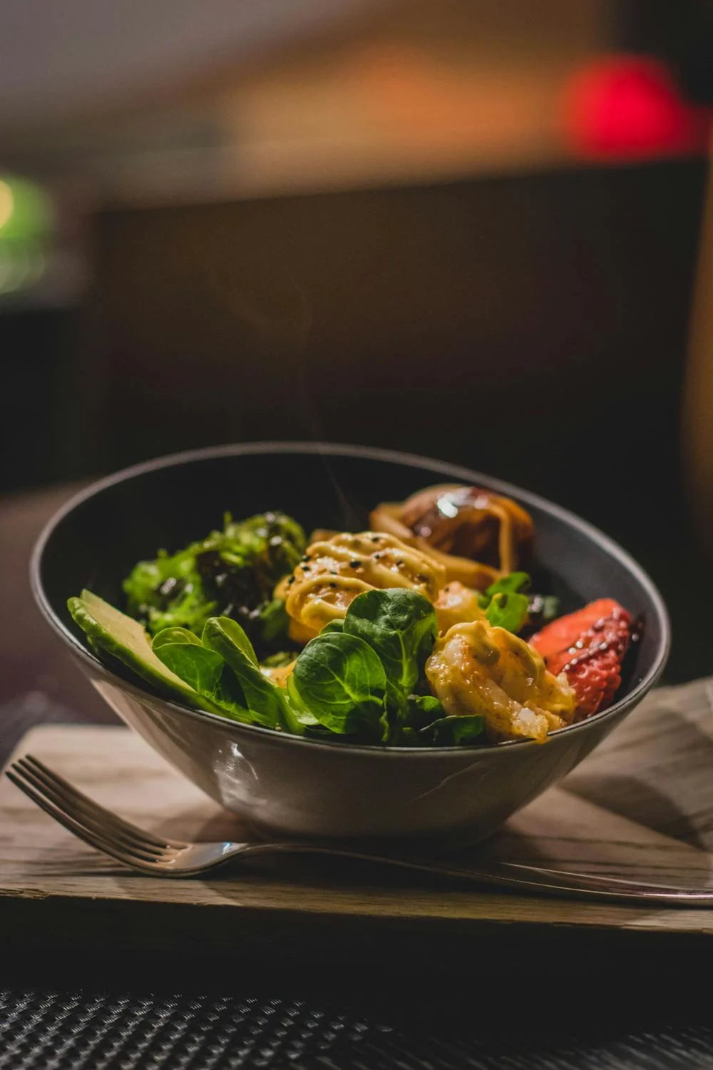
C- Dressing in the kitchen
Dressing in the kitchen is the art of arranging food on the plate in an attractive and appetising way. It is a crucial step in visually seducing customers before they even taste the dish. Here's how to explain food preparation in the kitchen, highlighting the principles, techniques and tips for successful preparation:

Slide 95
Basic Dressage Principles
  Balance
    Visual: The plate should be visually balanced, with a harmonious distribution of colours, shapes and textures.
    Gustatory: The flavours must be balanced, without one element dominating the others.
  Cleanliness
    The edges of the plate should be clean, with no splashes or finger marks.
    Use clean tongs or utensils to handle delicate foods.
  Simplicity
    Avoid overloading the plate. Leave plenty of space so that each element is clearly visible.
    Use a limited number of ingredients and toppings to avoid confusion.

Slide 96
Dressage Techniques
  Using Colour
    Choose foods in different colours to make the plate attractive.
    Play with contrasts (for example, green vegetables with a red sauce).
  Varied textures
    Combine crunchy, soft, creamy and crispy textures for a complete sensory experience.
    Place the crispy elements last to keep them fresh.
  Height and Structure
    Add height to add dimension to the plate (for example, by stacking ingredients or using metal circles to create structures).
    Use techniques such as rolling, stacking or layering to add depth.
  Focal points
    Create a focal point on the plate, often the main element of the dish, around which the other elements are arranged.
    Use asymmetrical placement techniques to draw the eye to the focal point.

Slide 97
Dressage Techniques
5. Use of empty spaces
    Don't fill the whole plate. Empty spaces can create an impression of sophistication and cleanliness.
    The empty areas also help to highlight the elements that have been erected.

Slide 98
Tips for Successful Dressage
  Dressage Tools
    Use precision tongs, quenelle spoons, brushes and piping bags for precise dressing.
    Moulds and cookie cutters can help to give food regular shapes.
  Toppings and Sauces
    Add fresh herbs, edible flowers or micro-pods for a visual effect and a touch of freshness.
    Arrange the sauces in an artistic way, either by glazing them delicately or using dots or lines to add dynamism.
  Temperature and freshness
    Arrange hot dishes just before serving to keep them at the right temperature.
    Cold dishes can be prepared in advance, but must be kept cool until serving.

Slide 99
Dressage examples
  Main course
    Main element : Place the meat or fish slightly off-centre.
    Accompaniments: Arrange the vegetables harmoniously around the main dish.
    Sauce: Drizzle or arrange in droplets around the dish.
  Dessert
    Base: Use a basic element such as a cake or mousse.
    Garnish: Add fresh fruit, coulis, chocolate chips or mint leaves.
    Presentation : Play with heights and textures, like crispy tiles or creamy creams
    In video dressage techniques Plate

Slide 100
Conclusion
Dressing is an art that requires practice, creativity and attention to detail. Successful dressing not only makes the dish attractive, it also enhances the eating experience by highlighting flavours and textures. By mastering the principles and techniques of dressage, a chef can transform an ordinary dish into a work of culinary art.

Slide 101
Exercises
Recipe Creation:
  Activity: Participants create their own recipes using local, seasonal ingredients. They experiment with different flavor combinations and cooking techniques.
  Example: A participant might create a dish of seared scallops with a citrus beurre blanc sauce, served with a side of roasted asparagus and quinoa.
Presentation of Dishes:
  Activity: Participants focus on the visual presentation of their dishes, using techniques such as plating, garnishing, and sauce decoration.
  Example: A participant might present a dessert of chocolate mousse with raspberry coulis, garnished with fresh berries and mint leaves.
Tasting and Feedback:
  Activity: Participants taste each other's creations and provide constructive feedback on flavor, texture, and presentation.
  Example: During a tasting session, participants might discuss the balance of flavors in a dish of grilled lamb chops with rosemary and garlic, served with a side of ratatouille.

Slide 102
DAY4
Basic pastry-making techniques

Slide 103
1.Introduction to Patisserie
  Introduction to the basic ingredients (flour, sugar, eggs, butter, etc.).
    Flour: Types and uses (T45, T55, etc.).
    Sugar: Granulated sugar, icing sugar, brown sugar.
    Eggs: Importance of eggs in pastry-making (binder, leavening).
    Butter: Sweet butter, semi-salted butter, margarine.
    Yeast: baking powder, baker's yeast.
    Other Ingredients : Almond powder, chocolate, milk, cream.
  Specific pastry hygiene rules.
    Hand washing and cleanliness of work surfaces.
    Preservation of ingredients and preparations.

Slide 104
2. Basic dough
Shortcrust pastry
Shortcrust Pastry
  Demonstration: sanding and milling techniques.
  Practical: Making individual fruit tarts.
  Tip: How to avoid the pastry shrinking.
Puff pastry
  Demonstration: Tempering, twisting and folding.
  Practical: Making palm trees or apple turnovers.
  Tip: Techniques for obtaining an even, crisp puff pastry.
Choux pastry
  Demonstration: Cooking the panade and incorporating the eggs.
  Practical: making cream puffs and eclairs.
  Tip: How to obtain plump, even cabbages.

Slide 105
3. Preparation of creams and fillings
  Pastry cream
    Demonstration: Cooking cream and tips for avoiding lumps.
    Practical: Making small filled choux pastries.
  Chantilly cream
Sweetened Whipped cream
  Demonstration: Techniques for whipping up a perfect whipped cream.
  Practical: To garnish desserts with whipped cream.
  Ganache
    Demonstration: Preparing the ganache for filling and icing.
Practical: Making chocolate truffles.

Slide 106
4. Making Classic Desserts
  Fruit Tart
    Demonstration: Assembling the tart with pastry cream and fresh fruit.
    Practical: Each participant makes their own fruit tart.
  Chocolate or coffee éclairs
    Demonstration: filling eclairs with chocolate custard and icing.
    Practical: Making individual eclairs.
  Cream puffs
    Demonstration: Garnishing the choux pastries with whipped or custard cream.
    Practical: Make choux pastries and decorate with icing sugar or fondant.

Slide 107
Rational work organisation: definition and practice.
The rational organisation of kitchen work, often referred to as the rationalised work method, aims to maximise efficiency, productivity and quality in a professional kitchen. Here are the main aspects of this organisation

Slide 108
1. Installation
  Preparing the ingredients
    Cutting and preparation in advance: The ingredients are washed, peeled, cut and ready to use before the start of the service.
    Portioning: Ingredients are weighed and measured for recipes, saving time and ensuring precision when cooking.
  Organisation of the Workstation
    Logical arrangements: Utensils, ingredients and equipment are arranged in such a way as to minimise movement.
    Accessibility: frequently used tools within easy reach.

Slide 109
2. Kitchen Brigade
  Allocation of tasks
    Dedicated stations: Each member of the team has specific responsibilities, for example, a chef saucier, a chef de partie, etc.
    Coordination: Communication and coordination between members of the brigade are essential to ensure a smooth workflow.
  Hierarchy
    Head Chef: Responsible for the entire kitchen, from menu planning to staff supervision.
    Sous-Chef: Assists the head chef and supervises the chefs de partie.
    Chefs de Partie: Specialise in a particular section of the kitchen (e.g. sauces, grills, pastries).

Slide 110
3. Workflow
  Logical Task Sequence
    Order of operations: Tasks are carried out in an order that optimises time and the use of equipment.
    Timing: Preparations are timed to ensure that all the elements of a dish are ready at the same time.
  Avoiding Time-outs
    Continuous work: Cooks move from one task to another without interruption, using waiting times (such as cooking) to move on to other preparations.
    Multitasking: Cooks must be able to manage several tasks simultaneously.

Slide 111
4. Standardisation and Consistency
  Standardised revenue
    Technical Data Sheets: Use of technical data sheets detailing each stage of preparation to guarantee the consistency of the dishes.
    Quality control: Implementation of procedures to check the quality of dishes before they are served.
  Training and Continuing Education
    Initial education: New employees receive training in the establishment's methods and standards.
    Ongoing training: Regular training sessions to improve skills and introduce new techniques.

Slide 112
5. Inventory and Cost Management
  *Stock control
    Regular stocktaking: Monitoring stocks to avoid wastage and shortages.
    Supply management: Planned orders to ensure ingredient availability while minimising storage costs.
  Calculation of costs
    Cost analysis**: Monitoring ingredient costs and adjusting selling prices to ensure profitability.
    Reducing waste: Implementing strategies to use up leftovers and minimise waste.

Slide 113
6. Health and safety
  Hygiene standards
    Cleaning and Disinfection: Strict protocols for cleaning workstations, utensils and equipment.
    Temperature control: Monitoring of cooking and storage temperatures to guarantee food safety.
  Safety at work
    Protective equipment: Use of gloves, aprons and safety shoes.
    Safety training: training staff in emergency procedures and good practice to avoid accidents.

Slide 114
3. Workflow
  Logical Task Sequence
    Order of operations: Tasks are carried out in an order that optimises time and the use of equipment.
    Timing: Preparations are timed to ensure that all the elements of a dish are ready at the same time.
  Avoiding Time-outs
    Continuous work: Cooks move from one task to another without interruption, using waiting times (such as cooking) to move on to other preparations.
    Multitasking: Cooks must be able to manage several tasks simultaneously.

Slide 115
Quiz
Day 5: Basic Pastry-Making Techniques
1. What are the basic ingredients used in pastry-making?
- a) Flour, sugar, eggs, butter
- b) Flour, salt, water, yeast
- c) Sugar, milk, eggs, yeast
- d) Butter, flour, water, salt
2. Which technique is used to prepare a homogeneous and crispy puff pastry?
- a) Sablage
- b) Kneading
- c) Laminating
- d) Blanching

Slide 116
Quiz
Day 4: Basic Pastry-Making Techniques
3. Which cream is prepared by whipping sweetened cream?
- a) Pastry cream
- b) Chantilly cream
- c) Ganache
- d) Custard
4. What is the process of making shortcrust pastry?
- a) Sablage and milling
- b) Tempering and folding
- c) Cooking and whipping
- d) Blanching and cooling

Slide 117
Quiz
Day 4: Basic Pastry-Making Techniques
5. What is the purpose of using a kitchen thermometer in pastry-making?
- a) To measure ingredient quantities
- b) To check the doneness of meats
- c) To ensure the correct temperature of pastries
- d) To mix ingredients properly

Slide 118
Answers
Day 5: Basic Pastry-Making Techniques
1. What are the basic ingredients used in pastry-making?
- a) Flour, sugar, eggs, butter
2. Which technique is used to prepare a homogeneous and crispy puff pastry?
- c) Laminating
3. Which cream is prepared by whipping sweetened cream?
- b) Chantilly cream
4. What is the process of making shortcrust pastry?
- a) Sablage and milling
5. What is the purpose of using a kitchen thermometer in pastry-making?
- c) To ensure the correct temperature of pastries

Slide 119
CONCLUSION

Slide 120
CONCLUSION
The rational organisation of work in the kitchen is a systematic approach that aims to optimise every aspect of the culinary process, from the preparation of ingredients to the serving of dishes. It is based on meticulous planning, a clear division of tasks, rigorous training and strict control of quality and hygiene standards. By implementing these principles, professional kitchens can improve efficiency, reduce costs and offer a high-quality culinary experience to their customers.

Slide 121




Well done. You have completed Module 1.2
Culinary Skills to Succeed
www.3kitchens.eu

